Slide 1
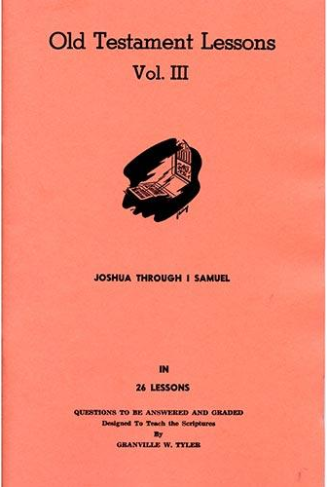
Last Days of Saul
Lesson # 25
1st Samuel 27 – 29
1st Chronicles 12:1-7, 19-22

Slide 2
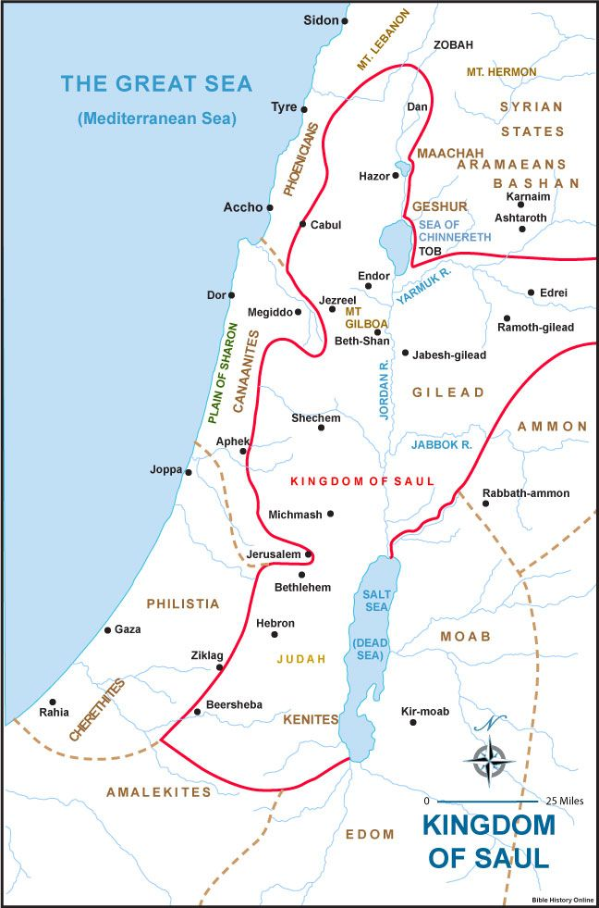
Kingdom of Saul

Slide 3
Southern Israel

Slide 4
Northern Israel

Slide 5
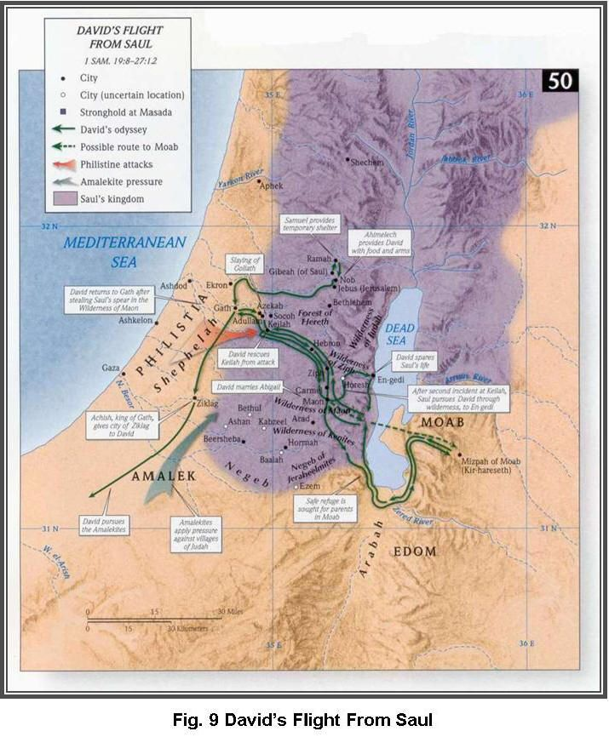

Slide 6
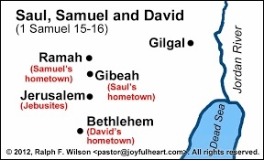
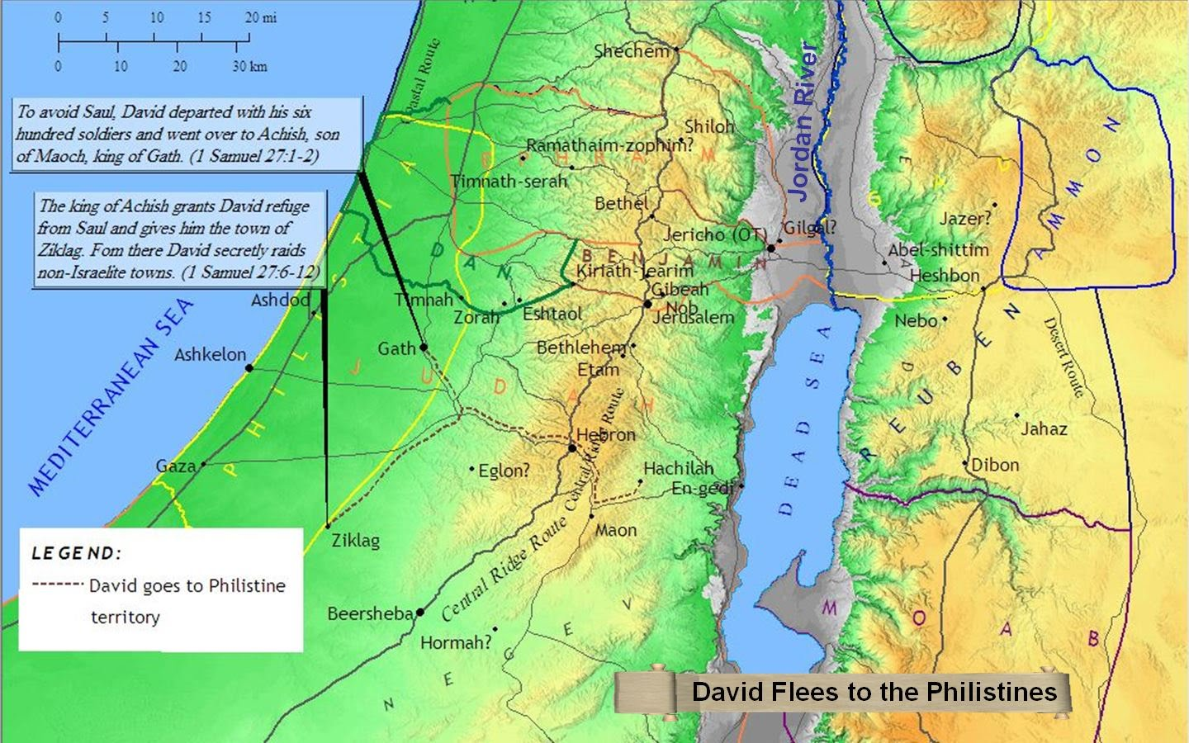
1 Samuel 27
1

Slide 7
2

Slide 8
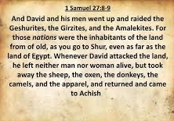
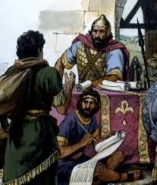
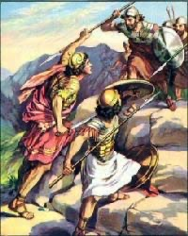
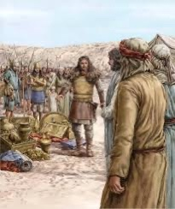
3

Slide 9
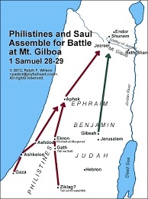
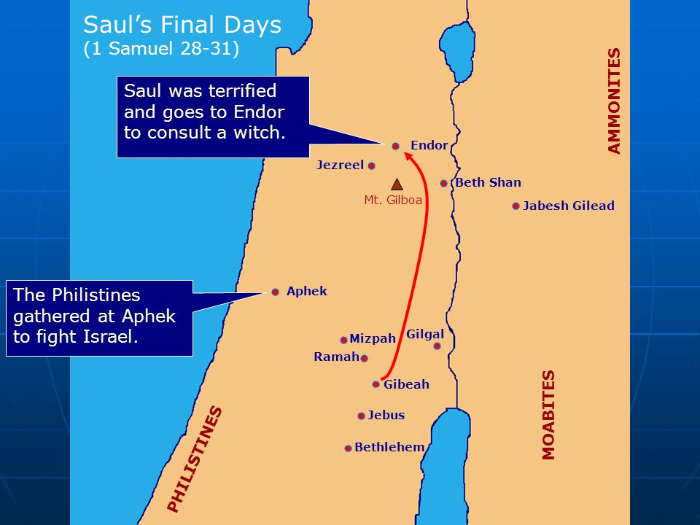
1 Samuel 28
1

Slide 10
2

Slide 11
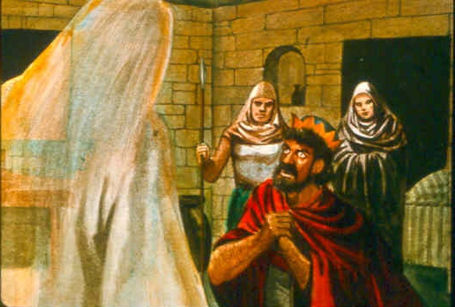
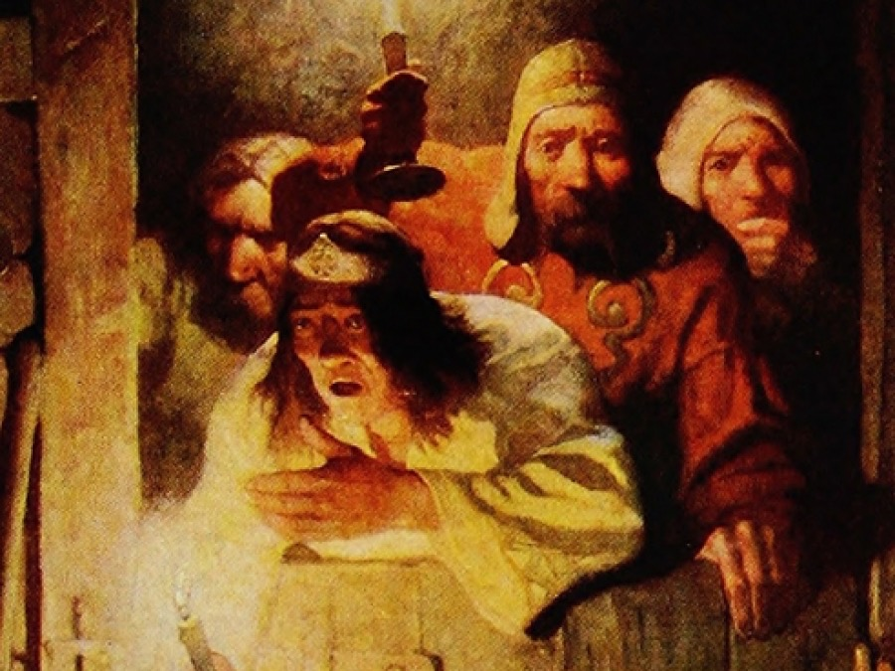
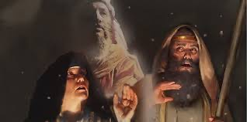
3

Slide 12
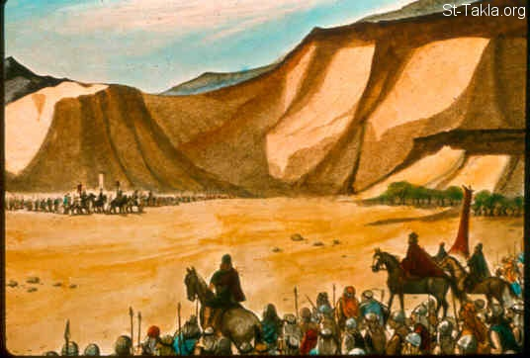
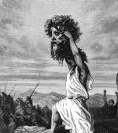
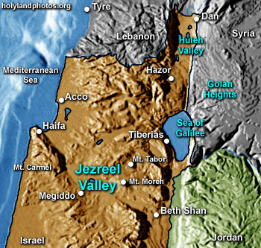
1 Samuel 29
1

Slide 13
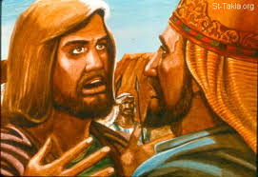
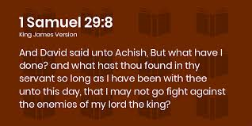
2

Slide 14
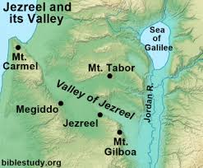
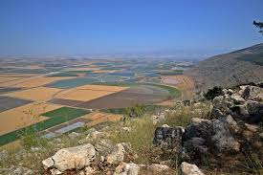
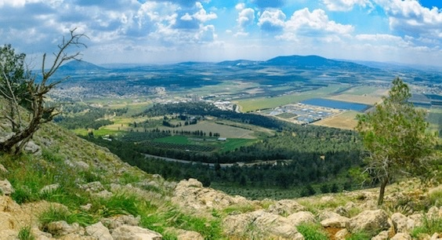
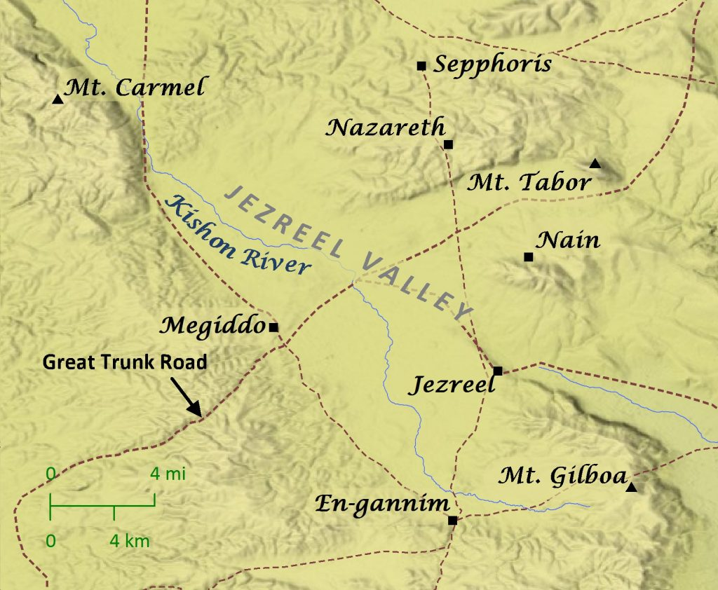
Significance of Jezreel Valley
3

Slide 15
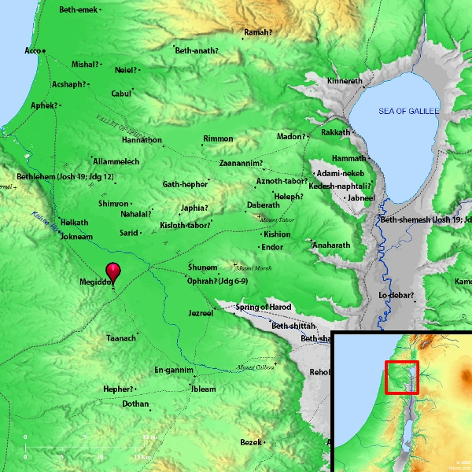
3

Slide 16
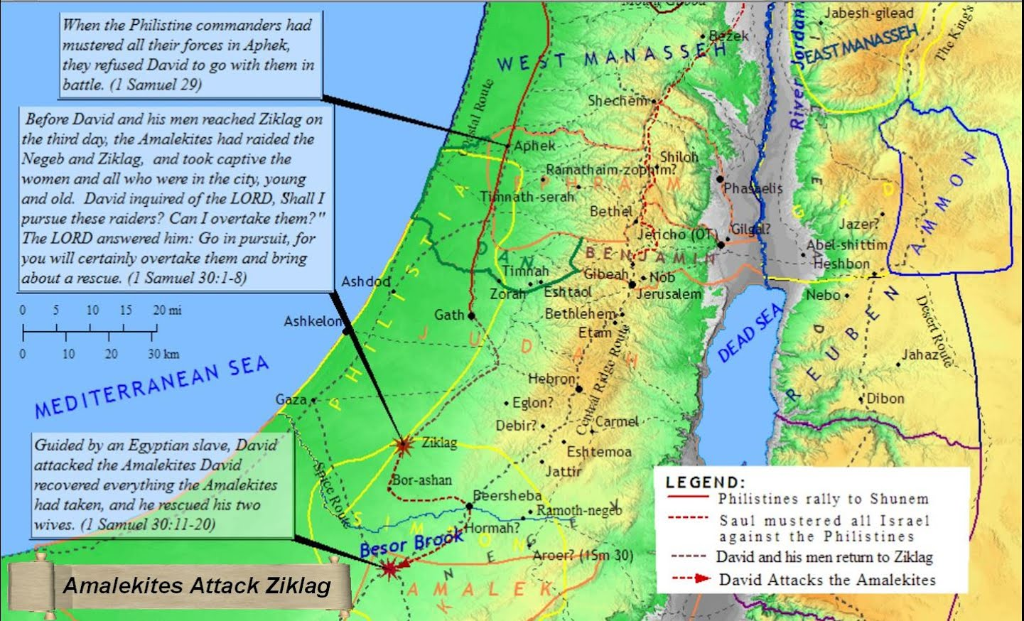
1 Samuel 30
1

Slide 17
1 Chronicles 12:21-22
²¹ And they helped David against the bands of raiders, for they were all mighty men of valor, and they were captains in the army. ²² For at that time they came to David day by day to help him, until it was a great army, like the army of God.

Slide 18
What Are Main Points?
David showed respect & honor to the king who governed – even the Philistine king
God could & did use unsavory characters to deliver His message at times
The Jezreel Valley comes to be a place of momentous battles & loss in Israelite history
God was working by His providence to bring the best for David & his coming kingship

Slide 19
For Sunday (February 27, 2022)
Lessons # 26
1st Samuel 30 – 31
1st Chronicles 10

