Slide 1
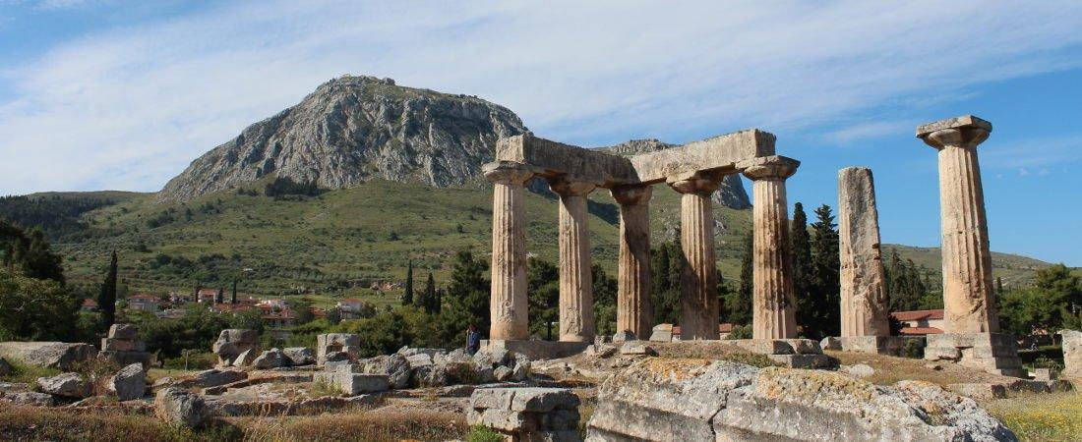
Paul’s Epistle of 1st Corinthians
84th Street church of Christ – March - May, 2022

Slide 2
Introduction
AUTHOR: PAUL, the apostle (1:1; 16:21)
PLACE OF WRITING: Ephesus (16:8)
TIME OF WRITING:
Probably in the spring of 57 A.D.
Shortly before the Jewish feast of Pentecost (16:8)
During his third missionary journey (Acts 19:1-41).

Slide 3
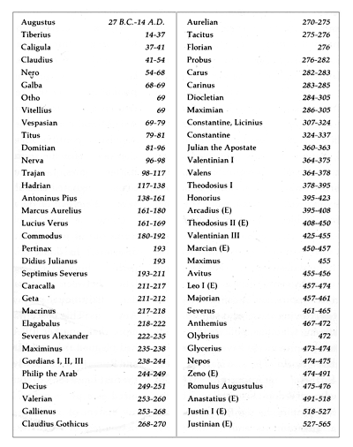
List of Roman Emporers

Slide 4
Introduction
BACKGROUND OF THE CITY OF CORINTH:
On the Isthmus of Greece about 50 miles to the east was the city of Athens
Became a very important commercial center
Known for its immorality found in the temple of Venus (Aphrodite)
BACKGROUND OF THE CHURCH AT CORINTH – Acts 18

Slide 5
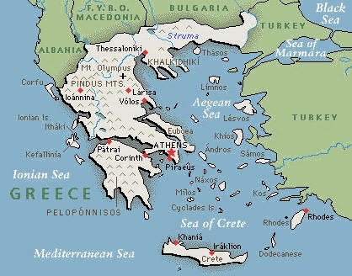
Map of Ancient Greece - Corinth

Slide 6
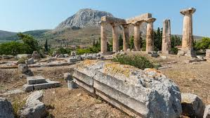
Ancient Corinth

Slide 7
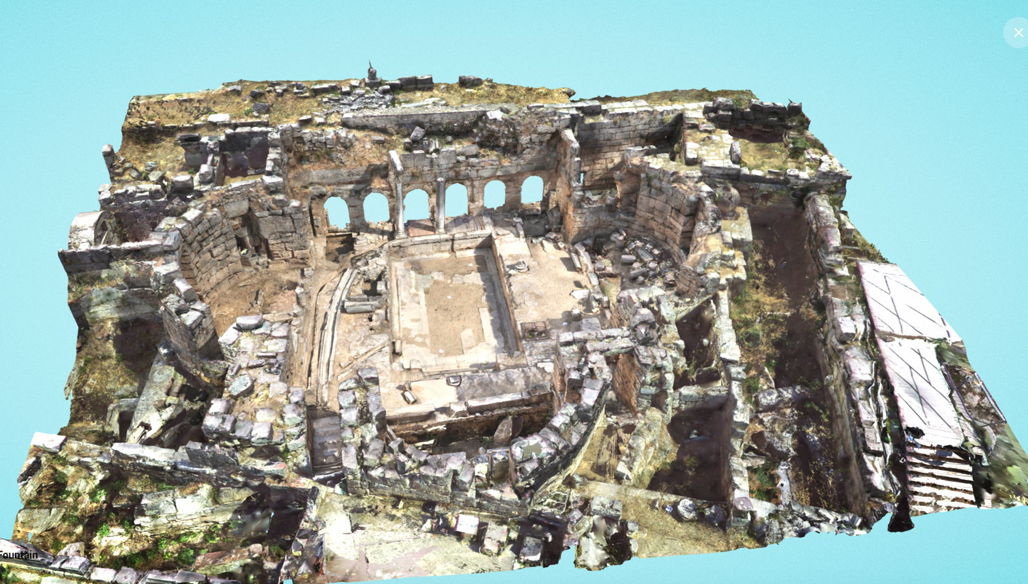
Ancient Corinth

Slide 8
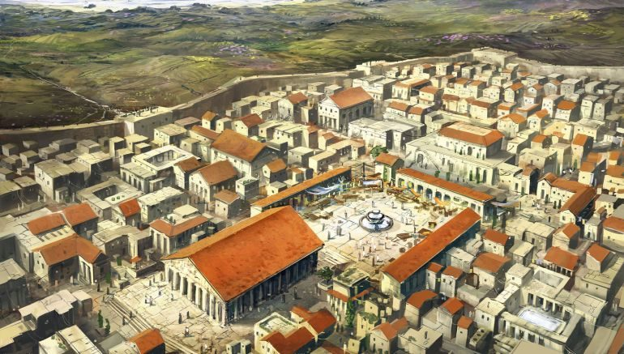
Ancient Corinth (reconstruction)

Slide 9
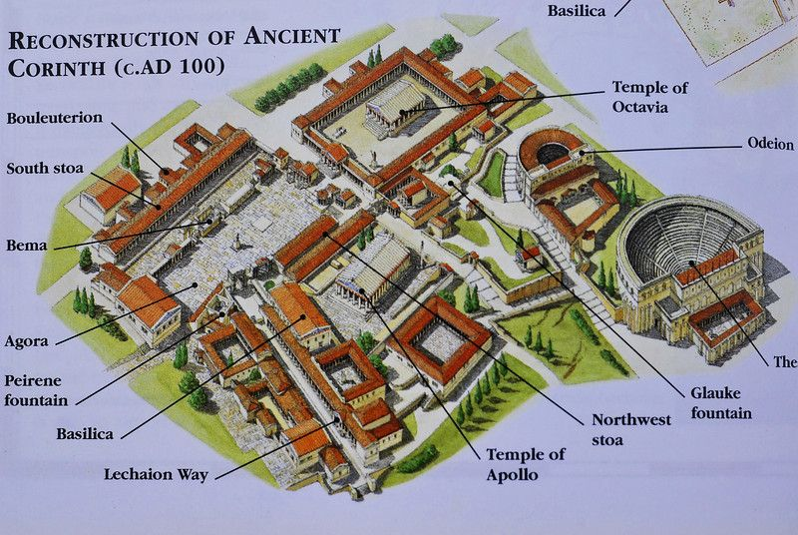
Map of Ancient Corinth

Slide 10
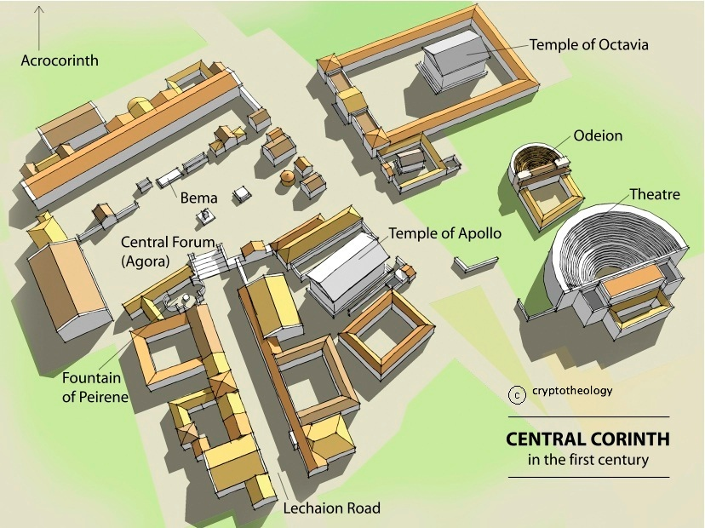
Map of Ancient Corinth

Slide 11
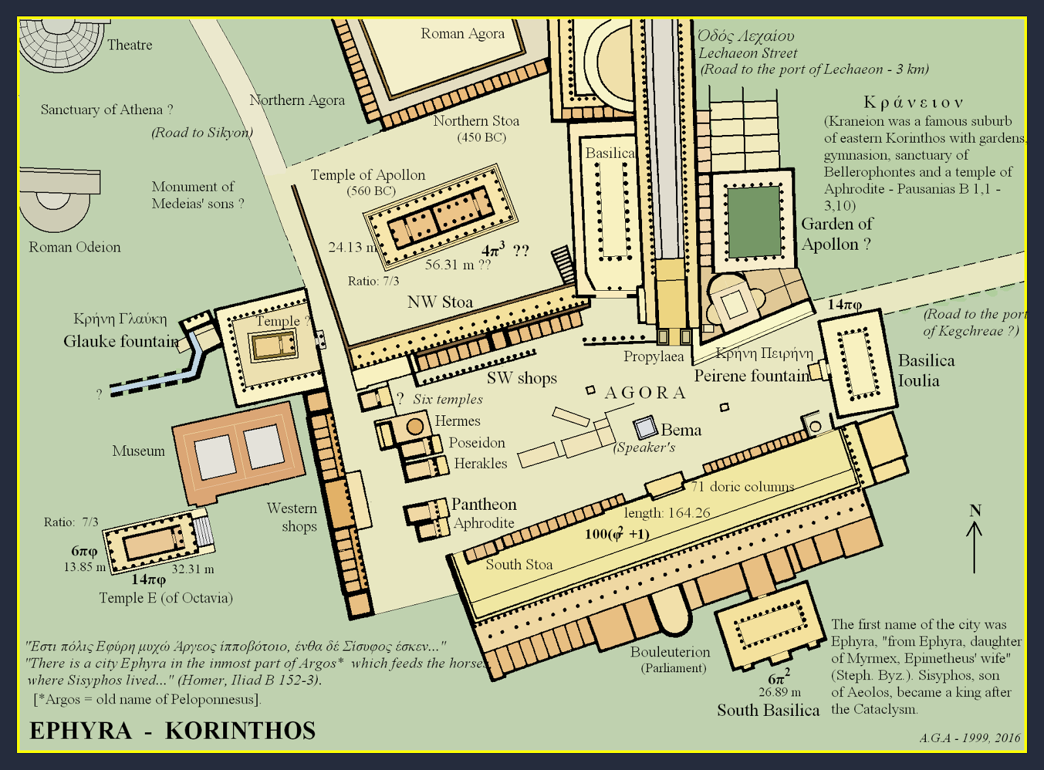
Map of Ancient Corinth

Slide 12
Outline
I. Introduction (1:1- 9)
II. Dealing with Problems Reported to Paul (1:10 – 6:20)
A. Problem of Factionalism (1:10 – 3:23)
B. Problem of Rejecting Paul’s Work (4:1-21)
C. Problem of the Fornicator and Church Discipline (5:1-13)
D. Taking Problems between Brethren to Civil Courts (6:1-11)
E. Responsibility to Glorify God with the Body (6:12-20)

Slide 13
III. Dealing with Questions Asked by the Corinthians (7:1 – 16:9)
A. “Now Concerning” – Marriage and Present Distress (7:1-40)
B. “Now Concerning” – Idolatry and Personal Liberty (8:1 – 11:1)
C. “Now… Remember Me” and Apostolic Tradition
1. Submission and Customs (11:2-16)
2. Pattern for Lord’s Supper (11:17-34)
D. “Now Concerning” – Spiritual Gifts (12:1 – 14:40)
E. “Now…” Concerning – The Resurrection (15:1-58)
F. “Now Concerning” – The Collection (16:1-9)
IV. Concluding Remarks (16:10-24)

Slide 14
1st Corinthians 1
¹ Paul, called to be an apostle of Jesus Christ through the will of God, and Sosthenes our brother,
² To the church of God which is at Corinth, to those who are sanctified in Christ Jesus, called to be saints, with all who in every place call on the name of Jesus Christ our Lord, both theirs and ours:
³ Grace to you and peace from God our Father and the Lord Jesus Christ.

Slide 15
1st Corinthians 1
⁴ I thank my God always concerning you for the grace of God which was given to you by Christ Jesus, ⁵ that you were enriched in everything by Him in all utterance and all knowledge, ⁶ even as the testimony of Christ was confirmed in you, ⁷ so that you come short in no gift, eagerly waiting for the revelation of our Lord Jesus Christ, ⁸ who will also confirm you to the end, that you may be blameless in the day of our Lord Jesus Christ. ⁹ God is faithful, by whom you were called into the fellowship of His Son, Jesus Christ our Lord.

Slide 16
1st Corinthians 1
¹⁰ Now I plead with you, brethren, by the name of our Lord Jesus Christ, that you all speak the same thing, and that there be no divisions among you, but that you be perfectly joined together in the same mind and in the same judgment. ¹¹ For it has been declared to me concerning you, my brethren, by those of Chloe’s household, that there are contentions among you. ¹² Now I say this, that each of you says, “I am of Paul,” or “I am of Apollos,” or “I am of Cephas,” or “I am of Christ.” ¹³ Is Christ divided? Was Paul crucified for you? Or were you baptized in the name of Paul?

Slide 17
1st Corinthians 1
¹⁴ I thank God that I baptized none of you except Crispus and Gaius, ¹⁵ lest anyone should say that I had baptized in my own name. ¹⁶ Yes, I also baptized the household of Stephanas. Besides, I do not know whether I baptized any other. ¹⁷ For Christ did not send me to baptize, but to preach the gospel, not with wisdom of words, lest the cross of Christ should be made of no effect.
¹⁸ For the message of the cross is foolishness to those who are perishing, but to us who are being saved it is the power of God. ¹⁹ For it is written:
“I will destroy the wisdom of the wise, And bring to nothing the understanding of the prudent.”

Slide 18
1st Corinthians 1
²⁰ Where is the wise? Where is the scribe? Where is the disputer of this age? Has not God made foolish the wisdom of this world? ²¹ For since, in the wisdom of God, the world through wisdom did not know God, it pleased God through the foolishness of the message preached to save those who believe. ²² For Jews request a sign, and Greeks seek after wisdom; ²³ but we preach Christ crucified, to the Jews a stumbling block and to Greeks foolishness, ²⁴ but to those who are called, both Jews and Greeks, Christ the power of God and the wisdom of God. ²⁵ Because the foolishness of God is wiser than men, and the weakness of God is stronger than men.

Slide 19
1st Corinthians 1
²⁶ For you see your calling, brethren, that not many wise according to the flesh, not many mighty, not many noble, are called. ²⁷ But God has chosen the foolish things of the world to put to shame the wise, and God has chosen the weak things of the world to put to shame the things which are mighty; ²⁸ and the base things of the world and the things which are despised God has chosen, and the things which are which are not, to bring to nothing the things that are ²⁹ that no flesh should glory in His presence. ³⁰ But of Him you are in Christ Jesus, who became for us wisdom from God — and righteousness and sanctification and redemption — ³¹ that, as it is written, “He who glories, let him glory in the Lord.”

Slide 20
1st Corinthians 2
¹ And I, brethren, when I came to you, did not come with excellence of speech or of wisdom declaring to you the testimony of God. ² For I determined not to know anything among you except Jesus Christ and Him crucified. ³ I was with you in weakness, in fear, and in much trembling. ⁴ And my speech and my preaching were not with persuasive words of human wisdom, but in demonstration of the Spirit and of power, ⁵ that your faith should not be in the wisdom of men but in the power of God.

Slide 21
1st Corinthians 2
⁶ However, we speak wisdom among those who are mature, yet not the wisdom of this age, nor of the rulers of this age, who are coming to nothing. ⁷ But we speak the wisdom of God in a mystery, the hidden wisdom which God ordained before the ages for our glory, ⁸ which none of the rulers of this age knew; for had they known, they would not have crucified the Lord of glory.
⁹ But as it is written:
“Eye has not seen, nor ear heard, nor have entered into the heart of man the things which God has prepared for those who love Him.”

Slide 22
1st Corinthians 2
¹⁰ But God has revealed them to us through His Spirit. For the Spirit searches all things, yes, the deep things of God. ¹¹ For what man knows the things of a man except the spirit of the man which is in him? Even so no one knows the things of God except the Spirit of God. ¹² Now we have received, not the spirit of the world, but the Spirit who is from God, that we might know the things that have been freely given to us by God.

Slide 23
1st Corinthians 2
¹³ These things we also speak, not in words which man’s wisdom teaches but which the Holy Spirit teaches, comparing spiritual things with spiritual. ¹⁴ But the natural man does not receive the things of the Spirit of God, for they are foolishness to him; nor can he know them, because they are spiritually discerned. ¹⁵ But he who is spiritual judges all things, yet he himself is rightly judged by no one. ¹⁶ For “who has known the mind of the Lord that he may instruct Him?” But we have the mind of Christ.

