Slide 1
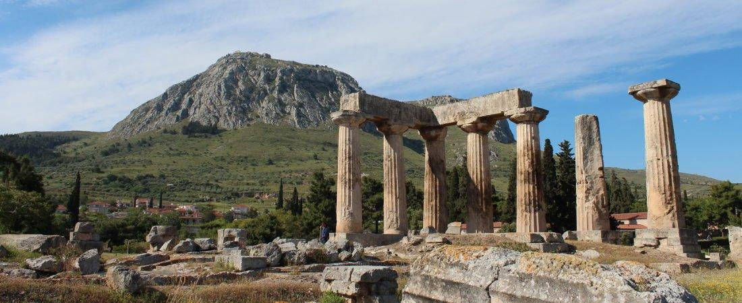
Paul’s Epistle of 1st Corinthians
84th Street church of Christ – March - May, 2022

Slide 2
Introduction
AUTHOR: PAUL, the apostle (1:1; 16:21)
PLACE OF WRITING: Ephesus (16:8)
TIME OF WRITING:
Probably in the spring of 57 A.D.
Shortly before the Jewish feast of Pentecost (16:8)
During his third missionary journey (Acts 18:1-28).

Slide 3
Introduction
BACKGROUND OF THE CITY OF CORINTH:
On the Isthmus of Greece about 50 miles to the east was the city of Athens
Became a very important commercial center
Known for its immorality found in the temple of Venus (Aphrodite)
BACKGROUND OF THE CHURCH AT CORINTH – Acts 18

Slide 4
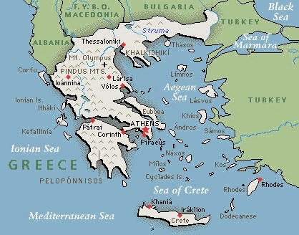
Map of Ancient Greece - Corinth

Slide 5
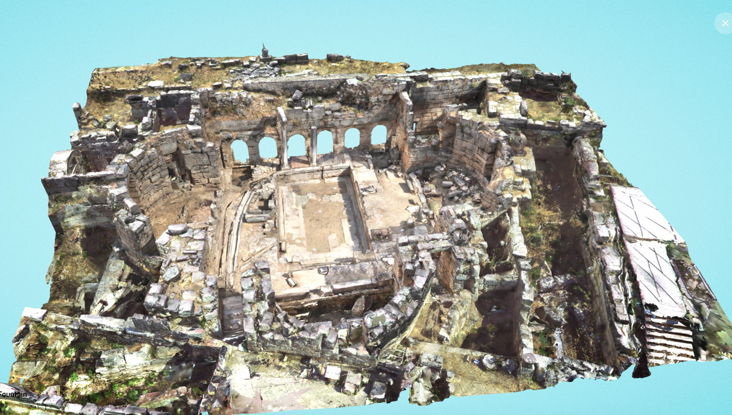
Ancient Corinth

Slide 6
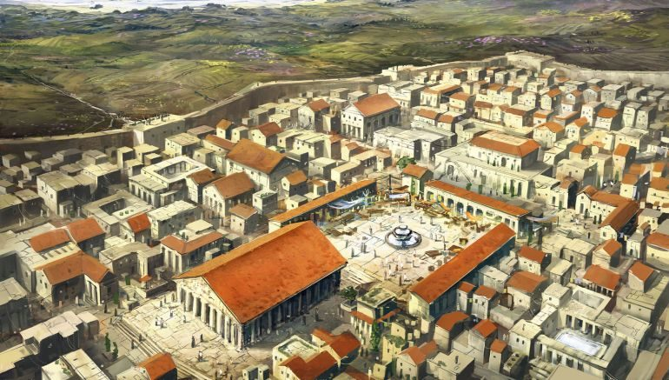
Ancient Corinth (reconstruction)

Slide 7
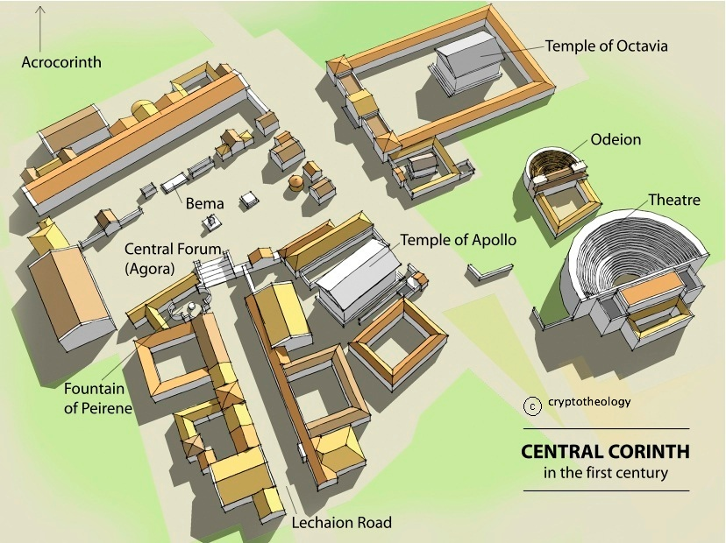
Map of Ancient Corinth

Slide 8
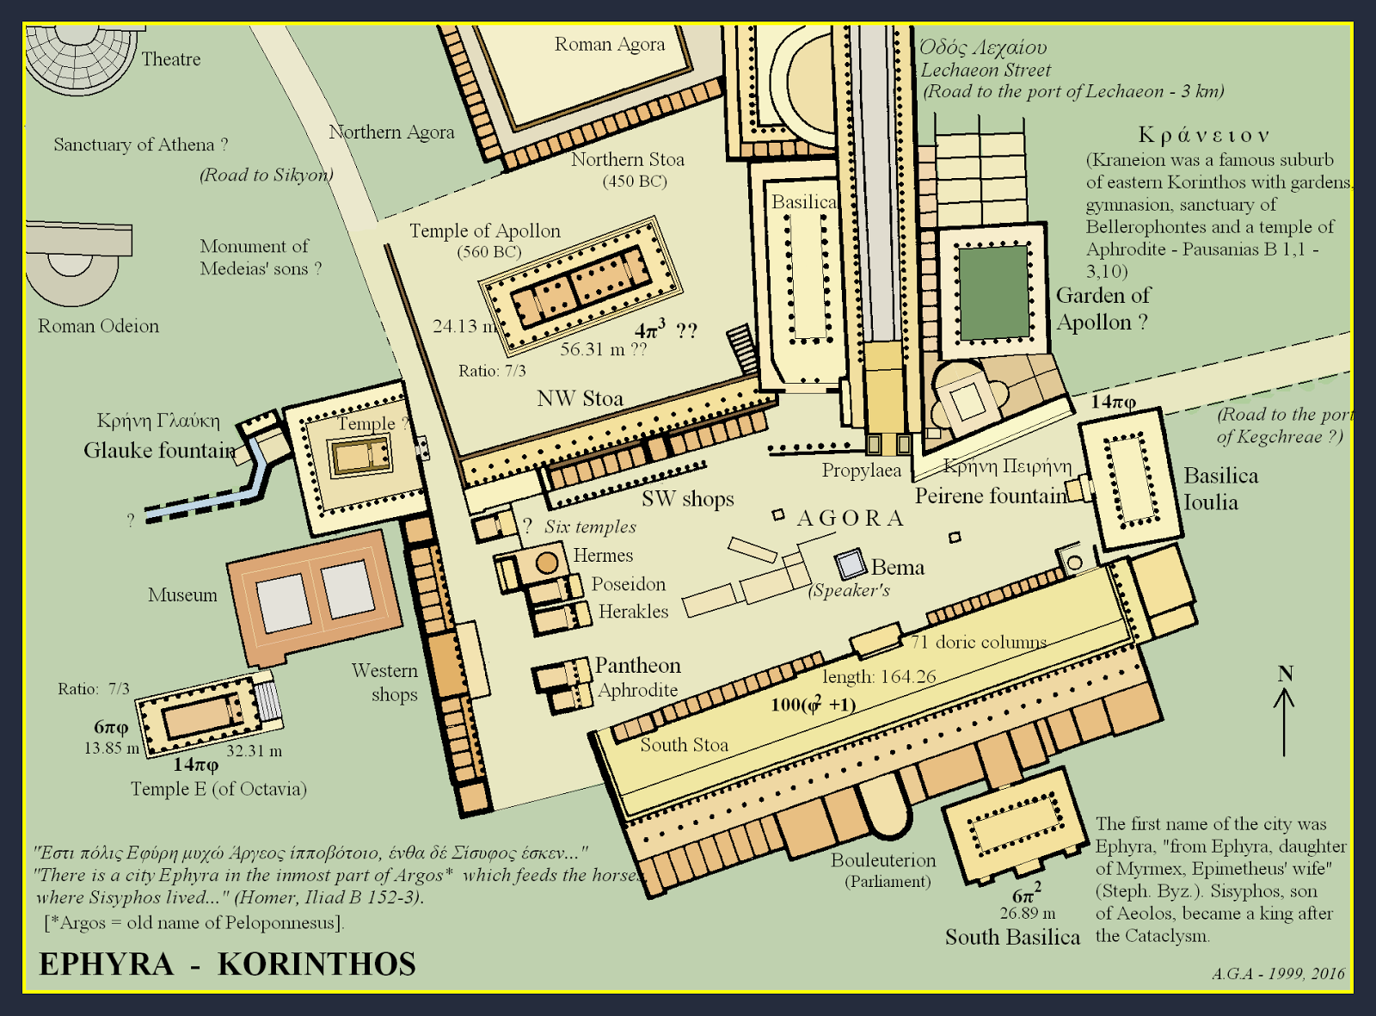
Map of Ancient Corinth

Slide 9
Outline
I. Introduction (1:1- 9)
II. Dealing with Problems Reported to Paul (1:10 – 6:20)
A. Problem of Factionalism (1:10 – 3:23)
B. Problem of Rejecting Paul’s Work (4:1-21)
C. Problem of the Fornicator and Church Discipline (5:1-13)
D. Taking Problems between Brethren to Civil Courts (6:1-11)
E. Responsibility to Glorify God with the Body (6:12-20)

Slide 10
1st Corinthians 1
Last Class
¹⁰ Now I plead with you, brethren, by the name of our Lord Jesus Christ, that you all speak the same thing, and that there be no divisions among you, but that you be perfectly joined together in the same mind and in the same judgment. ¹¹ For it has been declared to me concerning you, my brethren, by those of Chloe’s household, that there are contentions among you. ¹² Now I say this, that each of you says, “I am of Paul,” or “I am of Apollos,” or “I am of Cephas,” or “I am of Christ.” ¹³ Is Christ divided? Was Paul crucified for you? Or were you baptized in the name of Paul?

Slide 11
A Look at 1 Corinthians 1:14-31
1. NATURE OF THE DIVISION AT CORINTH (1:10-17)
A. AS REPORTED TO PAUL (1:10-12)
1) His plea for unity (10)
2) Some in Chloe's household reported contentions among them (11)
3) Involved factions following men (12)
B. PAUL'S INITIAL REACTION (1:13-17)
1) Rhetorical questions illustrating the absurdity of following after men (13)
2) Gratitude that he personally baptized few of them (14-17)
a) Lest any should accuse him of baptizing in his own name (14-15)
b) Being the one to baptize the believers was not his chief purpose (16-17)

Slide 12
2. FOLLY OF BOASTING IN HUMAN WISDOM (1:18-31)
A. GOD WILL DESTROY WISDOM OF WISE (1:18-25)
1) Granted, the message of the cross is foolish to some, but not to the saved (18)
2) But God will the destroy the wisdom of the world (19-20)
3) God chose to use what man deemed foolish and weak to save those who believe (21-25)
a) The world through its wisdom did not know God (21a)
b) God chose to save mankind through "the foolishness of preaching" [message preached - Christ crucified] (21b-24)
c) God's "foolishness" and "weakness” [as man might see it] is wiser and stronger than men (25)

Slide 13
B. CORINTHIANS' CALLING DEMONSTRATED THIS TRUTH (1:26-29)
1) Not many of them were "wise, mighty, or noble" (26)
2) But God has chosen those things that are "foolish, weak, base, despised, and which are not" to show their folly (27-28)
3) So that no flesh should glory in His presence (29)
C. INTENT WAS TO SHOW GLORY OF LORD (1:30-31)
1) Those in Christ showed the wisdom of God, through righteousness and sanctification and redemption (30)
2) We should glory only in Him (31)

Slide 14
1st Corinthians 1
¹⁴ I thank God that I baptized none of you except Crispus and Gaius, ¹⁵ lest anyone should say that I had baptized in my own name. ¹⁶ Yes, I also baptized the household of Stephanas. Besides, I do not know whether I baptized any other. ¹⁷ For Christ did not send me to baptize, but to preach the gospel, not with wisdom of words, lest the cross of Christ should be made of no effect.
¹⁸ For the message of the cross is foolishness to those who are perishing, but to us who are being saved it is the power of God. ¹⁹ For it is written:
“I will destroy the wisdom of the wise, And bring to nothing the understanding of the prudent.”

Slide 15
Questions
11. Why did Paul say he was glad he had only baptized a few in Corinth? Was it because baptism was not important? Prove your answer. ____________________ _________________________________________________________________
12. In what two ways do men view the message of the cross? __________________ ___________________________________________________________________
13. What is meant by the term “message of the cross”? _______________________ ____________________________________________________________________
14. “For since, in the ______________ of _________, the ______________ through ___________ did not know ________, it pleased God through the ____________ of the message _______________ to save those who _________________.”
15. What does the text say that the Jews were seeking? _____________________
16. What does the text say that the Gentiles were seeking? ___________________
17. How was the message of a crucified Christ seen by the Jews? _______________
18. How was the message of a crucified Christ seen by the Gentiles? ____________

Slide 16
1st Corinthians 1
¹⁴ I thank God that I baptized none of you except Crispus and Gaius, ¹⁵ lest anyone should say that I had baptized in my own name. ¹⁶ Yes, I also baptized the household of Stephanas. Besides, I do not know whether I baptized any other. ¹⁷ For Christ did not send me to baptize, but to preach the gospel, not with wisdom of words, lest the cross of Christ should be made of no effect.
¹⁸ For the message of the cross is foolishness to those who are perishing, but to us who are being saved it is the power of God. ¹⁹ For it is written:
“I will destroy the wisdom of the wise, And bring to nothing the understanding of the prudent.”

Slide 17
Questions
11. Why did Paul say he was glad he had only baptized a few in Corinth? Was it because baptism was not important? Prove your answer. ____________________ _________________________________________________________________
12. In what two ways do men view the message of the cross? __________________ ___________________________________________________________________
13. What is meant by the term “message of the cross”? _______________________ ____________________________________________________________________
14. “For since, in the ______________ of _________, the ______________ through ___________ did not know ________, it pleased God through the ____________ of the message _______________ to save those who _________________.”
15. What does the text say that the Jews were seeking? _____________________
16. What does the text say that the Gentiles were seeking? ___________________
17. How was the message of a crucified Christ seen by the Jews? _______________
18. How was the message of a crucified Christ seen by the Gentiles? ____________

Slide 18
Questions
11. Why did Paul say he was glad he had only baptized a few in Corinth? Was it because baptism was not important? Prove your answer. ____________________ _________________________________________________________________
12. In what two ways do men view the message of the cross? __________________ ___________________________________________________________________
13. What is meant by the term “message of the cross”? _______________________ ____________________________________________________________________
14. “For since, in the ______________ of _________, the ______________ through ___________ did not know ________, it pleased God through the ____________ of the message _______________ to save those who _________________.”
15. What does the text say that the Jews were seeking? _____________________
16. What does the text say that the Gentiles were seeking? ___________________
17. How was the message of a crucified Christ seen by the Jews? _______________
18. How was the message of a crucified Christ seen by the Gentiles? ____________

Slide 19
1st Corinthians 1
²⁰ Where is the wise? Where is the scribe? Where is the disputer of this age? Has not God made foolish the wisdom of this world? ²¹ For since, in the wisdom of God, the world through wisdom did not know God, it pleased God through the foolishness of the message preached to save those who believe. ²² For Jews request a sign, and Greeks seek after wisdom; ²³ but we preach Christ crucified, to the Jews a stumbling block and to Greeks foolishness, ²⁴ but to those who are called, both Jews and Greeks, Christ the power of God and the wisdom of God. ²⁵ Because the foolishness of God is wiser than men, and the weakness of God is stronger than men.

Slide 20
Questions
11. Why did Paul say he was glad he had only baptized a few in Corinth? Was it because baptism was not important? Prove your answer. ____________________ _________________________________________________________________
12. In what two ways do men view the message of the cross? __________________ ___________________________________________________________________
13. What is meant by the term “message of the cross”? _______________________ ____________________________________________________________________
14. “For since, in the ______________ of _________, the ______________ through ___________ did not know ________, it pleased God through the ____________ of the message _______________ to save those who _________________.”
15. What does the text say that the Jews were seeking? _____________________
16. What does the text say that the Gentiles were seeking? ___________________
17. How was the message of a crucified Christ seen by the Jews? _______________
18. How was the message of a crucified Christ seen by the Gentiles? ____________

Slide 21
1st Corinthians 1
²⁰ Where is the wise? Where is the scribe? Where is the disputer of this age? Has not God made foolish the wisdom of this world? ²¹ For since, in the wisdom of God, the world through wisdom did not know God, it pleased God through the foolishness of the message preached to save those who believe. ²² For Jews request a sign, and Greeks seek after wisdom; ²³ but we preach Christ crucified, to the Jews a stumbling block and to Greeks foolishness, ²⁴ but to those who are called, both Jews and Greeks, Christ the power of God and the wisdom of God. ²⁵ Because the foolishness of God is wiser than men, and the weakness of God is stronger than men.

Slide 22
Questions
11. Why did Paul say he was glad he had only baptized a few in Corinth? Was it because baptism was not important? Prove your answer. ____________________ _________________________________________________________________
12. In what two ways do men view the message of the cross? __________________ ___________________________________________________________________
13. What is meant by the term “message of the cross”? _______________________ ____________________________________________________________________
14. “For since, in the ______________ of _________, the ______________ through ___________ did not know ________, it pleased God through the ____________ of the message _______________ to save those who _________________.”
15. What does the text say that the Jews were seeking? _____________________
16. What does the text say that the Gentiles were seeking? ___________________
17. How was the message of a crucified Christ seen by the Jews? _______________
18. How was the message of a crucified Christ seen by the Gentiles? ____________

Slide 23
Questions
11. Why did Paul say he was glad he had only baptized a few in Corinth? Was it because baptism was not important? Prove your answer. ____________________ _________________________________________________________________
12. In what two ways do men view the message of the cross? __________________ ___________________________________________________________________
13. What is meant by the term “message of the cross”? _______________________ ____________________________________________________________________
14. “For since, in the ______________ of _________, the ______________ through ___________ did not know ________, it pleased God through the ____________ of the message _______________ to save those who _________________.”
15. What does the text say that the Jews were seeking? _____________________
16. What does the text say that the Gentiles were seeking? ___________________
17. How was the message of a crucified Christ seen by the Jews? _______________
18. How was the message of a crucified Christ seen by the Gentiles? ____________

Slide 24
1st Corinthians 1
²⁰ Where is the wise? Where is the scribe? Where is the disputer of this age? Has not God made foolish the wisdom of this world? ²¹ For since, in the wisdom of God, the world through wisdom did not know God, it pleased God through the foolishness of the message preached to save those who believe. ²² For Jews request a sign, and Greeks seek after wisdom; ²³ but we preach Christ crucified, to the Jews a stumbling block and to Greeks foolishness, ²⁴ but to those who are called, both Jews and Greeks, Christ the power of God and the wisdom of God. ²⁵ Because the foolishness of God is wiser than men, and the weakness of God is stronger than men.

Slide 25
Questions
11. Why did Paul say he was glad he had only baptized a few in Corinth? Was it because baptism was not important? Prove your answer. ____________________ _________________________________________________________________
12. In what two ways do men view the message of the cross? __________________ ___________________________________________________________________
13. What is meant by the term “message of the cross”? _______________________ ____________________________________________________________________
14. “For since, in the ______________ of _________, the ______________ through ___________ did not know ________, it pleased God through the ____________ of the message _______________ to save those who _________________.”
15. What does the text say that the Jews were seeking? _____________________
16. What does the text say that the Gentiles were seeking? ___________________
17. How was the message of a crucified Christ seen by the Jews? _______________
18. How was the message of a crucified Christ seen by the Gentiles? ____________

Slide 26
Questions
11. Why did Paul say he was glad he had only baptized a few in Corinth? Was it because baptism was not important? Prove your answer. ____________________ _________________________________________________________________
12. In what two ways do men view the message of the cross? __________________ ___________________________________________________________________
13. What is meant by the term “message of the cross”? _______________________ ____________________________________________________________________
14. “For since, in the ______________ of _________, the ______________ through ___________ did not know ________, it pleased God through the ____________ of the message _______________ to save those who _________________.”
15. What does the text say that the Jews were seeking? _____________________
16. What does the text say that the Gentiles were seeking? ___________________
17. How was the message of a crucified Christ seen by the Jews? _______________
18. How was the message of a crucified Christ seen by the Gentiles? ____________

Slide 27
1st Corinthians 1
²⁶ For you see your calling, brethren, that not many wise according to the flesh, not many mighty, not many noble, are called. ²⁷ But God has chosen the foolish things of the world to put to shame the wise, and God has chosen the weak things of the world to put to shame the things which are mighty; ²⁸ and the base things of the world and the things which are despised God has chosen, and the things which are which are not, to bring to nothing the things that are ²⁹ that no flesh should glory in His presence. ³⁰ But of Him you are in Christ Jesus, who became for us wisdom from God — and righteousness and sanctification and redemption — ³¹ that, as it is written, “He who glories, let him glory in the Lord.”

Slide 28
Questions
19. “For you see your ______________, brethren, that not many _______________ according to the __________________, not many __________________, not many ________________, are _________________.”
20. Why has God chosen the foolish, weak and base things of the world? _________ ____________________________________________________________________ ____________________________________________________________________
Thought Question:
Why are most of the worldly wise, wealthy and noble not attracted to the gospel message? How has the world changed the gospel message to attract those who are not attracted to the original gospel message? ________________________________ ____________________________________________________________________
____________________________________________________________________

Slide 29
1st Corinthians 1
²⁶ For you see your calling, brethren, that not many wise according to the flesh, not many mighty, not many noble, are called. ²⁷ But God has chosen the foolish things of the world to put to shame the wise, and God has chosen the weak things of the world to put to shame the things which are mighty; ²⁸ and the base things of the world and the things which are despised God has chosen, and the things which are which are not, to bring to nothing the things that are ²⁹ that no flesh should glory in His presence. ³⁰ But of Him you are in Christ Jesus, who became for us wisdom from God — and righteousness and sanctification and redemption — ³¹ that, as it is written, “He who glories, let him glory in the Lord.”

Slide 30
Questions
19. “For you see your ______________, brethren, that not many _______________ according to the __________________, not many __________________, not many ________________, are _________________.”
20. Why has God chosen the foolish, weak and base things of the world? _________ ____________________________________________________________________ ____________________________________________________________________
Thought Question:
Why are most of the worldly wise, wealthy and noble not attracted to the gospel message? How has the world changed the gospel message to attract those who are not attracted to the original gospel message? ________________________________ ____________________________________________________________________
____________________________________________________________________

Slide 31
Questions
19. “For you see your ______________, brethren, that not many _______________ according to the __________________, not many __________________, not many ________________, are _________________.”
20. Why has God chosen the foolish, weak and base things of the world? _________ ____________________________________________________________________ ____________________________________________________________________
Thought Question:
Why are most of the worldly wise, wealthy and noble not attracted to the gospel message? How has the world changed the gospel message to attract those who are not attracted to the original gospel message? ________________________________ ____________________________________________________________________
____________________________________________________________________

Slide 32
1st Corinthians
Next Class:
Chapter 2

