Slide 1
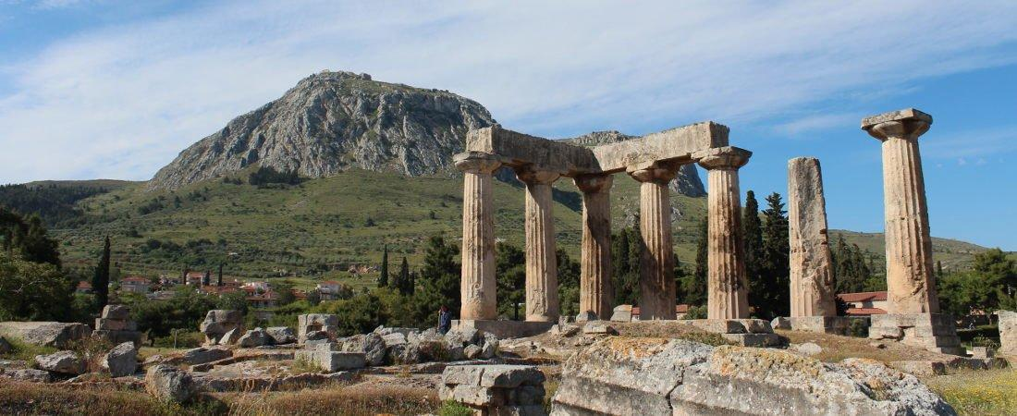
Paul’s Epistle of 1st Corinthians
84th Street church of Christ – March - May, 2022

Slide 2
Outline
I. Introduction (1:1- 9)
II. Dealing with Problems Reported to Paul (1:10 – 6:20)
A. Problem of Factionalism (1:10 – 3:23)
B. Problem of Rejecting Paul’s Work (4:1-21)
C. Problem of the Fornicator and Church Discipline (5:1-13)
D. Taking Problems between Brethren to Civil Courts (6:1-11)
E. Responsibility to Glorify God with the Body (6:12-20)

Slide 3
Outline
Today’s class
I. Introduction (1:1- 9)
II. Dealing with Problems Reported to Paul (1:10 – 6:20)
A. Problem of Factionalism (1:10 – 3:23)
B. Problem of Rejecting Paul’s Work (4:1-21)
C. Problem of the Fornicator and Church Discipline (5:1-13)
D. Taking Problems between Brethren to Civil Courts (6:1-11)
E. Responsibility to Glorify God with the Body (6:12-20)

Slide 4
1 Corinthians 2
Paul’s presentation of the gospel (v.1-5)
Paul’s presentation of the message did not point to himself (v.1-3)
Not with excellence of speech or wisdom – v.1
Not with persuasive words of human wisdom – v.4
He was with them in weakness, fear, and trembling – v.3

Slide 5
1 Corinthians 2
Paul’s presentation of the gospel (v.1-5)
Paul’s presentation of the message pointed to God (v.4-5)
He presented Christ and Him crucified – v.2
The words he spoke were in demonstration of the Spirit and power – v.4
This was so their faith would be in the power of God – v.5

Slide 6
1 Corinthians 2
Spiritual wisdom and it’s source (v.6-13)
The wisdom Paul spoke (v.6-9)
Not the wisdom of this age or of the rulers of this age – v.6
The wisdom of God – v.7
Spoken in a mystery, the hidden wisdom ordained before the ages by God (v.7)
The elite do not understand this wisdom, if they did, they would not have crucified Christ – v.8
God has prepared it for those who love Him – v.9

Slide 7
1 Corinthians 2
Spiritual wisdom and it’s source (v.6-13)
God has revealed wisdom to man through His Spirit – the source of revelation (v.10-13)
The Spirit searches the deep things of God – v.10
No one knows the things of God except the Spirit of God – v.11
The Spirit of God has revealed the things freely given by God – v.12
These are the things Paul spoke – v.13
It was not of man’s wisdom but that which the Holy Spirit teaches (v.13)

Slide 8
1 Corinthians 2
Spiritual wisdom and it’s source (v.6-13)
The one who receives revelation from God (v.14-16)
The natural man (physical/sensual) does not receive the revelation from God, it is foolishness to him – v.14
The spiritual man receives the revelation from God – v.15
We have been given revelation from God – v.16

