Slide 1
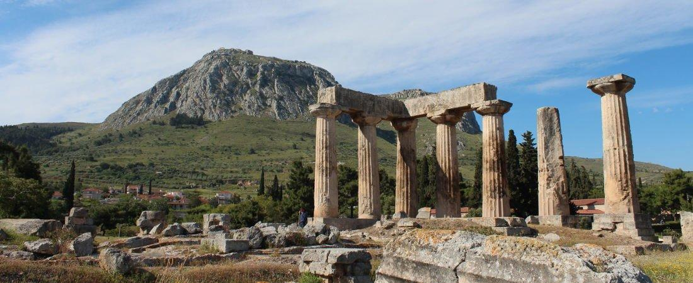
Paul’s Epistle of 1st Corinthians
84th Street church of Christ – March - May, 2022

Slide 2
Outline
I. Introduction (1:1- 9)
II. Dealing with Problems Reported to Paul (1:10 – 6:20)
A. Problem of Factionalism (1:10 – 3:23)
B. Problem of Rejecting Paul’s Work (4:1-21)
C. Problem of the Fornicator and Church Discipline (5:1-13)
D. Taking Problems between Brethren to Civil Courts (6:1-11)
E. Responsibility to Glorify God with the Body (6:12-20)

Slide 3
Outline
Today’s class
I. Introduction (1:1- 9)
II. Dealing with Problems Reported to Paul (1:10 – 6:20)
A. Problem of Factionalism (1:10 – 3:23)
B. Problem of Rejecting Paul’s Work (4:1-21)
C. Problem of the Fornicator and Church Discipline (5:1-13)
D. Taking Problems between Brethren to Civil Courts (6:1-11)
E. Responsibility to Glorify God with the Body (6:12-20)

Slide 4
1 Corinthians 4
Stewards of the mysteries of God (v.1-5)
The apostles are to be viewed as servants and stewards – v.1
Stewards are faithful in what they have been entrusted with – v.2
Judgement of stewards is done by the master – v.3-5
Man’s judgement has no bearing – v.3
Self judgement has no bearing – v.3-4
Judgment is to be left to God – v.5

Slide 5
1 Corinthians 4
The Corinthians needed to learn humility (v.6-13)
The Corinthians needed to learn how to think – v.6-8
Paul figuratively transferred the objects of division to he and Apollos – v.6
They were not to think beyond what was written
They were not to be puffed up against one another

Slide 6
1 Corinthians 4
The Corinthians needed to learn humility (v.6-13)
The Corinthians needed to learn how to think – v.6-8
Rhetorical questions showing they received the things they have from God; it was not of themselves – v.7
The Corinthians were boasting in themselves – v.8
Already full, rich, and have reigned as kings without us (separate from the apostles)

Slide 7
1 Corinthians 4
The Corinthians needed to learn humility (v.6-13)
The apostles in contrast to the Corinthians – v.9-13
The apostles had been made a spectacle to the world – v.9
Sarcastic and ironic statements – v.10
Apostles – fools for Christ, weak, dishonored
The Corinthians – wise in Christ, strong, distinguished

Slide 8
1 Corinthians 4
The Corinthians needed to learn humility (v.6-13)
The apostles in contrast to the Corinthians – v.9-13
The apostles hunger and thirst, are poorly clothed, beaten, and homeless – v.11
The apostles labor working with their own hands – v.12-13
Being reviled they bless, persecuted they endure, defamed they entreat
The apostles are the filth of the world, the offscouring of all things until now – v.13

Slide 9
1 Corinthians 4
Paul’s care for the brethren at Corinth (v.14-21)
Paul’s desire is for the Corinthians to learn – v.14-17
Paul was writing to warn them – v.14
Those at Corinth were begotten through Paul’s teaching of the gospel – v.15
Paul urged those at Corinth to imitate him – v.16
Paul sent Timothy to remind them and continue the teaching that is taught in every church – v.17

Slide 10
1 Corinthians 4
Paul’s care for the brethren at Corinth (v.14-21)
Paul plans to come to the brethren at Corinthians – v. 18-21
Some thought he wouldn’t, but Paul was going to come shortly, if the Lord wills – v.18-19
When Paul comes, he will come with the true power of the kingdom (gospel) compared to those at Corinth – v.19-20
The way Paul will come is dependent upon how the Corinthians react to the message – v.21

