Slide 1
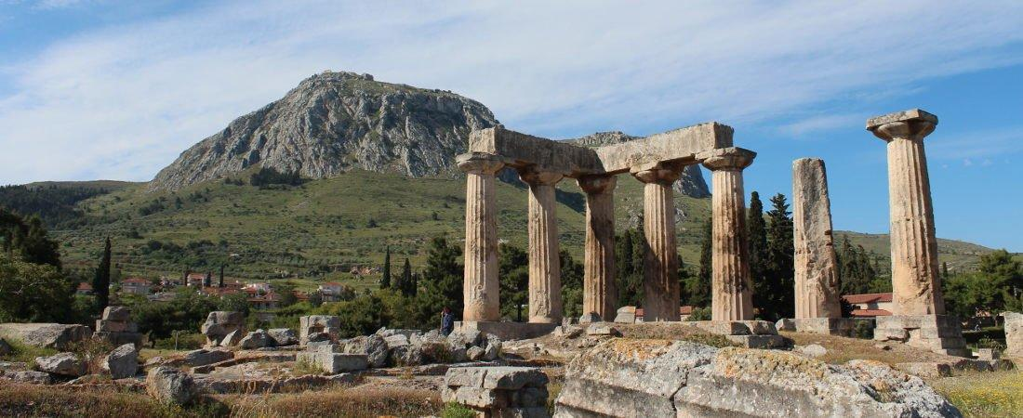
Paul’s Epistle of 1st Corinthians
84th Street church of Christ – March - May, 2022

Slide 2
Outline
I. Introduction (1:1- 9)
II. Dealing with Problems Reported to Paul (1:10 – 6:20)
A. Problem of Factionalism (1:10 – 3:23)
B. Problem of Rejecting Paul’s Work (4:1-21)
C. Problem of the Fornicator and Church Discipline (5:1-13)
D. Taking Problems between Brethren to Civil Courts (6:1-11)
E. Responsibility to Glorify God with the Body (6:12-20)

Slide 3
Outline
Today’s class
I. Introduction (1:1- 9)
II. Dealing with Problems Reported to Paul (1:10 – 6:20)
A. Problem of Factionalism (1:10 – 3:23)
B. Problem of Rejecting Paul’s Work (4:1-21)
C. Problem of the Fornicator and Church Discipline (5:1-13)
D. Taking Problems between Brethren to Civil Courts (6:1-11)
E. Responsibility to Glorify God with the Body (6:12-20)

Slide 4
1 Corinthians 6
Taking problems between brethren to civil courts (6:1-11)
Issue of taking a brother to civil court (v.1-6)
Do not take a brother to civil court before an unrighteous one (v.1)
The saints will judge the world and angels, you should be able to judge small civil matters (v.2-3)

Slide 5
1 Corinthians 6
Taking problems between brethren to civil courts (6:1-11)
Issue of taking a brother to civil court (v.1-6)
You should have one wise enough among you to judge instead of one in the world (v.4-5)
But you are not doing so and instead have unbelievers handling civil matters between brethren (v.6)

Slide 6
1 Corinthians 6
Taking problems between brethren to civil courts (6:1-11)
The effect of unrighteousness (v.7-11)
You should be willing to accept the wrong and let yourself be cheated (v.7)
You are doing the wrong and cheating (v.8)

Slide 7
1 Corinthians 6
Taking problems between brethren to civil courts (6:1-11)
The effect of unrighteousness (v.7-11)
The unrighteous will not inherit the kingdom of God (v.9-10)
You were unrighteous but have been washed, sanctified, and justified in the name of the Lord, so live like it (v.11)

Slide 8
1 Corinthians 6
Responsibility to glorify God with the body (6:12-20)
Our body is to be used in service to God (v.12-14)
We are to have self-control, even over liberties we have (v.12)
Our body is for the service of the Lord (v.13-14)
Food and the stomach are for each other, but the body is not for sexual immorality (v.13)
God raised Jesus and will raise us up by His power (v.14)

Slide 9
1 Corinthians 6
Responsibility to glorify God with the body (6:12-20)
Our body is not ours to do whatever we want with (v.15-20)
Our bodies are members of Christ, and we are to be one is spirit (v.15-17)
If you are joined with a harlot, you are one with a harlot, this is not to be the case, we are to be one with the Lord, do not use your body for sexual immorality (v.15-16)

Slide 10
1 Corinthians 6
Responsibility to glorify God with the body (6:12-20)
Our body is not ours to do whatever we want with (v.15-20)
Our body is the temple of the Holy Spirit, and we are not our own (v.18-20)
Flee sexual immorality (fornication) (v.18)
Sexual immorality defiles the body; it takes that which is to be used in service to the Lord, and uses it in a way completely contradictory to that service

Slide 11
1 Corinthians 6
Responsibility to glorify God with the body (6:12-20)
Our body is not ours to do whatever we want with (v.15-20)
Our body is the temple of the Holy Spirit, and we are not our own (v.18-20)
We are not our own, we were bought at a price, we are to glorify God with our body and spirit -v.19-20
We are God’s (v.20)

