Slide 1
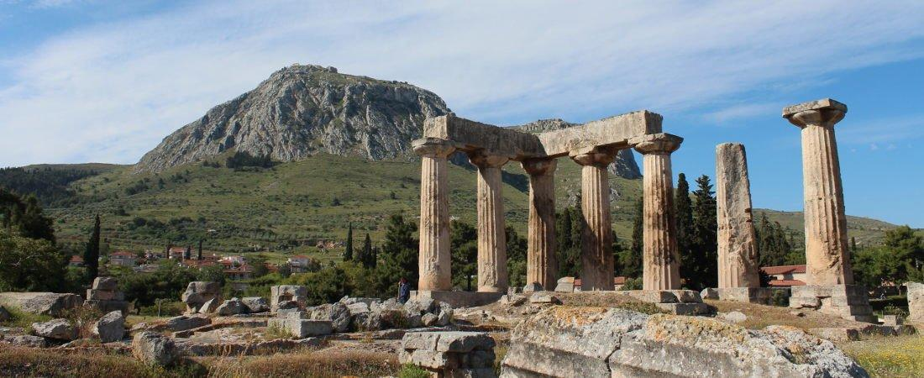
Paul’s Epistle of 1st Corinthians
Chapter 3

Slide 2
Outline
I. Introduction (1:1- 9)
II. Dealing with Problems Reported to Paul (1:10 – 6:20)
A. Problem of Factionalism (1:10 – 3:23)
B. Problem of Rejecting Paul’s Work (4:1-21)
C. Problem of the Fornicator and Church Discipline (5:1-13)
D. Taking Problems between Brethren to Civil Courts (6:1-11)
E. Responsibility to Glorify God with the Body (6:12-20)

Slide 3
1st Corinthians 2
Last Class
¹² Now we have received, not the spirit of the world, but the Spirit who is from God, that we might know the things that have been freely given to us by God. ¹³ These things we also speak, not in words which man’s wisdom teaches but which the Holy Spirit teaches, comparing spiritual things with spiritual. ¹⁴ But the natural man does not receive the things of the Spirit of God, for they are foolishness to him; nor can he know them, because they are spiritually discerned. ¹⁵ But he who is spiritual judges all things, yet he himself is rightly judged by no one. ¹⁶ For “who has known the mind of the Lord that he may instruct Him?” But we have the mind of Christ.

Slide 4
A Look at 1 Corinthians 3:1-23
THE CARNAL NATURE OF DIVISION (1-4)
CHRISTIANS AT CORINTH WERE CARNAL (1-2)
Prevented Paul from speaking to them as to spiritual people (1a)
Their carnality indicated that they were still babes in Christ, unable to receive solid food (1b)
EVIDENCE OF THEIR CARNALITY (3-4)
The envy, strife, and divisions among them (3)
Evidenced by in their calling themselves after men (4)

Slide 5
2. RELATION OF PREACHERS TO THEIR WORK (5-17)
PREACHERS ARE SERVANTS, USED BY GOD (5-7)
Ministers given the opportunity to serve God in various ways (5-6a)
But it is God who gives the increase (6b-7)
THEIR RELATION TO ONE ANOTHER AND THEIR WORK (8-17)
United in their work, though their labor and rewards may differ (8)
Fellow workers with God, they work on God's building (9)
Laying foundation (as Paul did) of Jesus Christ (10-11)
Building upon the foundation, using various materials to be tested at Judgment day (12-15)
Parallel of church to temple, manifesting Spirit (16)
Warning against anyone defiling the temple or church (17)

Slide 6
3. AVOID GLORYING IN WORLDLY WISDOM OR MEN (18-23)
REASONS NOT TO GLORY IN WORLDLY WISDOM (18-20)
You will only deceive yourself (18)
The wisdom of this world is foolishness with God (19-20)
REASONS NOT TO GLORY IN MEN (21-23)
All things are yours – intended to benefit church (21-22)
You are Christ's, and Christ is God's (23)

Slide 7
Questions
1. “And I, brethren, could not ___________ to you as to ___________ people but as to ________________, as to ______________ in Christ.”
2. What two kinds of spiritual food are specified in the text? ________ Which kind was needed by those at Corinth? ____________
3. What things showed that the Corinthian brethren were still “carnal”? _________________________________________________________
4. If several men are involved in working together for the Lord’s cause, to what does Paul liken them? ________________________________
5. “Now he who ____________ and he who _____________ are one, and each one will _____________ his own _____________ according to his own labor.”

Slide 8
Questions
6. Explain in your own words the parallel made in the text between builders of a building and brethren working together in the work of the Lord. ____________________________________________________ _________________________________________________________
7. In the analogy of the Lord’s work as a building, who is the foundation that can be rightly laid? __________________
8. When is our work in the building of the Lord’s work tested by fire? __________________________
9. How can the “wood, hay and straw” of our work be burned away, but us be saved in that day? __________________________________
10. How is the wisdom of this world viewed by God? _____________
Thought Question: How are we the temple of God with the Spirit dwelling within us?

Slide 9
1st Corinthians
Next Class:
Chapter 4

