Slide 1
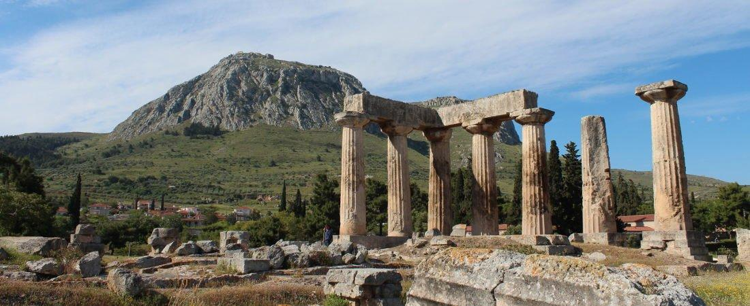
Paul’s Epistle of 1st Corinthians
Chapter 7a

Slide 2
Outline
I. Introduction (1:1- 9)
II. Dealing with Problems Reported to Paul (1:10 – 6:20)
A. Problem of Factionalism (1:10 – 3:23)
B. Problem of Rejecting Paul’s Work (4:1-21)
C. Problem of the Fornicator and Church Discipline (5:1-13)
D. Taking Problems between Brethren to Civil Courts (6:1-11)
E. Responsibility to Glorify God with the Body (6:12-20)

Slide 3
III. Dealing with Questions Asked by the Corinthians (7:1 – 16:9)
A. “Now Concerning” – Marriage and Present Distress (7:1-40)
B. “Now Concerning” – Idolatry and Personal Liberty (8:1 – 11:1)
C. “Now… Remember Me” and Apostolic Tradition
1. Submission and Customs (11:2-16)
2. Pattern for Lord’s Supper (11:17-34)
D. “Now Concerning” – Spiritual Gifts (12:1 – 14:40)
E. “Now…” Concerning – The Resurrection (15:1-58)
F. “Now Concerning” – The Collection (16:1-9)
IV. Concluding Remarks (16:10-24)

Slide 4
Last Class
1st Corinthians 6
¹⁸ Flee sexual immorality. Every sin that a man does is outside the body, but he who commits sexual immorality sins against his own body. ¹⁹ Or do you not know that your body is the temple of the Holy Spirit who is in you, whom you have from God, and you are not your own? ²⁰ For you were bought at a price; therefore glorify God in your body and in your spirit, which are God’s.

Slide 5
A Look at 1 Corinthians 7:1-40
I. INSTRUCTIONS CONCERNING THOSE MARRIED (1-24)
A. IN GENERAL (1-9)
1. It is good to marry to avoid sexual immorality (1-2)
2. Proper attitudes to govern the marriage relationship (3-4)
3. Abstinence appropriate for short times devoted to fasting and prayer (5-6)
4. Living single life with self-control is a gift from God, so unmarried and widows should marry if they cannot exercise self-control (7-9)
B. IN REGARDS TO DEPARTING FROM SPOUSE (10-16)
1. As commanded by the Lord (10-11)
a. A wife is not to depart from her husband; if she does, let her remain unmarried or else be reconciled (10-11a)
b. A husband is not to leave his wife (11b)
2. As instructed by Paul (12-16)
a. Christians are not to leave their unbelieving spouses (12-13)
b. Because of the "sanctifying influence" the believer can have on the family (14)
c. If unbeliever departs, the believer is not under a slavery bondage, so let the unbeliever depart – not compelled to follow them (15)
d. These instructions given in view of the possibility of the believer being able to save the unbelieving spouse – not always possible (16)

Slide 6
C. PRINCIPLES GOVERNING PAUL'S INSTRUCTIONS (17-24)
1. As the Lord has called each one, in that state, so let him walk (17)
2. The example of circumcision versus uncircumcision (18-19a)
3. Keeping commandments of God is point, not circumcision (19b)
4. Example of remaining as a slave if called as slave versus being free – general principle is to abide in the state you were called (20-24)
II. INSTRUCTIONS CONCERNING THOSE SINGLE (25-40)
A. FOR THOSE WHO ARE VIRGINS (25-38)
1. Paul gives his personal judgment in light of the "present distress": remain as you are (25-26)
2. If you are married, remain so; but those who are single would be spared much trouble if they remain so in light of coming distress (27-31)
3. Remaining unmarried enables them to serve the Lord without distraction, being totally devoted to Him (32-35)
4. If it is necessary, the single may marry (36)
5. The choice is not between good and bad, but between good and better under the present circumstances (37-38)
B. FOR THOSE WHO ARE WIDOWS (39-40)
1. They are free to marry, but only "in the Lord" (39)
2. Though Paul's personal judgment is that such a one will be better to remain single, which is also the advice (though not demanded) of the Spirit of God (40)

Slide 7
Questions
1. What is said in the first verse of this chapter to let the reader know that a new section of the book has begun? _______________________
2. One of the purposes for marriage is to avoid ___________________.
3. Let the ___________ render to his _________ the _______________ due her, and likewise also the ___________ to her ________________. The wife does not have _____________ over her own _____________, but the husband does. And likewise the ______________ does not have ________________ over his own _______________, but the wife does.
4. Husbands and wives are forbidden from depriving the other from the sexual bond except under what specific conditions? _______________ _________________________________________________________
5. What advice did Paul give to “the unmarried and to the widows”? __ _________________________________________________________

Slide 8
Questions
6. What were the unmarried and widows to do if they could not exercise self-control? _______________________________________________
7. What did Paul command “the married” to do? ___________________ Was this just Paul’s advice or the command of the Lord? ____________
8. What did Paul instruct those married to an unbeliever to do if the unbeliever is willing to stay with that believer? ____________________
9. What is the believer to do if the unbeliever departs? ______________ Is the believer given a right to remarry in this case? ________ Prove your answer.
10. What is the repeated instruction to those “called” in various situations as seen in verses 17-24? ______________________________________
11. Since this is given as a parallel to Paul’s comments in verses 10-16, what must we conclude about the overall instruction here? ___________ __________________________________________________________

Slide 9
1st Corinthians
Next Class:
Chapter 7:25-40

