Slide 1
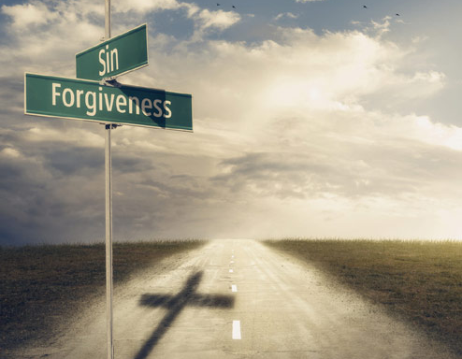
How Do We View Sin & Forgiveness?
Psalm 32

Slide 2
Psalm 32:1-11
¹ Blessed is he whose transgression is forgiven, whose sin is covered. ² Blessed is the man to whom the Lord does not impute iniquity, and in whose spirit there is no deceit. ³ When I kept silent, my bones grew old through my groaning all the day long. ⁴ For day and night Your hand was heavy upon me; my vitality was turned into the drought of summer. Selah
⁵ I acknowledged my sin to You, and my iniquity I have not hidden. I said, “I will confess my transgressions to the Lord,” and You forgave the iniquity of my sin. ⁶ For this cause everyone who is godly shall pray to You in a time when You may be found; surely in a flood of great waters they shall not come near him. ⁷ You are my hiding place; You shall preserve me from trouble; You shall surround me with songs of deliverance. Selah
⁸ I will instruct you and teach you in the way you should go; I will guide you with My eye. ⁹ Do not be like the horse or like the mule, which have no understanding, which must be harnessed with bit and bridle, else they will not come near you. ¹⁰ Many sorrows shall be to the wicked; but he who trusts in the Lord, mercy shall surround him. ¹¹ Be glad in the Lord and rejoice, you righteous; and shout for joy, all you upright in heart!

Slide 3
Psalm 32:1-11
¹ Blessed is he whose transgression is forgiven, whose sin is covered. ² Blessed is the man to whom the Lord does not impute iniquity, and in whose spirit there is no deceit. ³ When I kept silent, my bones grew old through my groaning all the day long. ⁴ For day and night Your hand was heavy upon me; my vitality was turned into the drought of summer. Selah

Slide 4
Seeing the Beauty of Forgiveness
Pictured in the most beautiful terms
Old Testament descriptions
Psa. 103:12 Sin removed as far as east from west
Isa. 43:25 Sin blotted out & remembered no more
Isa. 44:22 Sin blotted out like a thick cloud
Isa. 55:7 “For He will abundantly pardon”
New Testament descriptions
Col. 1:14 “Redemption through His blood”
Eph. 1:7 “According to the riches of His grace”
Col. 2:13 Being dead, made alive together with Him
Heb. 10:14-18 Perfected, sanctified, sin not remembered

Slide 5
Psalm 32:1-11
¹ Blessed is he whose transgression is forgiven, whose sin is covered. ² Blessed is the man to whom the Lord does not impute iniquity, and in whose spirit there is no deceit. ³ When I kept silent, my bones grew old through my groaning all the day long. ⁴ For day and night Your hand was heavy upon me; my vitality was turned into the drought of summer. Selah
⁵ I acknowledged my sin to You, and my iniquity I have not hidden. I said, “I will confess my transgressions to the Lord,” and You forgave the iniquity of my sin. ⁶ For this cause everyone who is godly shall pray to You in a time when You may be found; surely in a flood of great waters they shall not come near him. ⁷ You are my hiding place; You shall preserve me from trouble; You shall surround me with songs of deliverance. Selah

Slide 6
Seeing the Desire for Forgiveness
Once we realize our sins, must examine options on how we deal with our sins
Woe to us if we remain silent & try to hide sin
Prov. 28:13a Do not prosper if we cover our sins
Isa. 29:15 Woe to those who hide sin in the dark
Isa. 30:1 Woe to those taking no counsel from God
Blessing seen in acknowledging & forsaking our sins
Prov. 28:13b If confess & forsake, we obtain mercy
1 John 1:9 If we confess sins, He is faithful forgiving all
Lk. 15:18-21 Like returning to lost love of one’s father

Slide 7
Psalm 32:1-11
¹ Blessed is he whose transgression is forgiven, whose sin is covered. ² Blessed is the man to whom the Lord does not impute iniquity, and in whose spirit there is no deceit. ³ When I kept silent, my bones grew old through my groaning all the day long. ⁴ For day and night Your hand was heavy upon me; my vitality was turned into the drought of summer. Selah
⁵ I acknowledged my sin to You, and my iniquity I have not hidden. I said, “I will confess my transgressions to the Lord,” and You forgave the iniquity of my sin. ⁶ For this cause everyone who is godly shall pray to You in a time when You may be found; surely in a flood of great waters they shall not come near him. ⁷ You are my hiding place; You shall preserve me from trouble; You shall surround me with songs of deliverance. Selah
⁸ I will instruct you and teach you in the way you should go; I will guide you with My eye. ⁹ Do not be like the horse or like the mule, which have no understanding, which must be harnessed with bit and bridle, else they will not come near you. ¹⁰ Many sorrows shall be to the wicked; but he who trusts in the Lord, mercy shall surround him. ¹¹ Be glad in the Lord and rejoice, you righteous; and shout for joy, all you upright in heart!

Slide 8
Seeing the Way to Avoid Future Sin
Once we are forgiven of past sins, how do we view sin to avoid it in the future?
All begin by fearing the punishment for sin
Matt. 10:28 Fear destruction of body & soul in hell
2 Thess. 1:7-9 Render vengeance & eternal destruction
But we must grow to see sin as God sees it
Ezra 9:10-15 Unclean, abomination, filth, great guilt…
Lk. 15:15-16 Like wanting to eat with the pigs’ slop
2 Pet. 2:20-22 Dog to its vomit, sow wallowing in mire
Final step is to serve God out of love
1 Jn. 4:16-19 Perfect love casts out fear; obey of love

Slide 9
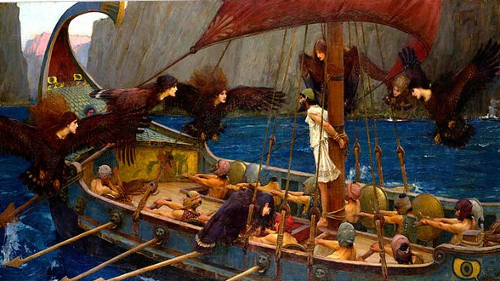
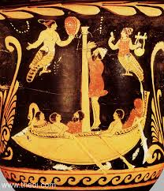
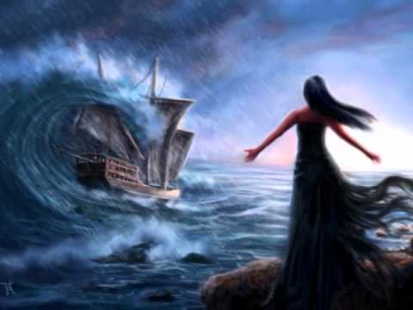
It’s time for us to sing the sweeter song!

