Slide 1
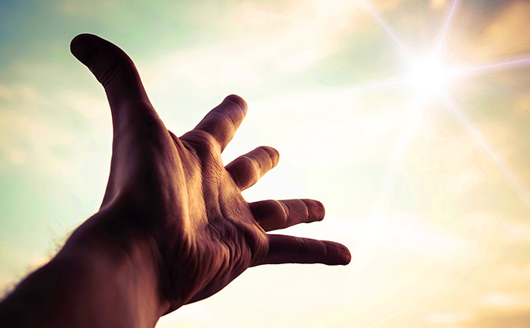
“He Who Comes to God...”
Hebrews 11:1-6

Slide 2
Hebrews 11:1-6
¹ Now faith is the substance of things hoped for, the evidence of things not seen. ² For by it the elders obtained a good testimony. ³ By faith we understand that the worlds were framed by the word of God, so that the things which are seen were not made of things which are visible. ⁴ By faith Abel offered to God a more excellent sacrifice than Cain, through which he obtained witness that he was righteous, God testifying of his gifts; and through it he being dead still speaks. ⁵ By faith Enoch was taken away so that he did not see death, “and was not found, because God had taken him”; for before he was taken he had this testimony, that he pleased God. ⁶ But without faith it is impossible to please Him, for he who comes to God must believe that He is, and that He is a rewarder of those who diligently seek Him.

Slide 3
Hebrews 11:1-6
¹ Now faith is the substance of things hoped for, the evidence of things not seen. ² For by it the elders obtained a good testimony. ³ By faith we understand that the worlds were framed by the word of God, so that the things which are seen were not made of things which are visible. ⁴ By faith Abel offered to God a more excellent sacrifice than Cain, through which he obtained witness that he was righteous, God testifying of his gifts; and through it he being dead still speaks. ⁵ By faith Enoch was taken away so that he did not see death, “and was not found, because God had taken him”; for before he was taken he had this testimony, that he pleased God. ⁶ But without faith it is impossible to please Him, for he who comes to God must believe that He is, and that He is a rewarder of those who diligently seek Him.

Slide 4
The One Who Comes to God...
What it means to “Come to God”
John 6:44-45 One taught & has learned comes (Matt. 11:28f)
Ephesians 4:20-24 We “learn Christ” as we learn & obey will
Must believe that He is
John 8:24 Without faith, we die in sin – salvation impossible
Romans 1:16-25 God has given all enough evidence to believe
Must believe that He is the rewarder
Revelation 22:12
2 Timothy 4:7-8 Lord gives crown of righteousness (1 Pet. 5:4)
That He rewards those who “diligently seek Him”
Deuteronomy 4:29 Lord will be found if sought with all being
Jeremiah 29:13 Seek Lord with whole heart (Acts 17:24f)
Please understand that all of these fit together!

