Slide 2
¹ Now faith is the substance of things hoped for, the evidence of things not seen. ² For by it the elders obtained a good testimony. ³ By faith we understand that the worlds were framed by the word of God, so that the things which are seen were not made of things which are visible. ⁴ By faith Abel offered to God a more excellent sacrifice than Cain, through which he obtained witness that he was righteous, God testifying of his gifts; and through it he being dead still speaks. ⁵ By faith Enoch was taken away so that he did not see death, and was not found, because God had taken him; for before he was taken he had this testimony, that he pleased God. ⁶ But without faith it is impossible to please Him, for he who comes to God must believe that He is, and that He is a rewarder of those who diligently seek Him. ⁷ By faith Noah, being divinely warned of things not yet seen, moved with godly fear, prepared an ark for the saving of his household, by which he condemned the world and became heir of the righteousness which is according to faith. ⁸ By faith Abraham obeyed when he was called to go out to the place which he would receive as an inheritance. And he went out, not knowing where he was going. ⁹ By faith he dwelt in the land of promise as in a foreign country, dwelling in tents with Isaac and Jacob, the heirs with him of the same promise; ¹⁰ for he waited for the city which has foundations, whose builder and maker is God.
¹ Now faith is the substance of things hoped for, the evidence of things not seen. ² For by it the elders obtained a good testimony. ³ By faith we understand that the worlds were framed by the word of God, so that the things which are seen were not made of things which are visible. ⁴ By faith Abel offered to God a more excellent sacrifice than Cain, through which he obtained witness that he was righteous, God testifying of his gifts; and through it he being dead still speaks. ⁵ By faith Enoch was taken away so that he did not see death, and was not found, because God had taken him; for before he was taken he had this testimony, that he pleased God. ⁶ But without faith it is impossible to please Him, for he who comes to God must believe that He is, and that He is a rewarder of those who diligently seek Him. ⁷ By faith Noah, being divinely warned of things not yet seen, moved with godly fear, prepared an ark for the saving of his household, by which he condemned the world and became heir of the righteousness which is according to faith. ⁸ By faith Abraham obeyed when he was called to go out to the place which he would receive as an inheritance. And he went out, not knowing where he was going. ⁹ By faith he dwelt in the land of promise as in a foreign country, dwelling in tents with Isaac and Jacob, the heirs with him of the same promise; ¹⁰ for he waited for the city which has foundations, whose builder and maker is God.
14 Times
in 10 verses

Slide 3
For we walk by faith, not by sight (2 Cor 5:7).
For in it the righteousness of God is revealed from faith to faith; as it is written, the just shall live by faith (Rom 1:17).
I have been crucified with Christ; it is no longer I who live, but Christ lives in me; and the life which I now live in the flesh I live by faith in the Son of God, who loved me and gave Himself for me (Gal 2:20).
But Jesus answered him, saying, it is written, man shall not live by bread alone, but by every word of God (Lk 4:4).
So then faith comes by hearing, and hearing by the word of God (Rom 10:17).

Slide 4
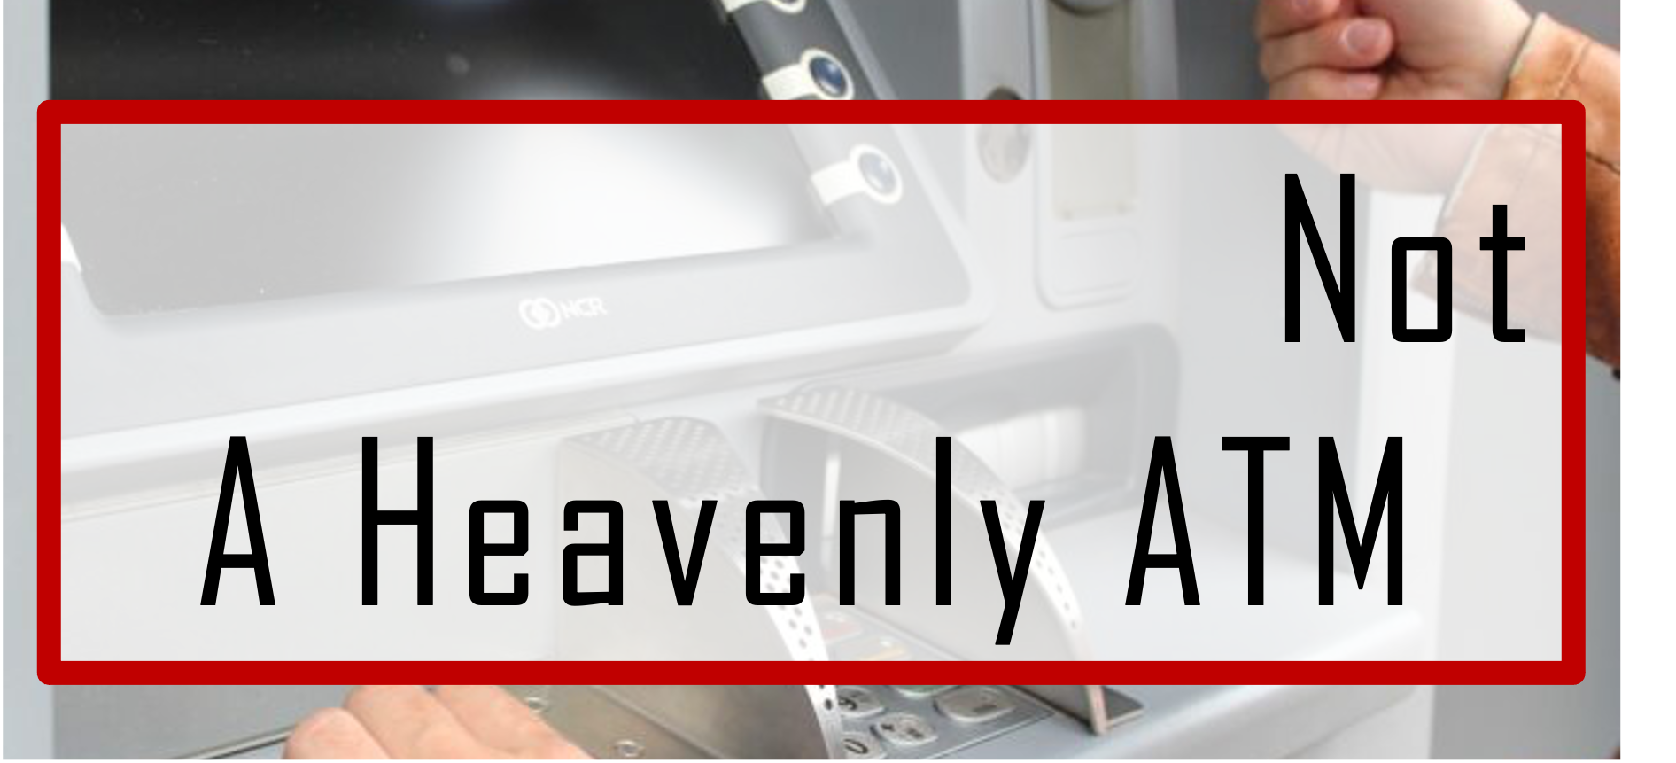

Slide 5
Hebrews 11: 1, 3, 6
Now faith is the substance of things hoped for, the evidence of things not seen.
By faith we understand that the worlds were framed by the word of God, so that the things which are seen were not made of things which are visible.
But without faith it is impossible to please Him, for he who comes to God must believe that He is, and that He is a rewarder of those who diligently seek Him.
CONFIDENCE
CONVICTION
COMPREHENSION
COMMITMENT

Slide 6
By faith Abel offered to God a more excellent sacrifice than Cain, through which he obtained witness that he was righteous, God testifying of his gifts … (Heb 11:4)
By faith Enoch was taken away so that he did not see death, and was not found, because God had taken him; for before he was taken he had this testimony, that he pleased God (Heb 11:5).
By faith Noah, being divinely warned of things not yet seen, moved with godly fear, prepared an ark for the saving of his household, by which he condemned the world and became heir of the righteousness which is according to faith (Heb 11:7).
By faith he (Abraham) dwelt in the land of promise as in a foreign country, dwelling in tents with Isaac and Jacob, the heirs with him of the same promise; for he waited for the city which has foundations, whose builder and maker is God (Heb 11:9-10).
Waits
Works
Walks
Worships

