Slide 2
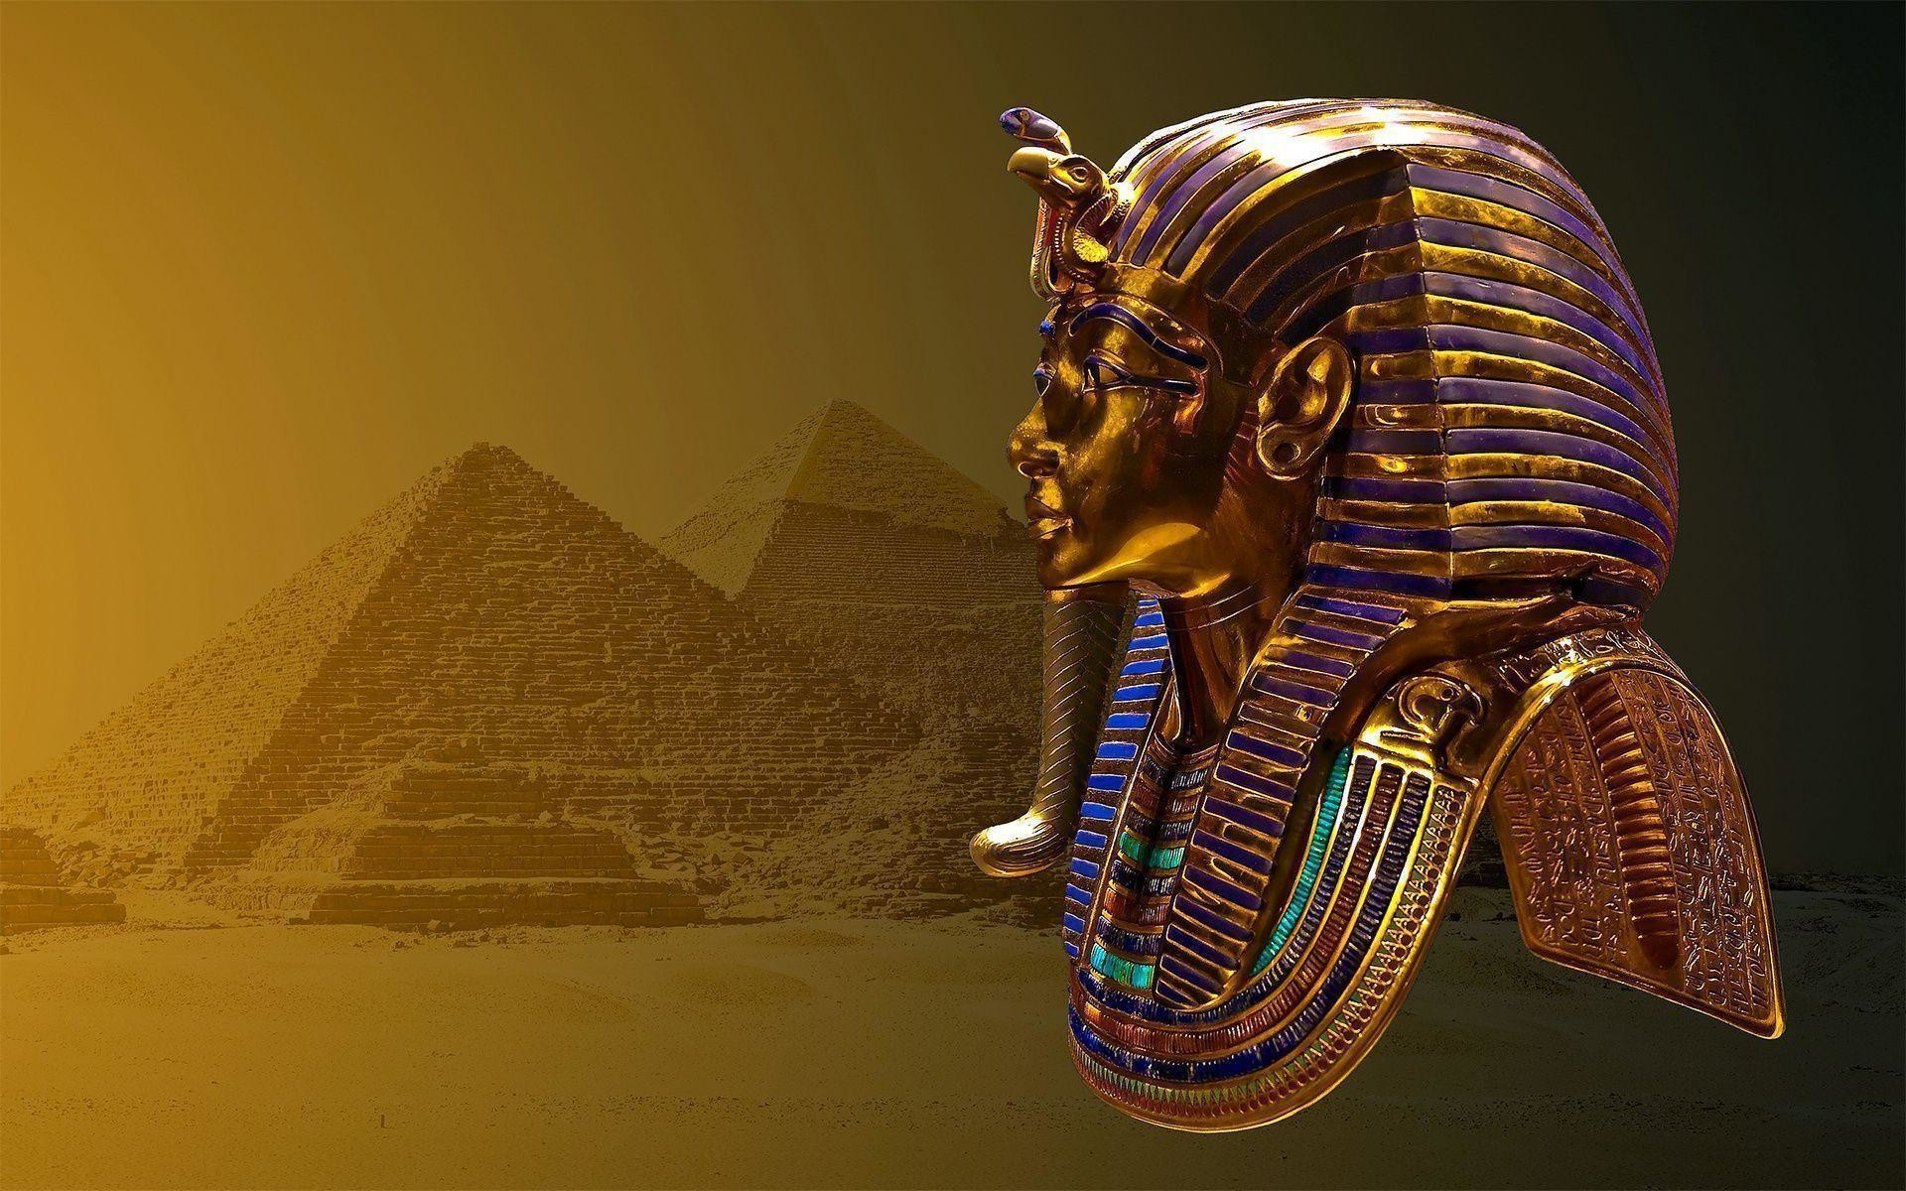

Slide 3
And I will harden Pharaoh’s heart, and multiply My signs and My wonders in the land of Egypt (Exod 7:3).
Then the magicians of Egypt did so with their enchantments; and Pharaoh’s heart grew hard, and he did not heed them, as the Lord had said (Exod 7:22).
But when Pharaoh saw that there was relief, he hardened his heart and did not heed them, as the Lord had said (Exod 8:15).

Slide 4
So the Lord said to Moses … I will harden Pharaoh’s heart …
Exodus 7:3
And the Lord said to Moses … I will harden his heart, so that he will not let the people go.
Exodus 4:21

Slide 5
Then the magicians of Egypt did so with their enchantments; and Pharaoh’s heart grew hard, and he did not heed them, as the Lord had said. And Pharaoh turned and went into his house. Neither was his heart moved by this.
Exodus 7:22

Slide 6
But when Pharaoh saw that there was relief, he hardened his heart and did not heed them, as the Lord had said.
Exodus 8:15
But Pharaoh hardened his heart at this time also …
Exodus 8:32

