Slide 2
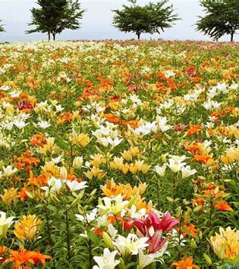
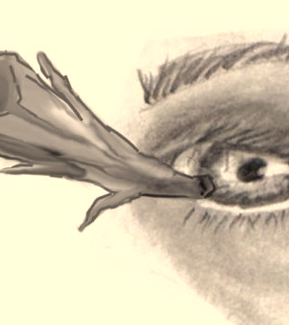
So why do you worry about clothing? Consider the lilies of the field, how they grow: they neither toil nor spin, (Matt 6:28).
And why do you look at the speck in your brother’s eye, but do not consider the plank in your own eye? (Matt 7:3).

Slide 3
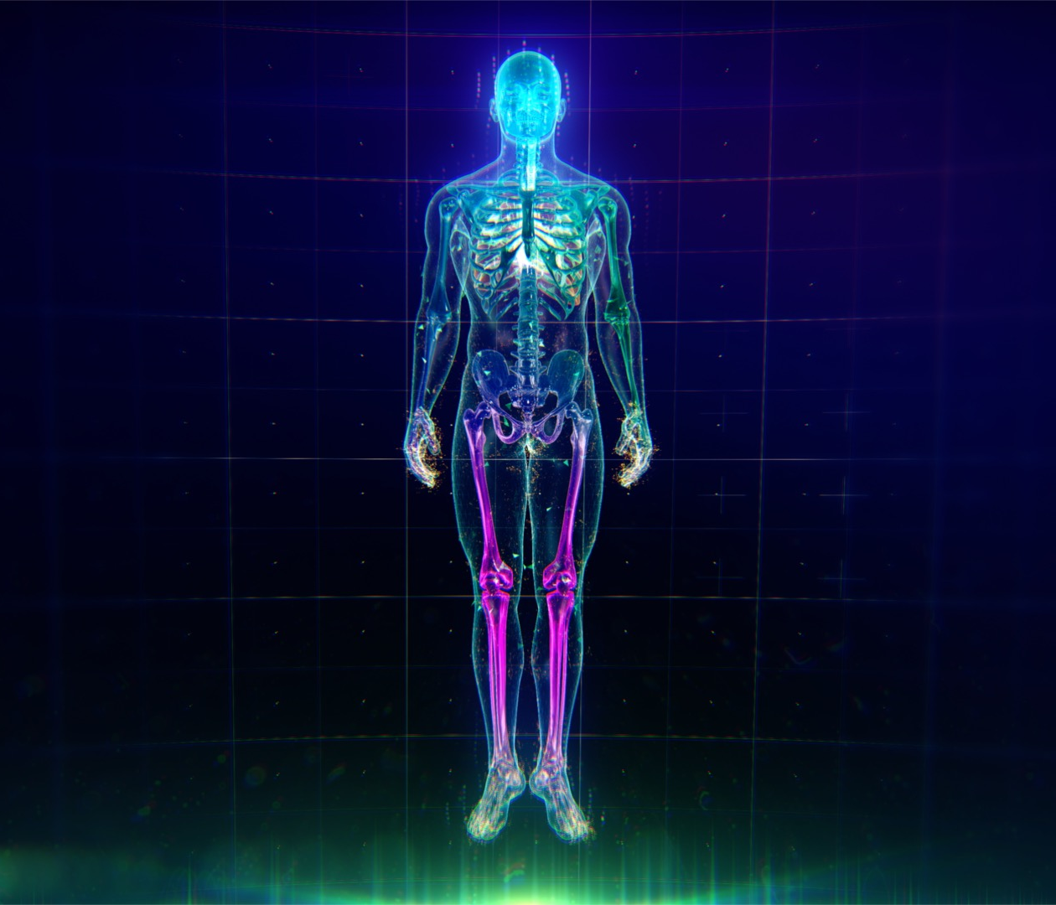
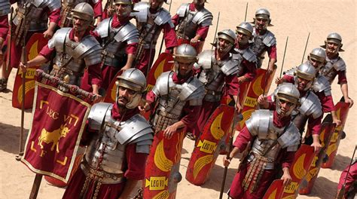
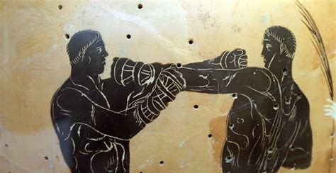
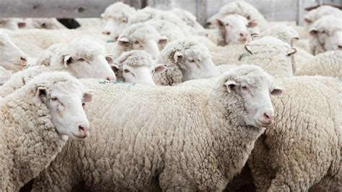
Soldiers, Eph 6:10-17
Boxers, 1 Cor 9:26
Human Body
1 Cor 12:12
Sheep, Jn 10:14

Slide 4
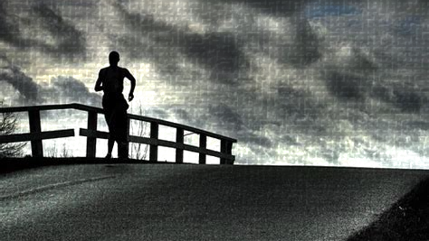
“Therefore we also, since we are surrounded by so great a cloud of witnesses, let us lay aside every weight, and the sin which so easily ensnares us, and let us run with endurance the race that is set before us, looking unto Jesus, the author and finisher of our faith …”

Slide 5
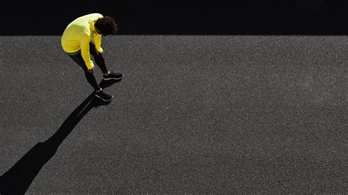
I have finished the race . . . Finally, there is laid up for me the crown of righteousness, which the Lord, the righteous Judge, will give to me on that Day, and not to me only but also to all who have loved His appearing . . .
(2 Timothy 4:7-8)

