Slide 2
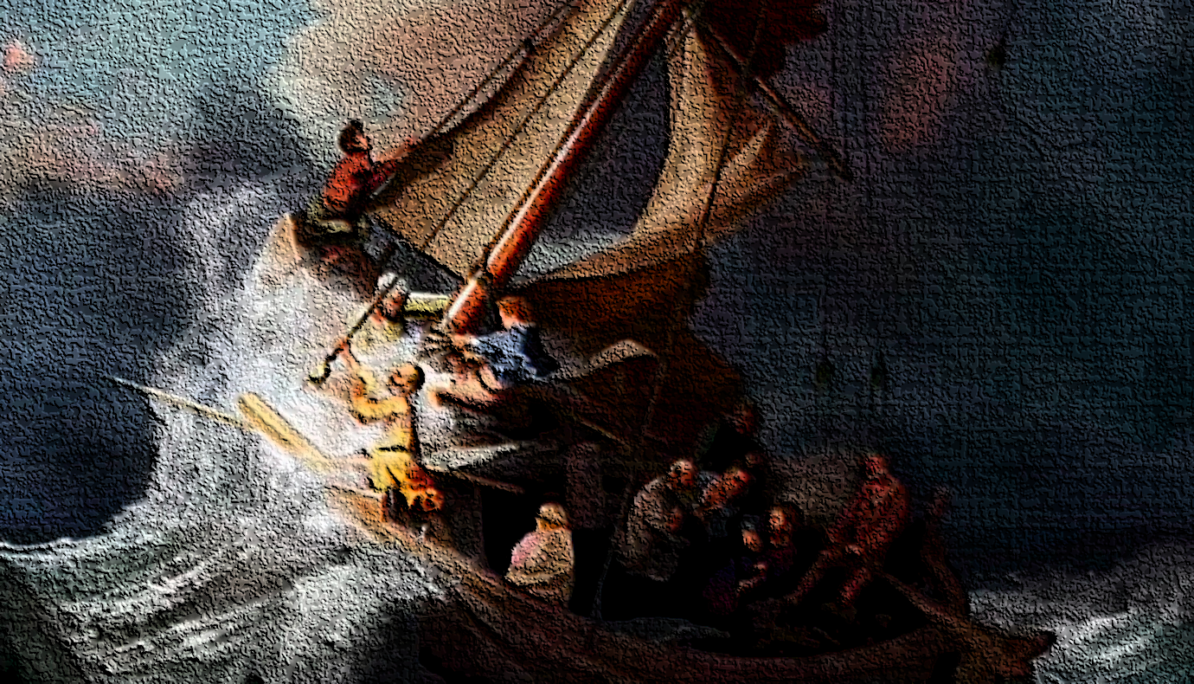
²³ Now when He got into a boat, His disciples followed Him. ²⁴ And suddenly a great tempest arose on the sea, so that the boat was covered with the waves. But He was asleep. ²⁵ Then His disciples came to Him and awoke Him, saying, Lord, save us! We are perishing!
²⁶ But He said to them, why are you fearful, O you of little faith? Then He arose and rebuked the winds and the sea, and there was a great calm.
Matthew 8:23-26

Slide 3
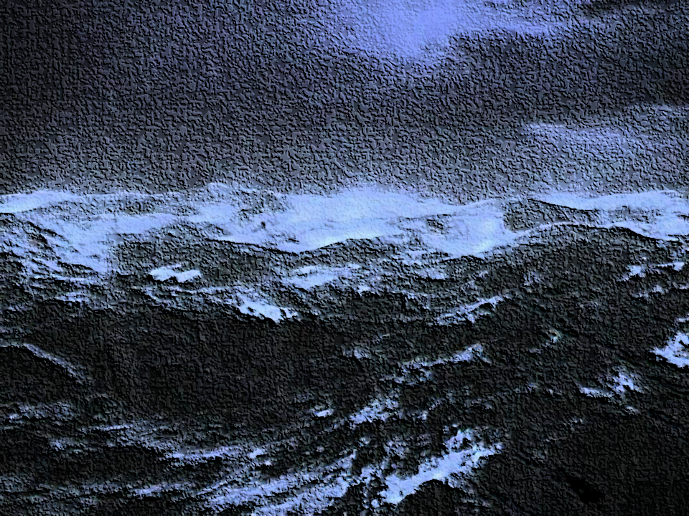
And suddenly a great tempest arose on the sea…
Seismos: A shaking, an earthquake,
(13 times translated earthquake, Matt 27:54).

Slide 4
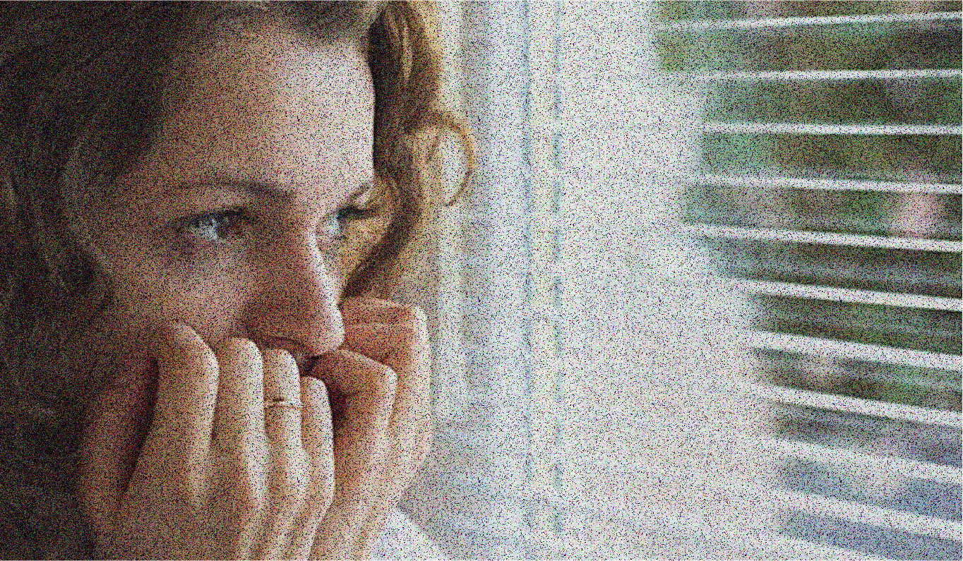
And I say to you, My friends, do not be afraid of those who kill the body,
Matthew 10:28
Therefore, I say to you, do not worry about your life ...
Matthew 6:25
Let not your heart be troubled, neither let it be afraid.
John 14:27
Do not fear therefore; you are of more value than many sparrows.
Matthew 10:31

Slide 5
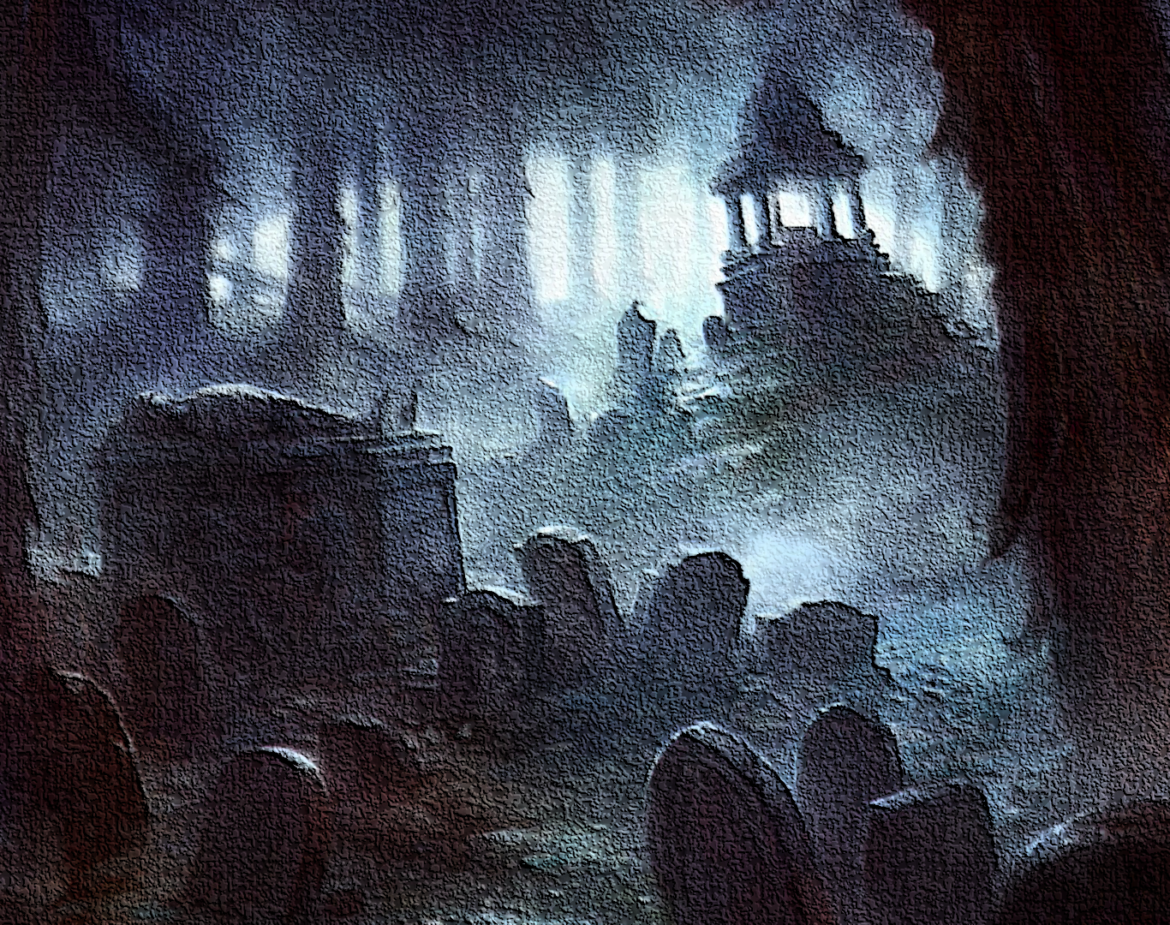
Have Unrealistic Expectations
Have Misperceived our Fears
Have Hidden / Secret Sins
Have Little / No Faith

Slide 6
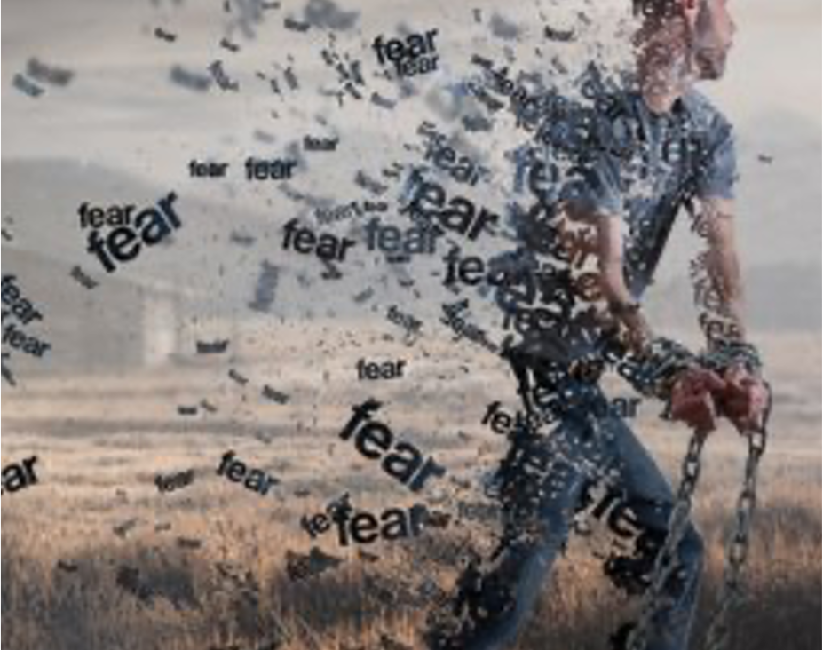
A Deep Abiding Faith in God
A Steadfast Trust in His Promises
A Clear Memory of His Provisions
A Firm Acceptance of His Will

