Slide 1
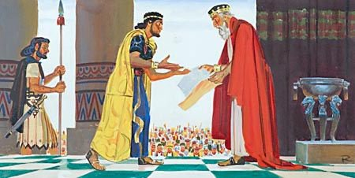
“As For You, My Son...”
1st Chronicles 28:9-20

Slide 2
1 Chronicles 28:9-20
⁹ “As for you, my son Solomon, know the God of your father, and serve Him with a loyal heart and with a willing mind; for the Lord searches all hearts and understands all the intent of the thoughts. If you seek Him, He will be found by you; but if you forsake Him, He will cast you off forever. ¹⁰ Consider now, for the Lord has chosen you to build a house for the sanctuary; be strong, and do it.” ¹¹ Then David gave his son Solomon the plans for the vestibule, its houses, its treasuries, its upper chambers, its inner chambers, and the place of the mercy seat; ¹² and the plans for all that he had by the Spirit, of the courts of the house of the Lord, of all the chambers all around, of the treasuries of the house of God, and of the treasuries for the dedicated things...
²⁰ And David said to his son Solomon, “Be strong and of good courage, and do it; do not fear nor be dismayed, for the Lord God – my God – will be with you. He will not leave you nor forsake you, until you have finished all the work for the service of the house of the Lord.”

Slide 3
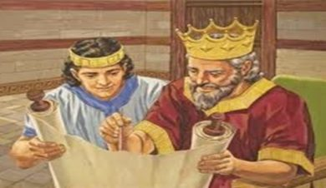
Lessons Godly Parents Want Their Children to Learn
Importance of truly knowing God
2 Timothy 1:12-13
Need to serve God with loyalty of heart
Deuteronomy 10:12
Psalm 119:2, 34
God fully knows all hearts & thoughts
Ezekiel 11:5
John 2:24-25
Desire for parent’s faith to live in their children
2 Timothy 1:3-5; 3:14-17
Need for strength & courage in serving Lord
2 Chronicles 32:7-8
Philippians 1:27-28
Faithfulness of God & His true people
1 Peter 4:19
1 Kings 19

