Slide 1
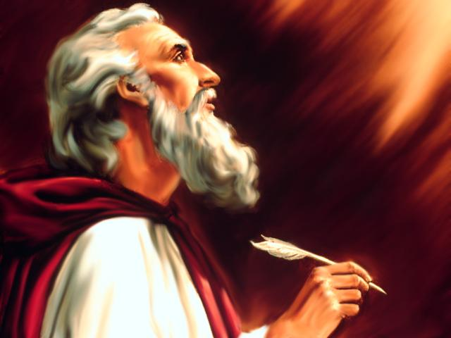
Studies in the Book of
Isaiah

Slide 2
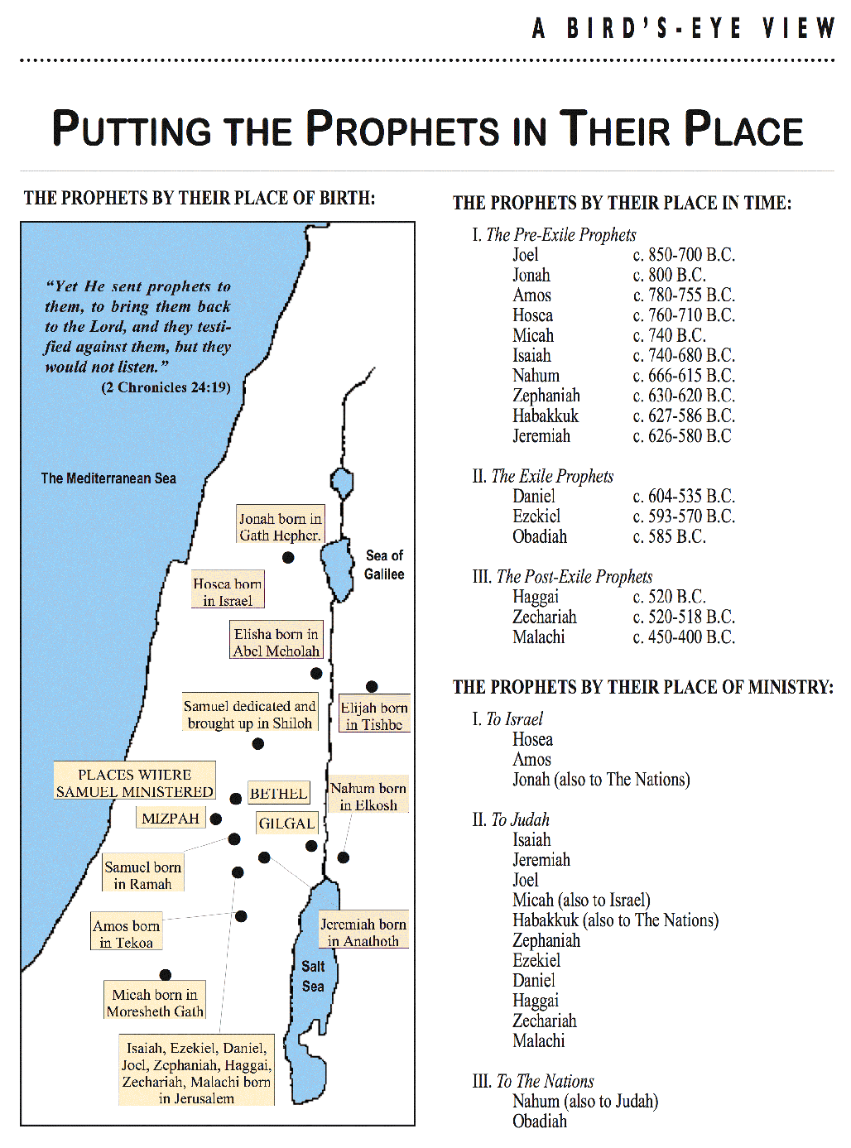

Slide 3


Slide 4
Isaiah
How Can People Have Confidence In
Message Of The Prophet?
Distant Future Prophecy (Messianic)
Time of Prophet
Near Future Prophecy
Fulfillment
Fulfillment

Slide 5
Historical Outline of Book of Isaiah
ASSYRIAN PERIOD - CONFLICT & VICTORY (1-39)
  Prophecies Concerning Judah and Jerusalem (1-12)
  Prophecies Concerning the Nations (13-27)
  The Source of True Deliverance (28-35)
  Historical Interlude (36-39)
II. BABYLONIAN PERIOD - HOPE FOR TROUBLED TIMES (40-66)
  The One True God Versus Idols (40-48)
  Salvation through the Suffering Servant (49-53)
  The Future Glory for God’s People (54-66)

Slide 6
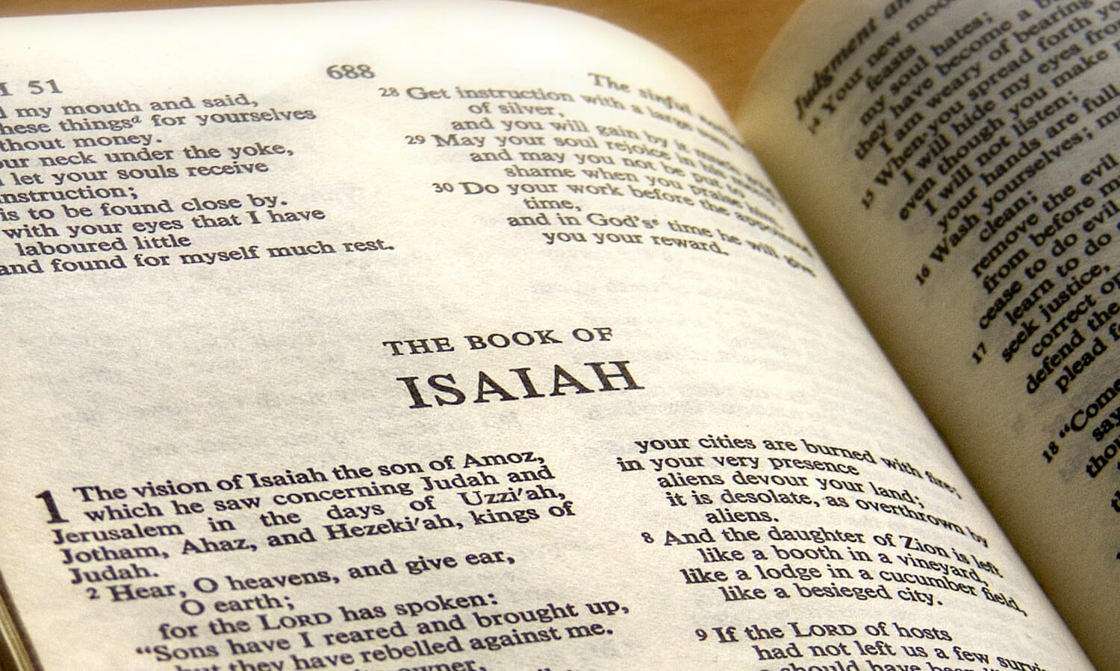
Phrases of Note in Isaiah
Designation for God used most commonly by Isaiah is Jehovah (Yahweh), "The Lord of Hosts" - used 62 times in the book
Another common term used by Isaiah for God, "The Holy One Of Israel", is used 25 times, but found only six times in the rest of the Bible
Isaiah repeatedly urges Judah & Jerusalem to have faith:
  "Trust in the Holy One of Israel"
  "Wait upon the Lord"

Slide 7
Isaiah
Discourses and Prophecies centering in Jerusalem and Judaea, (Chs. 1-12).
  Judah's social sins, (Chs. 1-5).
    Introduction – "The Great Arraignment," (Ch. 1).
      Thoughtlessness of Judah toward Jehovah—spiritual sickness, (vv. 1-9).
      Formalism in worship – worship made vain by wickedness vs. what God desires, (vv. 10-17).
      Pardon offered – call to reason, (vv. 18-23).
      Judgment – Salvation through judgment; purging the dross; cleansing the people, (vv. 24-31).
    Three distinct pictures of Zion, (Chs. 2-4).
      Jerusalem, the ideal – her future exaltation--"on time's horizon." (2:1-4).
      Jerusalem, the real – her present idolatry, "today." (2:5-4:1).
        Wealth and its corruptions, (2:5-11).
        Pride and idols – these must go, (2:12-22).

Slide 8
Questions
1. Look in a Bible Dictionary or Bible Encylopedia and list three things we know about the prophet Isaiah. _____________________________________________ _________________________________________________________________
2. How is Isaiah described in the first verse of the book? ___________________
3. How many times is the name of Isaiah mentioned in the Bible? ____________
4. Give three places in the New Testament where the book of Isaiah is quoted? __ _________________________________________________________________
5. What is the approximate date for the writing of Isaiah? ___________________
6. In the days of what kings of Judah was Isaiah a prophet? _________________ _________________________________________________________________

Slide 9
Questions
7. List three phrases used by the prophet in the first chapter to describe the evil present in the nation of Judah? ________________________________________ _________________________________________________________________ _________________________________________________________________
8. To what destroyed cities does Isaiah liken the evil of Judah? ______________
9. What does the prophet tell them to do in order to make an acceptable change? _________________________________________________________________ _________________________________________________________________
10. Describe the difference between the charges of sin seen in chapter 1 and the hope seen in chapter 2. ______________________________________________
Thought Question:
Why is meant by “it shall come to pass in the latter days that the mountain of the Lord’s house shall be established on the top of the mountains?” When was it fulfilled?

Slide 10
ISAIAH
Next Class
Studies in the Book of
3:1 – 6:13

