Slide 1
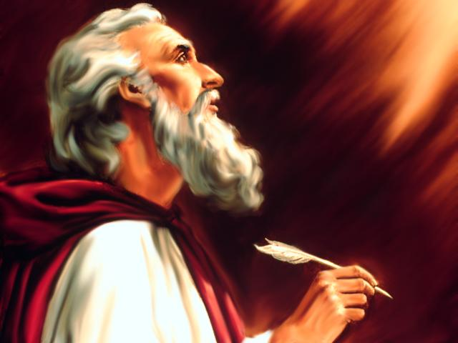
Studies in the Book of
Isaiah

Slide 2
Isaiah
How Can People Have Confidence In
Message Of The Prophet?
Distant Future Prophecy (Messianic)
Time of Prophet
Near Future Prophecy
Fulfillment
Fulfillment

Slide 3
Historical Outline of Book of Isaiah
ASSYRIAN PERIOD - CONFLICT & VICTORY (1-39)
  Prophecies Concerning Judah and Jerusalem (1-12)
  Prophecies Concerning the Nations (13-27)
  The Source of True Deliverance (28-35)
  Historical Interlude (36-39)
II. BABYLONIAN PERIOD - HOPE FOR TROUBLED TIMES (40-66)
  The One True God Versus Idols (40-48)
  Salvation through the Suffering Servant (49-53)
  The Future Glory for God’s People (54-66)

Slide 4
Isaiah
Discourses and Prophecies centering in Jerusalem and Judaea, (Chs. 1-12).
  Judah's social sins, (Chs. 1-5).
    Introduction – "The Great Arraignment," (Ch. 1).
      Thoughtlessness of Judah toward Jehovah—spiritual sickness, (vv. 1-9).
      Formalism in worship – worship made vain by wickedness vs. what God desires, (vv. 10-17).
      Pardon offered – call to reason, (vv. 18-23).
      Judgment – Salvation through judgment; purging the dross; cleansing the people, (vv. 24-31).
    Three distinct pictures of Zion, (Chs. 2-4).
      Jerusalem, the ideal – her future exaltation--"on time's horizon." (2:1-4).
      Jerusalem, the real – her present idolatry, "today." (2:5-4:1).
        Wealth and its corruptions, (2:5-11).
        Pride and idols – these must go, (2:12-22).

Slide 5
Discourses and Prophecies centering in Jerusalem and Judaea, (Chs. 1-12).
  Judah's social sins, (Chs. 1-5).
    Introduction – "The Great Arraignment," (Ch. 1).
      Thoughtlessness of Judah toward Jehovah—spiritual sickness, (vv. 1-9).
      Formalism in worship – worship made vain by wickedness vs. what God desires, (vv. 10-17).
      Pardon offered – call to reason, (vv. 18-23).
      Judgment – Salvation through judgment; purging the dross; cleansing the people, (vv. 24-31).
    Three distinct pictures of Zion, (Chs. 2-4).
      Jerusalem, the ideal – her future exaltation--"on time's horizon." (2:1-4).
      Jerusalem, the real – her present idolatry, "today." (2:5-4:1).
        Wealth and its corruptions, (2:5-11).
        Pride and idols – these must go, (2:12-22).
        Ruling classes denounced, (3:1-12).
        Jehovah's judgment against them, (3:13-15).
        Wanton women rebuked for their wickedness, (3:16- 4:1).
      Jerusalem the redeemed – her eventual purification through travail and judgment, (4:2-6 – the prophet returns to the idea of 2:1-4).

Slide 6
B. The Prophet's inaugural vision and commission (ca. 740), (Ch. 6).
  The vision – Jehovah's majesty and the prophet's woe, (vv. 1-4).
  The call – the prophet's sanctification, (vv. 5-8).
  The commission and message, (vv. 9-13).

Slide 7
B. The Prophet's inaugural vision and commission (ca. 740), (Ch. 6).
  The vision – Jehovah's majesty and the prophet's woe, (vv. 1-4).
  The call – the prophet's sanctification, (vv. 5-8).
  The commission and message, (vv. 9-13).
C. Judah's political entanglements – Isaiah as statesman, (Chs. 7-12).
  Immanuel – history and prediction intermingled, (7:1-10:4).
    The Syro-Ephraimitic uprising, (Ch. 7). [Ephraim – Israel; northern]
      Address to Ahaz, (vv. 1-9).
      No faith – sign given to the house of David (vv. 10-16).
      The threat to Judah -- destruction from Assyria, (vv. 17-25).
    Isaiah 7:14 – Virgin – Found 5 times in plural, 4 times in singular:
      Plural – Alamoth
        Song of Sol. 1:3 – unmarried maidens who seek a husband.
        Song of Sol. 6:8 – queens (married), concubines (probably married), maidens (or virgins, Alamoth)
        Psalm 68:25 – “And on either side virgins with timbrels.”
        Psalm 46: title – No evidence that it could be referred to a married woman.
        I Chron. 15:20 – probably maidens' voices. Evident in last 2 verses there is no evidence that these "alamoth" were married.

Slide 8
      ii. Singular – Alma
        Genesis 24:43 – Rebekkah, "maiden," the servant is looking for an unmarried woman for Isaac. Verse 16, she is called "a virgin (different word)”
        Exodus 2:8 – Miriam, at discovery of Moses.
        Proverbs 30:19 – “...the way of a man with a virgin”
        Isaiah 7:14 – The virgin conceives.
    The sign of Maher-shalal-hash-baz: Jehovah, not Judah's enemies, is to be feared, (8:1-15).
    The message rejected -- now committed to Isaiah's disciples for the future, (8:16-9:7).
      Darkness of the present, (8:16-22).
        [Isaiah 8:20 – “To the law and to the testimony! If they do not speak according to this word, it is because there is no light in them.”]

Slide 9
Contrasts to Remember
God’s faithful remnant
Assurance found in God
Belief in God’s word
Take hope in God’s signs
See hope in destruction of the wicked & their ways
See destruction of wicked as preparation for faithful remnant
Ask for hastening of judgment
Driven to the light of truth
Unfaithful people
Assurance in alliances, etc.
Disbelief & Disregard of word
Seek assurance in other ways
Look at destruction of physical Israel as utter loss
Look at destruction of Israel as reason for rejection of faith in God
Refuse to believe that destruction is truly coming
“They will be driven into darkness”

Slide 10
      ii. Singular – Alma
        Genesis 24:43 – Rebekkah, "maiden," the servant is looking for an unmarried woman for Isaac. Verse 16, she is called "a virgin (different word)”
        Exodus 2:8 – Miriam, at discovery of Moses.
        Proverbs 30:19 – “the way of a man with a virgin”
        Isaiah 7:14 – The virgin conceives.
    The sign of Maher-shalal-hash-baz: Jehovah, not Judah's enemies, is to be feared, (8:1-15).
    The message rejected -- now committed to Isaiah's disciples for the future, (8:16-9:7).
      Darkness of the present, (8:16-22).
        [Isaiah 8:20 – “To the law and to the testimony! If they do not speak according to this word, it is because there is no light in them.”]
      Light of the future – the first to go, the first to receive light, (9:1-7).

Slide 11

Isaiah 9:1-7 (NASB)
¹ But there will be no more gloom for her who was in anguish. In earlier times, He treated the land of Zebulun and the land of Naphtali with contempt, but later on He will make it glorious, by the way of the sea, on the other side of the Jordan, Galilee of the Gentiles.
² The people who walk in darkness, Will see a great light;
Those who live in a dark land, The light will shine on them.
³ You will multiply the nation, You will increase their joy;
They will rejoice in Your presence, As with the joy of harvest,
As people rejoice when they divide the spoils.
⁴ For You will break the yoke of their burden and the staff on their shoulders,
The rod of their oppressor, as at the battle [Lit. “days”] of Midian.
⁵ For every boot of the marching warrior in the roar of battle,
And cloak rolled in blood, will be for burning, fuel for the fire.
⁶ For a Child will be born to us, a Son will be given to us;
And the government will rest on His shoulders;
And His name will be called Wonderful Counselor, Mighty God,
Eternal Father, Prince of Peace.
⁷ There will be no end to the increase of His government or of peace, On the throne of David and over his kingdom, To establish it and to uphold it with justice and righteousness, From then on and forevermore. The zeal of the Lord of armies will accomplish this.
cf. Exodus 2-3

Slide 12
Questions
1. Who went up to make war against Jerusalem? __________________________ _________________________________________________________________
2. Read 2 Kings 16:1-4 and give a summary of the character and actions of King Ahaz of Judah. ____________________________________________________ _________________________________________________________________
3. What did God tell Isaiah to inform Ahaz about the outcome of Rezin and Pekah’s attack on Jerusalem? ________________________________________
4. How many years from that time would it be until Ephraim was broken? ______
5. What was the sign that God promised to give Ahaz? ______________________ __________________________________________________________________
6. Where in the New Testament is Isaiah 7:14 quoted and how is it said to be fulfilled? __________________________________________________________ __________________________________________________________________

Slide 13
Questions
7. What are the names of Isaiah’s sons and what are the meanings of those names? __________________________________________________________________ __________________________________________________________________
8. On whom alone was Isaiah told to depend? _____________________________
9. Instead of going for advice from “mediums and wizards,” where is Isaiah instructed to seek truth? ______________________________________________
10. Of whom is Isaiah 9:6-7 speaking? Show proof of your answer. ____________ __________________________________________________________________
Thought Question: Could Isaiah 7:14 be fulfilled at two different times rather than just once? If so, how? If not, how do we explain the context as dealing only with the birth of Christ while the text says it was a sign to Ahaz of Israel’s doom?

Slide 14
ISAIAH
Next Class
Studies in the Book of
9:8 – 10:34

