Slide 1
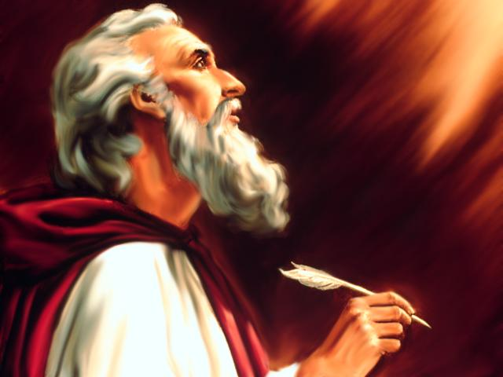
Studies in the Book of
Isaiah

Slide 2
Isaiah
How Can People Have Confidence In
Message Of The Prophet?
Distant Future Prophecy (Messianic)
Time of Prophet
Near Future Prophecy
Fulfillment
Fulfillment

Slide 3
Historical Outline of Book of Isaiah
ASSYRIAN PERIOD - CONFLICT & VICTORY (1-39)
  Prophecies Concerning Judah and Jerusalem (1-12)
  Prophecies Concerning the Nations (13-27)
  The Source of True Deliverance (28-35)
  Historical Interlude (36-39)
II. BABYLONIAN PERIOD - HOPE FOR TROUBLED TIMES (40-66)
  The One True God Versus Idols (40-48)
  Salvation through the Suffering Servant (49-53)
  The Future Glory for God’s People (54-66)

Slide 4
Isaiah
Discourses and Prophecies centering in Jerusalem and Judaea, (Chs. 1-12).
  Judah's social sins, (Chs. 1-5).
  B. The Prophet's inaugural vision and commission (ca. 740), (Ch. 6).
  C. Judah's political entanglements – Isaiah as statesman, (Chs. 7-12).
    Immanuel – history and prediction intermingled, (7:1-10:4).
    Assyria – the rod of Jehovah's anger, (10:5-34).
    The Messianic age, (Chs. 11-12).
Prophetic discourses directed against Foreign Nations, (Chs.13-23).
  Downfall of Babylon, heir of the Assyrians, (13:1-14:27).
  A series of short prophecies against the Nations, (14:28-21:17).
    (Nations included Philistia, Moab, Damascus, Israel, Assyria, Ethiopia, Egypt, Ethiopia, Babylon, Edom, Arabia, Jerusalem and Tyre)

Slide 5
World Judgment and the salvation of Jehovah's people (Chs. 24-27).
  Imminence of a general world judgment, (Ch. 24).
    Desolation of the earth and of the city, (vv. 1-13).
    Dawn of a better day, (vv. 14-16a).
    Premature songs of rejoicing – more judgment to come, (vv. 16b-20).
    Zion shall emerge triumphant, (vv. 21-23).
  Hymns of thanksgiving for the divine mercy, (25:1-26:19).
    A hymn of thanksgiving, (vv. 1-5).
    Blessedness of the Messianic age, (vv. 6-8).
    Another hymn of thanksgiving – joy in the midst of desolation, (vv. 9-12).
    Song of praise for deliverance and for Jehovah's strength – a song of the redeemed in Mount Zion; Israel raised from the dead, (26:1-19).
  Salvation of the people of Jehovah – Israel's chastisements are salutary, (26:20-27:13).
    Protection in the midst of judgment, (26:20-27:1).
    The fruit-bearing vineyard under protection of Jehovah, (27:2-6).
    Chastening by Jehovah unto salvation, (27:7-13).

Slide 6
World Judgment and the salvation of Jehovah's people (Chs. 24-27).
  Imminence of a general world judgment, (Ch. 24).
    Desolation of the earth and of the city, (vv. 1-13).
    Dawn of a better day, (vv. 14-16a).
    Premature songs of rejoicing – more judgment to come, (vv. 16b-20).
    Zion shall emerge triumphant, (vv. 21-23).
  Hymns of thanksgiving for the divine mercy, (25:1-26:19).
    A hymn of thanksgiving, (vv. 1-5).
    Blessedness of the Messianic age, (vv. 6-8).
    Another hymn of thanksgiving – joy in the midst of desolation, (vv. 9-12).
    Song of praise for deliverance and for Jehovah's strength – a song of the redeemed in Mount Zion; Israel raised from the dead, (26:1-19).
  Salvation of the people of Jehovah – Israel's chastisements are salutary, (26:20-27:13).
    Protection in the midst of judgment, (26:20-27:1).
    The fruit-bearing vineyard under protection of Jehovah, (27:2-6).
    Chastening by Jehovah unto salvation, (27:7-13).

Slide 7
Questions
1. This section begins with the statement” The Lord makes the earth empty and makes it waste.” Is this meant literally or figuratively? ____________________
2. And it shall be: as with the ____________, so with the _________; as with the ____________, so with the _______________; as with the _______________, so with the ___________; as with the ___________, so with the ___________; as with the __________, so with the ____________; as with the ___________, so with the _______________.
3. What is the reason given in Isaiah 24:5 for God’s judgment that is promised? __ __________________________________________________________________
4. What is the basic point in Isaiah 24:7-13 about the effect of God’s judgment when it is completed? ______________________________________________________ __________________________________________________________________
5. Who are those lifting their voices in jubilation as described in Isaiah 24:14-15? _________________________________________________________________

Slide 8
Questions
6. What is Isaiah’s response to this expression of jubilation? _________________ _________________________________________________________________
7. Why does Isaiah express praise to God (Isaiah 25:1-5) after God’s judgment is promised in chapter 24? _____________________________________________
8. What is meant by “in this mountain” in Isaiah 25:6? _____________________
9. What specific country is mentioned as the recipient of God’s coming judgment? Why? ___________________________________________________________
Thought Question: Is the phrase “in that day” of Isaiah 24:21 speaking of the same day or period of time noted by “in that day” of Isaiah 25:? Or are they speaking of a different times? Please explain and give a reason for your answer.

Slide 9
ISAIAH
Next Class
Studies in the Book of
9:8 – 10:34

