Slide 2
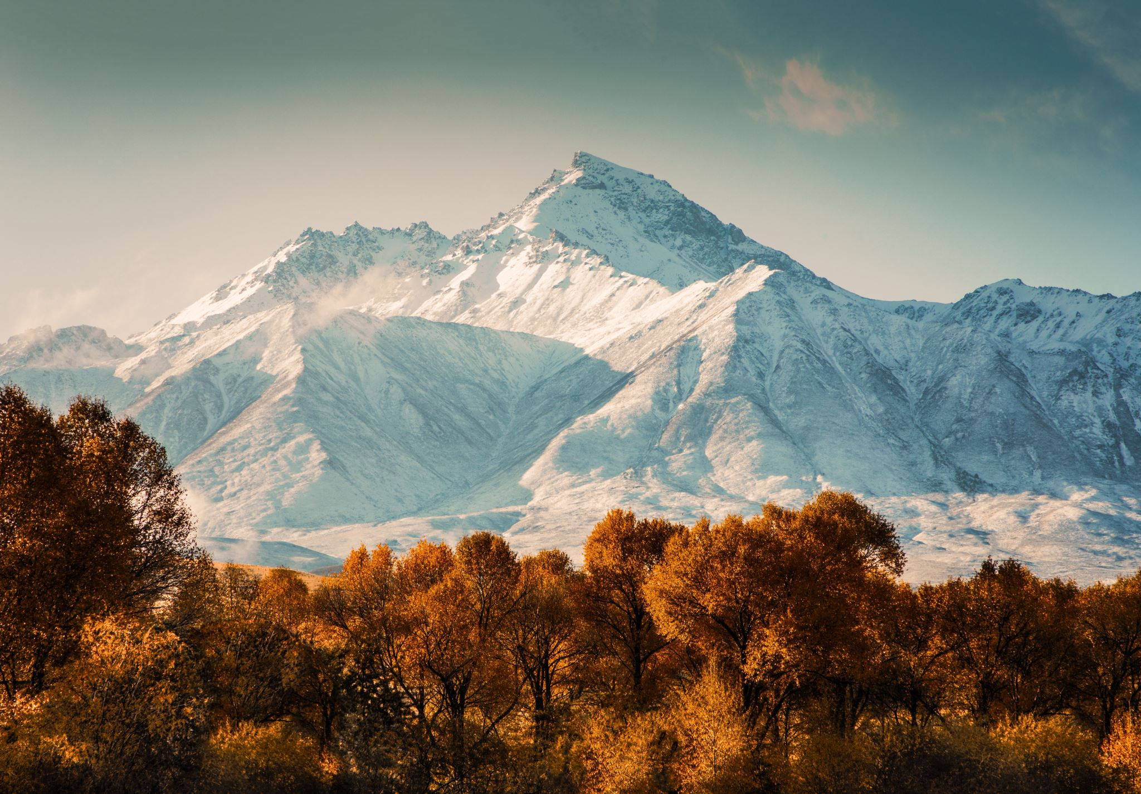

Slide 3
False Teachers
“Where is the promise of His coming?” (3:4)
“While they promise them liberty, they themselves are slaves of corruption.” (2:19)

Slide 4
A Call to Growth
“Grow in the grace and knowledge of our Lord and Savior Jesus Christ.” (3:18)
“Grace and peace be multiplied to you in the knowledge of God and of Jesus our Lord.” (1:2)

Slide 5
Provision “all things that pertain to life and godliness”
Participation “you may be partakers of the divine nature”
Protection ”you will never stumble”
Passage “an entrance will be supplied to you abundantly”

