Slide 1
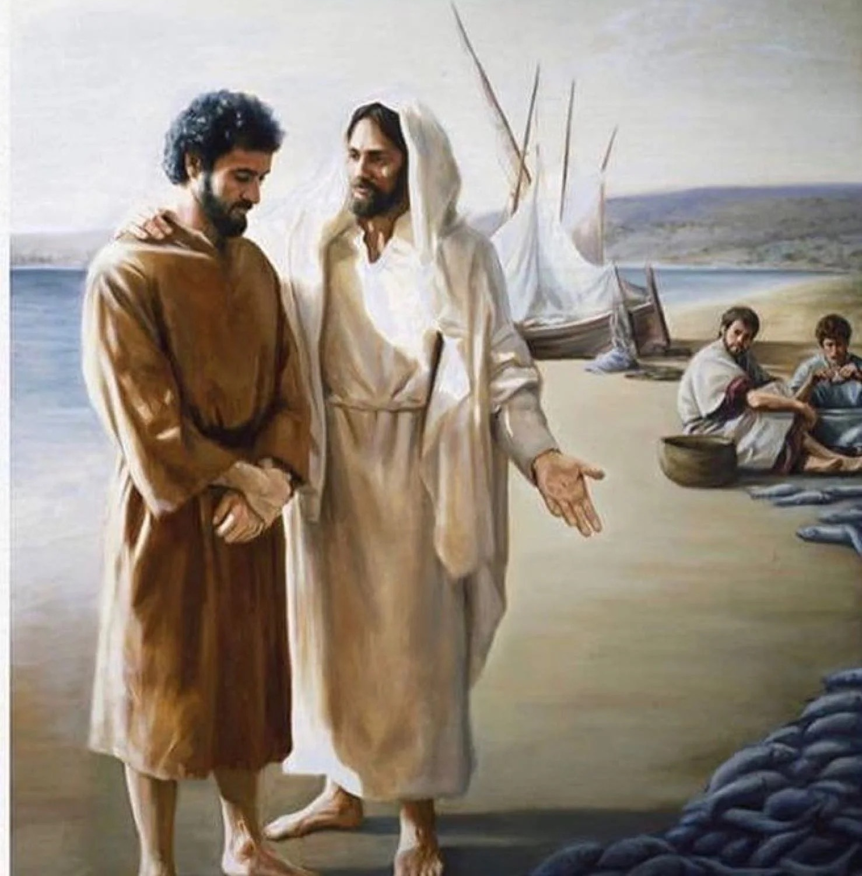
Jesus Teaches His Love to Peter
John 21:15-19

Slide 2
John 21:15-19
¹⁵ So when they had eaten breakfast, Jesus said to Simon Peter, “Simon, son of Jonah, do you love Me more than these?”
He said to Him, “Yes, Lord; You know that I love You.”
He said to him, “Feed My lambs.”
¹⁶ He said to him again a second time, “Simon, son of Jonah, do you love Me?”
He said to Him, “Yes, Lord; You know that I love You.”
He said to him, “Tend My sheep.”
¹⁷ He said to him the third time, “Simon, son of Jonah, do you love Me?” Peter was grieved because He said to him the third time, “Do you love Me?”
And he said to Him, “Lord, You know all things; You know that I love You.”
Jesus said to him, “Feed My sheep.”

Slide 3
John 21:15-19
¹⁵ So when they had eaten breakfast, Jesus said to Simon Peter, “Simon, son of Jonah, do you agapao Me more than these?”
He said to Him, “Yes, Lord; You know that I phileo You.”
He said to him, “Feed My lambs.”
¹⁶ He said to him again a second time, “Simon, son of Jonah, do you agapao Me?”
He said to Him, “Yes, Lord; You know that I phileo You.”
He said to him, “Tend My sheep.”
¹⁷ He said to him the third time, “Simon, son of Jonah, do you phileo Me?” Peter was grieved because He said to him the third time, “Do you phileo Me?”
And he said to Him, “Lord, You know all things; You know that I phileo You.”
Jesus said to him, “Feed My sheep.”

Slide 4
John 21:15-19
¹⁵ So when they had eaten breakfast, Jesus said to Simon Peter, “Simon, son of Jonah, do you love Me more than these?” He said to Him, “Yes, Lord; You know that I love You.” He said to him, “Feed My lambs.” ¹⁶ He said to him again a second time, “Simon, son of Jonah, do you love Me?” He said to Him, “Yes, Lord; You know that I love You.” He said to him, “Tend My sheep.” ¹⁷ He said to him the third time, “Simon, son of Jonah, do you love Me?” Peter was grieved because He said to him the third time, “Do you love Me?” And he said to Him, “Lord, You know all things; You know that I love You.” Jesus said to him, “Feed My sheep.
¹⁸ Most assuredly, I say to you, when you were younger, you girded yourself and walked where you wished; but when you are old, you will stretch out your hands, and another will gird you and carry you where you do not wish.” ¹⁹ This He spoke, signifying by what death he would glorify God. And when He had spoken this, He said to him, “Follow Me.”

Slide 5
John 21:15-19
¹⁵ So when they had eaten breakfast, Jesus said to Simon Peter, “Simon, son of Jonah, do you love Me more than these?” He said to Him, “Yes, Lord; You know that I love You.” He said to him, “Feed My lambs.” ¹⁶ He said to him again a second time, “Simon, son of Jonah, do you love Me?” He said to Him, “Yes, Lord; You know that I love You.” He said to him, “Tend My sheep.” ¹⁷ He said to him the third time, “Simon, son of Jonah, do you love Me?” Peter was grieved because He said to him the third time, “Do you love Me?” And he said to Him, “Lord, You know all things; You know that I love You.” Jesus said to him, “Feed My sheep.
¹⁸ Most assuredly, I say to you, when you were younger, you girded yourself and walked where you wished; but when you are old, you will stretch out your hands, and another will gird you and carry you where you do not wish.” ¹⁹ This He spoke, signifying by what death he would glorify God. And when He had spoken this, He said to him, “Follow Me.”

Slide 6
What Jesus Taught Peter about Love
Requires selfless action of service, not mere feeling
Matthew 26:33-35 → v. 47-51 (cf. John 18:10 – Peter)
Ezekiel 33:30-33
Matthew 7:21-23
Requires suffering in that service
2 Timothy 3:12
Matthew 5:10-12
1 Peter 3:13-14 → 1 Peter 4:12-16
Requires service as priority over earthly ties
Matthew 10:34-37
John12:42-43 → Matthew 7:13-14 → Matthew 10:22
1 John 2:15
Have I learned the lessons about love that Peter needed?

Slide 7
The Love Jesus Taught We Must Learn
John 21:15-19

