Slide 2
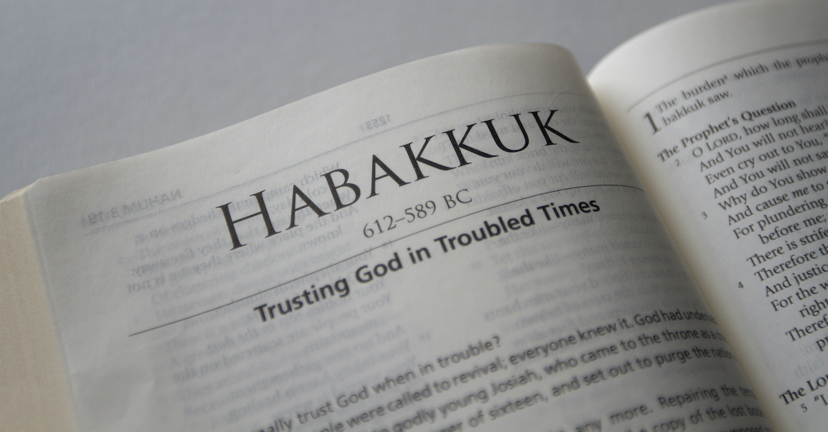
“The Just Shall Live By Faith”
A Survey of The Book of Habakkuk

Slide 3
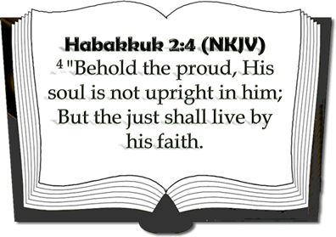
“The Just Shall Live By Faith”
Romans 1:17 (NKJV) ¹⁷ For in it the righteousness of God is revealed from faith to faith; as it is written, "The just shall live by faith."
Galatians 3:11 (NKJV) ¹¹ But that no one is justified by the law in the sight of God is evident, for "the just shall live by faith."
Hebrews 10:38 (NKJV) ³⁸ Now the just shall live by faith; But if anyone draws back, My soul has no pleasure in him.“
This always has been and always will be the case!

Slide 4
“The Just Shall Live By Faith”
Date of writing: 612-606 B.C.
Habakkuk’s statement: “I must wait quietly for the day of trouble, for the coming up of the people that invade us” (3:16).
The oppression of Judah and the carrying of the first group into Babylon, 605 B.C., had not taken place yet.
This book was written after the beginning of Babylon’s westward move for world conquest, but prior to the invasion of Jerusalem.
This always has been and always will be the case!

Slide 5
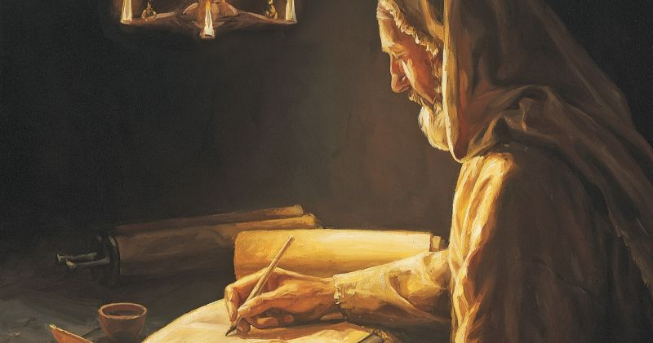
Author - Habakkuk: [Love's Embrace] Nothing is known of Habakkuk's birthplace or heritage. Unlike the other prophets, Habakkuk presented his message in the form of questions addressed to God - (Hab. 1:2,3).
Written - 612-606 B.C. (3:16)

Slide 6
“The Just Shall Live By Faith”
Faith Struggling With His Own Sinful Nation and the Lord’s Reply – 1:1-11
The prophet’s struggle: How can God remain indifferent to the wickedness of His people? (1:2)
The prophet’s lamentation: wickedness & violence rules in the land (1:3,4)
God’s reply – “I am raising up the Chaldeans” to judge this people – 1:5,6
God’s description of their character – Bitter, hasty, terrible, dreadful, violent, mockers, idolatrous – 1:6-11

Slide 7
“The Just Shall Live By Faith”
Faith Struggling With The Solution & The Lord’s Reply – 1:12-2:20
The prophet’s perplexity – How can a holy God employ an impure and godless agent? – (1:12,13)
The prophet’s rationalization – The Chaldeans were more wicked than Israel – (1:14-2:1)
God’s reply – (2:2-20)
Write it down and make it plain – (2)
The time will come – (3)
A proud soul is not upright – but the just shall live by faith – (4)
Five woes proclaimed against wicked – (5-20)

Slide 8
“The Just Shall Live By Faith”
Faith Struggling With The Solution & The Lord’s Reply – 1:12-2:20
Five woes proclaimed against wicked (5-20)
Woe – Endless appetite for conquest Hab. 2:5-8
Woe – Greed and Pride – Hab. 2:9-11
Woe – Enrichment through bloodshed Hab. 2:12-14
Woe – Corruption of neighbors Hab. 2:15-17
Woe to those given over to idolatry Hab. 2:18-20

Slide 9
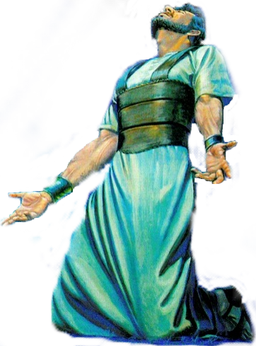
“The Just Shall Live By Faith”
The Prophets "Prayer":
Fear & Humility With Hope before God - 3:1-16
Praise for the Person of God (3:1-3)–(Asking that in His wrath He remember mercy - Praised God as Holy; Glorious; Praiseworthy)
Praise for the Power of God (3:4-7) – (God’s exposing light; His judgment upon the nations; power over the earth)
Praise for the Purpose of God (3:8-16) – (Bringing both judgment to the wicked and salvation to His people )
Humility & Hope Before God (3:16) – (He trembled at what he has heard, that he will have rest in the day of trouble )

Slide 10
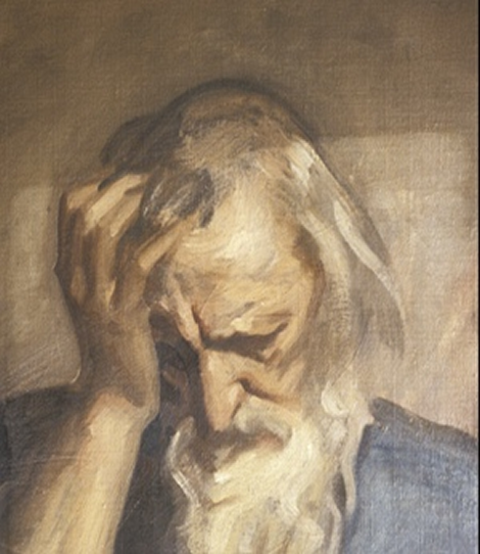
“The Just Shall Live By Faith”
The Prophets “Song":
Faith Glorying In Assurance - 3:17-19
Habakkuk 3:17-19 (NKJV) ¹⁷ Though the fig tree may not blossom, Nor fruit be on the vines; Though the labor of the olive may fail, And the fields yield no food; Though the flock may be cut off from the fold, And there be no herd in the stalls--

Slide 11
“The Just Shall Live By Faith”
The Prophets “Song":
Faith Glorying In Assurance - 3:17-19
Habakkuk 3:17-19 (NKJV) ¹⁸ Yet I will rejoice in the Lord, I will joy in the God of my salvation. ¹⁹ The Lord God is my strength; He will make my feet like deer's feet, And He will make me walk on my high hills. To the Chief Musician. With my stringed instruments.

Slide 12
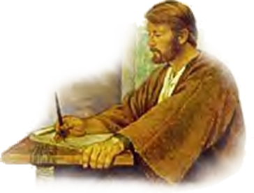
“The Just Shall Live By Faith”
Faith Struggling With A Problem & The Lord’s Reply – 1:1-11
Faith Struggling With The Solution & The Lord’s Reply – 1:12-2:20
The Prophets Prayer: Fear & Humility With Hope before God - 3:1-16
The Prophets “Song“: Faith Glorying In Assurance - 3:17-19
Habakkuk 1:1 (NKJV) ¹ The burden which the prophet Habakkuk saw.

Slide 13
“The Just Shall Live By Faith”
God will judge the wicked
The faithful often suffer because of wickedness of others
Evil is self destructive
The fact of divine discipline
“The just shall live by his faith”
Habakkuk 1:1 (NKJV) ¹ The burden which the prophet Habakkuk saw.

Slide 14
“The Just Shall Live By Faith”
Romans 1:17 (NKJV) ¹⁷ For in it the righteousness of God is revealed from faith to faith; as it is written, "The just shall live by faith."
Galatians 3:11 (NKJV) ¹¹ But that no one is justified by the law in the sight of God is evident, for "the just shall live by faith."
Hebrews 10:38 (NKJV) ³⁸ Now the just shall live by faith; But if anyone draws back, My soul has no pleasure in him.“
This always has been and always will be the case!

