Slide 1
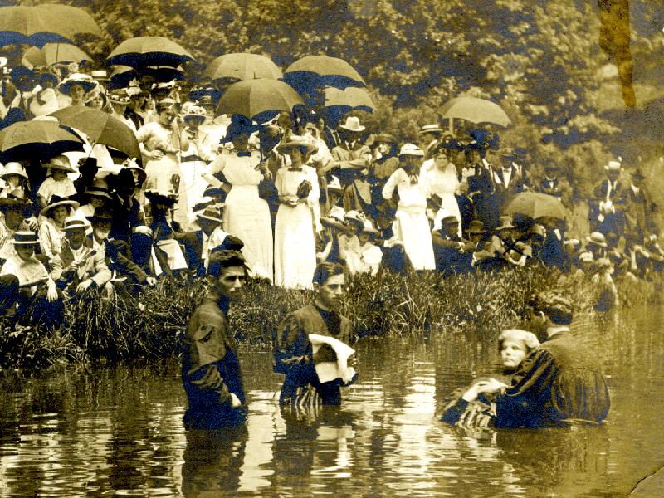
Five Views of Baptism

Slide 2
The Atheist View
“He who believes and is baptized is just following superstition & will not be saved because there is no salvation.”
They have rejected the existence of God and the authority of scripture.
John 3:18; Psalm 14:1

Slide 3
John 3:18
He who believes in Him is not condemned; but he who does not believe is condemned already, because he has not believed in the name of the only begotten Son of God.

Slide 4
Psalm 14:1
The fool has said in his heart, “There is no God.” They are corrupt, They have done abominable works, There is none who does good.

Slide 5
The Universalist View
“He who believes not and is not baptized will be saved because all will be saved.”
They have rejected the nature of “love” as revealed in God’s word, and replaced it with their own idea of a loving God.
John 12:48

Slide 6
John 12:48
“He who rejects Me, and does not receive My words, has that which judges him--the word that I have spoken will judge him in the last day.”
His is a corrupted view of deity, having remade God into an image like man.

Slide 7
The Catholic View
“He who believes not, but is baptized will be saved.”
Infant baptism is a result of their belief that a child is born into the world inheriting the sins of entire lineage, thus totally depraved.
Ezekiel 18:20 Luke 18:15-17; Romans 10:17

Slide 8
Ezekiel 18:20
The soul who sins shall die. The son shall not bear the guilt of the father, nor the father bear the guilt of the son. The righteousness of the righteous shall be upon himself, and the wickedness of the wicked shall be upon himself.

Slide 9
Luke 18:15-17
Then they also brought infants to Him that He might touch them; but when the disciples saw it, they rebuked them. ¹⁶ But Jesus called them to Him and said, “Let the little children come to Me, and do not forbid them; for of such is the kingdom of God. ¹⁷ Assuredly, I say to you, whoever does not receive the kingdom of God as a little child will by no means enter it.”

Slide 10
Mainstream Denominational View
“He who believes and is not baptized will be saved.”
They deny necessity for baptism by equating obedience with salvation by works.
Acts 2:38; 1 Peter 3:21

Slide 11
Acts 2:38
Then Peter said to them, “Repent, and let every one of you be baptized in the name of Jesus Christ for the remission of sins; and you shall receive the gift of the Holy Spirit.”

Slide 12
1 Peter 3:21
Corresponding to that, baptism now saves you — not the removal of dirt from the flesh, but an appeal to God for a good conscience — through the resurrection of Jesus Christ (NAS).

Slide 13
The View of our Lord
“He who believes and is baptized will be saved; but he who does not believe will be condemned” (Mark 16:16).
No amount of human manipulation will change the eternal truth of Mark 16:16. Beware of all that change the gospel as commanded by Christ. Only the pure, unchanged gospel can save your soul!

