Slide 1
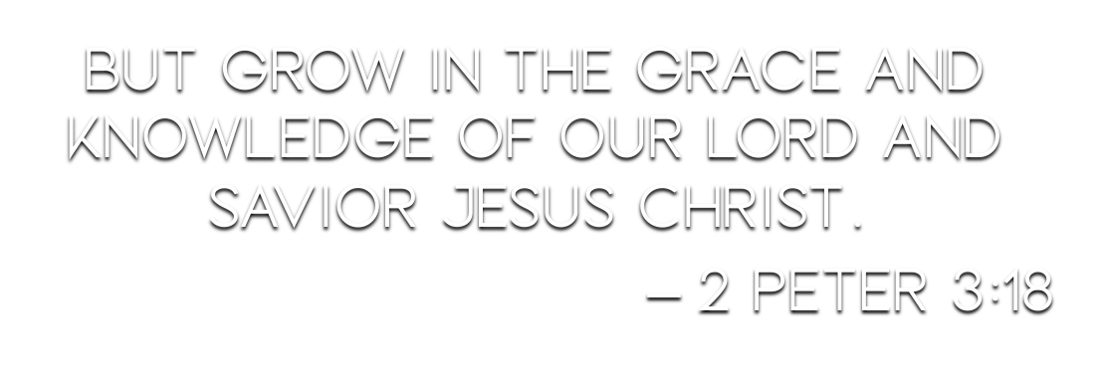

Slide 3
self-control (especially continence): — temperance. (STRONG)
restraint of one’s emotions, impulses, or desires, self-control (BDAG)
self-control (the virtue of one who masters his desires and passions, especially his sensual appetites) (THAYER)

Slide 4
self-control (especially continence): — temperance. (STRONG)
restraint of one’s emotions, impulses, or desires, self-control (BDAG)
self-control (the virtue of one who masters his desires and passions, especially his sensual appetites) (THAYER)

Slide 5
from kratos, “strength,” occurs in Acts 24:25; Gal. 5:23; 2 Pet. 1:6 (twice), in all of which it is rendered “temperance”; the RV marg., “self-control” is the preferable rendering, as “temperance” is now limited to one form of self-control; the various powers bestowed by God upon man are capable of abuse; the right use demands the controlling power of the will under the operation of the Spirit of God; in Acts 24:25 the word follows “righteousness,” which represents God’s claims, self-control being man’s response thereto; in 2 Pet. 1:6, it follows “knowledge,” suggesting that what is learned requires to be put into practice. (VINE)

Slide 6
from kratos, “strength,” occurs in Acts 24:25; Gal. 5:23; 2 Pet. 1:6 (twice), in all of which it is rendered “temperance”; the RV marg., “self-control” is the preferable rendering, as “temperance” is now limited to one form of self-control; the various powers bestowed by God upon man are capable of abuse; the right use demands the controlling power of the will under the operation of the Spirit of God; in Acts 24:25 the word follows “righteousness,” which represents God’s claims, self-control being man’s response thereto; in 2 Pet. 1:6, it follows “knowledge,” suggesting that what is learned requires to be put into practice. (VINE)

Slide 7
“Self-control” is at odds with the widely held view of man’s corrupt nature.
Man is created in the image of God – Genesis 1:26; 2:7, 18-20; John 4:24
The flesh is not inherently sinful – Ecclesiastes 7:29; Hebrews 2:14; 4:15; 7:27
Man has a choice – Galatians 5:16-17
Jesus was a man as we are and chose not to sin – Romans 8:3; Heb. 2:14; 1 John 4:2-3

Slide 8
God revealed commands for man to obey – Ecclesiastes 12:13-14
These commands conflict with the flesh, and a choice must be made – Galatians 5:17-25
Man must deny himself and submit to God – Mark 8:34-38
Man must be mindful of the spiritual, discern God’s will, and follow it – Romans 8:5-8; 1 Corinthians 2:14

Slide 9
Our aim for something greater leads to “self-control” – 2 Peter 1:4, 11
“Self-control” must be developed, and requires:
Humility – James 1:13-15
Self-denial – Matthew 16:21-28
Self-discipline – 1 Corinthians 9:24-27

