Slide 1
Lesson 3: The Birth and Childhood of Jesus Luke 2

Slide 2
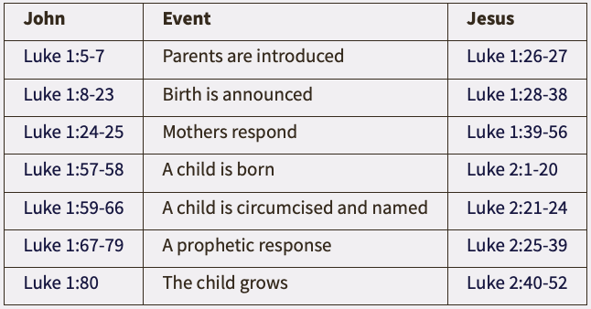
Lesson 3: The Birth and Childhood of Jesus
Parallels Between John and Jesus
(IVP Dictionary of Jesus and the Gospels – The Gospel of Luke)

Slide 3
Lesson 3: The Birth and Childhood of Jesus
The Birth of Jesus (2:1-7)
Journey from Nazareth to Bethlehem

Slide 4
Lesson 3: The Birth and Childhood of Jesus

Slide 5
Lesson 3: The Birth and Childhood of Jesus
The Birth of Jesus (2:1-7)
Journey from Nazareth to Bethlehem
Arrival in Bethlehem and no room in the inn
Greek word translated for inn is katalyma – also translated as guestroom in Mark 14:14 and Luke 22:11
The birth of Jesus, the Messiah (v7)
Fulfillment of 3 prophecies

Slide 6
Lesson 3: The Birth and Childhood of Jesus
The Visit of the Shepherds (2:8-20)
The announcement by the angel of “good tidings” (v10-11)
The sign to the shepherds (v12)
The shepherds meet Jesus and their response (v17 & 20)

Slide 7
Lesson 3: The Birth and Childhood of Jesus
Circumcision and Presentation of Jesus (2:22-40)
On the 8th day, Jesus is named and circumcised (v21)
Journey to the temple in Jerusalem

Slide 8
Lesson 3: The Birth and Childhood of Jesus

Slide 9
Lesson 3: The Birth and Childhood of Jesus
Circumcision and Presentation of Jesus (2:22-40)
On the 8th day, Jesus is named and circumcised (v21)
Journey to the temple in Jerusalem
Simeon’s confirmation of Jesus as the Christ (v26)
Anna’s thanksgiving to God (v38)
Journey back to Nazareth? (v39)

Slide 10
Lesson 3: The Birth and Childhood of Jesus

Slide 11
Lesson 3: The Birth and Childhood of Jesus
Jesus’ Observance of the Passover at 12 years old (2:41-50)
Only recorded event of Jesus between infant and ministry around age of 30
Annual journey to Jerusalem to observe the Passover (v41-42)
Jesus is left behind
Jesus’ response, “Why did you seek Me? Did you not know that I must be about My Father’s business?” (v49)

Slide 12
Lesson 3: The Birth and Childhood of Jesus
Conclusion (2:51-52)
Traveled back to Nazareth
Jesus subjected Himself to His parents (v51)
Jesus increased in wisdom, stature, and in favor with God and Man (v52)

