Slide 2
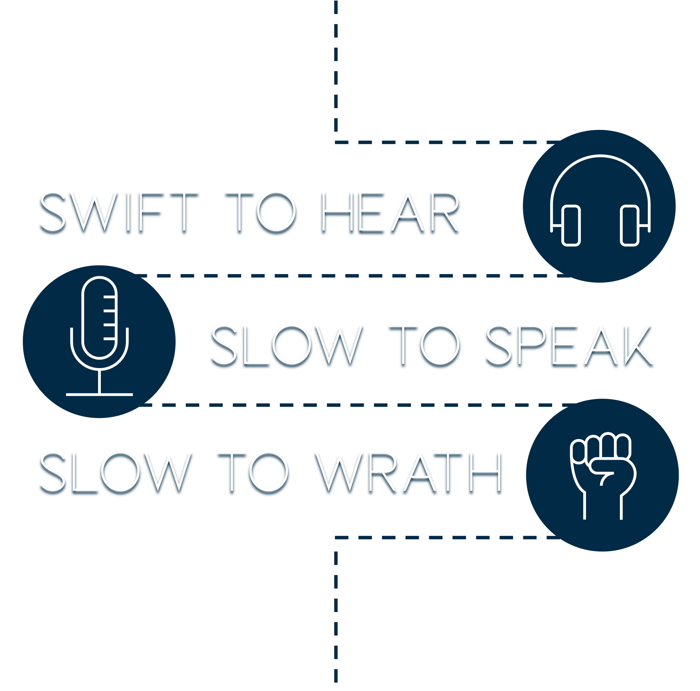

Slide 3
Knowing that God has Spoken
Knowing that God has Chosen Men to Proclaim His message

Slide 4
Knowing Your Speech Reveals Your Heart
Knowing You Must Speak where the Bible Speaks

Slide 5
Knowing You are Fallible
Knowing Wrath Does Not Produce the Righteousness of God
Receive the Word with Meekness

