Slide 2
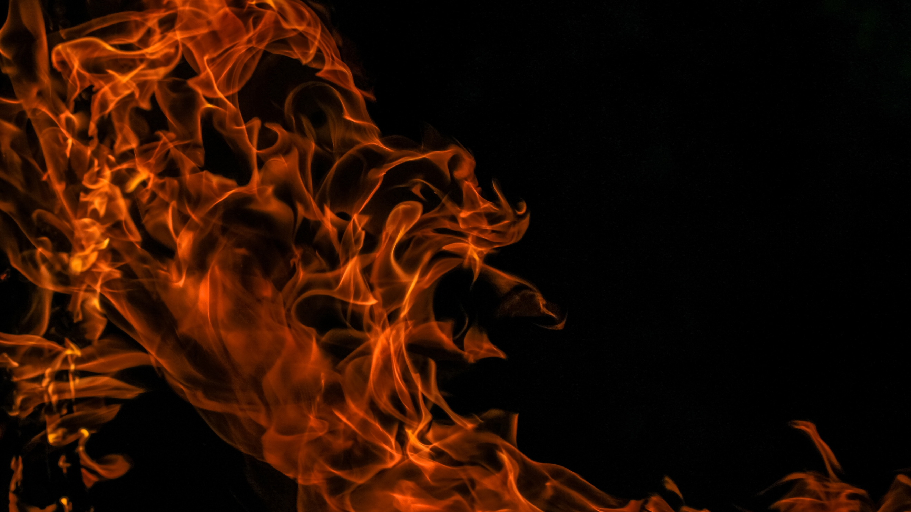

Slide 3
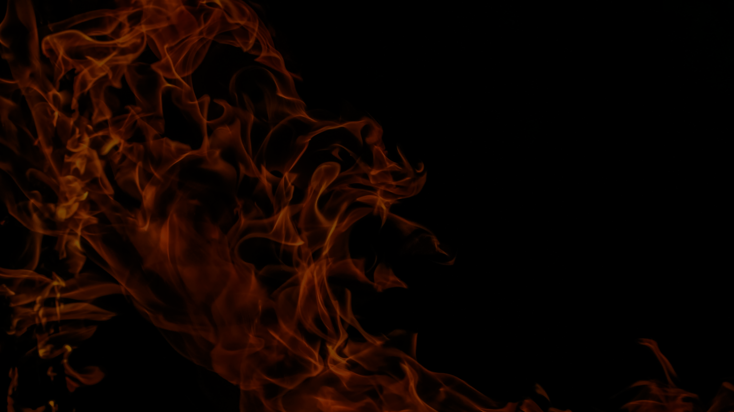
The Text in Context
Jesus’ dividing effect – Luke 2:34-35
11:53-54 – rejected.
12:1 – call for disciples to be separate.
12:1, 13, 22, 41, 54 – division of people.
12:49-53 – a fire of division is kindled at the cross (cf. 1 Corinthians 1:22-24)

Slide 4
Christ Divides
The nature of division – 1 Cor. 11:19 – distinguishes approved from unapproved. (cf. 1 John 2:18-23)
Includes the positive effect of bringing others to the light – Ephesians 5:8-14
Brings clarity – 2 Timothy 2:19; Luke 11:23

Slide 5
The Text in Context
Fire often stands for trial.
Division brings trial, and is a trial itself:
12:1 – avoiding their hypocrisy means standing opposed to them.
12:4-5, 11-12 – exhortation to not fear implies persecution.

Slide 6
Following Christ Brings Trials
Christ to undergo trial, and calls disciples to follow – 12:50; 9:21-26
Fire of trial benefits us – Mark 9:49-50
Fire helps prove our faith – 1 Peter 1:6-9; 4:12-16
We are appointed to it – 1 Thess. 3:3-4
Saved through fire – 1 Corinthians 13:15

Slide 7
The Text in Context
Context is sandwiched with judgment – 11:47-51; 12:57-13:5
Rightly directed fear – 12:4-5, 8-9 – fear the Judge.
Soul required – 12:20
Jesus to return, be ready – 12:35-48
Jesus’ death kindles the fire of judgment – 12:49-50; John 12:31-33; 16:8-11

Slide 8
Christ Will Come in Judgment
Mercy, salvation, peace, etc. – Luke 1:50, 68-70; 2:13-14, 30-32; 4:18-19; 19:9-10
Judgment – Luke 1:51-53; 3:7-9, 15-17; 6:24-26; 10:12-16; 13:34-35
Christ will come to judge – Heb. 9:27-28
We must all appear in judgment – 2 Corinthians 5:9-11

