Slide 3
Joshua’s Commitment
Linked to Moses – Exodus 24:13; 33:11; Numbers 11:28
Ever faced with God’s word – Exodus 17:14; Deuteronomy 31:14-30
Faced with a personal choice to apply God’s word – Deuteronomy 1:38; 3:28; 31:7-8; Joshua 1:6-9

Slide 4
Personal Commitment is Foundational to Spiritual Leadership in the Home
Attempted leadership without personal commitment – Romans 2:17-24
Must take heed to self – 1 Tim. 4:16; Ezra 7:6, 9-10
Cannot do it without Christ – John 15:5

Slide 5
Joshua’s Leadership
Defeated Amalek – Exodus 17:13
Opposition to idolatry at Sinai – Exodus 32:17-18; 33:11
Faith among doubting spies – Numbers 14:1-9
Chosen to succeed Moses – Deuteronomy 3:28
National leadership presupposes commitment to the leadership of his home – Genesis 18:19; Joshua 24:15

Slide 6
Spiritual Leadership in the Home Results from Conscious Effort
Materials for a spiritual home – Proverbs 24:3-4
Ruling the house well – 1 Timothy 3:4, 12; Ephesians 5:23, 25; 1 Samuel 2-3
Firm, active, loving leadership – Deuteronomy 6:6-9; Ephesians 6:4

Slide 7
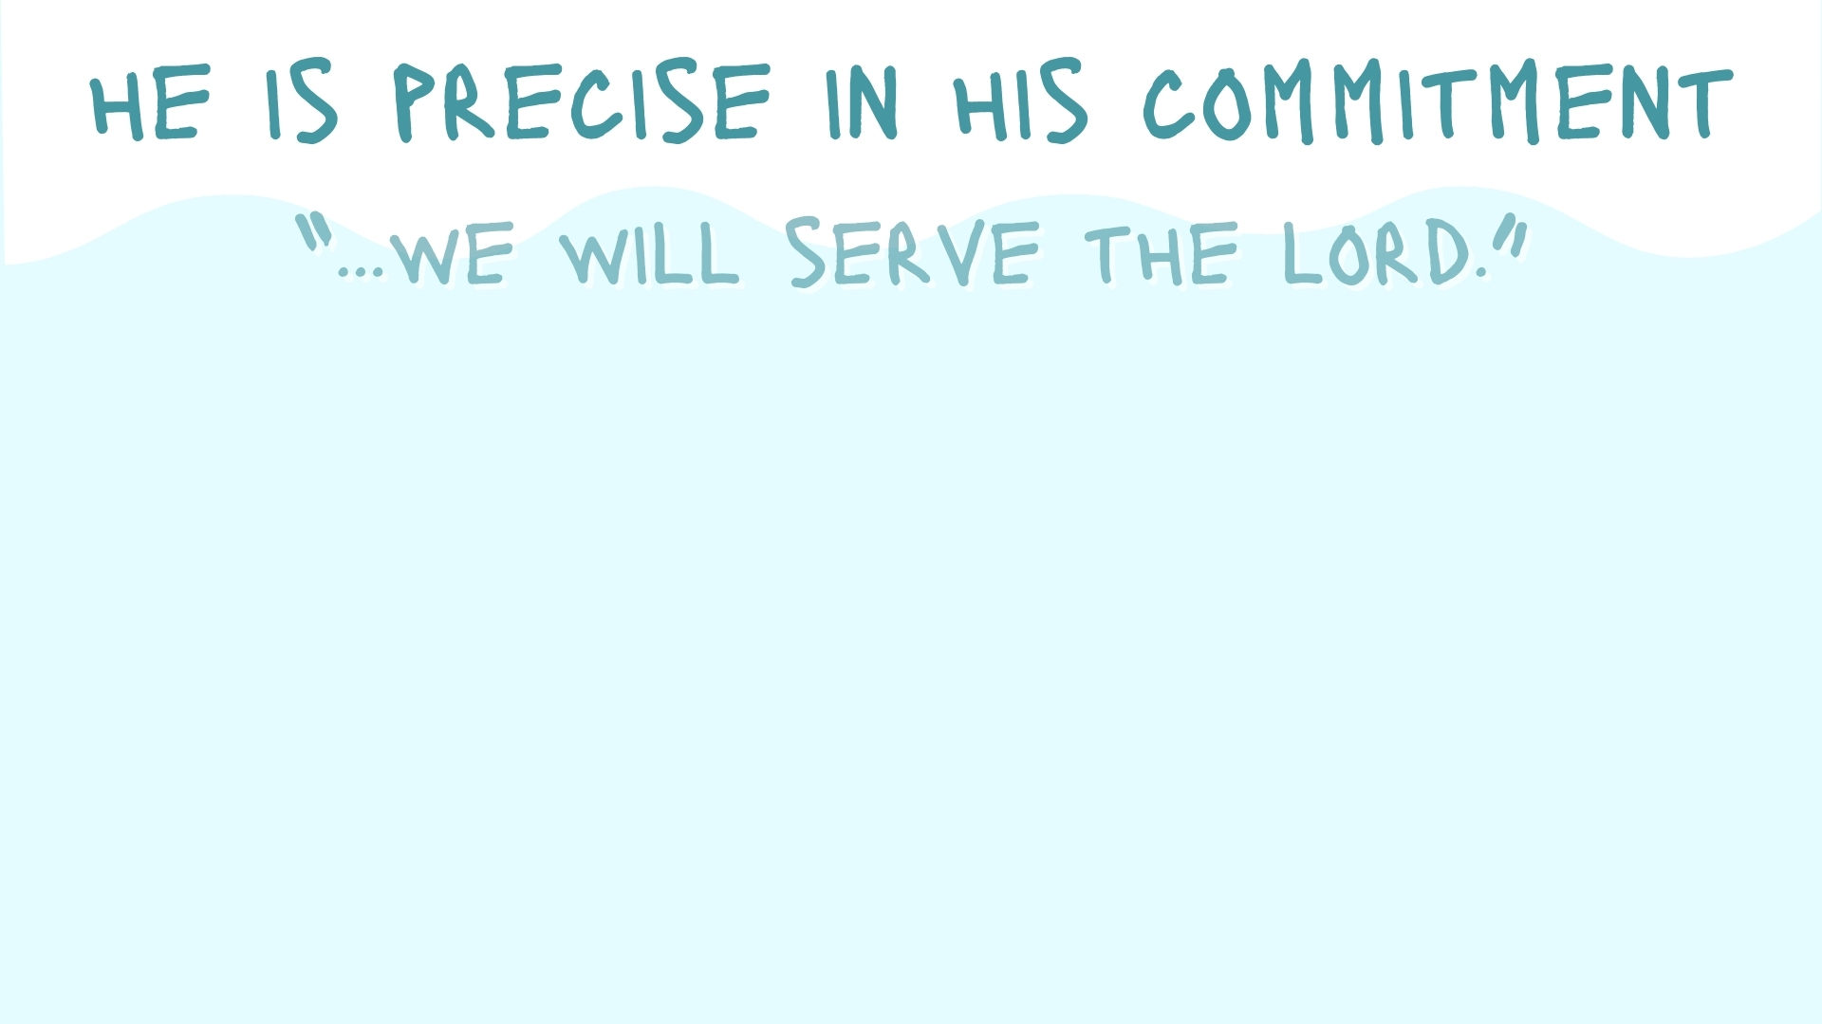
Joshua’s Commitment to the Lord (Joshua 24)
Spiritual Leadership in the Home Requires a Specific and Exclusive Choice Which Dictates All Other Choices
Excludes all other choices – Deuteronomy 6:4-5, 13-14
God’s family man chooses God for his family over all else!

