Slide 1

Lesson 4
Psalms 1 and 150: Import of First and Last Psalms

Slide 2

Psalms 1 and 150
Psalm 1
1) Blessed is the man Who walks not in the counsel of the ungodly, nor stands in the path of sinners, Nor sits in the seat of the scornful; 2) But his delight is in the law of the LORD, And in His law he meditates day and night. 3) He shall be like a tree Planted by the rivers of water, That brings forth its fruit in its season, Whose leaf also shall not wither; And whatever he does shall prosper. 4) The ungodly are not so, But are like the chaff which the wind drives away. 5) Therefore the ungodly shall not stand in the judgement, Nor sinners in the congregation of the righteous. 6) For the LORD knows the way of the righteous, But the way of the ungodly shall perish.

Slide 3
Psalms 1 and 150
Psalm 1 General Overview
Sets tone for entire book
Characteristics of both the blessed and ungodly man
Perception vs reality
Final outcome for the ungodly

Slide 4
Psalms 1 and 150
Psalm 1
1) Blessed is the man Who walks not in the counsel of the ungodly, nor stands in the path of sinners, Nor sits in the seat of the scornful; 2) But his delight is in the law of the LORD, And in His law he meditates day and night. 3) He shall be like a tree Planted by the rivers of water, That brings forth its fruit in its season, Whose leaf also shall not wither; And whatever he does shall prosper. 4) The ungodly are not so, But are like the chaff which the wind drives away. 5) Therefore the ungodly shall not stand in the judgement, Nor sinners in the congregation of the righteous. 6) For the LORD knows the way of the righteous, But the way of the ungodly shall perish.

Slide 5
Psalms 1 and 150
“Blessed is the man…”
Blessings & Cursings - Hebrew word בְּרָכָה “braka” Psa 3:8; 24:5
בְּרָכָה “esher” – exclamatory word. “O the blessedness of….”
Happiness
Positive state of being
New Testament passage?

Slide 6
Psalms 1 and 150
Sermon on the Mount
Matthew 5: 1-11
V3 – “blessed are the poor in spirit…”
V4 - “blessed are those who mourn…”
V5 - “blessed are the meek..”
V6 – “blessed are those who hunger…”
V7 – “blessed are the merciful…”
V8 – “blessed are the pure in heart…”
V9 – “blessed are the peacemakers…”
V 10 – “blessed are those who are persecuted for righteousness’ sake..”
V 11 – “blessed are you when they revile, persecute, and falsely say all kinds of
evil against you because of me…”

Slide 7
Psalms 1 and 150
Psalm 1
1) Blessed is the man Who walks not in the counsel of the ungodly, nor stands in the path of sinners, Nor sits in the seat of the scornful; 2) But his delight is in the law of the LORD, And in His law he meditates day and night. 3) He shall be like a tree Planted by the rivers of water, That brings forth its fruit in its season, Whose leaf also shall not wither; And whatever he does shall prosper. 4) The ungodly are not so, But are like the chaff which the wind drives away. 5) Therefore the ungodly shall not stand in the judgement, Nor sinners in the congregation of the righteous. 6) For the LORD knows the way of the righteous, But the way of the ungodly shall perish.

Slide 8
Psalms 1 and 150
“…who walks not in the counsel of the ungodly, nor stands in the path of sinners, nor sits in the seat of the scornful.”
Negative perspective
Progressive Parallelism – Walk, Stand, Sit
Walk Casual acceptance
Stand Waiting around to join in
Sit Entrenched, promoting, endorsing
We are either growing closer to God or drifting further away
Old Testament example?
Lot – Gen 13:12, Gen 19, 2 Peter 2:7

Slide 9
Psalms 1 and 150
Psalm 1
1) Blessed is the man Who walks not in the counsel of the ungodly, nor stands in the path of sinners, Nor sits in the seat of the scornful; 2) But his delight is in the law of the LORD, And in His law he meditates day and night. 3) He shall be like a tree Planted by the rivers of water, That brings forth its fruit in its season, Whose leaf also shall not wither; And whatever he does shall prosper. 4) The ungodly are not so, But are like the chaff which the wind drives away. 5) Therefore the ungodly shall not stand in the judgement, Nor sinners in the congregation of the righteous. 6) For the LORD knows the way of the righteous, But the way of the ungodly shall perish.

Slide 10
Psalms 1 and 150
2) But his delight is in the law of the LORD, And in His law he meditates day and night. 3) He shall be like a tree Planted by the rivers of water, That brings forth its fruit in its season, Whose leaf also shall not wither; And whatever he does shall prosper.
Positive Perspective
Delights in the law of the LORD and meditates in it continually
Meditates
– הָגָה “haga” Strong’s: “to murmur (in pleasure or anger); by implication, to ponder – mourn, mutter, speak, study, talk, utter. Psa 2:1; 35:28; 37:30; 38:12; 63:6; 71:24; 77:12; 115:7; 143:5

Slide 11
Psalms 1 and 150
2) But his delight is in the law of the LORD, And in His law he meditates day and night. 3) He shall be like a tree Planted by the rivers of water, That brings forth its fruit in its season, Whose leaf also shall not wither; And whatever he does shall prosper.
What are the effects of this lifestyle?
Stable foundation – Matthew 7:24-27
Bears fruit – Luke 13:6-9
Will prosper – Matt 13:8, 23
Spiritually…physically…both? - Matt 5:12

Slide 12
Psalms 1 and 150
Psalm 1
1) Blessed is the man Who walks not in the counsel of the ungodly, nor stands in the path of sinners, Nor sits in the seat of the scornful; 2) But his delight is in the law of the LORD, And in His law he meditates day and night. 3) He shall be like a tree Planted by the rivers of water, That brings forth its fruit in its season, Whose leaf also shall not wither; And whatever he does shall prosper. 4) The ungodly are not so, But are like the chaff which the wind drives away. 5) Therefore the ungodly shall not stand in the judgement, Nor sinners in the congregation of the righteous. 6) For the LORD knows the way of the righteous, But the way of the ungodly shall perish.

Slide 13
Psalms 1 and 150
Psalm 1
1) Blessed is the man Who walks not in the counsel of the ungodly, nor stands in the path of sinners, Nor sits in the seat of the scornful; 2) But his delight is in the law of the LORD, And in His law he meditates day and night. 3) He shall be like a tree Planted by the rivers of water, That brings forth its fruit in its season, Whose leaf also shall not wither; And whatever he does shall prosper. 4) The ungodly are not so, But are like the chaff which the wind drives away. 5) Therefore the ungodly shall not stand in the judgement, Nor sinners in the congregation of the righteous. 6) For the LORD knows the way of the righteous, But the way of the ungodly shall perish.

Slide 14
Psalms 1 and 150
4) The ungodly are not so, But are like the chaff which the wind drives away. 5) Therefore the ungodly shall not stand in the judgement, Nor sinners in the congregation of the righteous.
Contrasted with the “Blessed man”
No firm foundation, no stability – James 1:5-8
“THEREFORE” - as a result of..
Ungodly will have no place before God in the end
Sinners not accepted among the congregation – Eph 5:25-27

Slide 15
Psalms 1 and 150
Psalm 1
1) Blessed is the man Who walks not in the counsel of the ungodly, nor stands in the path of sinners, Nor sits in the seat of the scornful; 2) But his delight is in the law of the LORD, And in His law he meditates day and night. 3) He shall be like a tree Planted by the rivers of water, That brings forth its fruit in its season, Whose leaf also shall not wither; And whatever he does shall prosper. 4) The ungodly are not so, But are like the chaff which the wind drives away. 5) Therefore the ungodly shall not stand in the judgement, Nor sinners in the congregation of the righteous. 6) For the LORD knows the way of the righteous, But the way of the ungodly shall perish.

Slide 16
Psalms 1 and 150
Psalm 1
1) Blessed is the man Who walks not in the counsel of the ungodly, nor stands in the path of sinners, Nor sits in the seat of the scornful; 2) But his delight is in the law of the LORD, And in His law he meditates day and night. 3) He shall be like a tree Planted by the rivers of water, That brings forth its fruit in its season, Whose leaf also shall not wither; And whatever he does shall prosper. 4) The ungodly are not so, But are like the chaff which the wind drives away. 5) Therefore the ungodly shall not stand in the judgement, Nor sinners in the congregation of the righteous. 6) For the LORD knows the way of the righteous, But the way of the ungodly shall perish.

Slide 17
Psalms 1 and 150
Psalm 1
6) For the LORD knows the way of the righteous, But the way of the ungodly shall perish.
Psalms 119: 105 - Thy word is a lamp unto my feet and light unto my path.
Nahum 1:7 – The LORD is good, A stronghold in the day of trouble; And he knows those who trust in Him.

Slide 18
Psalms 1 and 150
Psalm 1
6) For the LORD knows the way of the righteous, But the way of the ungodly shall perish.
Psalm 119: 105 - Thy word is a lamp unto my feet and light unto my path.
Nahum 1:7 – The LORD is good, A stronghold in the day of trouble; And he knows those who trust in Him.

Slide 19
Psalms 1 and 150
Psalm 1
1) Blessed is the man Who walks not in the counsel of the ungodly, nor stands in the path of sinners, Nor sits in the seat of the scornful; 2) But his delight is in the law of the LORD, And in His law he meditates day and night. 3) He shall be like a tree Planted by the rivers of water, That brings forth its fruit in its season, Whose leaf also shall not wither; And whatever he does shall prosper. 4) The ungodly are not so, But are like the chaff which the wind drives away. 5) Therefore the ungodly shall not stand in the judgement, Nor sinners in the congregation of the righteous. 6) For the LORD knows the way of the righteous, But the way of the ungodly shall perish.

Slide 20
Psalms 1 and 150
Psalm 150
1) PRAISE the LORD! Praise God in His sanctuary; Praise Him in His mighty firmament! 2) Praise Him for His might acts; Praise Him according to His excellent greatness! 3) Praise Him with the sound of the trumpet; Praise Him with the lute and harp! 4) Praise Him with the timbrel and dance; Praise Him with the stringed instruments and flutes! 5) Praise Him with loud cymbals; Praise Him clashing cymbals! 6) Let everything that has breath praise the LORD. Praise the LORD!

Slide 21
Psalms 1 and 150
Psalm 150
1) PRAISE the LORD! Praise God in His sanctuary; Praise Him in His mighty firmament! 2) Praise Him for His might acts; Praise Him according to His excellent greatness! 3) Praise Him with the sound of the trumpet; Praise Him with the lute and harp! 4) Praise Him with the timbrel and dance; Praise Him with the stringed instruments and flutes! 5) Praise Him with loud cymbals; Praise Him clashing cymbals! 6) Let everything that has breath praise the LORD. Praise the LORD!

Slide 22
Psalms 1 and 150
Psalm 150
Praise! – Hebrew word “הָלַל“ (halal) “to be clear; to shine, to make a show, to boast, to celebrate, glory, give (light), (sing, be worthy of) praise
Used 13 times in this short 6 verse psalm
Where? In His sanctuary and in His mighty firmament (vrs 1)
Why? For His might acts and excellent greatness (vrs 2)
How? With instruments and dance (vrs 3-5)
Who? Everything that has breath! (vrs 6)
Notes:
His sanctuary and mighty firmament – 1 Cor 3:16-17. Certainly we are to praise Him in our gathering together in worship, but how about in our daily life, if we are a vessel, heart and mind, filled with God’s word like the blessed man from Psalm 1?

Slide 23
Psalms 1 and 150
Psalm 150
Praise Him!
Where? In His sanctuary and in His mighty firmament (vrs 1)
1 Chronicles 23:25-32 – Tabernacle rests in Jerusalem and Levites appointed to assist its needs, including giving thanks and praise
Ezra 3:10-11 – Praise offered up at the laying of foundation of temple rebuild
Revelation 19:1-5 – Great multitude, 24 elders, 4 creatures all worshiping and praising God
Notes:
His sanctuary and mighty firmament – 1 Cor 3:16-17. Certainly we are to praise Him in our gathering together in worship, but how about in our daily life, if we are a vessel, heart and mind, filled with God’s word like the blessed man from Psalm 1?

Slide 24
Psalms 1 and 150
Psalm 150
Praise Him!
Why? For His might acts and excellent greatness (vrs 2)
Deuteronomy 10:21 – He is your praise, and He is your God, who has done for you these great and awesome things which your eyes have seen
Psalm 21:13 – Be exalted, O LORD, in Your own strength! We will sing and praise Your power.

Slide 25
Psalms 1 and 150
Psalm 150
How? With instruments and dance (vrs 3-6)
Trumpet
Lute
Harp
Timbrel
Stringed instruments
Flutes
Cymbals

Slide 26
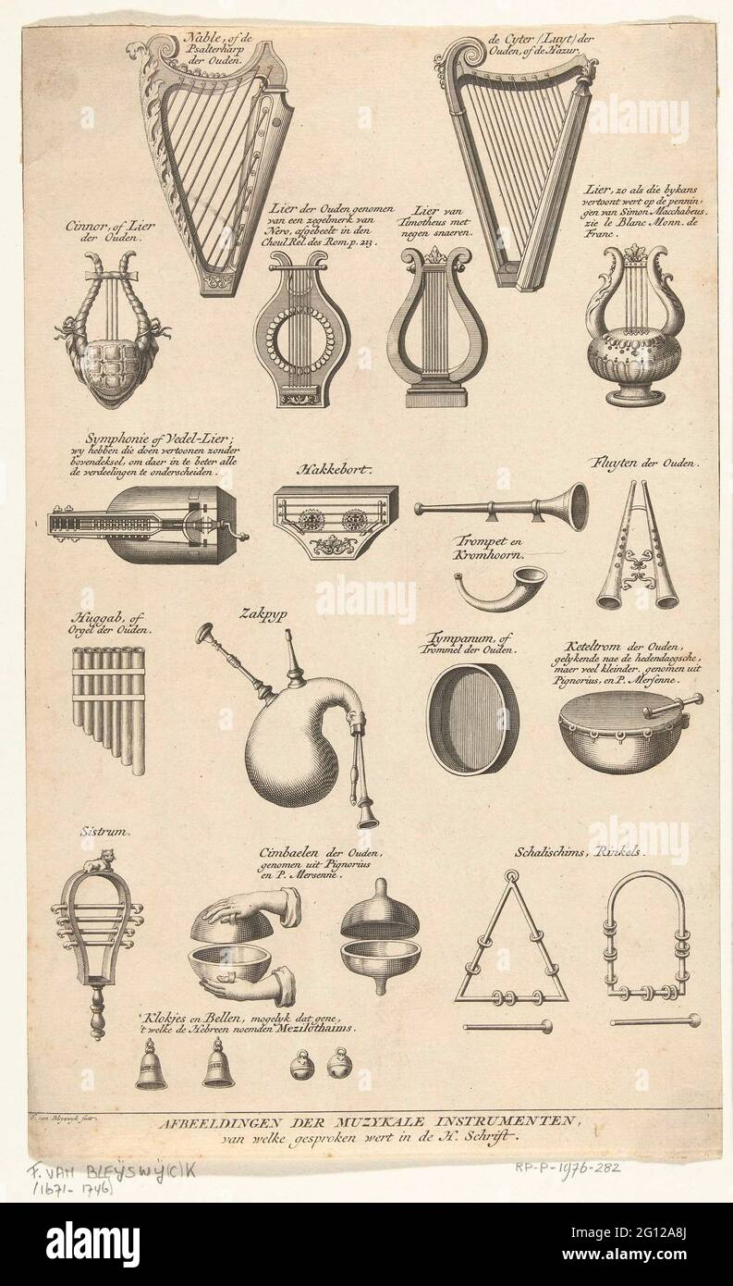
Psalms 1 and 150
Psalm 150
How? With instruments and dance (vrs 3-6)
Trumpet
Lute
Harp
Timbrel
Stringed instruments
Flutes
Cymbals

Slide 27
Psalms 1 and 150
Psalm 150
How? With instruments and dance (vrs 3-6)
Commanded and required in O.T. worship – 1 Chron 23
Commanded and required now?
Commanded to sing: Eph 5:18-20, Heb 13:15
Colossians 3:16
James 5:13 – “…Is anyone cheerful? Let him sing psalms.”

Slide 28
Psalms 1 and 150
Psalm 150
How?
Singing with instruments and dance in old testament times
Singing ONLY in new testament times!
Eph 5:19 - …”singing and making melody in your heart…”
Sing(ing) – “ado” – to sing, chant, to the praise of anyone
Making melody – “psallo” - to pluck, to cause to vibrate by touching, to twitch, to twang
Anyone can sing praise to God and make melody in their heart anywhere, any time!

Slide 29
Psalms 1 and 150
Psalm 150
How?
With the spirit and understanding
John 4:23-24 - We must worship in spirit and truth
1 Corinthians 14:15 – “What is the conclusion then? I will pray with the spirit, and I will also pray with the understanding. I will sing with the spirit, and I will also sing with the understanding.”
God wants our whole heart!

Slide 30
Psalms 1 and 150
Psalm 150
Praise Him!
Who? Everything that has breath! (vrs 6)
Psalm 67:3, 5 – Let the people praise You, O God; Let all the peoples praise You.
Psalm 33: 1 – Rejoice in the LORD, O you righteous! For praise from the upright is beautiful.

Slide 31
Psalms 1 and 150
Psalm 150
Praise Him!
Who? Everything that has breath! (vrs 6)
What does it say about our life if:
We never sing songs of praise or thanks to God?
If we only ever sing secular songs?
Never sing in our worship?
Can we be pleasing and acceptable to God?

Slide 32
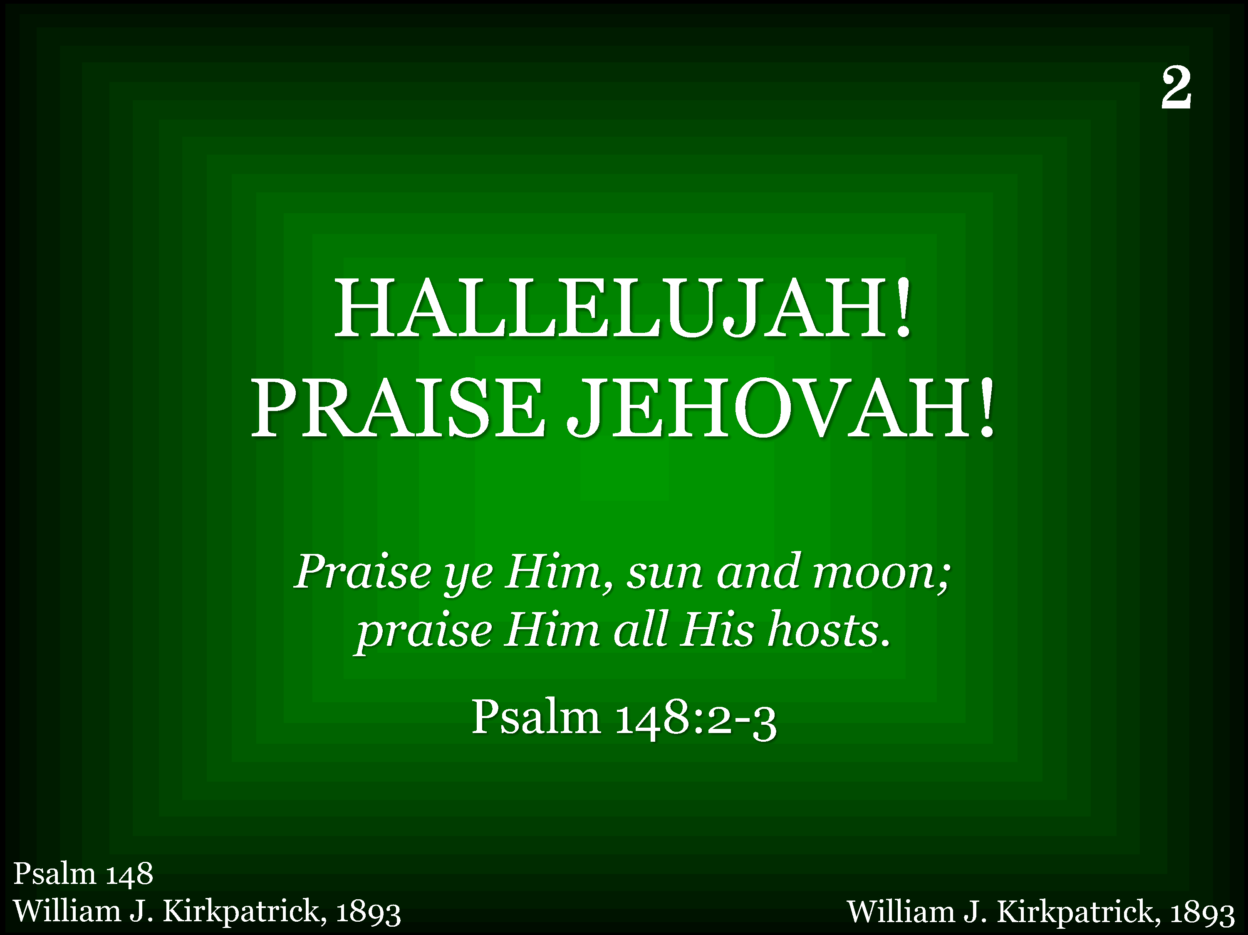
002 - Hallelujah! Praise Jehovah - Title

Slide 33
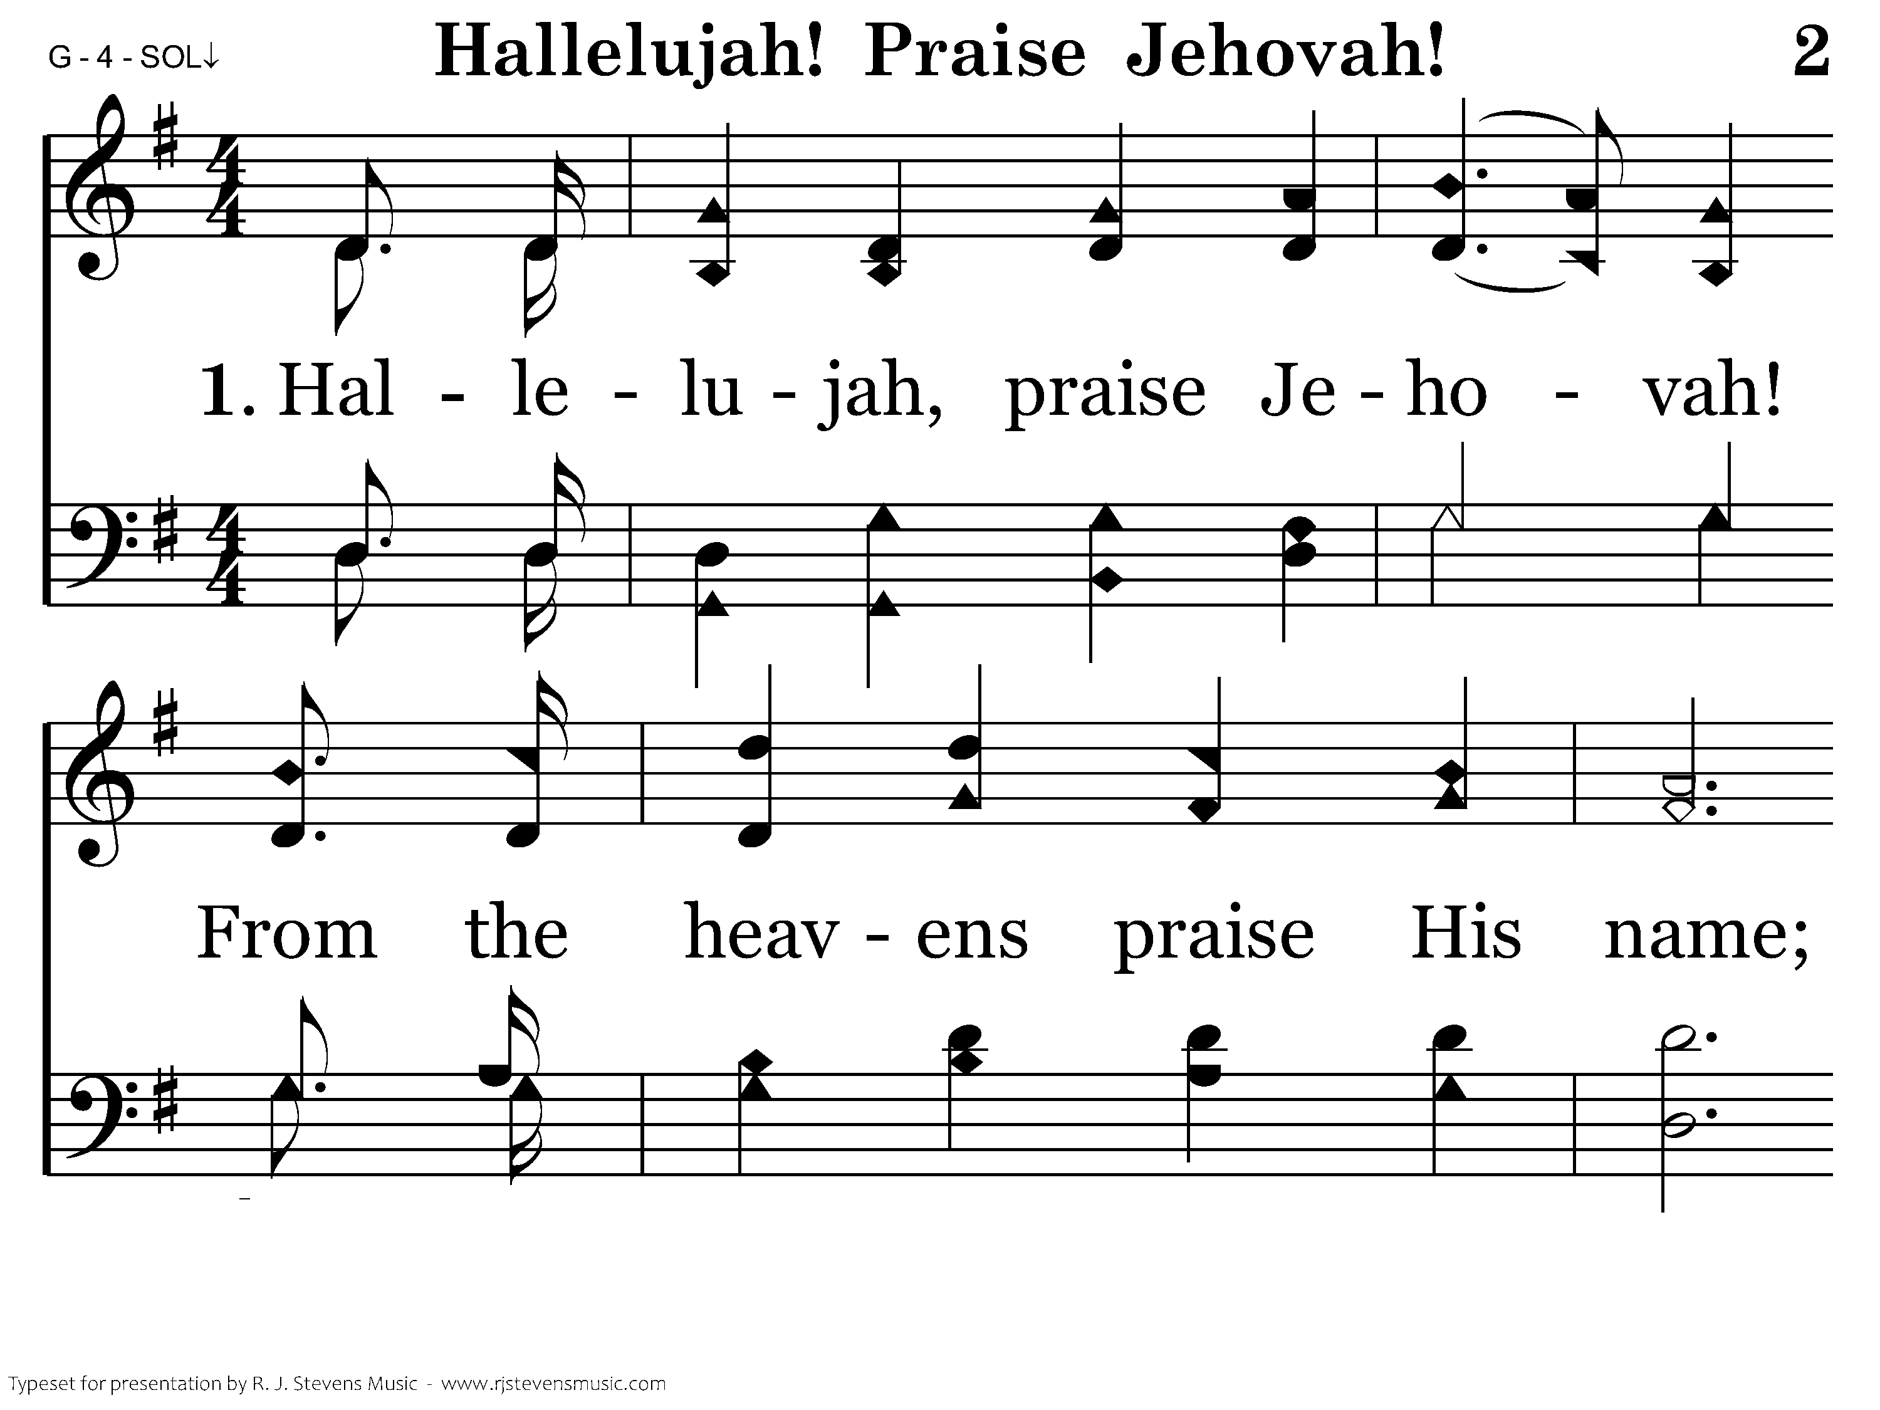
002 - Hallelujah! Praise Jehovah - 1.1

Slide 34
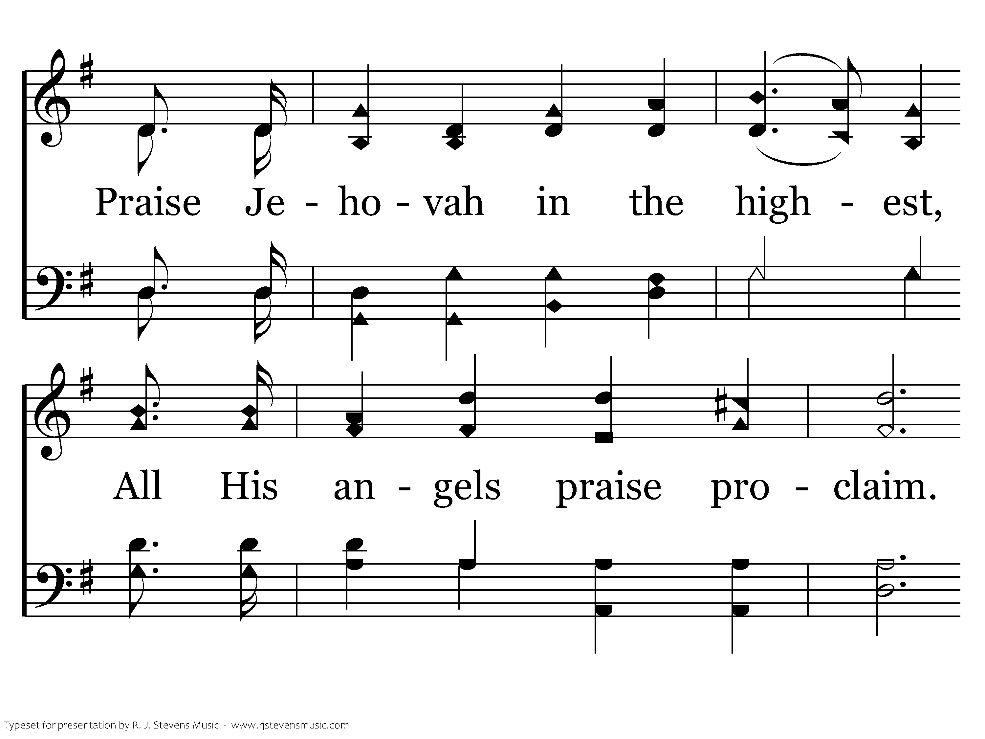
002 - Hallelujah! Praise Jehovah - 1.2

Slide 35
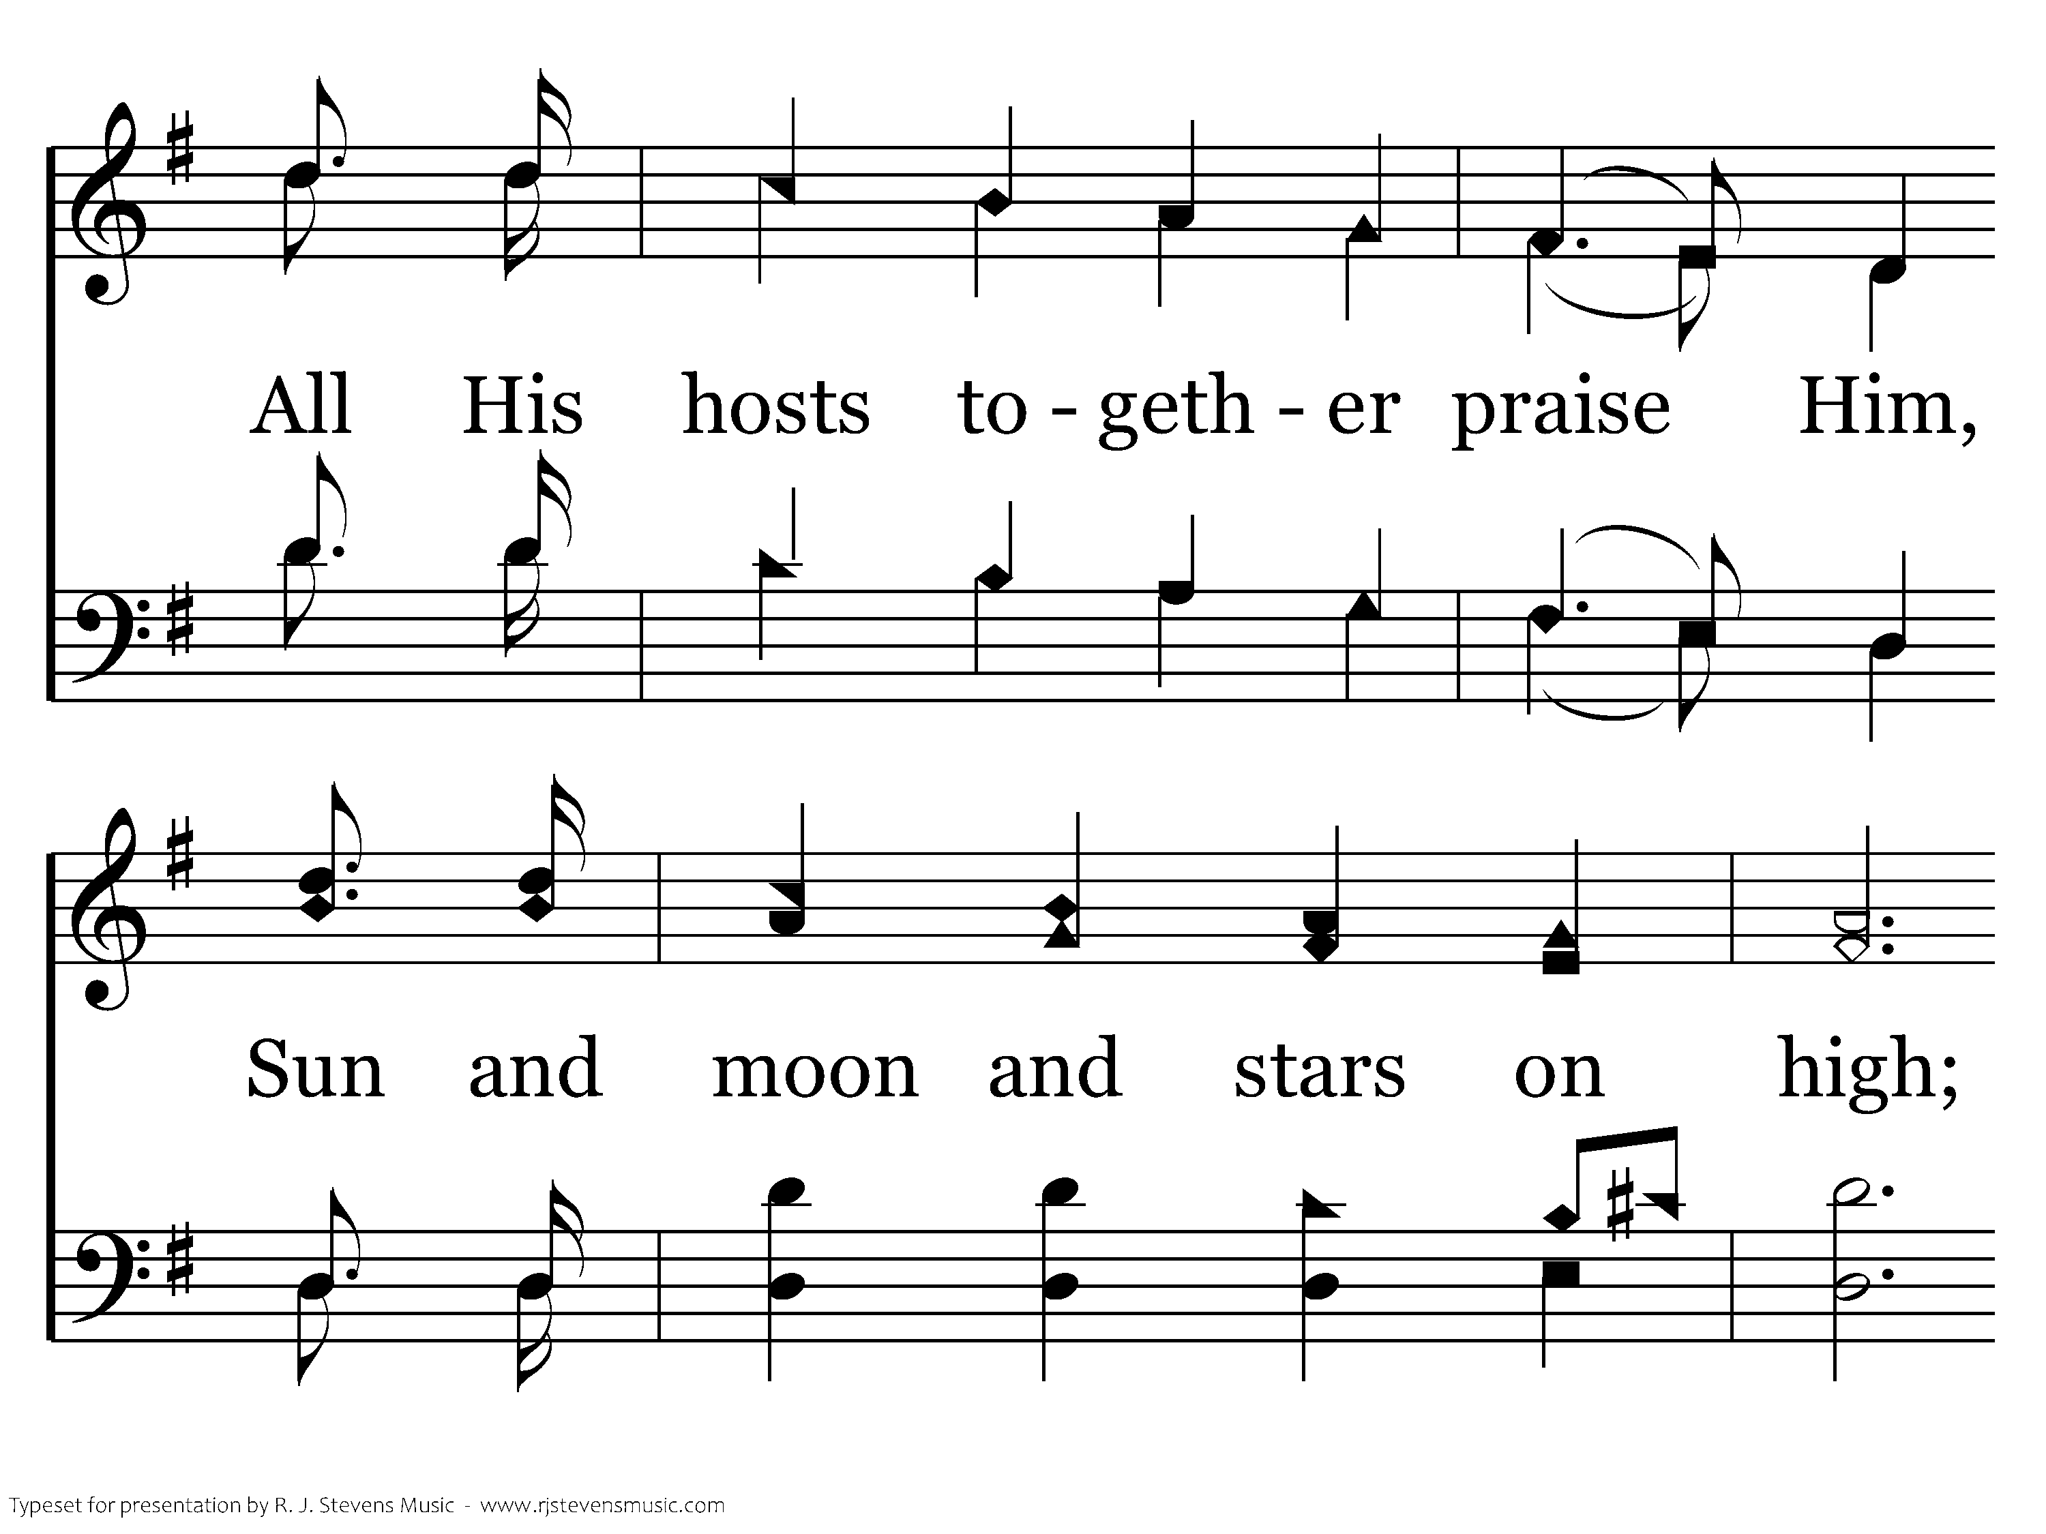
002 - Hallelujah! Praise Jehovah - 1.3

Slide 36
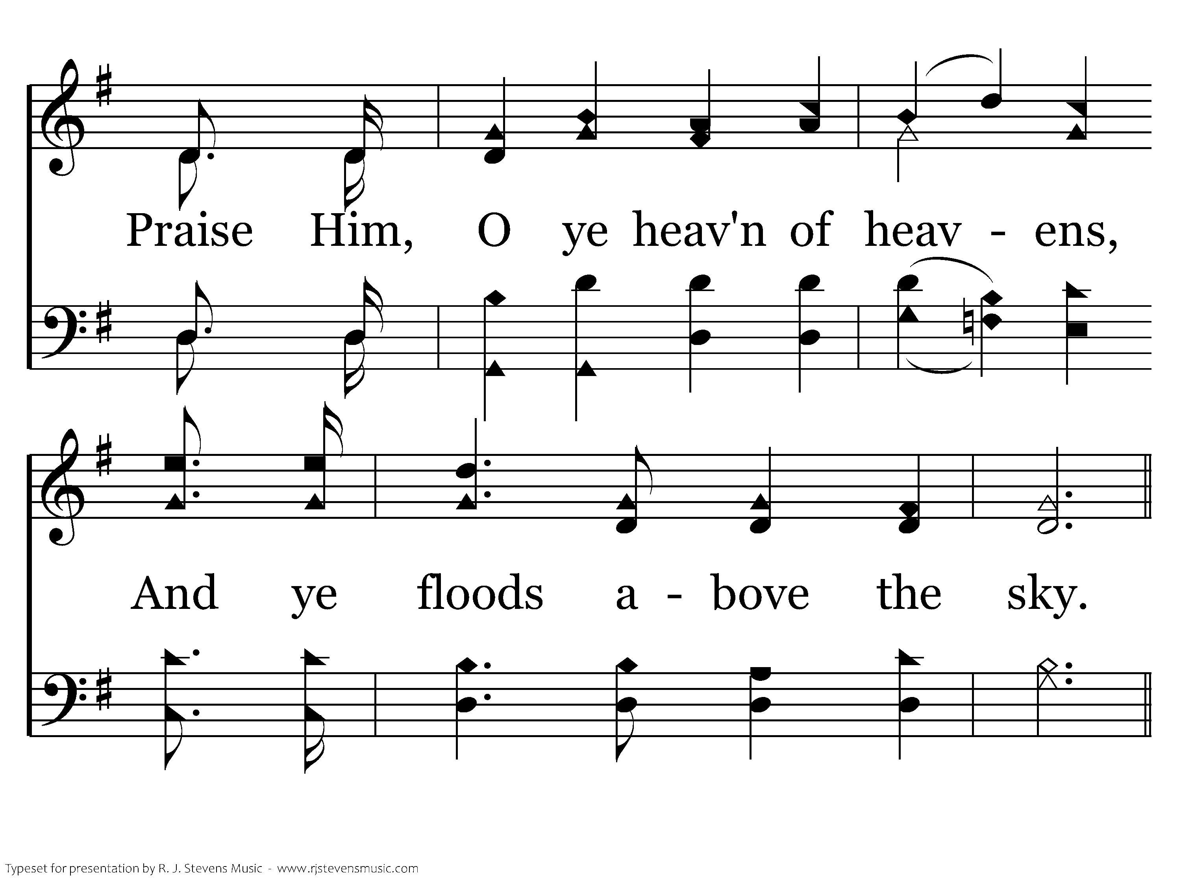
002 - Hallelujah! Praise Jehovah - 1.4

Slide 37
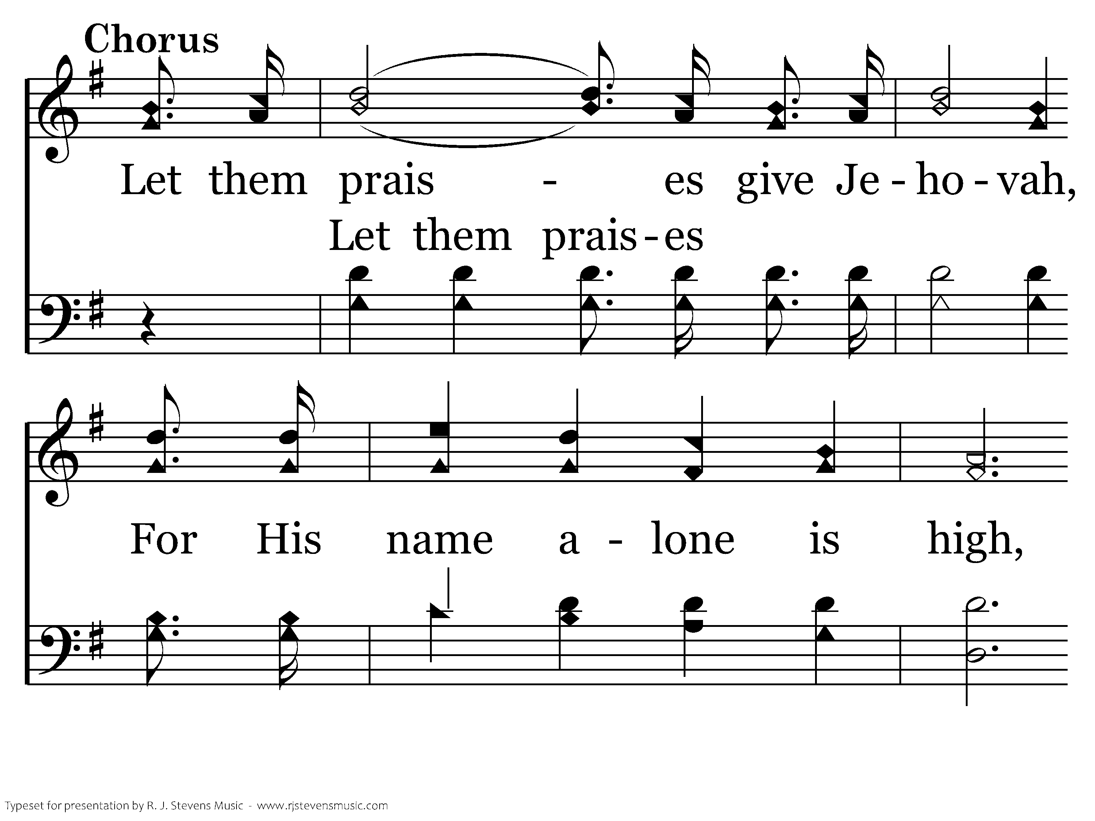
002 - Hallelujah! Praise Jehovah - C.1

Slide 38
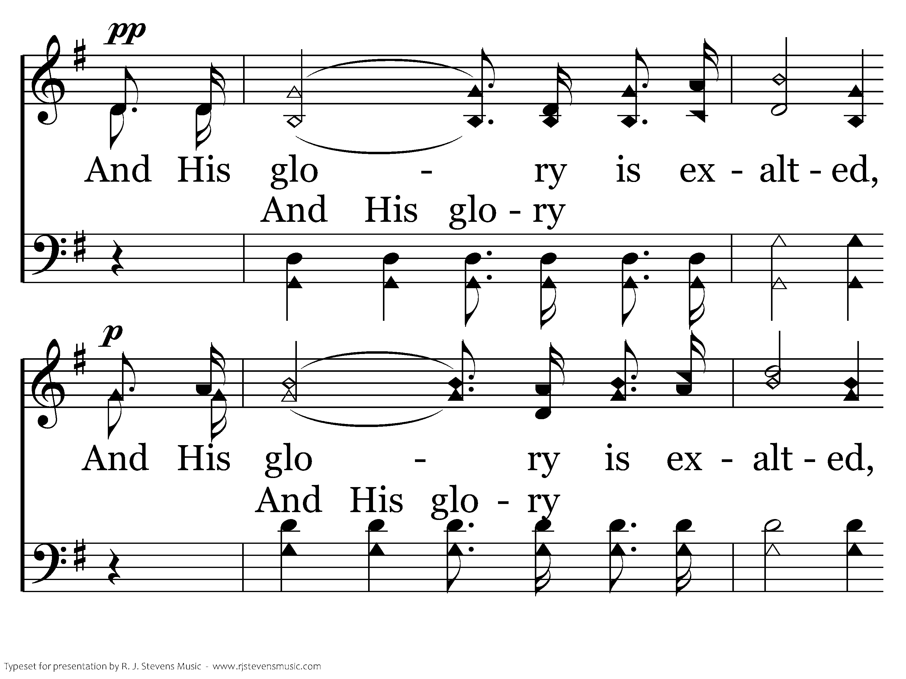
002 - Hallelujah! Praise Jehovah - C.2

Slide 39
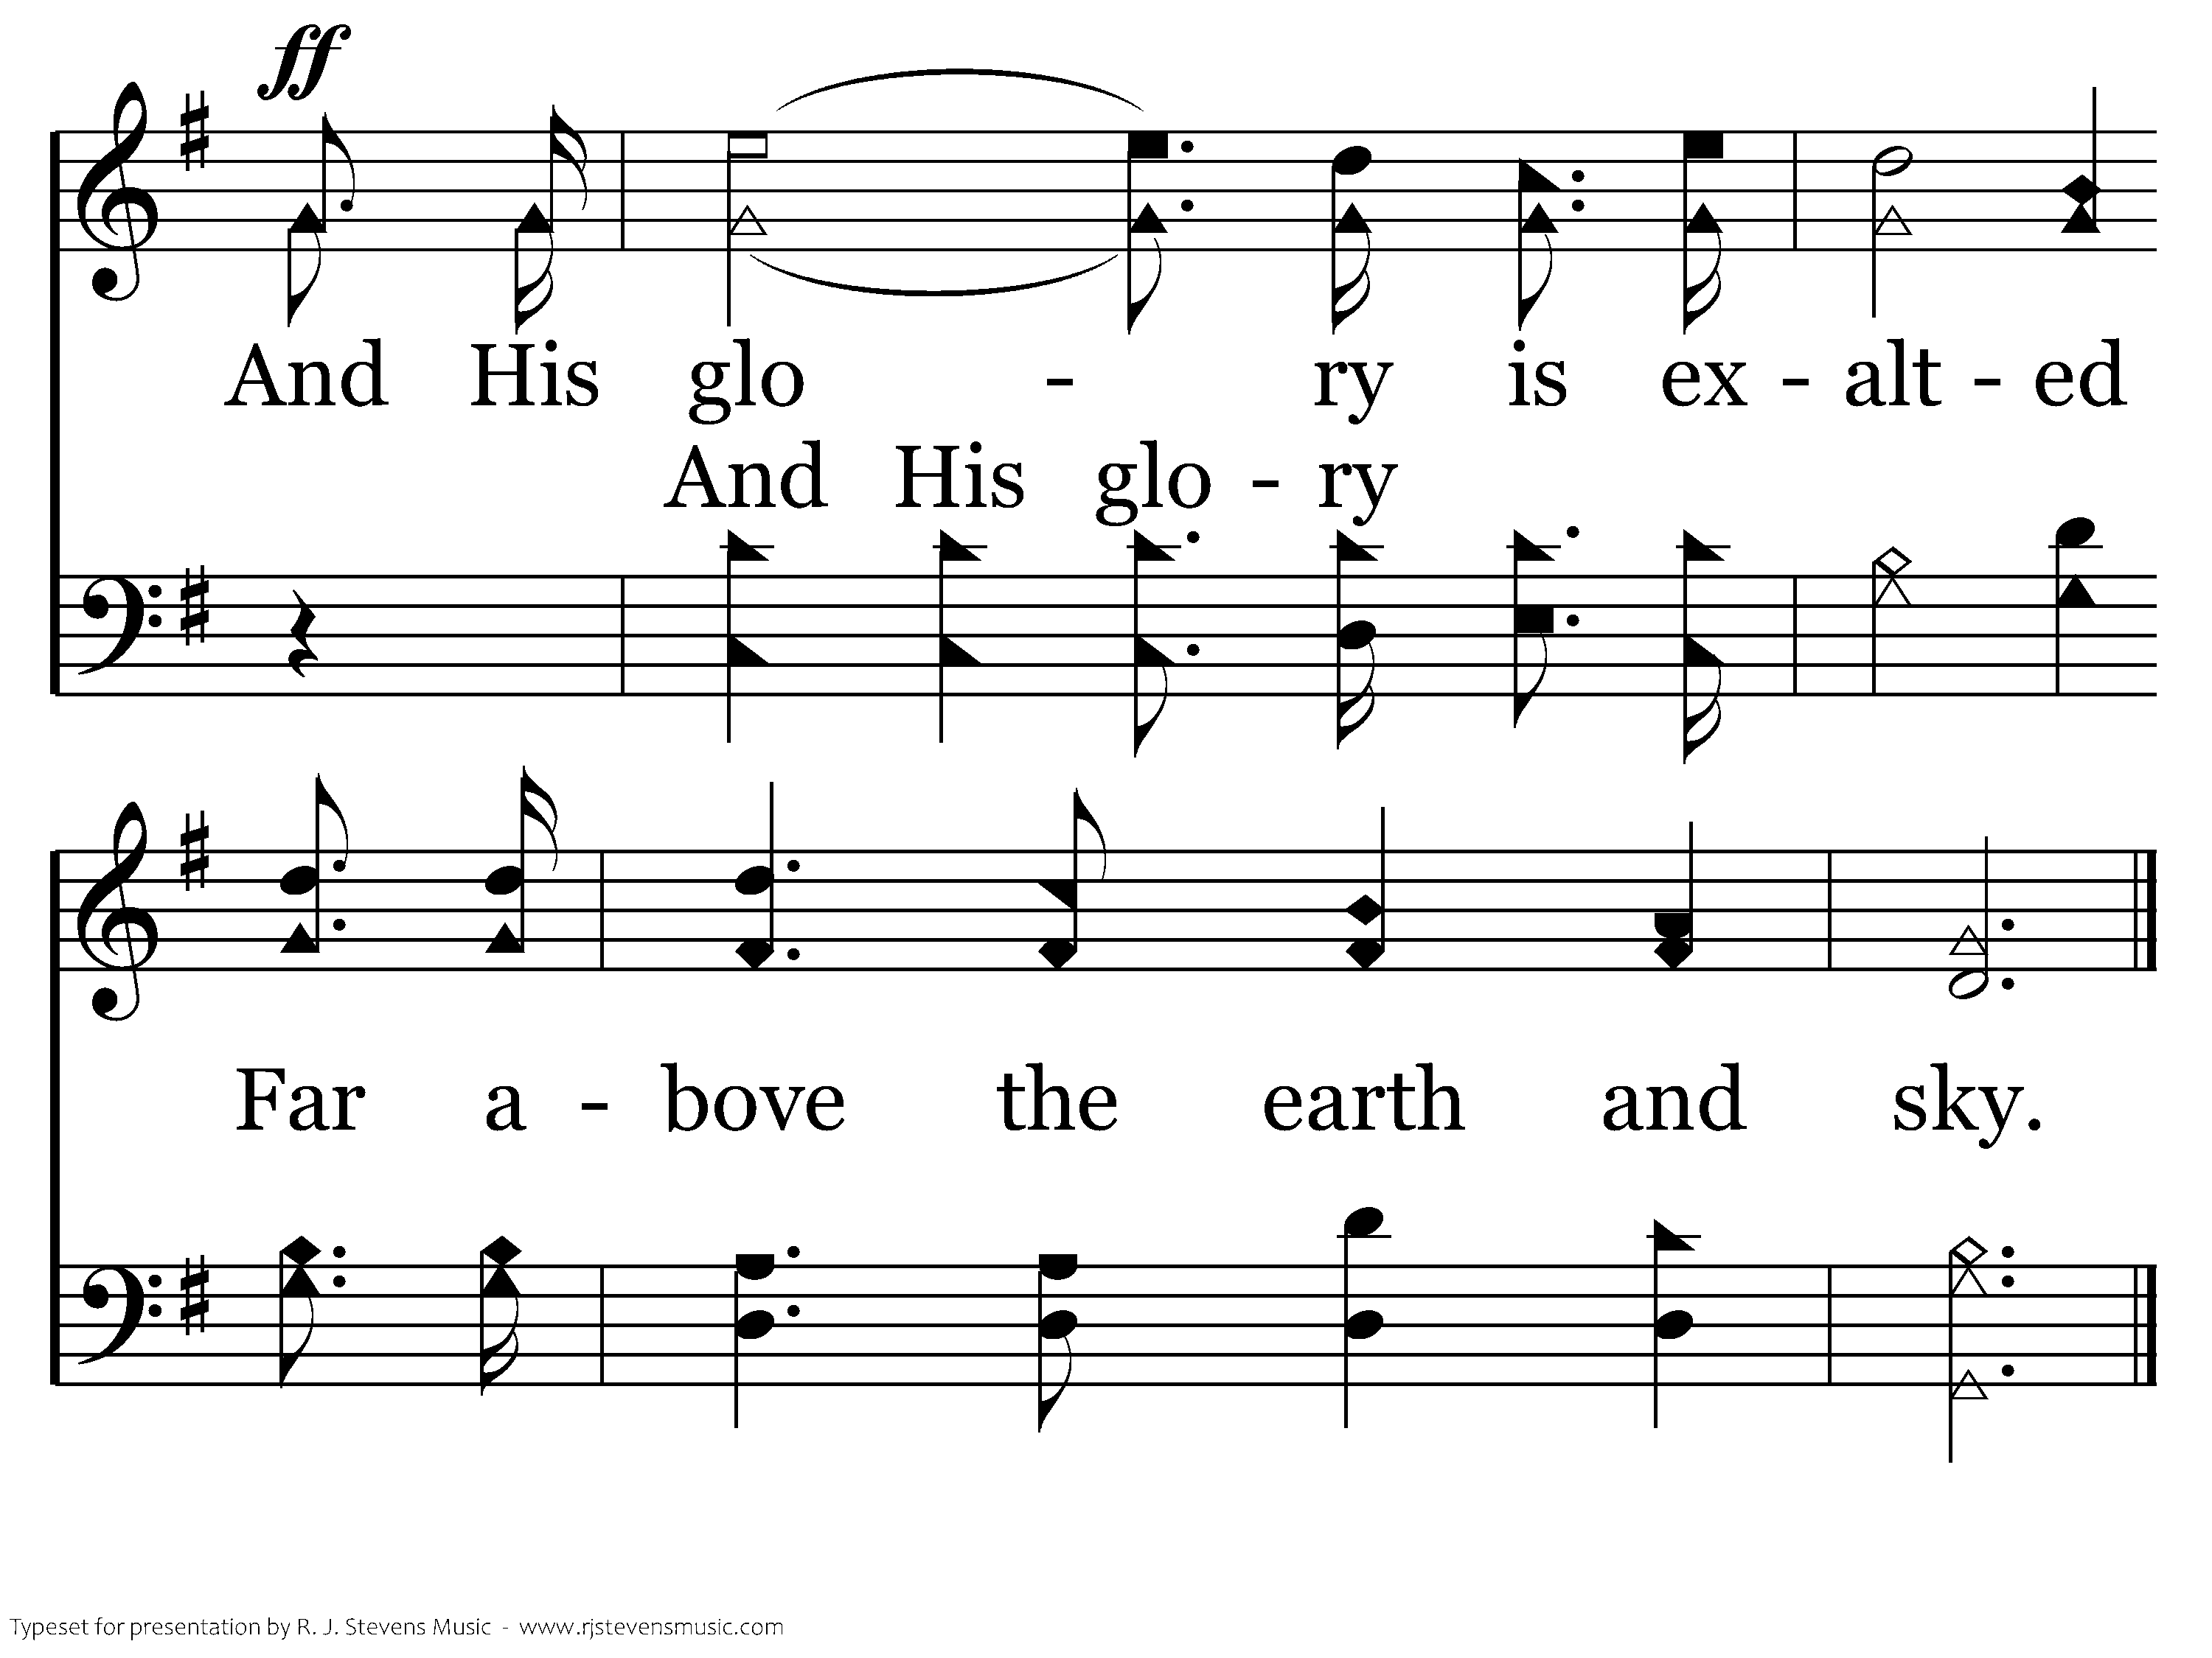
002 - Hallelujah! Praise Jehovah - C.3
End of Verse 1

Slide 40
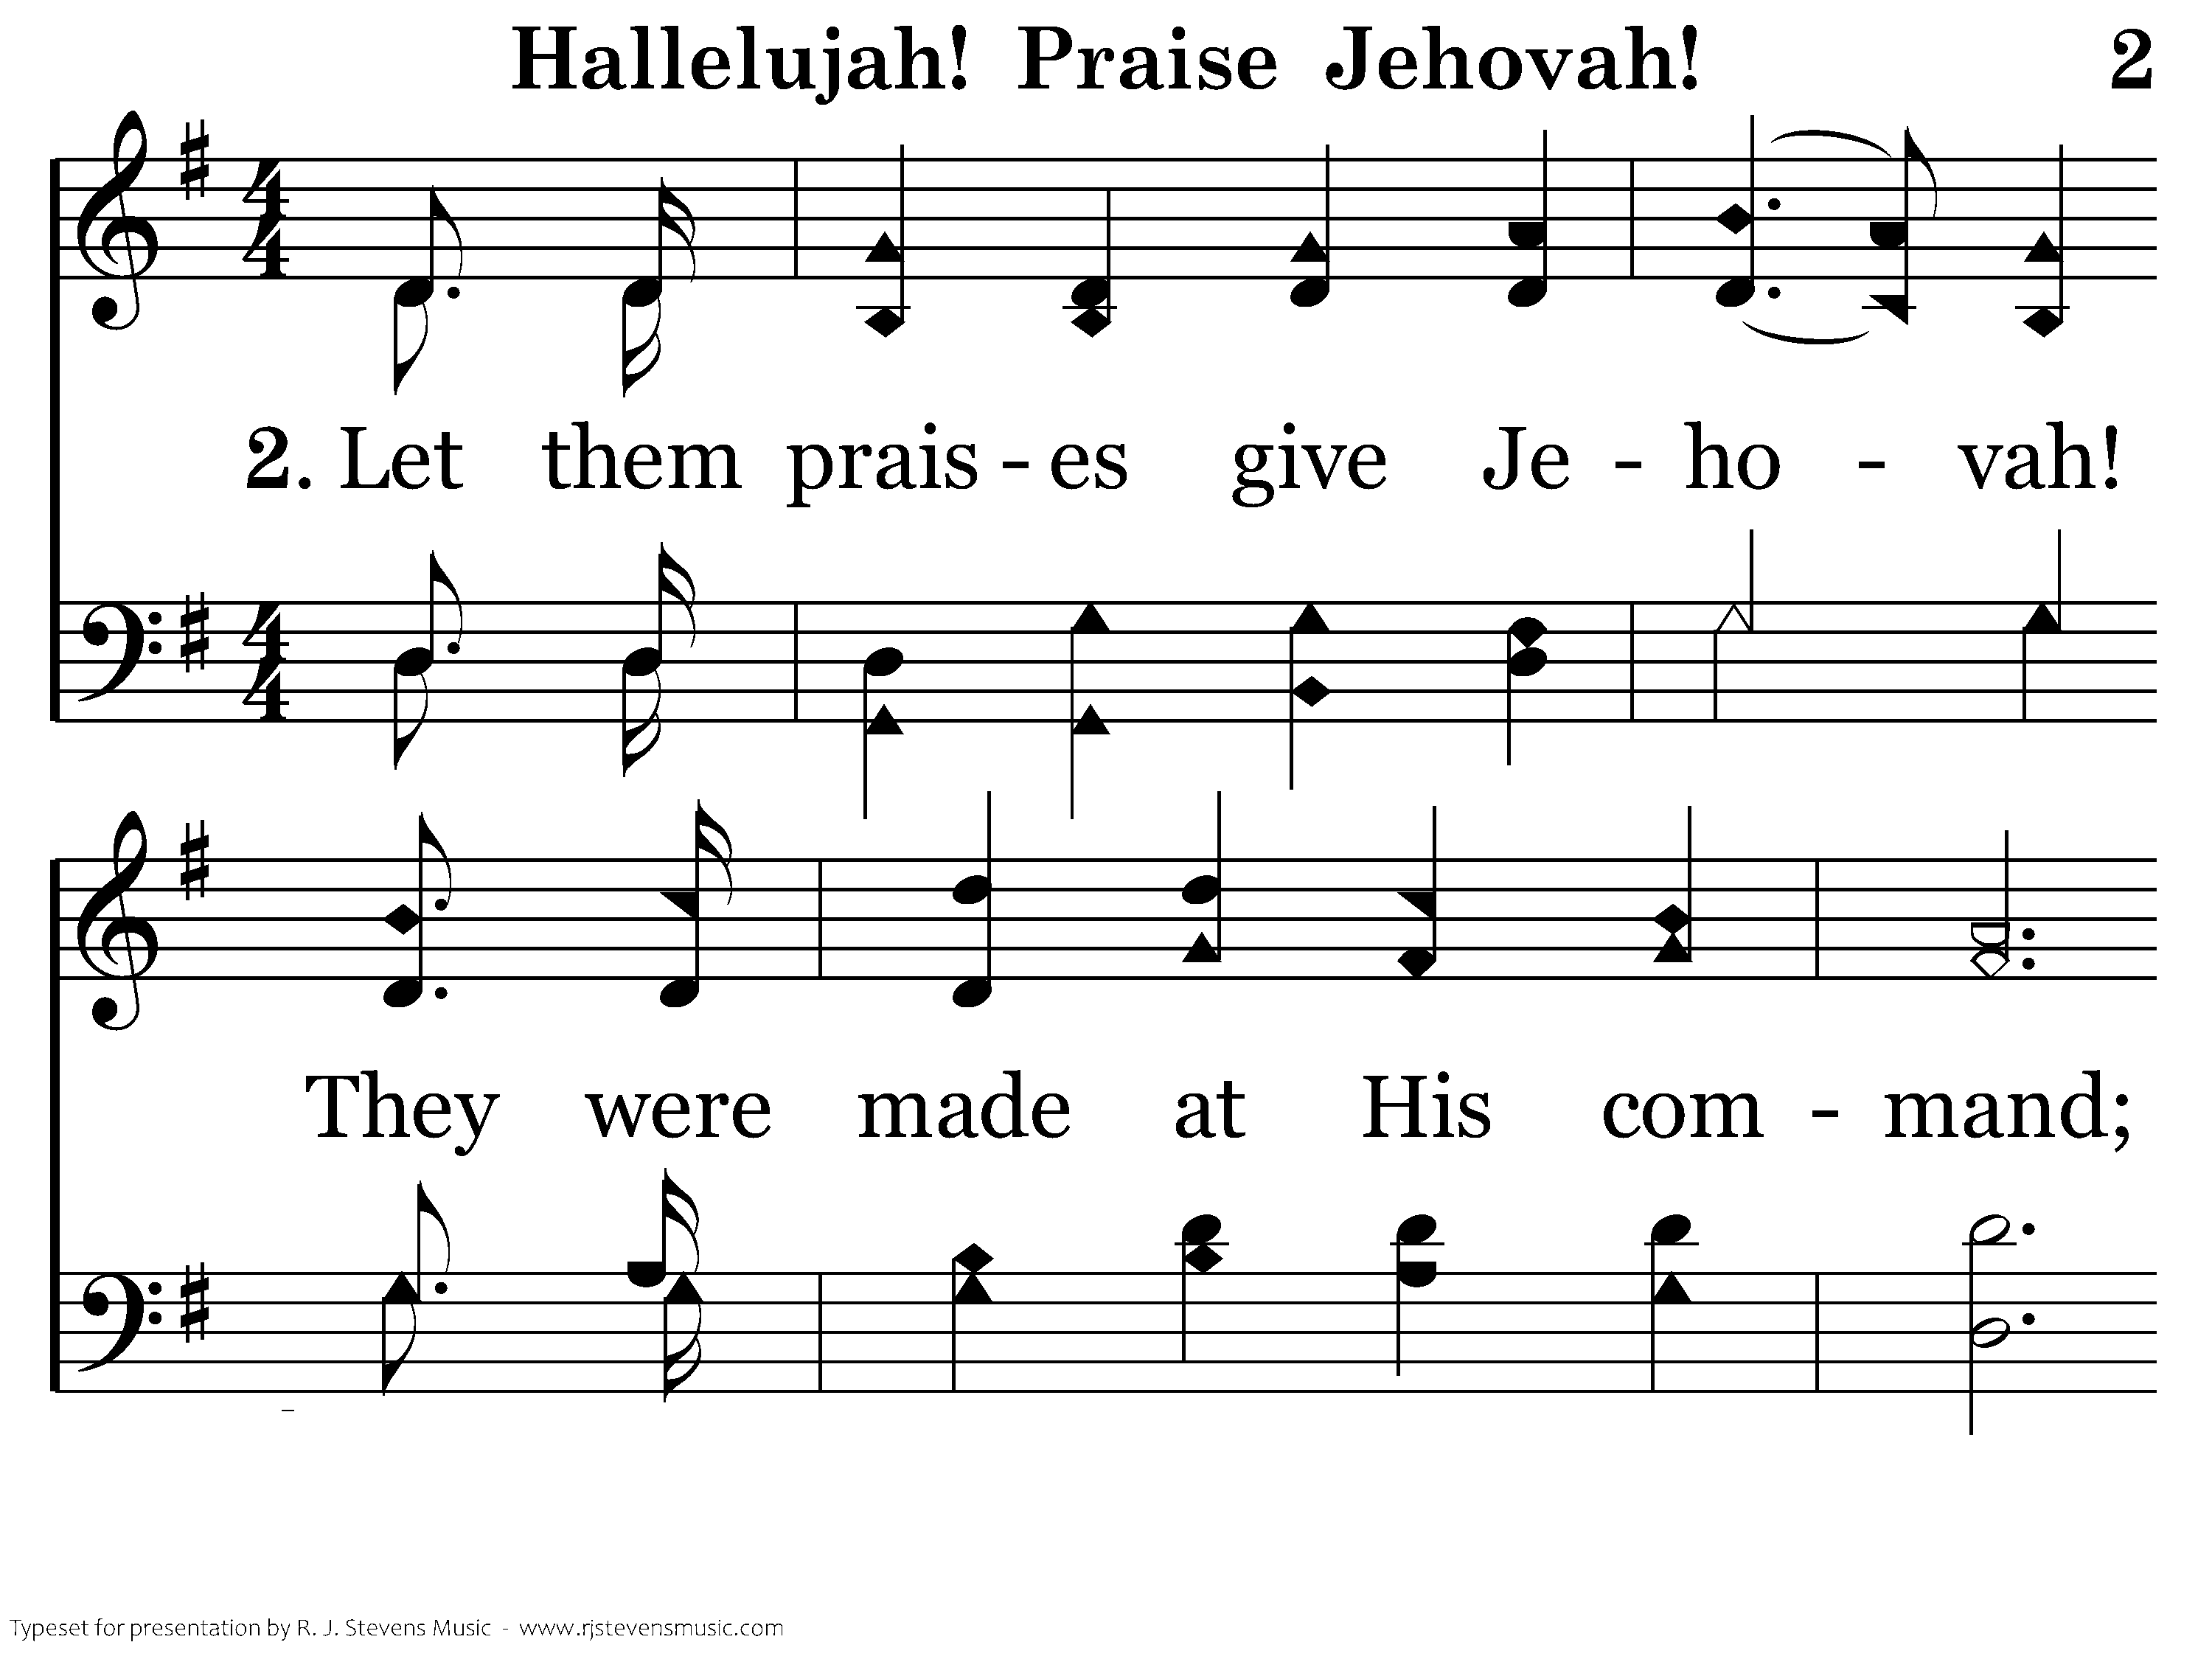
002 - Hallelujah! Praise Jehovah - 2.1

Slide 41
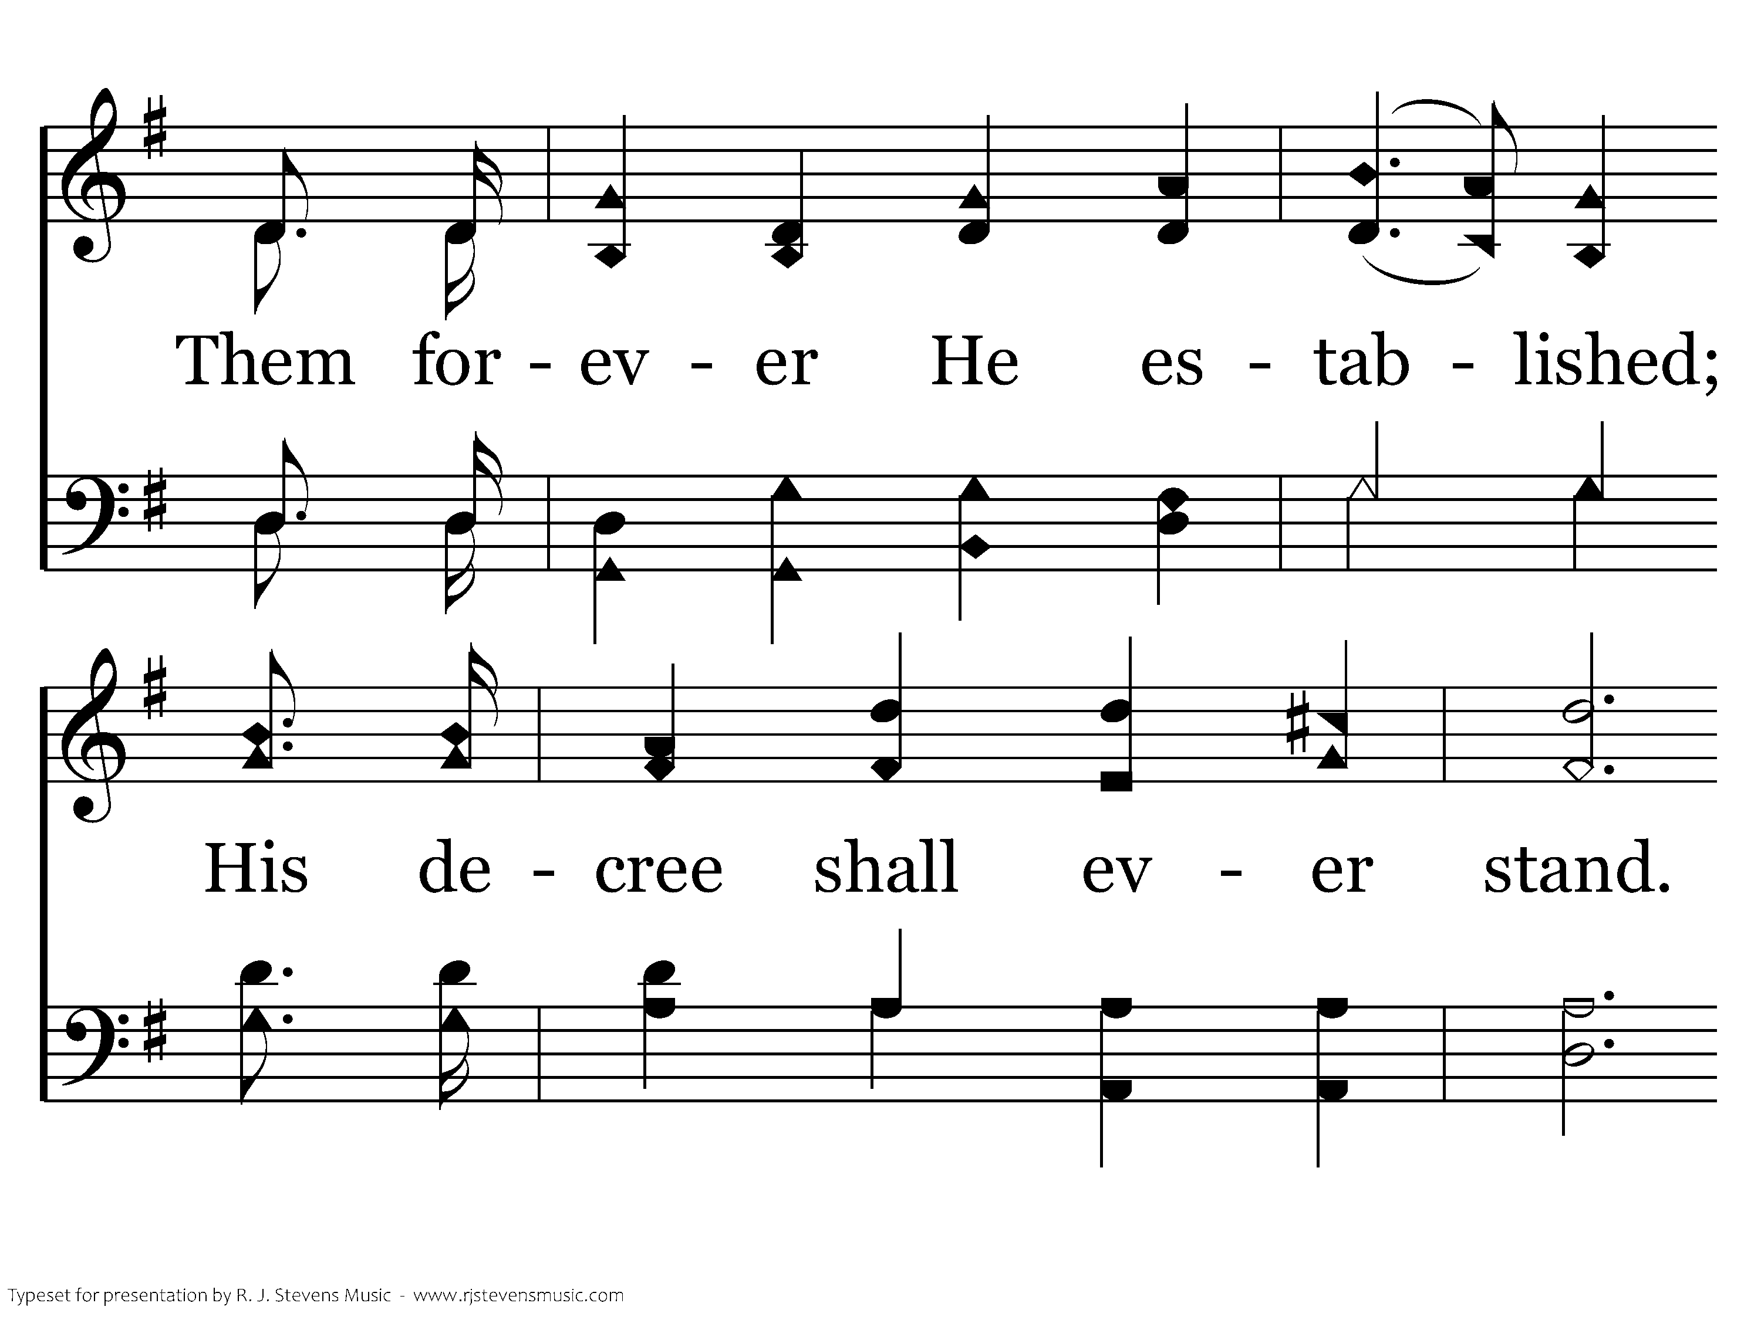
002 - Hallelujah! Praise Jehovah - 2.2

Slide 42
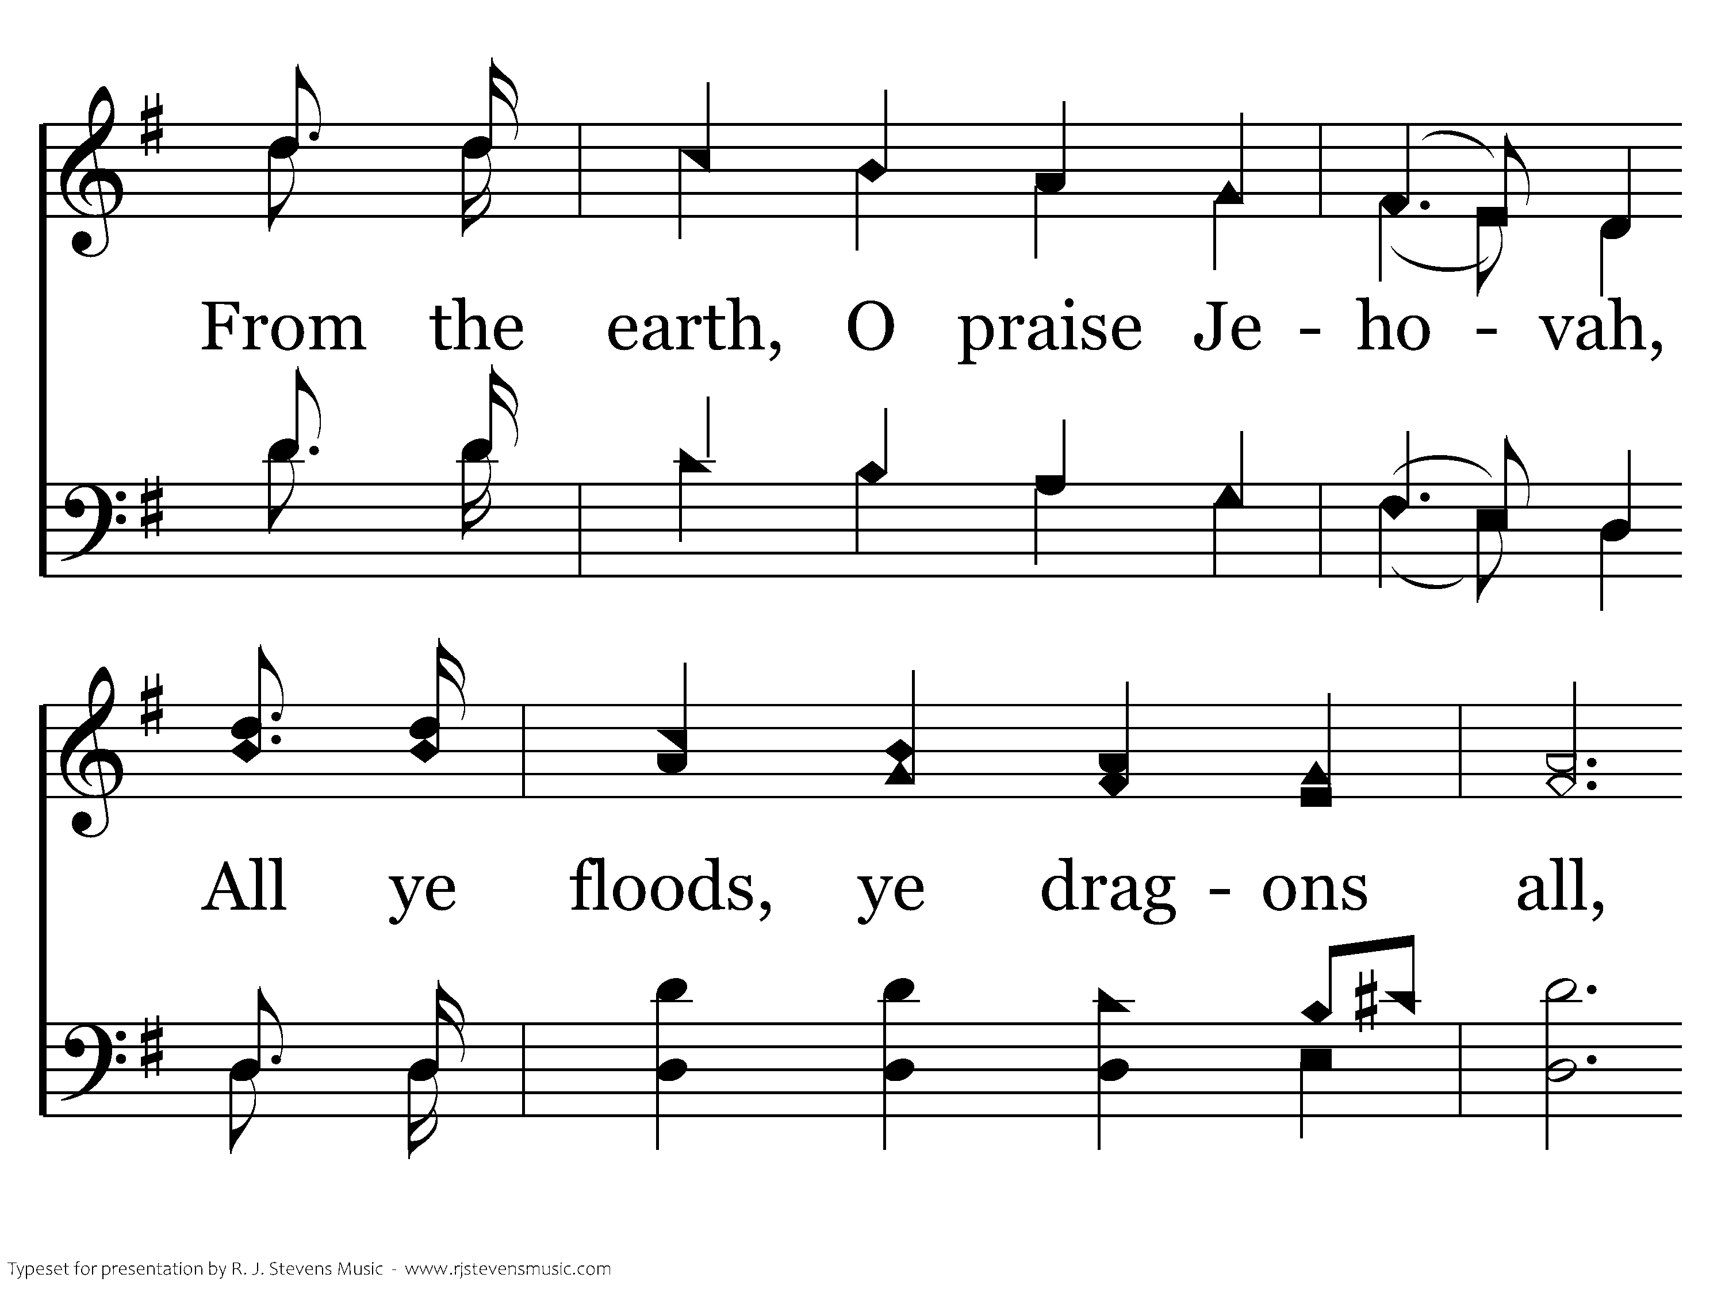
002 - Hallelujah! Praise Jehovah - 2.3

Slide 43
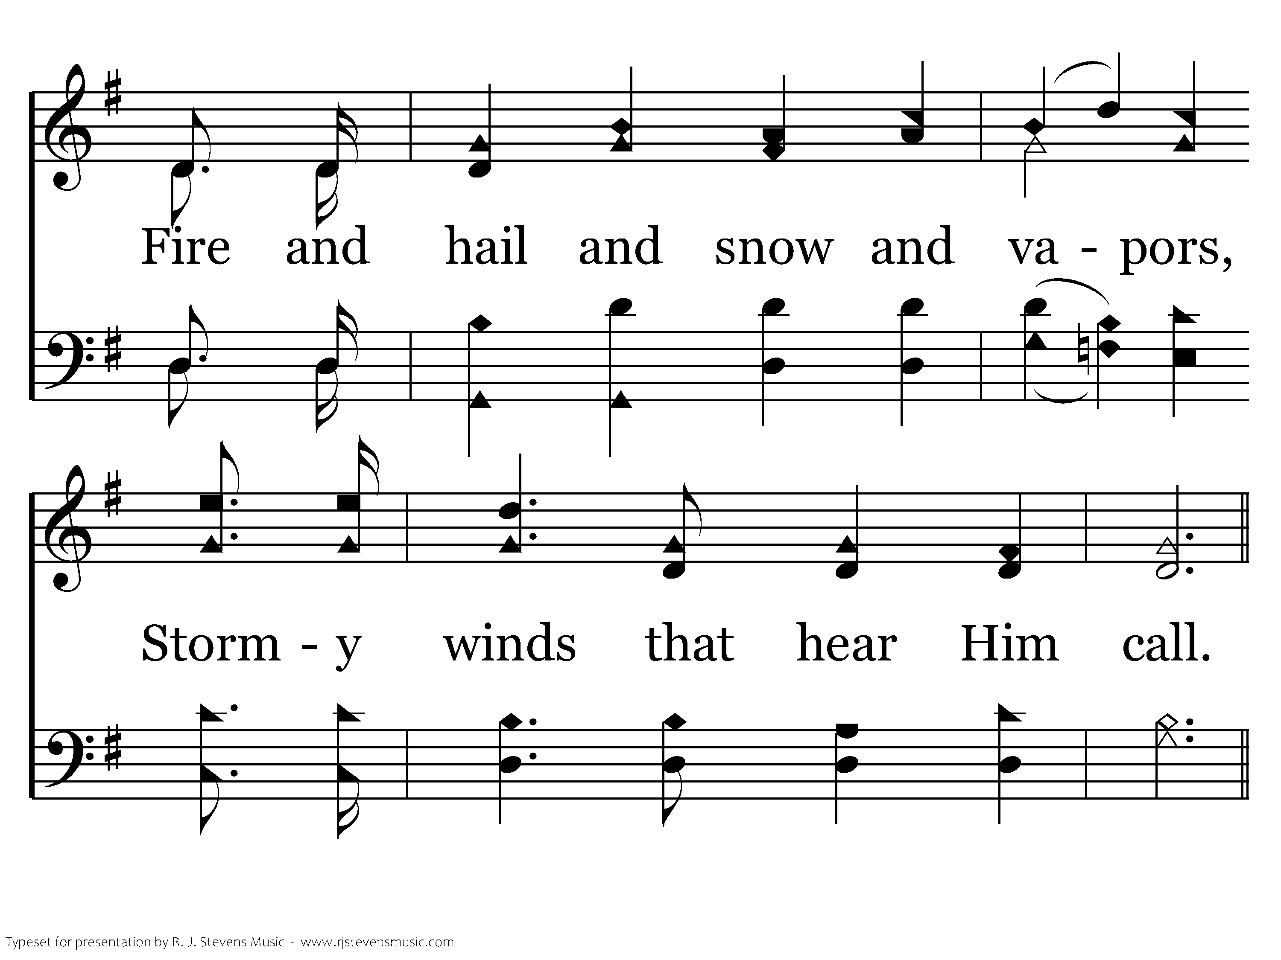
002 - Hallelujah! Praise Jehovah - 2.4

Slide 44
002 - Hallelujah! Praise Jehovah - C.1

Slide 45
002 - Hallelujah! Praise Jehovah - C.2

Slide 46
002 - Hallelujah! Praise Jehovah - C.3
End of Verse 2

Slide 47
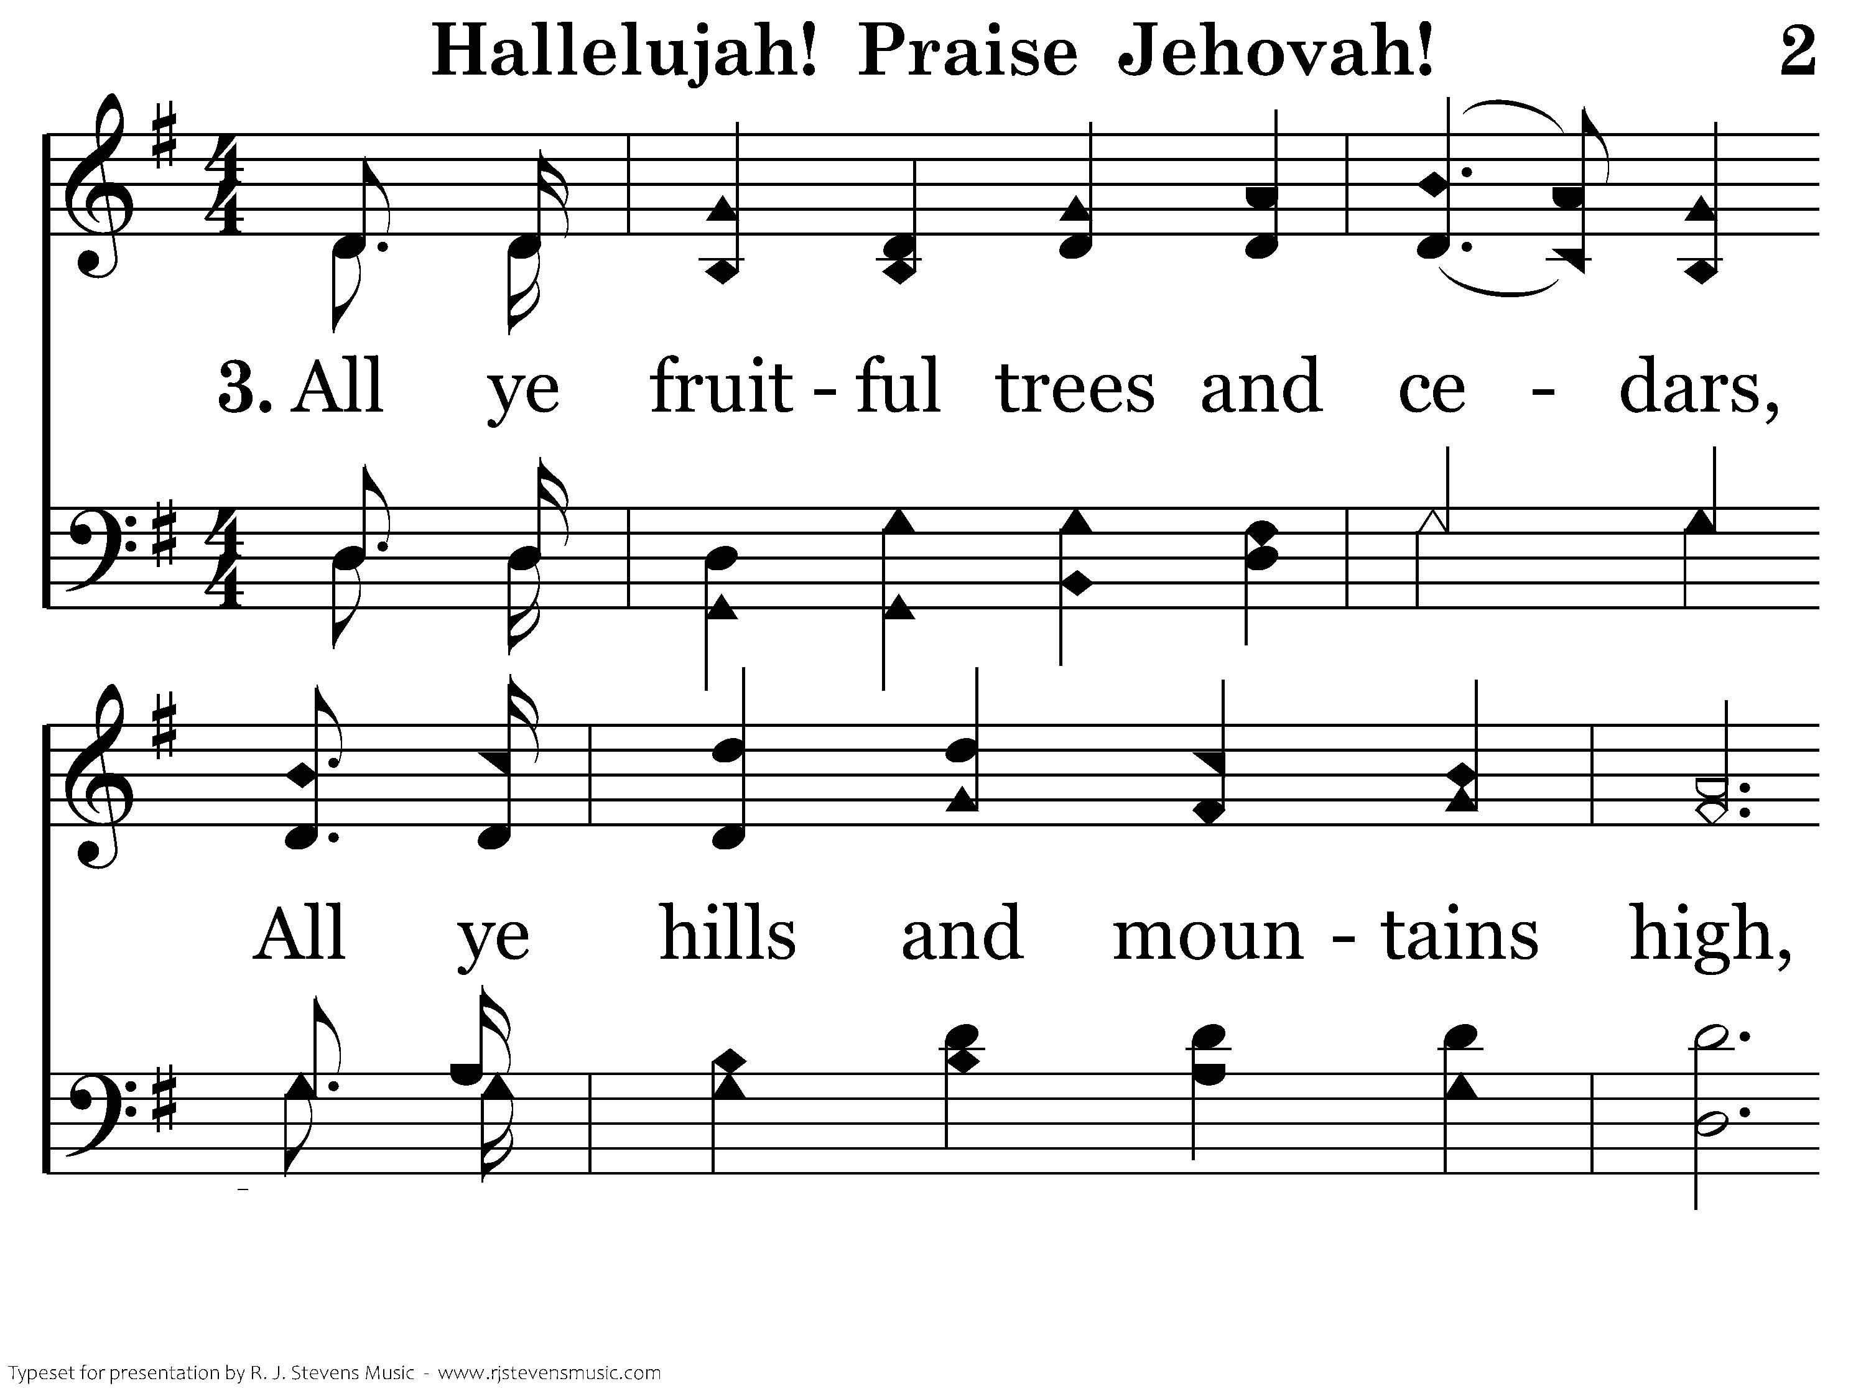
002 - Hallelujah! Praise Jehovah - 3.1

Slide 48
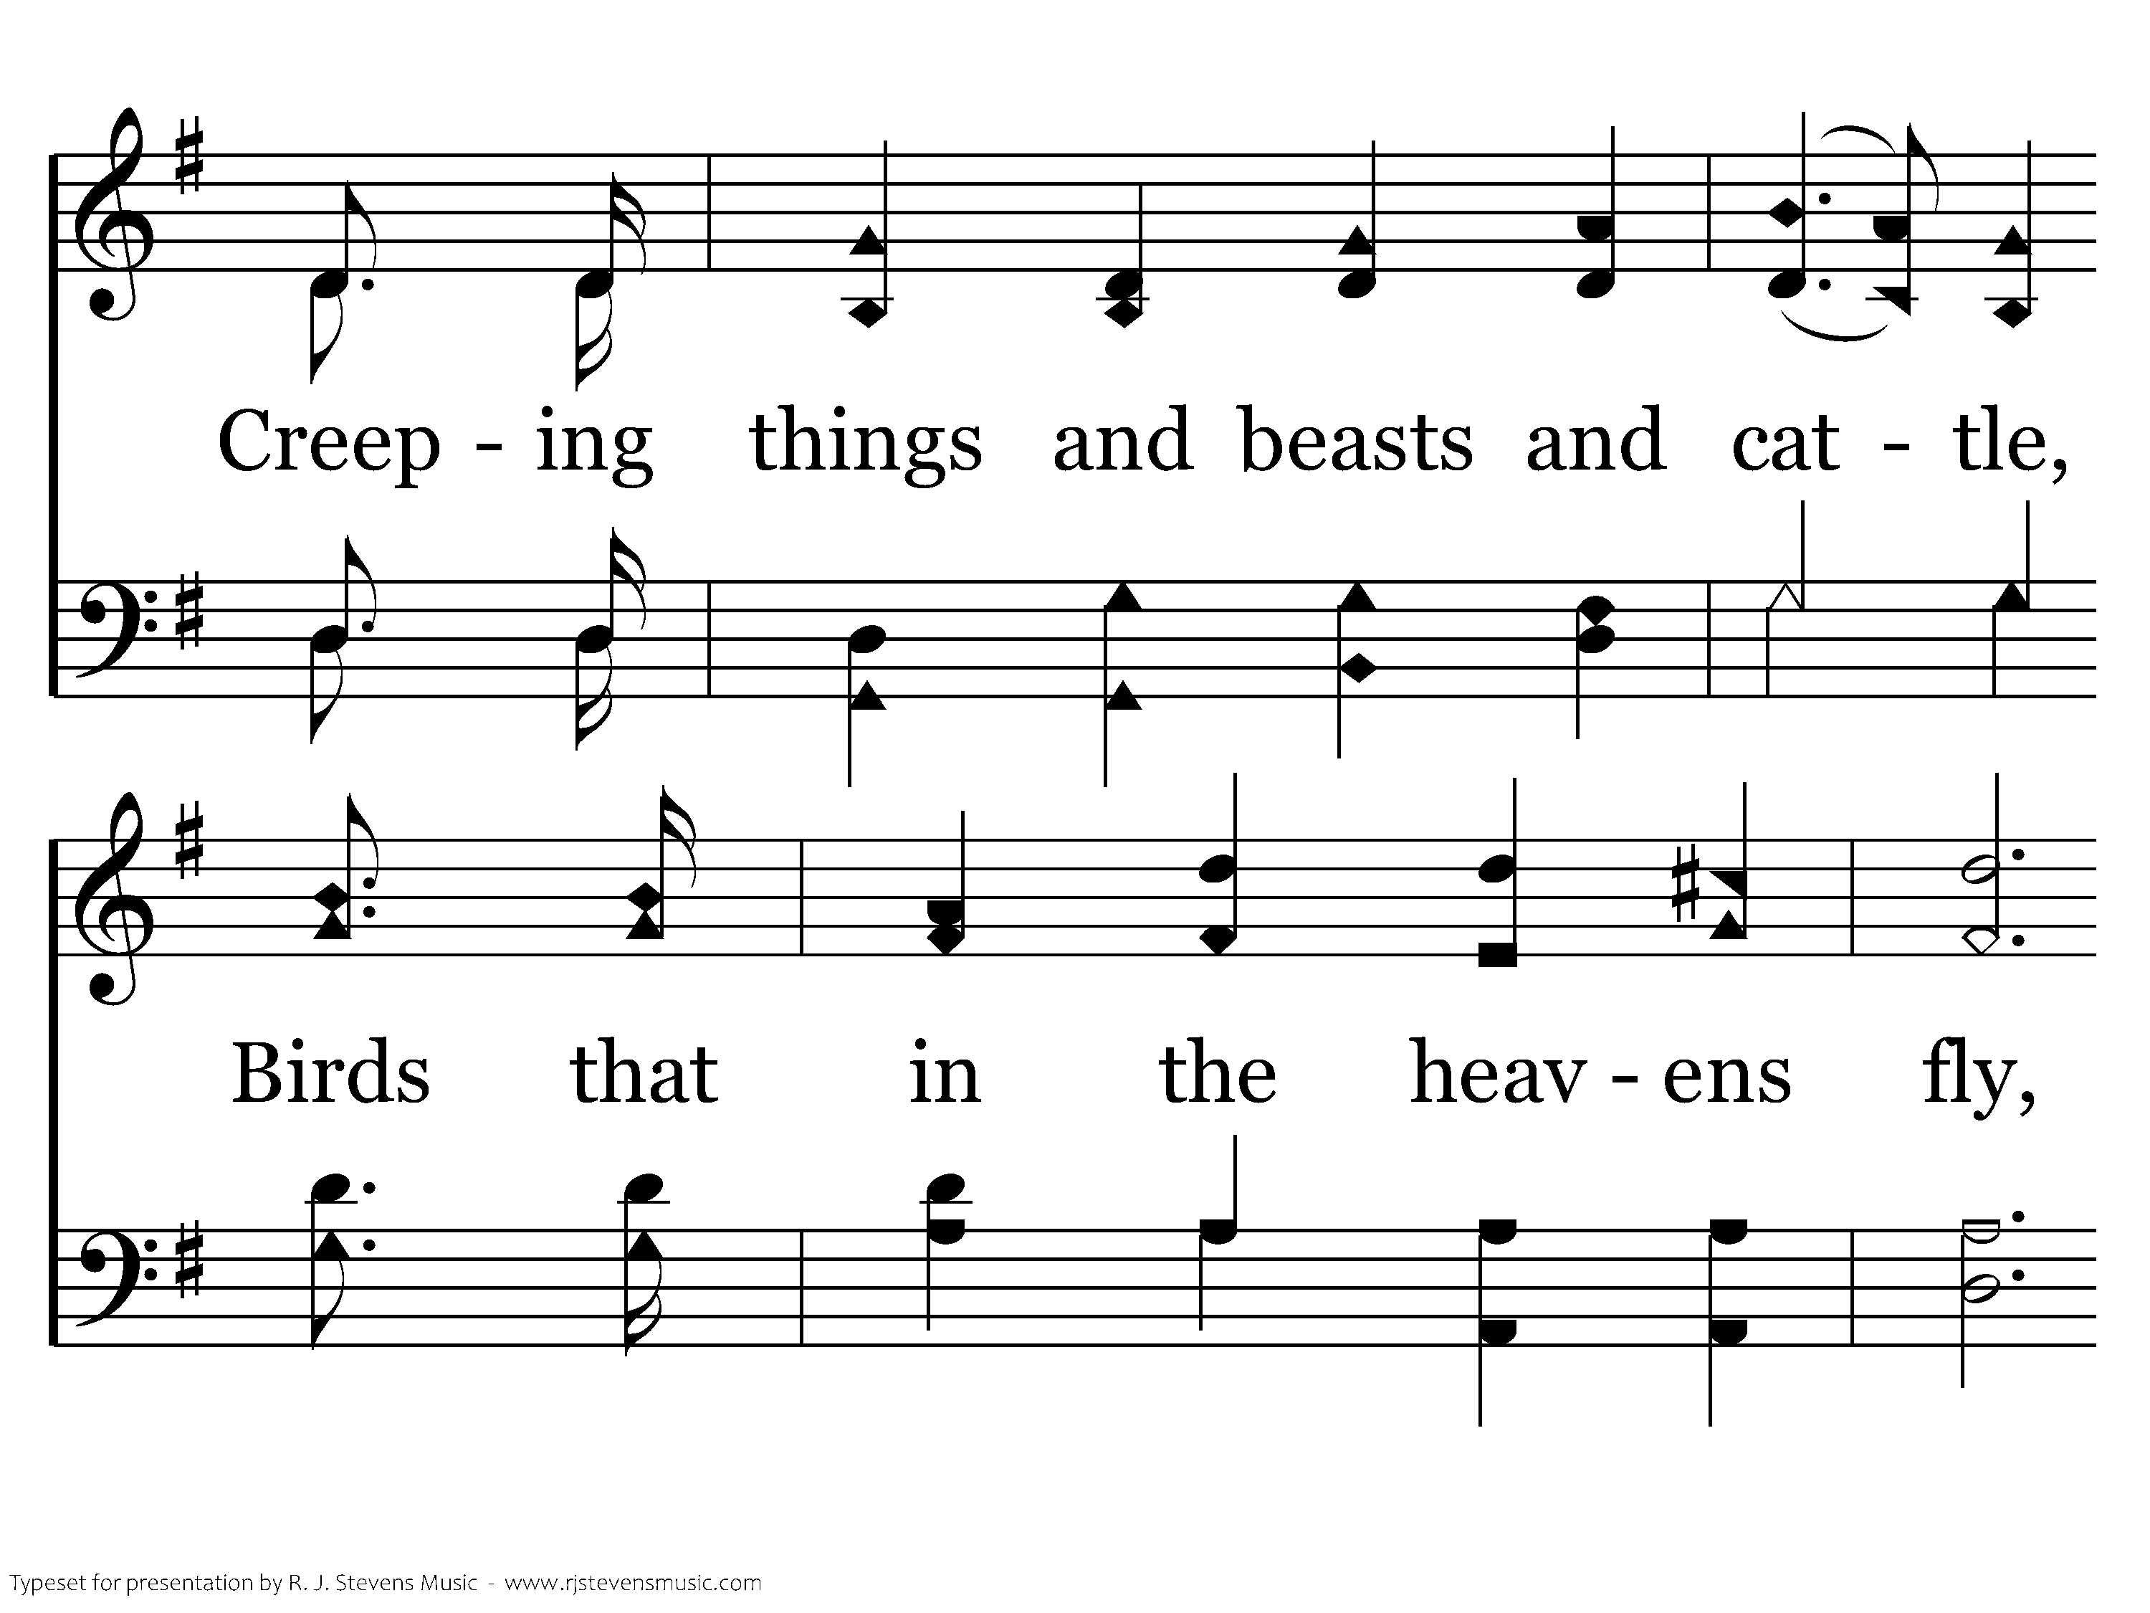
002 - Hallelujah! Praise Jehovah - 3.2

Slide 49
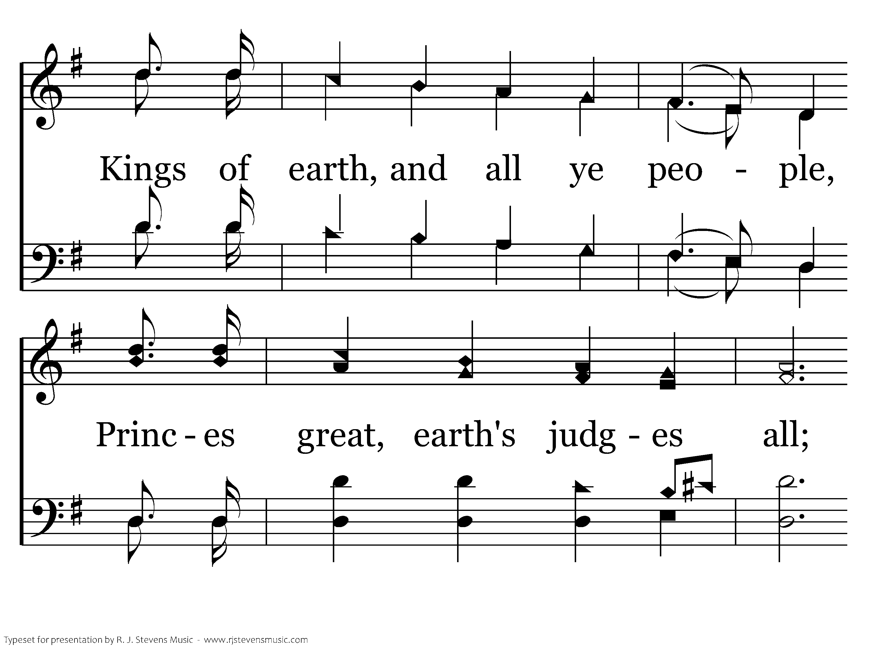
002 - Hallelujah! Praise Jehovah - 3.3

Slide 50
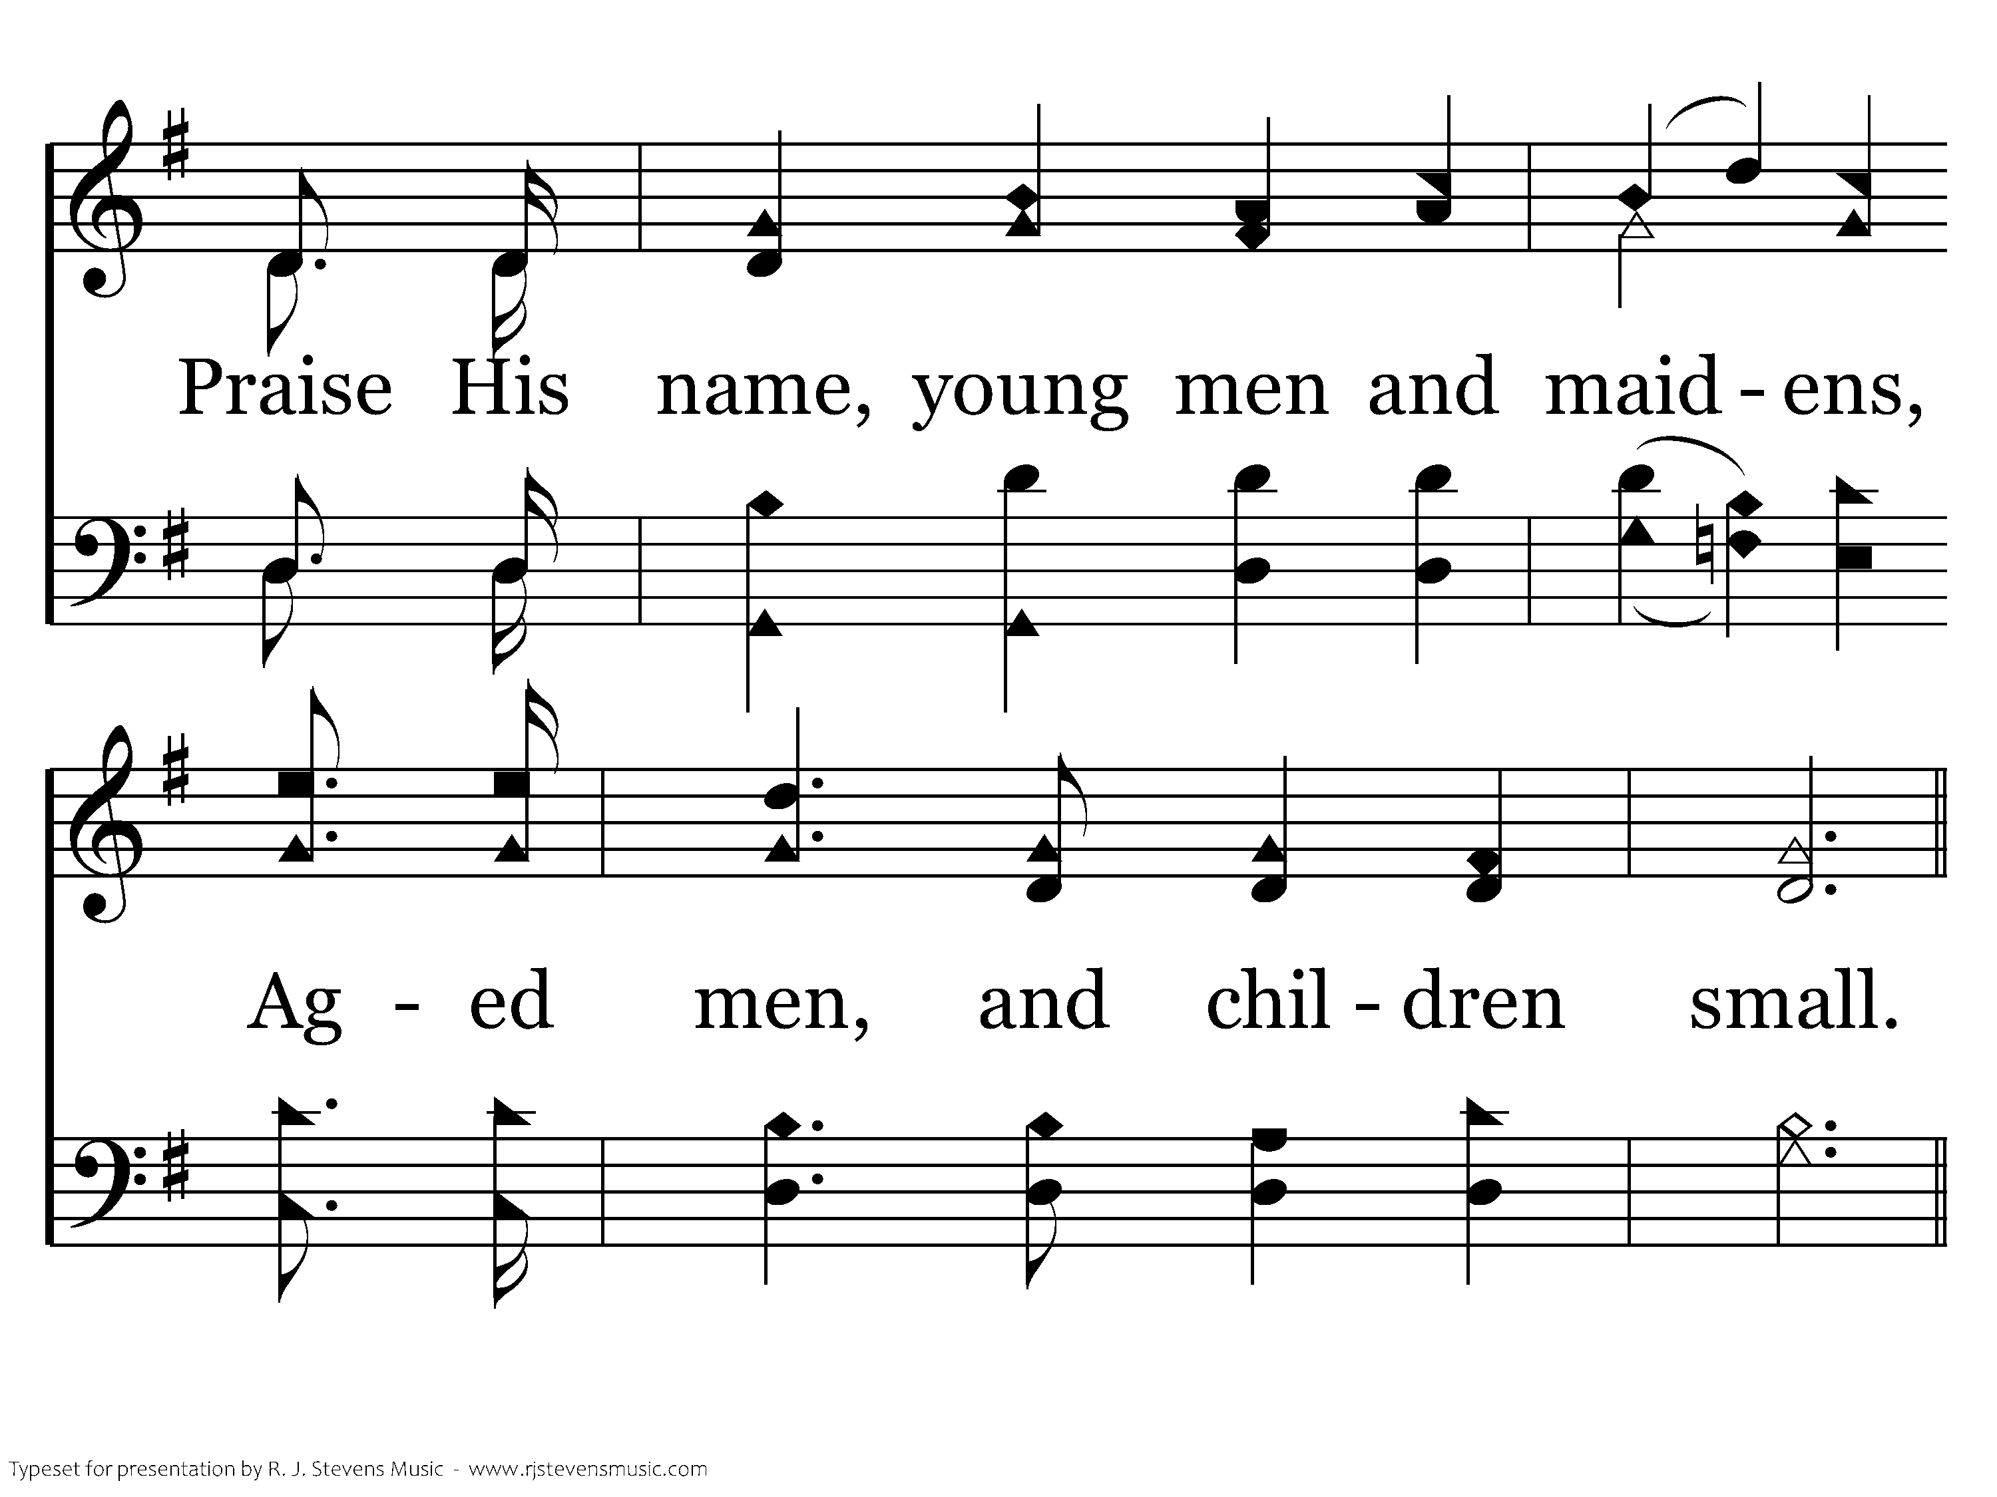
002 - Hallelujah! Praise Jehovah - 3.4

Slide 51
002 - Hallelujah! Praise Jehovah - C.1

Slide 52
002 - Hallelujah! Praise Jehovah - C.2

Slide 53
002 - Hallelujah! Praise Jehovah - C.3
End of Song

