Slide 3
“Stand fast therefore in the liberty by which Christ has made us free, and do not be entangled again with a yoke of bondage…For in Christ Jesus neither circumcision nor uncircumcision avails anything, but faith working through love.”

Slide 4
“For you, brethren, have been called to liberty; only do not use liberty as an opportunity for the flesh, but through love serve one another. For all the law is fulfilled in one word, even in this: ‘You shall love your neighbor as yourself.’”

Slide 5
Spirit – “led by the Spirit” (v. 18) – objective.
Galatians 3:1-5 – fellowship w/ Spirit
Ephesians 5:17-18; 6:17; Colossians 3:16 – through word.
Flesh – “the things that you wish” (v. 17) – subjective.
Ephesians 2:3; Romans 8:3 – left to self, carrying out own desires, leads to sin.

Slide 6
“WORKS of the flesh” (v. 19) – cf. Galatians 2:16; 3:12; Romans 4:4 – these are products of our own making.
“FRUIT of the Spirit” (v. 22) – cf. James 1:18, 21 – a product of an outside source planted within us (cf. Galatians 2:20).

Slide 7
“For the flesh lusts against the Spirit, and the Spirit against the flesh; and these are contrary to one another, so that you do not do the things that you wish…And those who are Christ’s have crucified the flesh with its passions and desires. If we live in the Spirit, let us also walk in the Spirit.” (vv. 17, 24-25)

Slide 8
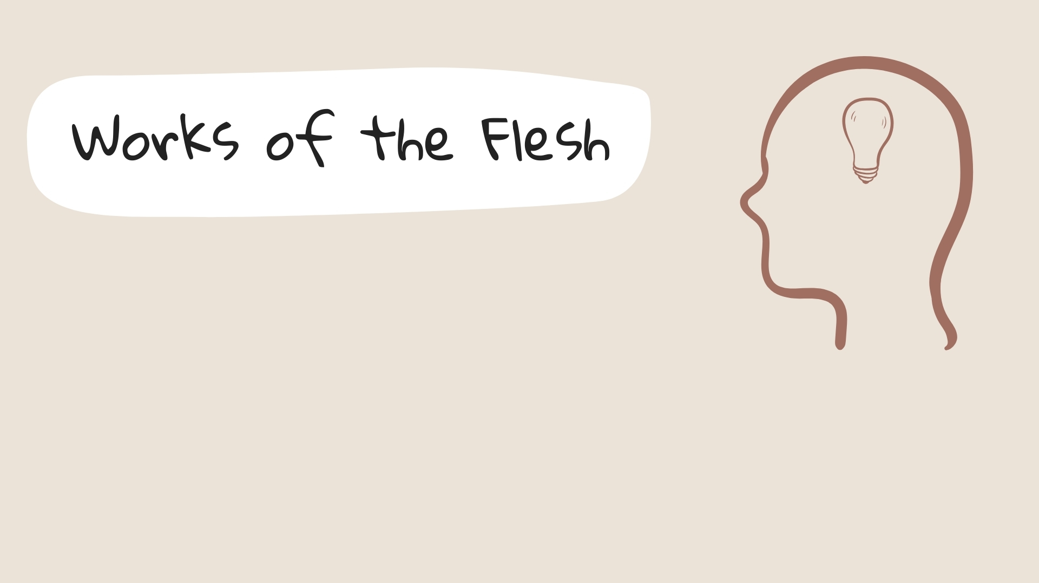
“the works of the flesh are evident”
“and the like”

Slide 9
Sexual – (Adultery), Fornication, Uncleanness, Lewdness
Religious – Idolatry, Sorcery
Relational – Hatred, Contentions, Jealousies, Outbursts of Wrath
Divisive – Selfish Ambitions, Dissensions, Heresies, Envy, (Murders)
Intoxication – Drunkenness, Revelries

Slide 10
“of which I tell you beforehand, just as I also told you in time past, that those who practice such things will not inherit the kingdom of God.”
(v. 21) (cf. 6:7-8)

Slide 11
“the fruit of the Spirit” – singular.
Core – Love, Joy, Peace
Relational effect – Longsuffering, Kindness, Goodness
Relational effect – Faithfulness, Gentleness, Self-control

Slide 12
“Against such there is no law.”
(v. 23) (cf. v. 21; 6:7-8)
“If we live in the Spirit, let us also walk in the Spirit.” (v. 25)

