Slide 2
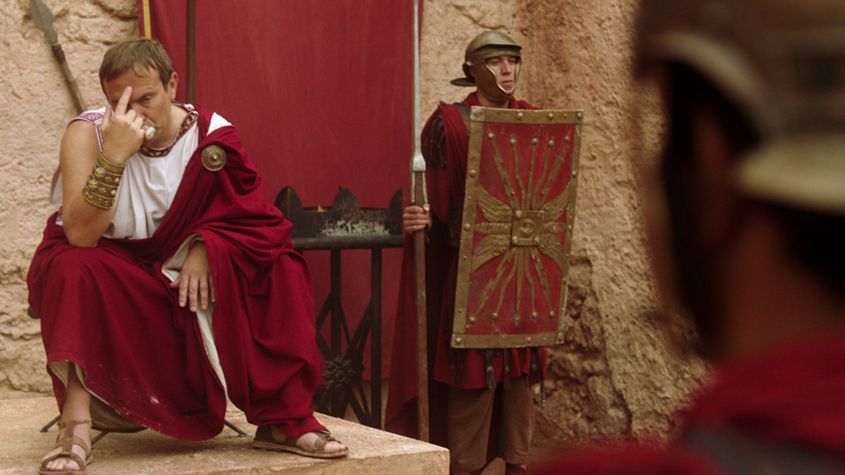

Slide 3
Men Can Give Birth
Women Can Have Prostate Cancer
A Little Boy Can become A Girl
Pedophiles now: minor-attracted persons
The term “Boys & Girls” is Offensive
Being Colorblind is Racist
Equality is now discrimination
Men Should Use Women’s Restrooms
Replace He / She Pronouns With Xe
Many Babies are Misgendered at Birth
Eighty-One Different Genders
God as “Father” is Misogynist

Slide 4
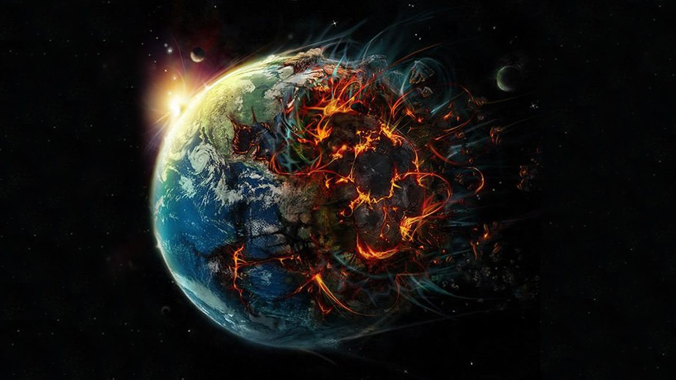

Slide 5
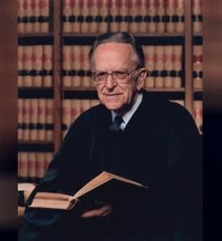
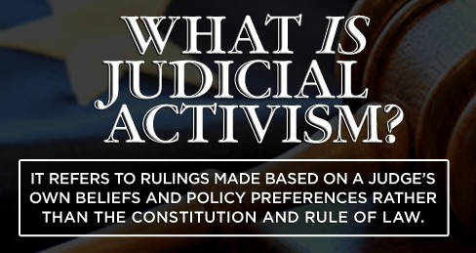
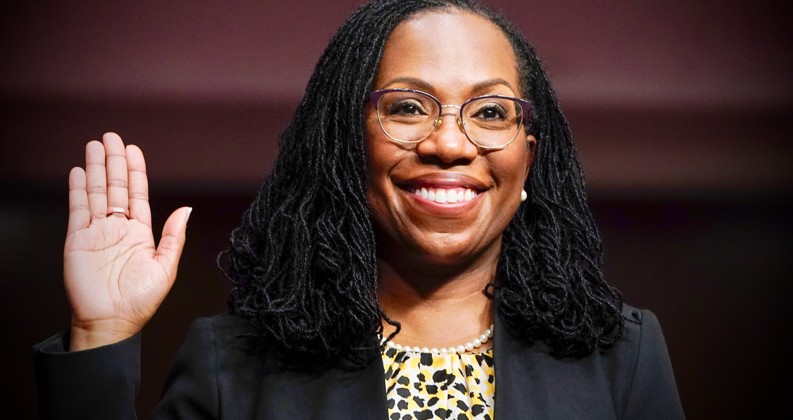
Harry Blackmun (1972)
14th Amendment legalized killing of infants
“Justice” based upon groups instead of individuals
Riot Violence Unpunished
Judge Ketanji Brown Jackson

Slide 6
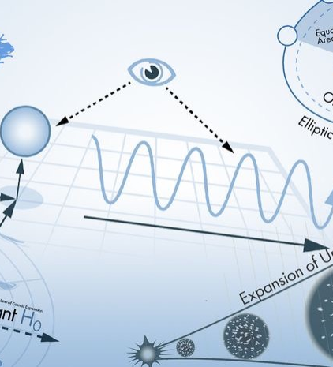
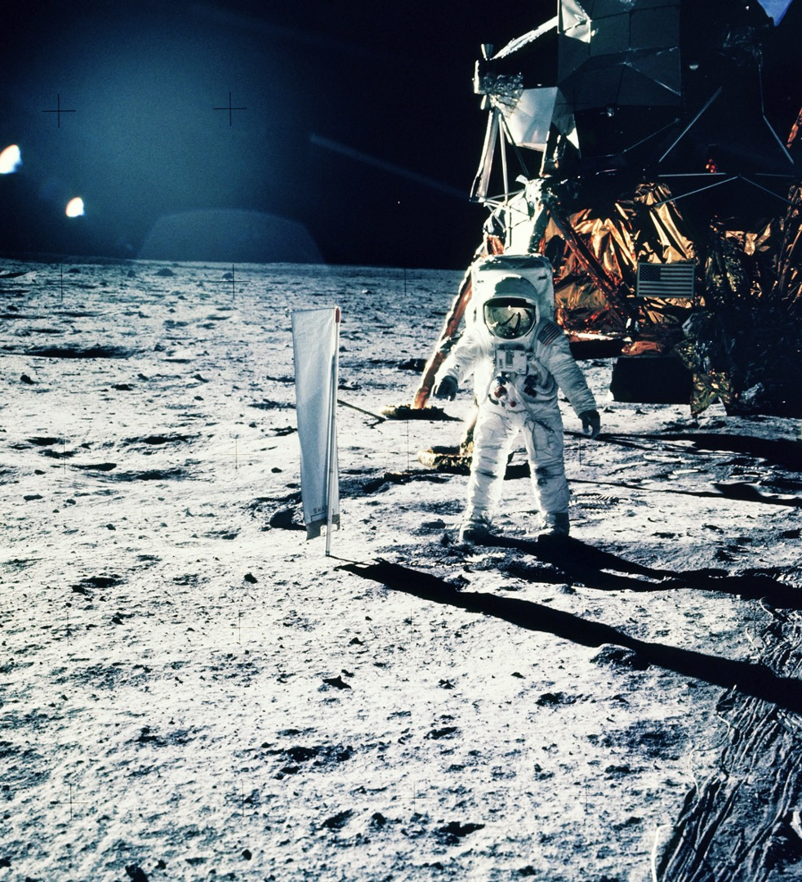

Slide 7
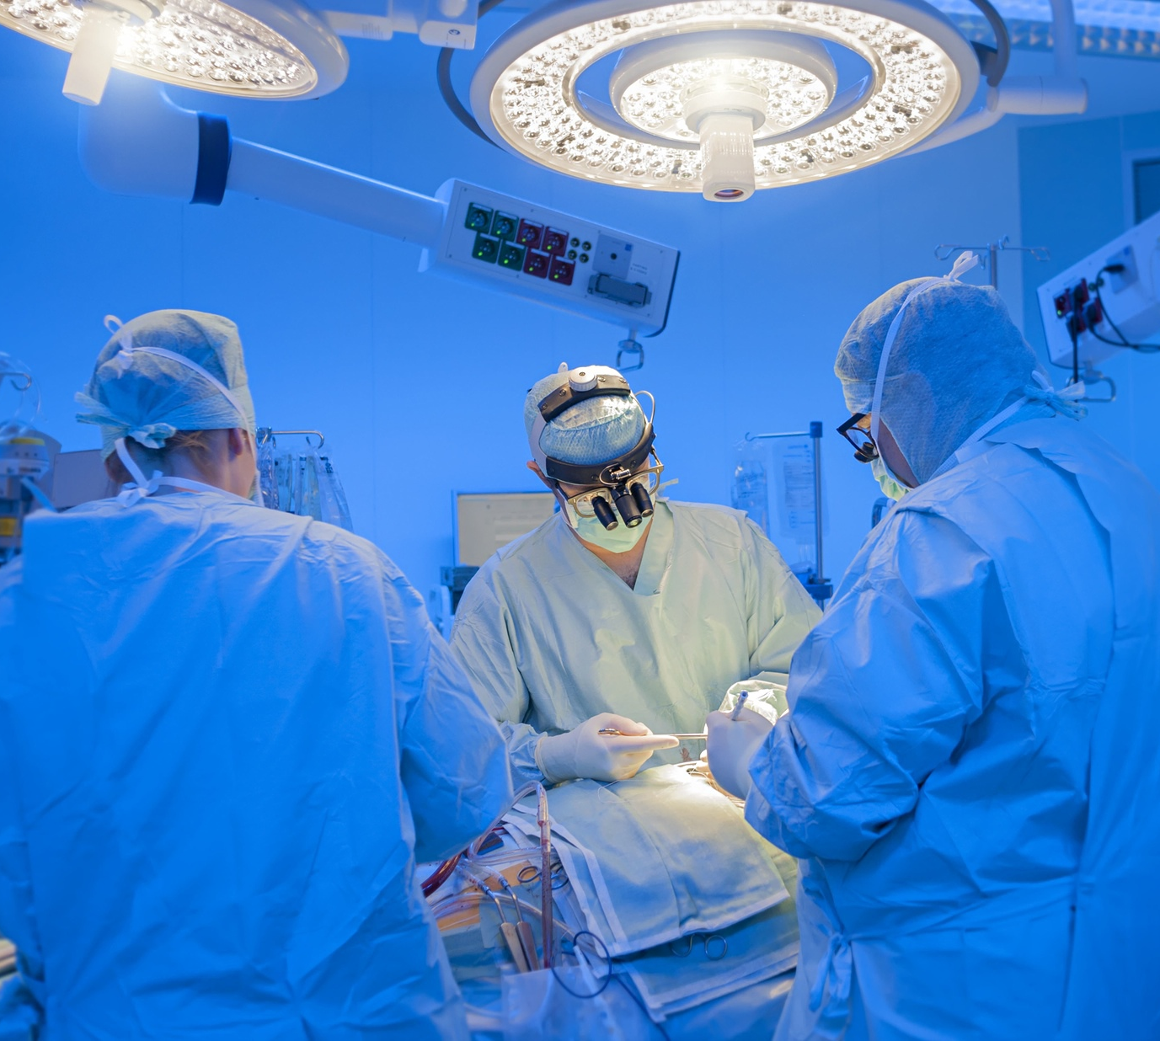
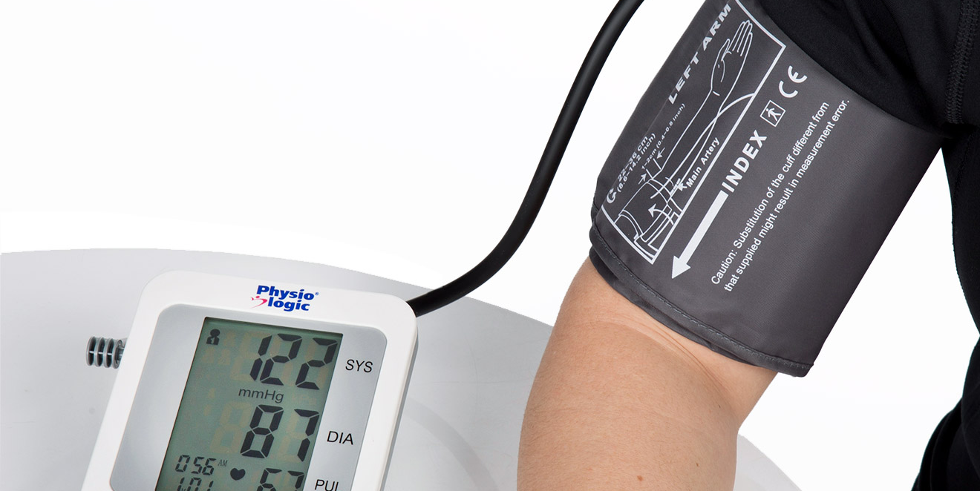
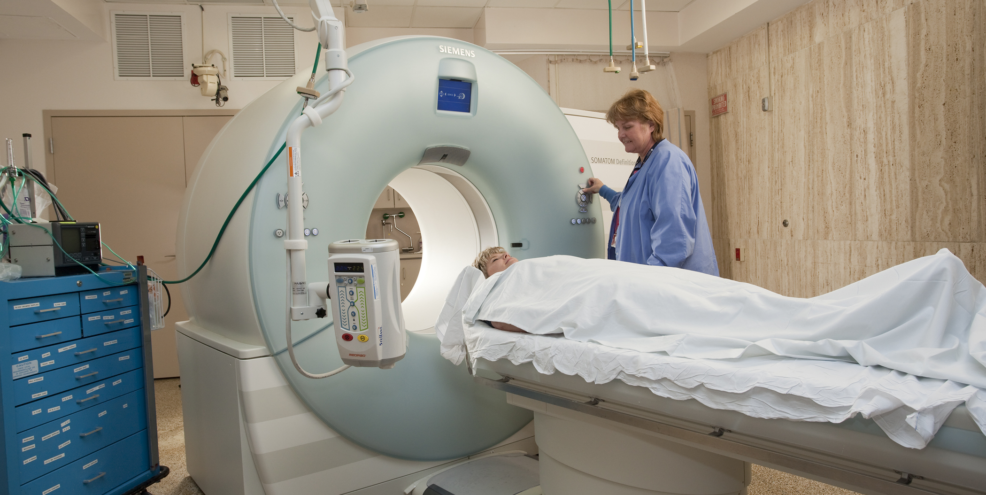

Slide 8
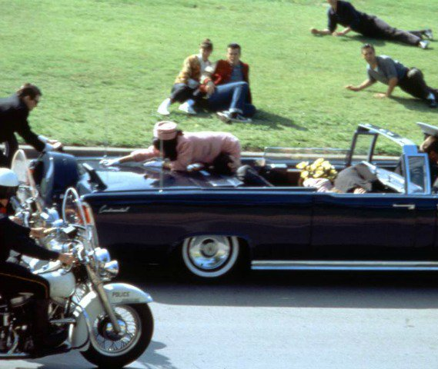
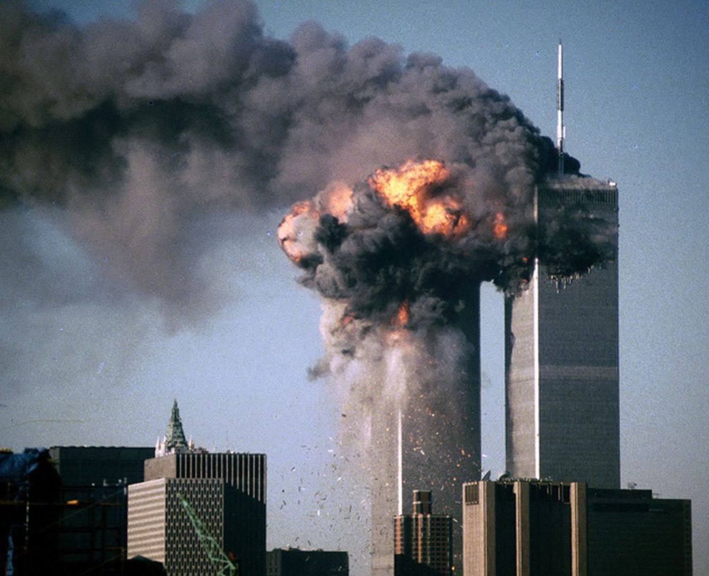
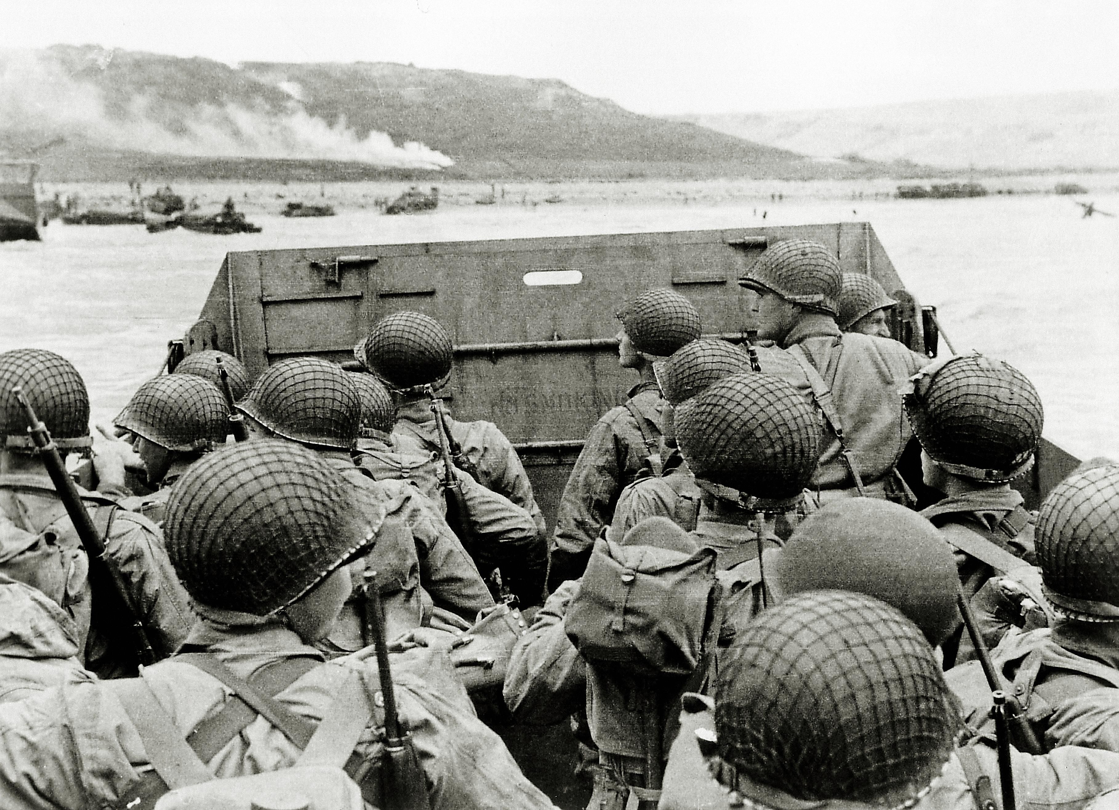

Slide 9
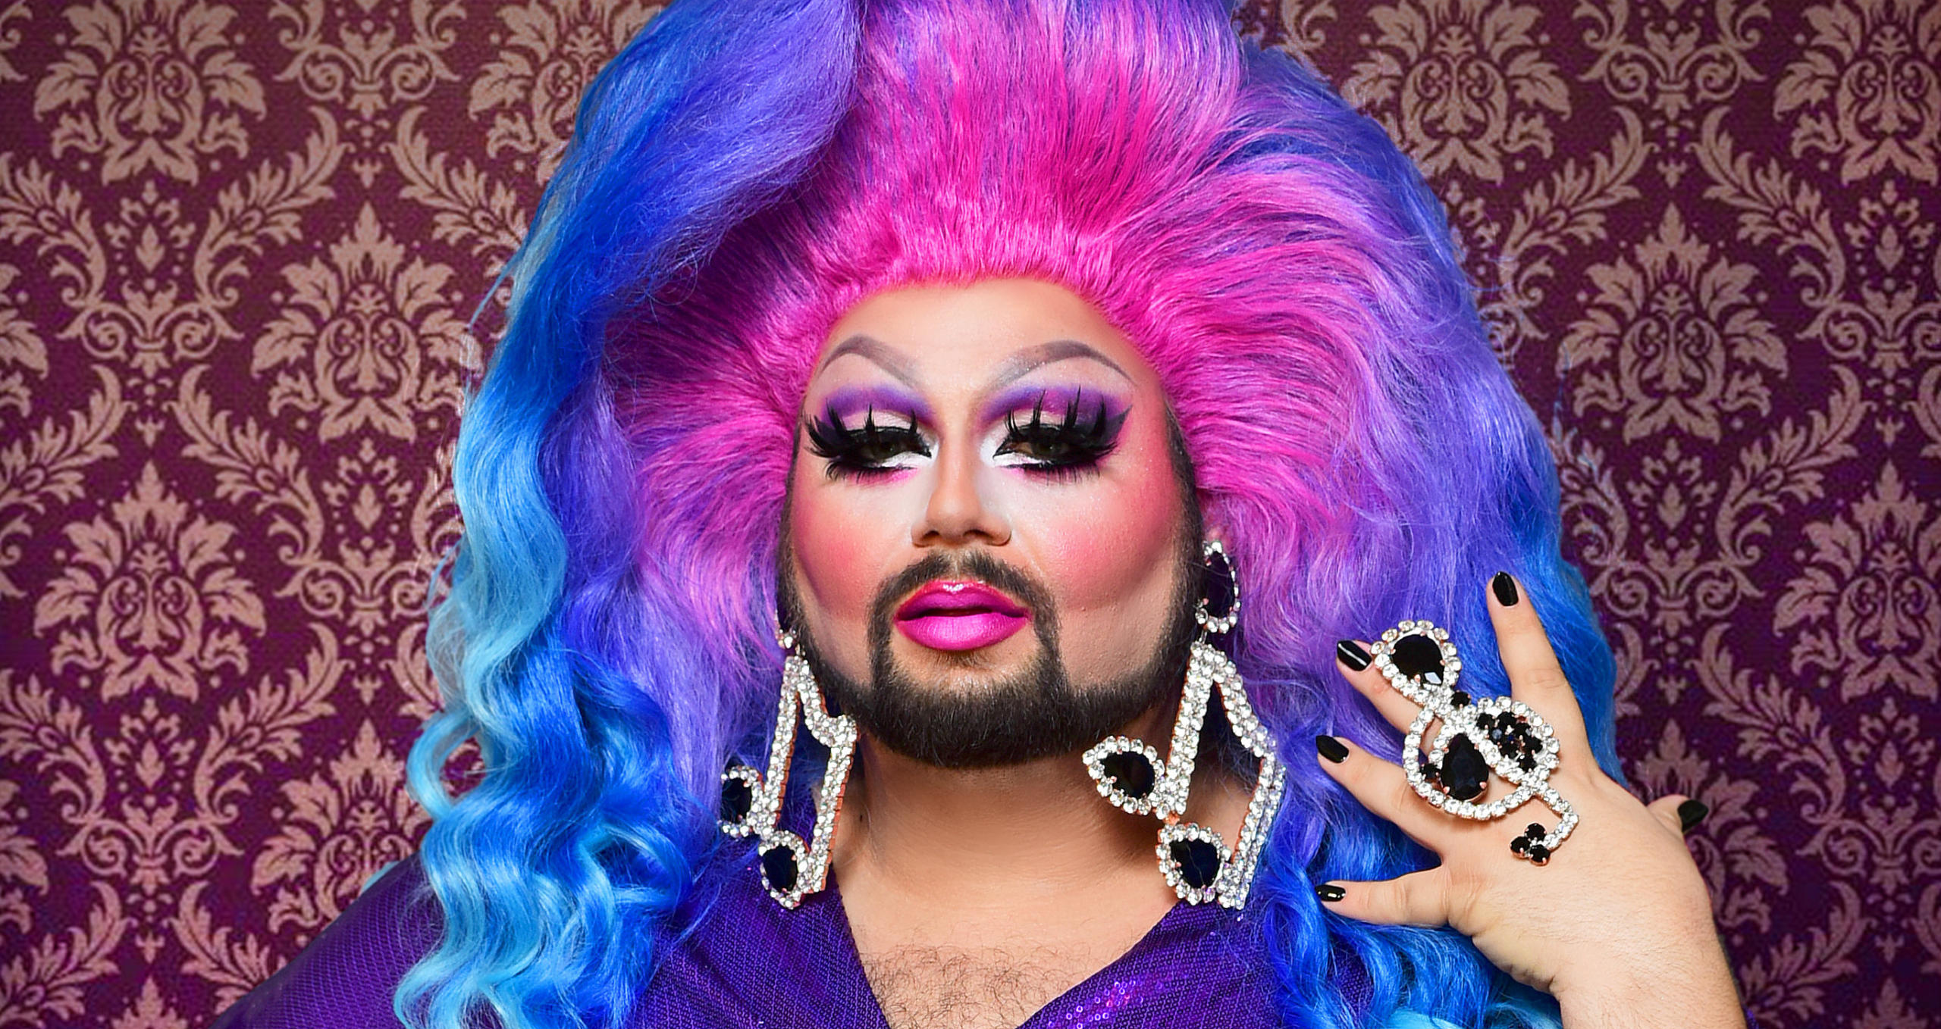
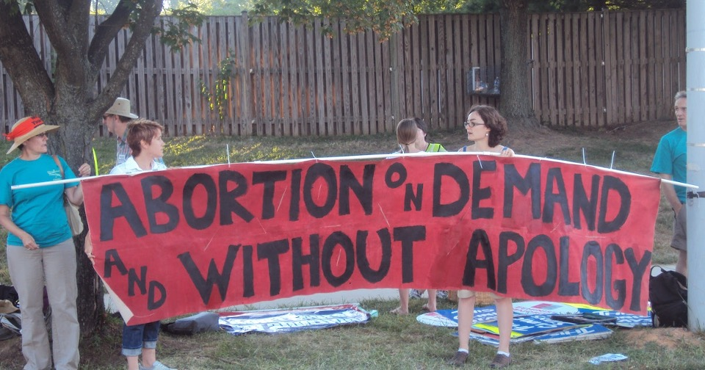
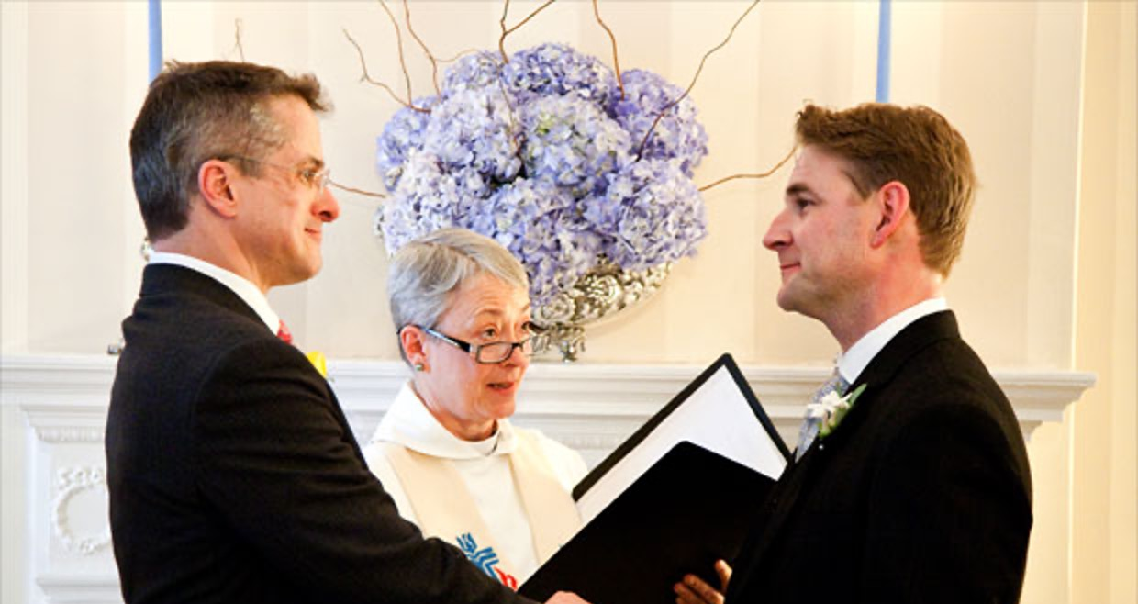
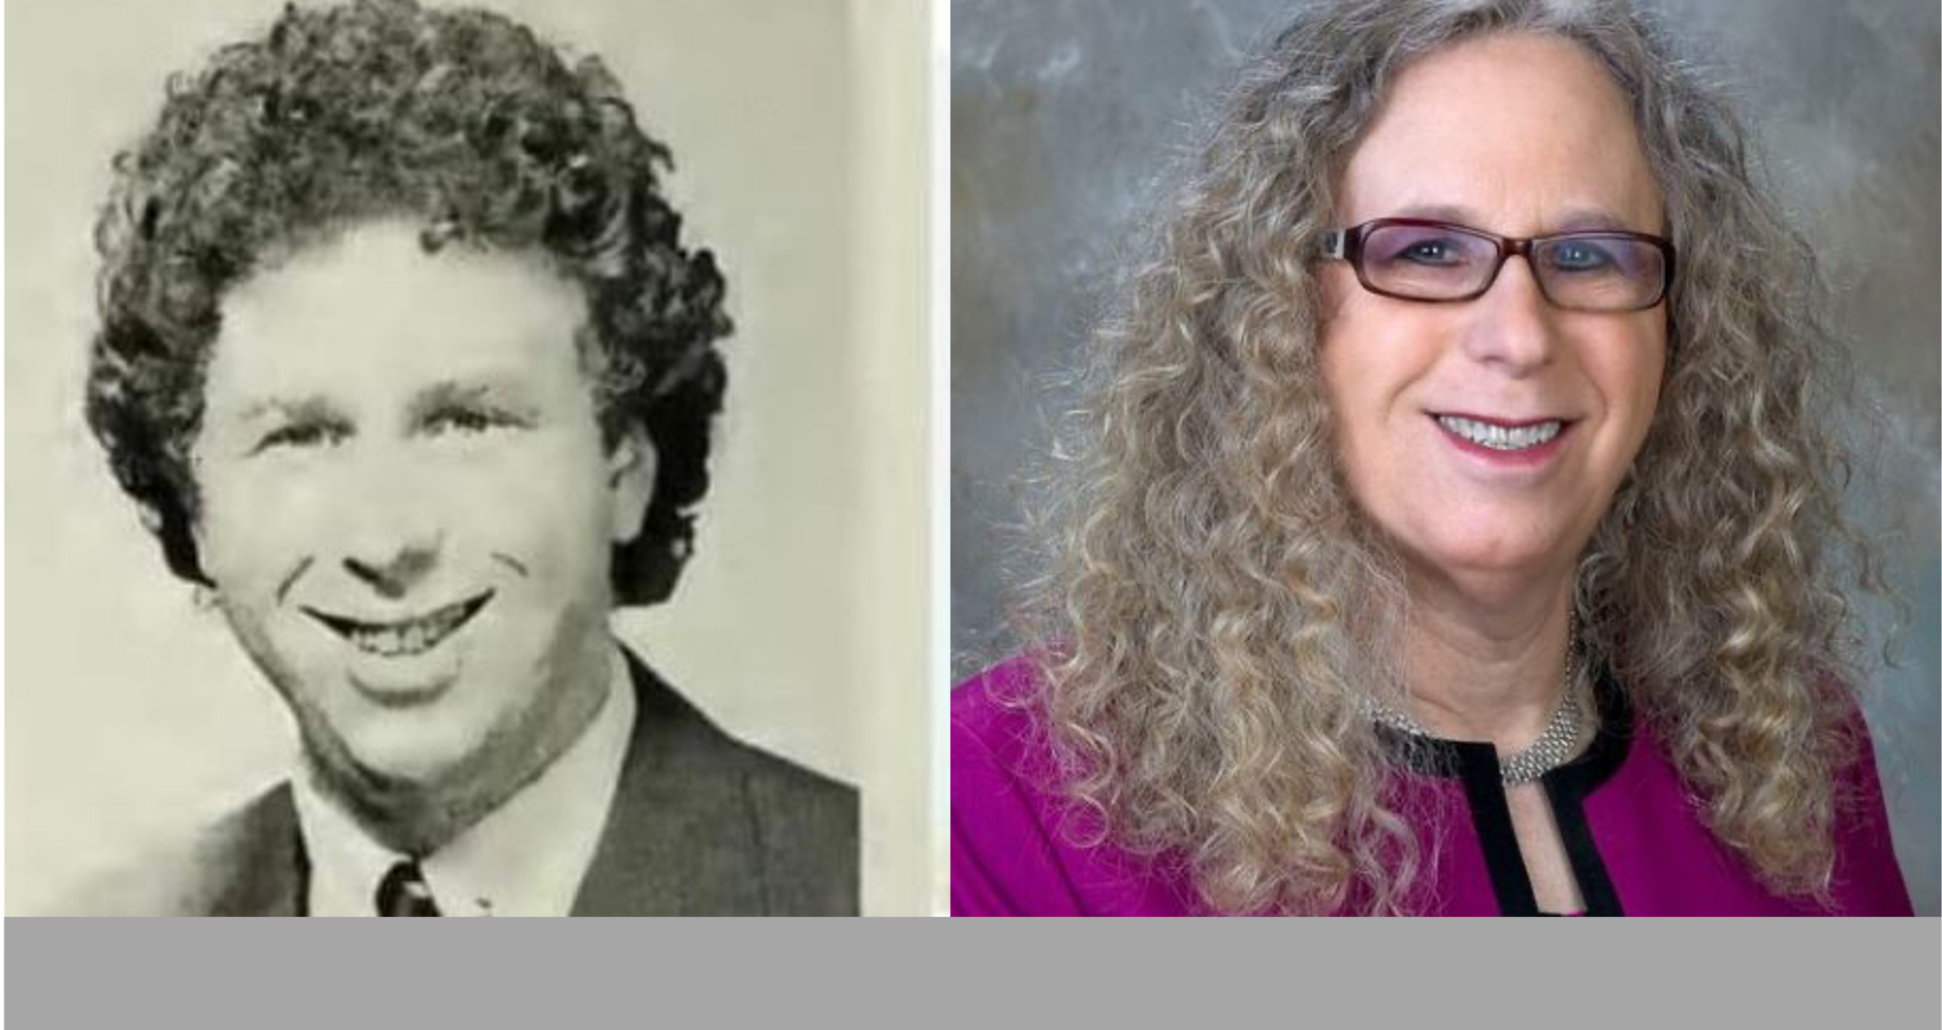

Slide 10
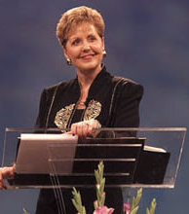
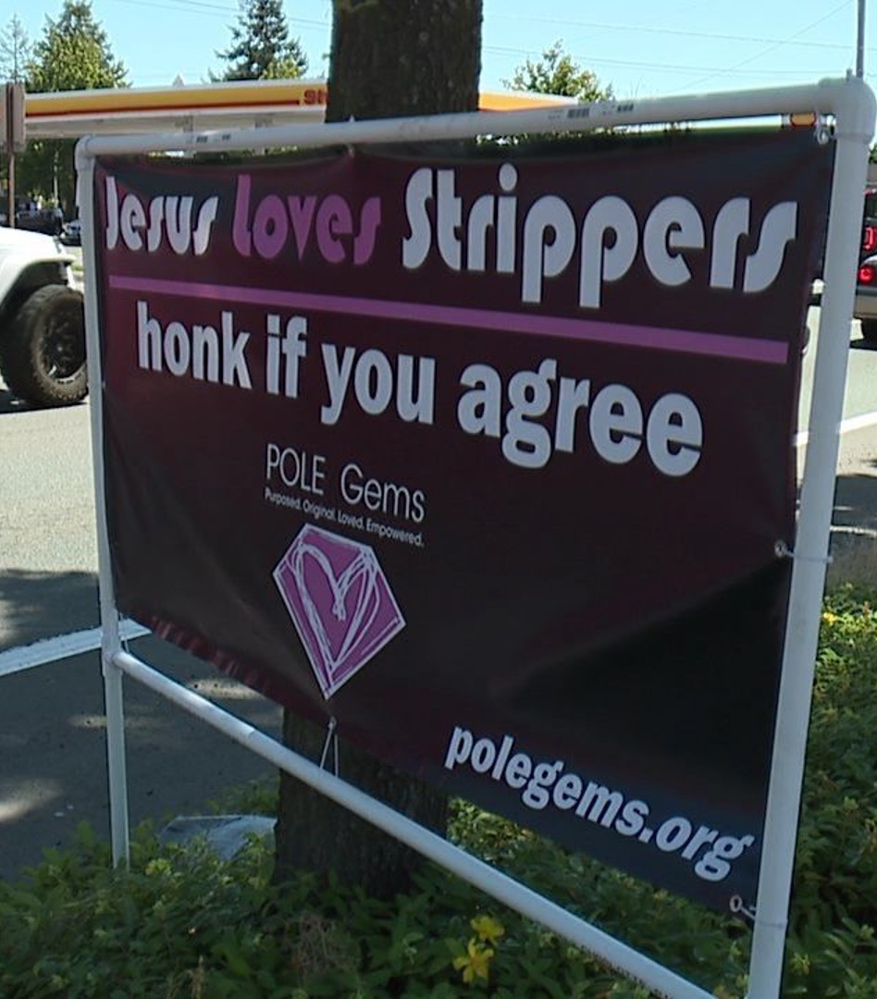
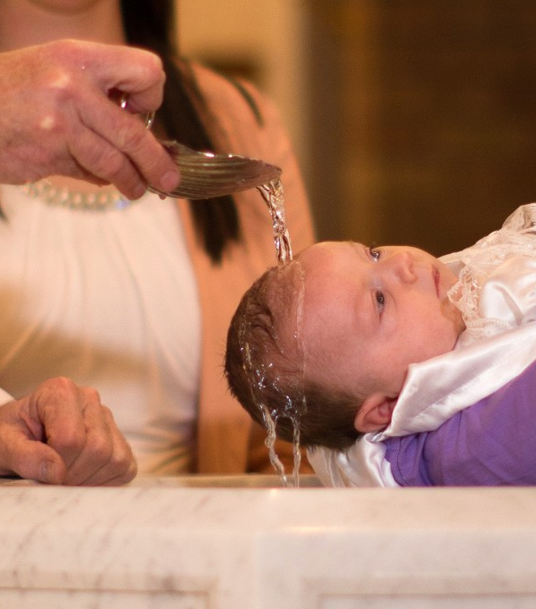
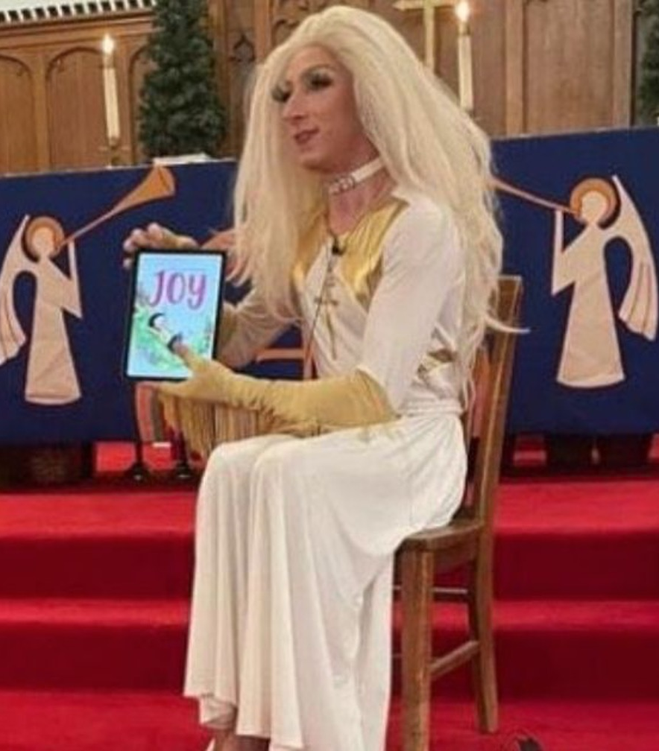
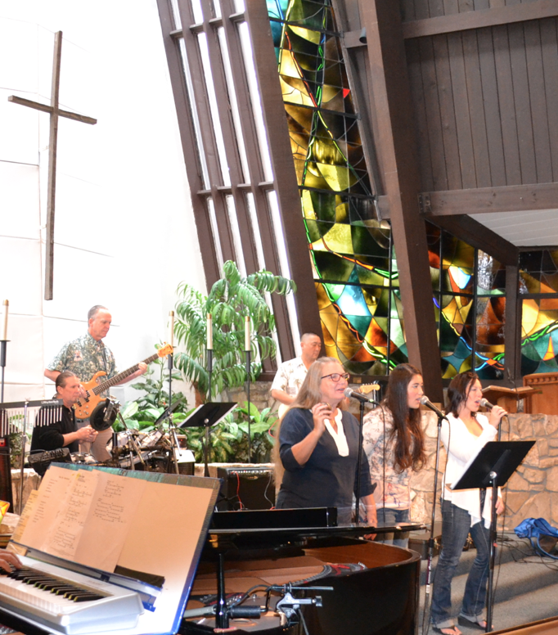

Slide 11
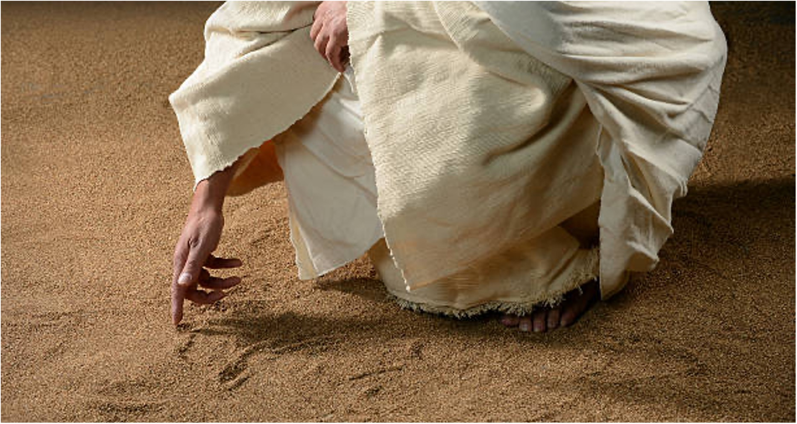
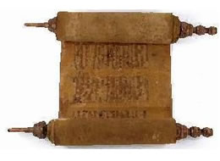
Jesus said…, I am the way, the truth, and the life. No one comes to the Father except through Me.
John 14:6
Sanctify them by Your truth. Your word is truth.
John 17:17

Slide 12
Jesus is the embodiment of Truth, Eph 4:21 ~ “Truth is in Jesus.”
Jesus rules in the “Kingdom of Truth,” Jn 18:36-37.
Only the Truth of His Word sets us free, Jn 8:31-32 (from lies, bondage).
The gospel is the revelation of His Truth, Ac 26:25; Gal 2:14; 1 Thess 2:13.
The Truth of God is the gospel of our salvation, Eph 1:13
The Truth of God is that which provides us with hope, Col 1:5 ~ “of which you heard before in the word of the truth of the gospel…”

Slide 13
We Can & Must Know & Understand the truth ~ Jn 8:32; 1 Tim 2:4
We Can & Must Continue in that truth ~ 2 Tim 4:3-4
We Can & Must Declare the Truth ~ Eph 4:15
We Can & Must Expose all Untruth ~ Eph 5:11
We Cannot & We Must Not compromise the truth ~ 1 Thess 5:21-22; 2 Cor 6:14-16

