Slide 1
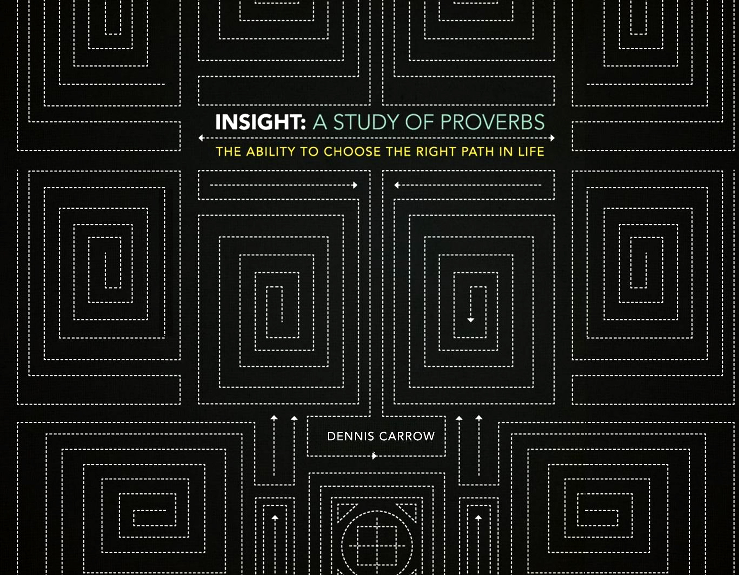

Slide 2
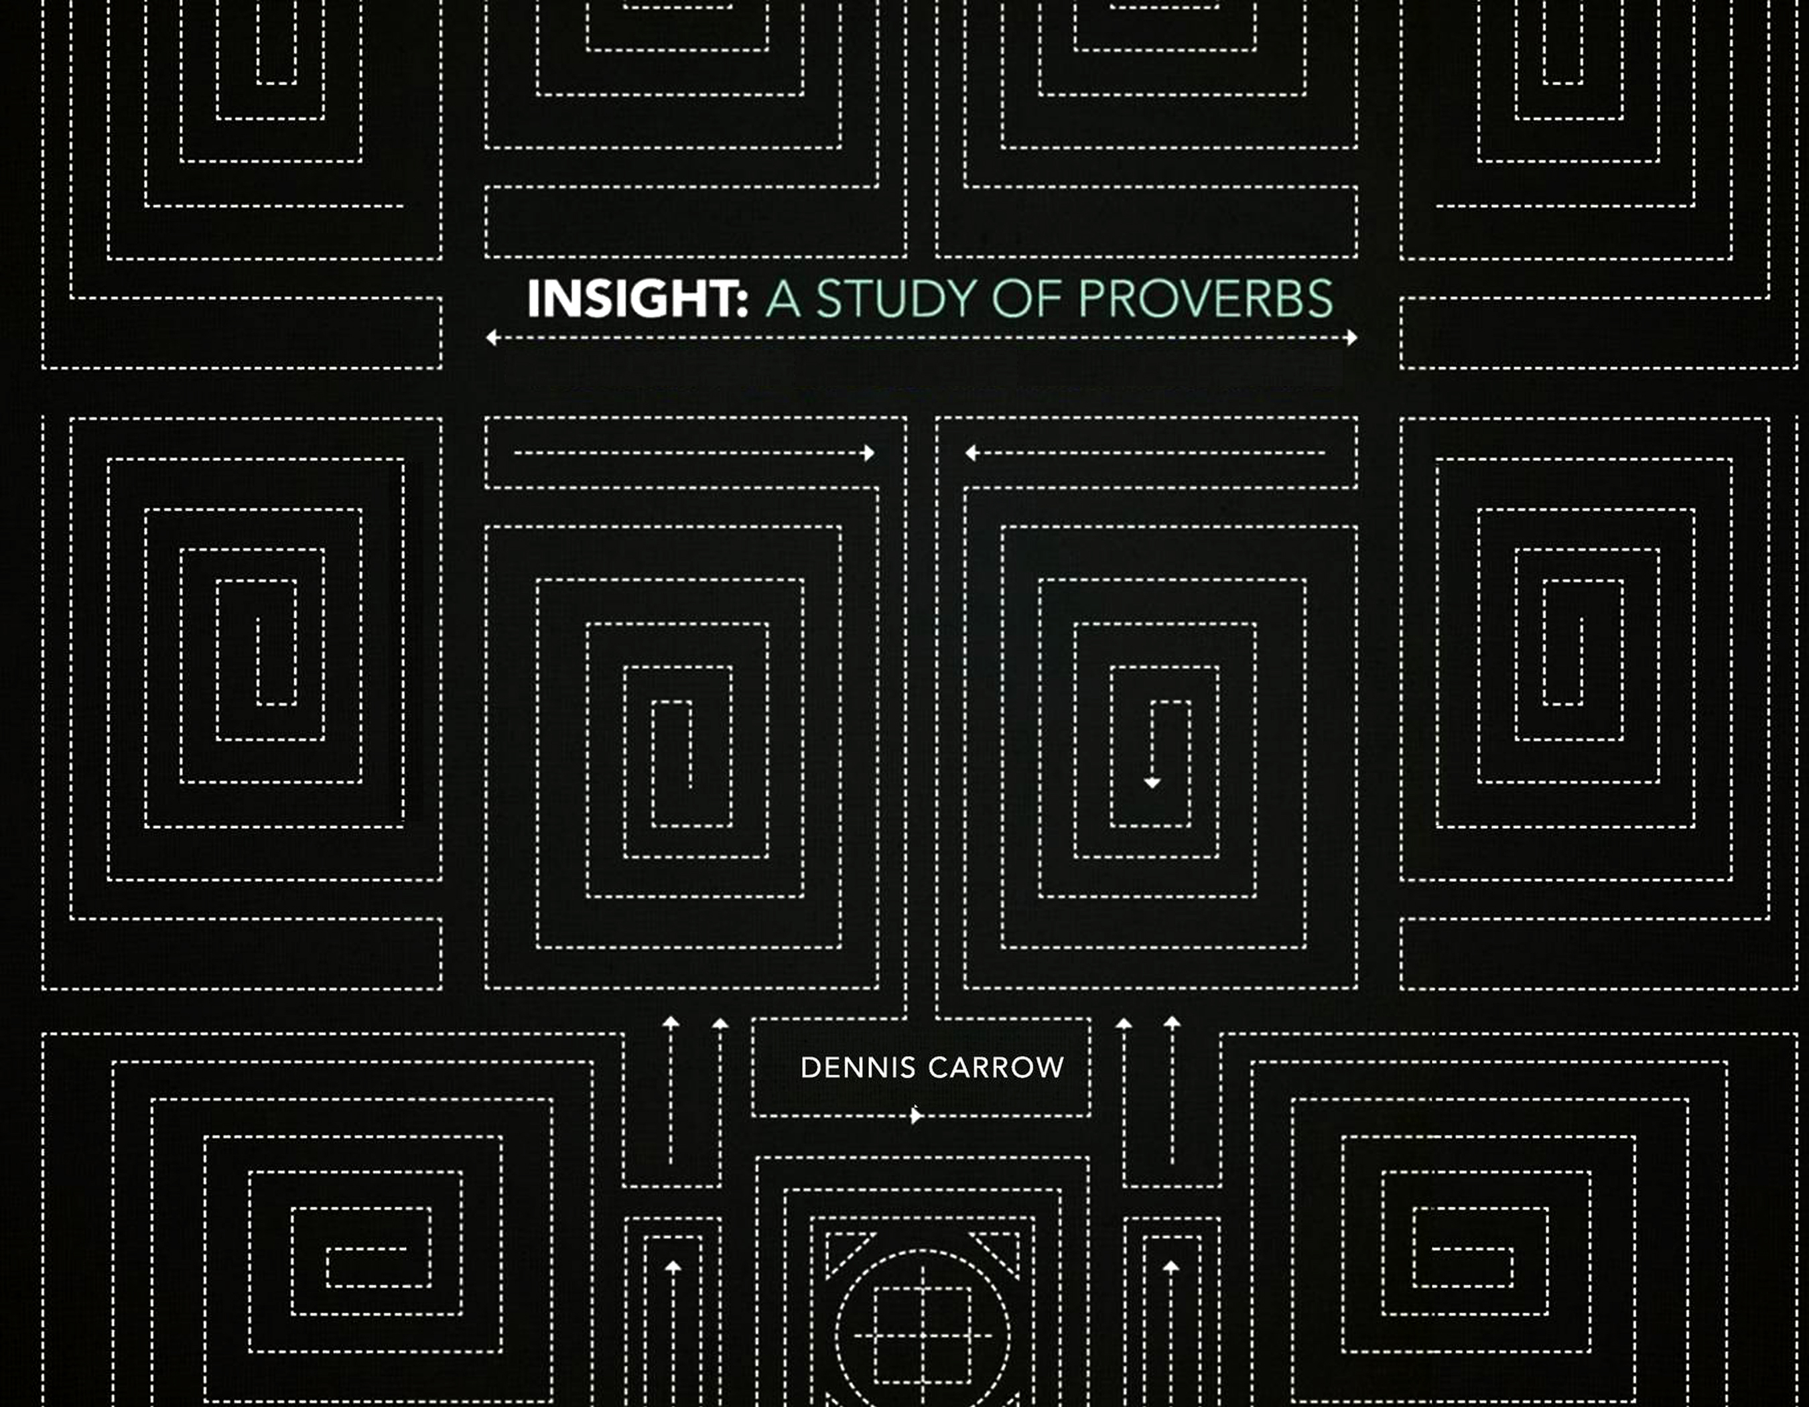
Introspection:
The Wise Heart Knows Itself
Proverbs 10 - 13

Slide 3

An Open Mind Finds Wisdom
(Read Proverbs 14:1-9)
Introspection: The Wise Heart Knows Itself

Slide 4
The Volatility of the Conscience
(Read Proverbs 14: 10-14)
Introspection: The Wise Heart Knows Itself

Slide 5
The Walk of the Wise Looks Carefully Where He Steps
(Read Proverbs 14:5-25)
Introspection: The Wise Heart Knows Itself

Slide 6
Oppression, Anger, and Envy - A Reproach to Any People
(Read Proverbs 14:26-35)
Introspection: The Wise Heart Knows Itself

Slide 7
Meditate and Memorize:
“There is a way that seems right to a man, But its end is the way of death.”
Proverbs 14:12
Introspection: The Wise Heart Knows Itself

Slide 8
Questions to Consider
Introspection: The Wise Heart Knows Itself
What two elements are essential in gaining understanding? (Vs. 6b, 29)
Discuss how we identify being filled with our own ways as opposed to being satisfied from above.
Read and discuss Philippians 4:6-7, 11-13.

