Slide 1
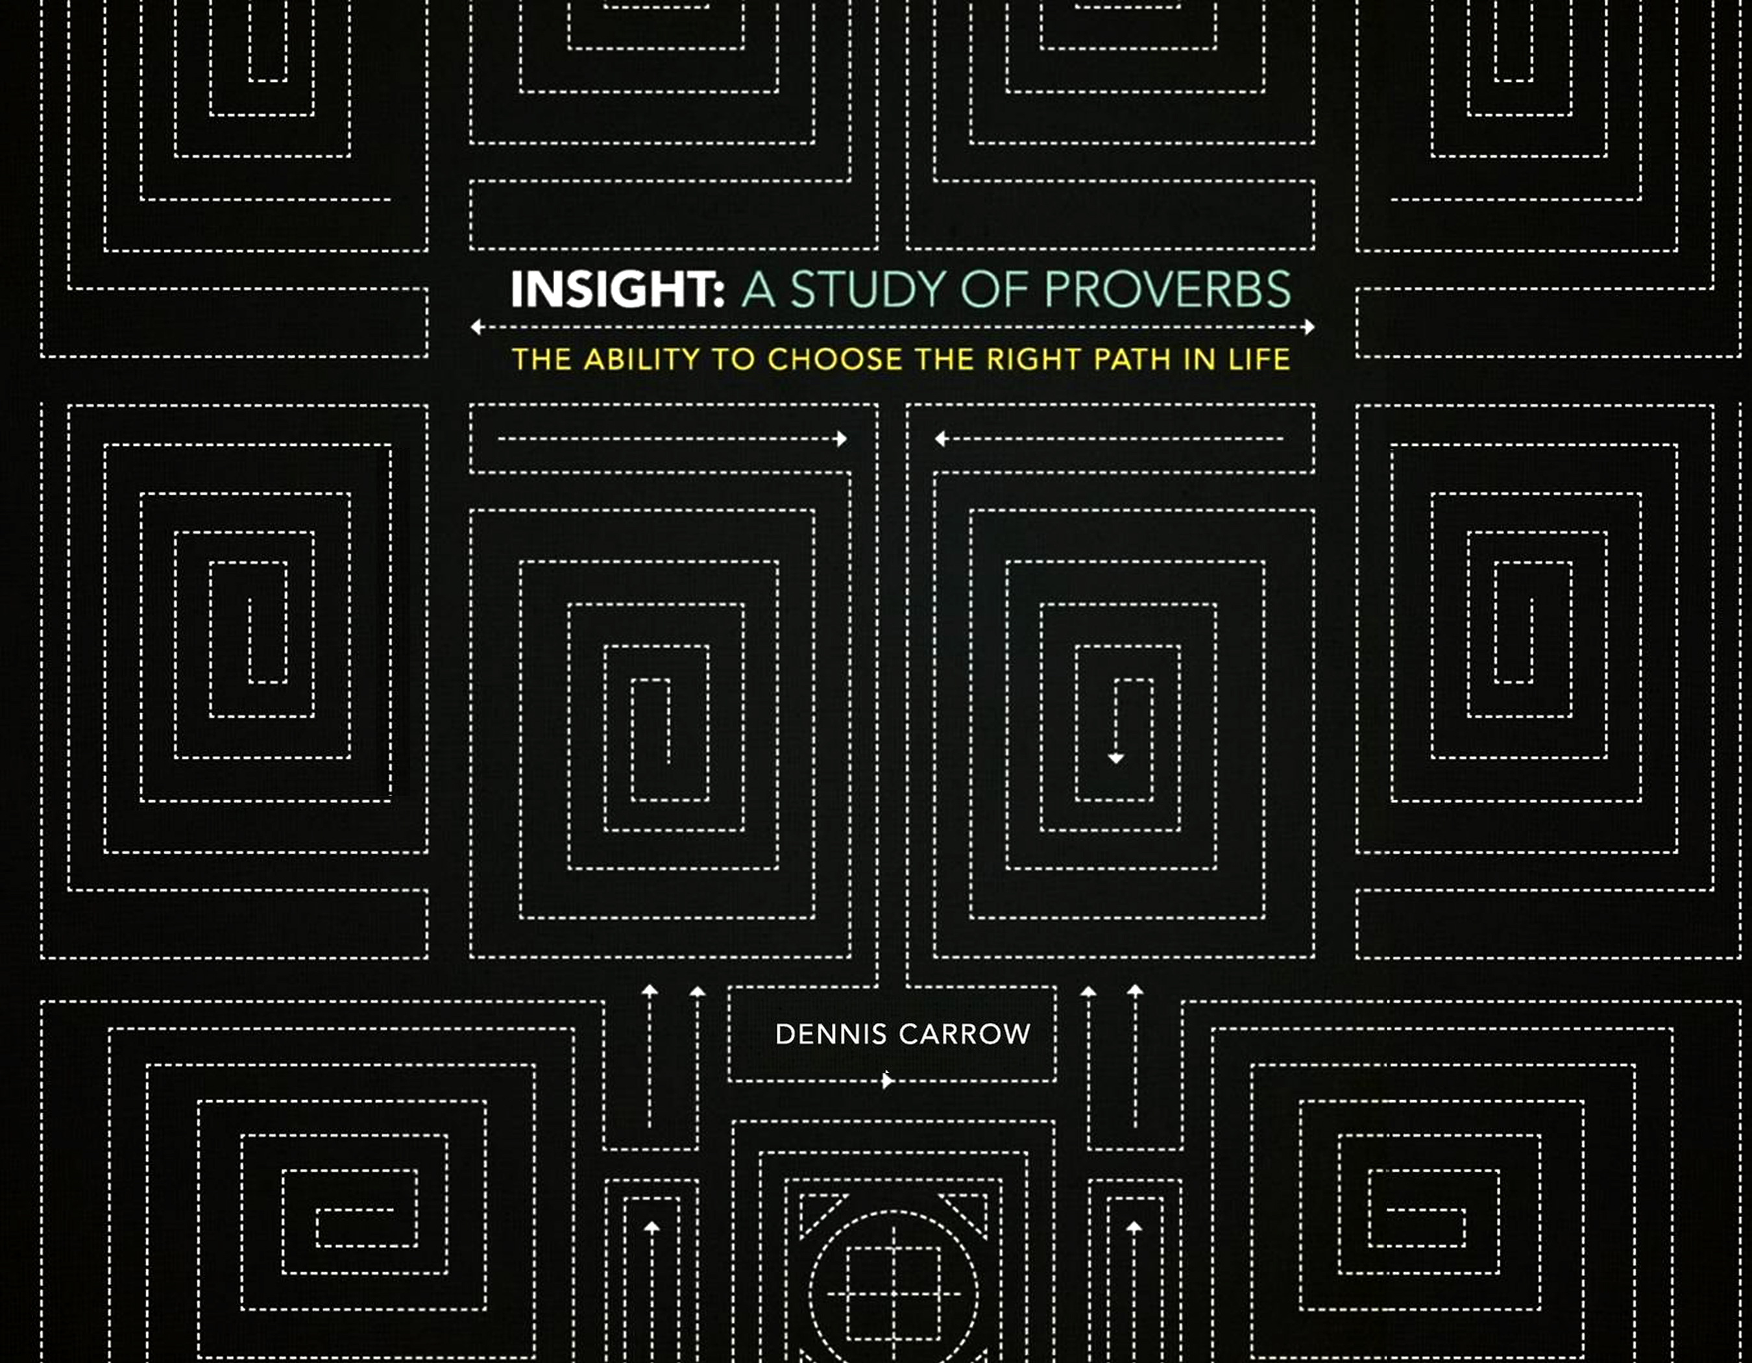

Slide 2
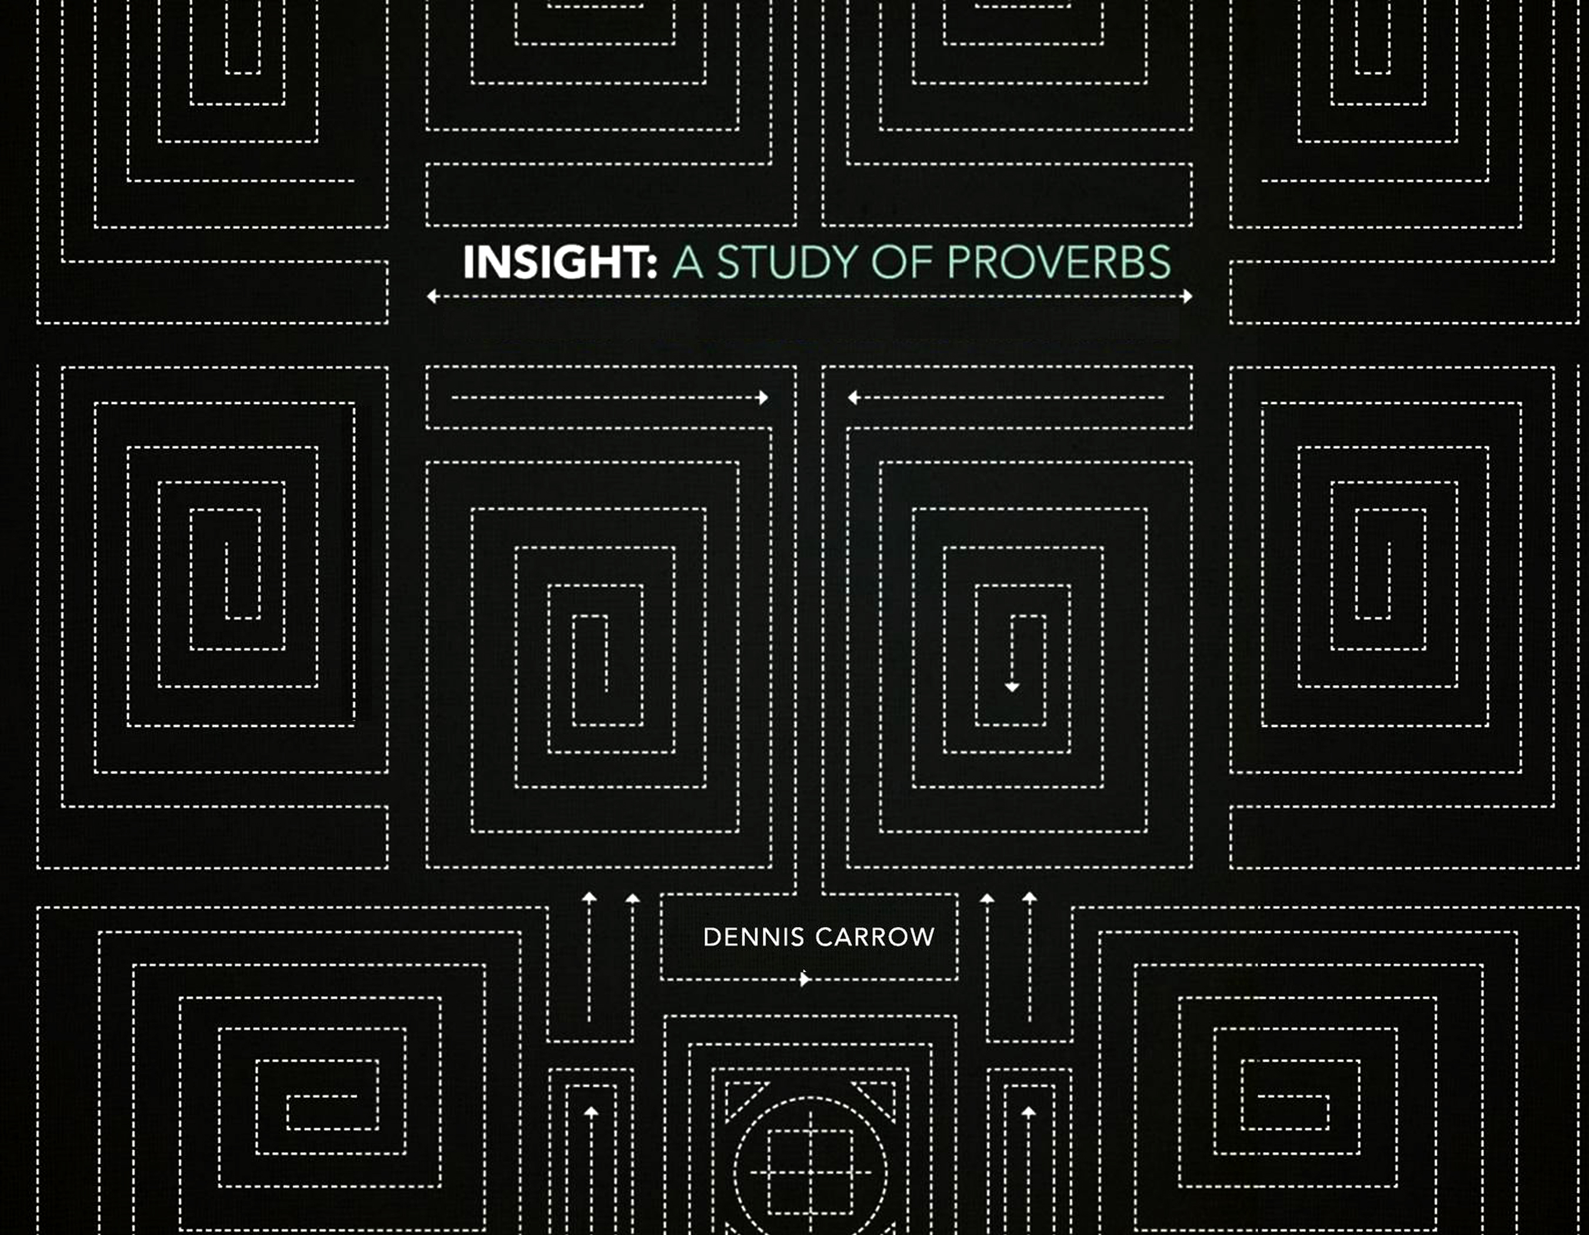
The Mirror Of Our Heart:
The Word We Speak
Proverbs 15 & 16

Slide 3

Proper Disposition and Doctrine Make the Difference
(Read Proverbs 15)
The Mirror Of Our Heart: The Words We Speak
Proper communication:
Brings a cheerful countenance. V. 13
Calms contentions. V. 18
Lives joyfully. V. 23

Slide 4
A Submissive Mind Leads to the Control of the Tongue
(Read Proverbs 16)
The Mirror Of Our Heart: The Words We Speak
We prepare the heart to receive instruction, God provides the words of instruction (v. 1).
We commit our actions to things right,
God establishes our thoughts (v. 3).
When we please God, He provides peace (v. 7).
We plan our lives around God, God directs our steps (v. 9).

Slide 5
Meditate and Memorize:
“Pride goes before destruction and a haughty spirit before a fall.”
Proverbs 16:18
The Mirror Of Our Heart: The Words We Speak

Slide 6
Questions to Consider
The Mirror Of Our Heart: The Words We Speak
How should we respond to someone is angry with us?
What is the best method to use in making plans for the future (15:22)?
What does a positive attitude, pleasant words, and a heart that trusts in God have in common (15:13,26; 16:20)?

