Slide 1
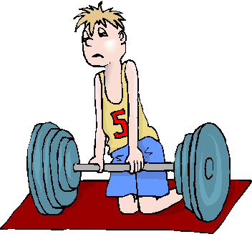
Four Reasons for Spiritual Weakness
“…the whole body, joined and knit together by what every joint supplies, according to the effective working by which every part does its share, causes growth of the body…”
(Eph. 4:16)

Slide 2
Four Reasons for Spiritual Weakness
Spiritual Immaturity
1 Corinthians 3:1-2

Slide 3
Four Reasons for Spiritual Weakness
Spiritual Immaturity
1 Corinthians 3:1-2
Ephesians 4:14

Slide 4
Four Reasons for Spiritual Weakness
Spiritual Immaturity
1 Corinthians 3:1-2
Ephesians 4:14
1 Peter 2:2

Slide 5
Four Reasons for Spiritual Weakness
Spiritual Immaturity
1 Corinthians 3:1-2; Ephesians 4:14; 1 Peter 2:2
Worldly Distractions
Matthew 26:41

Slide 6
Four Reasons for Spiritual Weakness
Spiritual Immaturity
1 Corinthians 3:1-2; Ephesians 4:14; 1 Peter 2:2
Worldly Distractions
Matthew 26:41; Ephesians 6:11-13

Slide 7
Four Reasons for Spiritual Weakness
Spiritual Immaturity
1 Corinthians 3:1-2; Ephesians 4:14; 1 Peter 2:2
Worldly Distractions
Matthew 26:41; Ephesians 6:11-13; James 1:2-3

Slide 8
Four Reasons for Spiritual Weakness
Spiritual Immaturity
1 Corinthians 3:1-2; Ephesians 4:14; 1 Peter 2:2
Worldly Distractions
Matthew 26:41; Ephesians 6:11-13
Being Overcome By Sin
Galatians 6:1

Slide 9
Four Reasons for Spiritual Weakness
Spiritual Immaturity
1 Corinthians 3:1-2; Ephesians 4:14; 1 Peter 2:2
Worldly Distractions
Matthew 26:41; Ephesians 6:11-13
Being Overcome By Sin
Galatians 6:1; James 5:19-20

Slide 10
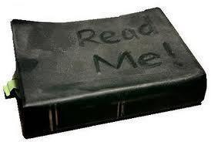
Four Reasons for Spiritual Weakness
Spiritual Immaturity
1 Corinthians 3:1-2; Ephesians 4:14; 1 Peter 2:2
Worldly Distractions
Matthew 26:41; Ephesians 6:11-13; James 1:2-3
Being Overcome By Sin
Galatians 6:1; James 5:19-20
Neglecting God’s Word
Hebrews 5:11 – 6:2

Slide 11
Four Reasons for Spiritual Weakness
Spiritual Immaturity
1 Corinthians 3:1-2; Ephesians 4:14; 1 Peter 2:2
Worldly Distractions
Matthew 26:41; Ephesians 6:11-13; James 1:2-3
Being Overcome By Sin
Galatians 6:1; James 5:19-20
Neglecting God’s Word
Hebrews 5:11 – 6:2; Hosea 4:6

Slide 12
Four Reasons for Spiritual Weakness
Spiritual Immaturity
1 Corinthians 3:1-2; Ephesians 4:14; 1 Peter 2:2
Worldly Distractions
Matthew 26:41; Ephesians 6:11-13; James 1:2-3
Being Overcome By Sin
Galatians 6:1; James 5:19-20
Neglecting God’s Word
Hebrews 5:11 – 6:2; Hosea 4:6; Ephesians 4:17-18

Slide 13
Spiritual Weakness Brings Fall into Sin
⁵ For those who live according to the flesh set their minds on the things of the flesh, but those who live according to the Spirit, the things of the Spirit…
… ⁷ Because the carnal mind is enmity against God; for it is not subject to the law of God, nor indeed can be.
(Romans 8:5, 7)

