Slide 1
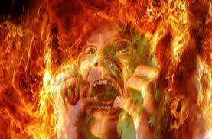
Things a Lost Man Learned Too Late
Luke 16:19-31

Slide 2
Luke 16:19-31
¹⁹ “There was a certain rich man who was clothed in purple and fine linen and fared sumptuously every day. ²⁰ But there was a certain beggar named Lazarus, full of sores, who was laid at his gate,²¹ desiring to be fed with the crumbs which fell from the rich man’s table. Moreover the dogs came and licked his sores. ²² So it was that the beggar died, and was carried by the angels to Abraham’s bosom. The rich man also died and was buried. ²³ And being in torments in Hades, he lifted up his eyes and saw Abraham afar off, and Lazarus in his bosom. ²⁴ “Then he cried and said, ‘Father Abraham, have mercy on me, and send Lazarus that he may dip the tip of his finger in water and cool my tongue; for I am tormented in this flame.’ ²⁵ But Abraham said, ‘Son, remember that in your lifetime you received your good things, and likewise Lazarus evil things; but now he is comforted and you are tormented. ²⁶ And besides all this, between us and you there is a great gulf fixed, so that those who want to pass from here to you cannot, nor can those from there pass to us.’ ²⁷ “Then he said, ‘I beg you therefore, father, that you would send him to my father’s house, ²⁸ for I have five brothers, that he may testify to them, lest they also come to this place of torment.’²⁹ Abraham said to him, ‘They have Moses and the prophets; let them hear them.’ ³⁰ And he said, ‘No, father Abraham; but if one goes to them from the dead, they will repent.’ ³¹ But he said to him, ‘If they do not hear Moses and the prophets, neither will they be persuaded though one rise from the dead.’”

Slide 3
Abraham’s bosom (Paradise)
Carried by angels
Lazarus
Rich Man
GREAT GULF
Died
Torments
Luke 16:19-31
Chart from Joe Price

Slide 4
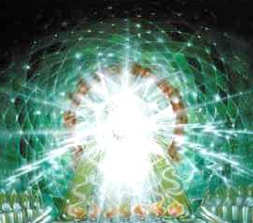
HADES
Heaven
Abraham’s bosom
R
GREAT GULF
Torments
R
Judgment
Hell
Chart from Joe Price

Slide 5
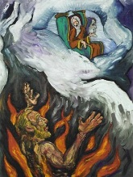
This Rich Man Learned Some Things After His Death…
But He Learned Them Too Late!

Slide 6
The Finality of Death
The rich man learn need to obey in life…. but too late
Death fixes our eternal fate
Hebrew 9:27
Ecclesiastes 9:11
2nd chance doctrines are false
Catholic purgatory
Mormonism’s works for dead
Hindu reincarnation
Stresses present responsibility

Slide 7
The Folly of Materialism
Rich man learned his wealth was fleeting…. but too late
Vanity of earthly priorities
Proverbs 23:5; 27:24
Proper view of earthly wealth
1 Timothy 6:9-10
Matthew 19:23-24; 6:19-21
1 Timothy 6:17-19
Wealth tends to breed pride rather than trust in God

Slide 8
The Urgency of Evangelism
Rich man learned urgency of teaching others…. but too late
Many today are like him – no understanding of its urgency
Destiny of sinners should spur us to bring them to salvation
2 Corinthians 5:11, 14
Romans 10:1; 11:14
1 Corinthians 9:19-22
Do we really love lost souls?

Slide 9
The Reality of Torment
Rich man not focused on the Judgment…. until too late
Abraham reminded him of his former place vs. Lazarus
“Remember” means torment is conscious stated
Wicked face such torment
Revelation 14:11; 20:14-15
Matthew 25:41
2 Thessalonians 1:7-9

