Slide 1
The Megachurch
Movement

Slide 4
What is a megachurch?
Basic definition:
2,000+ members that attend weekly
(number sometimes based on seating)

Slide 5
“Megachurch” Facts…

Slide 6
Top 5 largest churches in U.S.
Lakewood Church 43,500
Joel Osteen Houston,TX
North Point Community Church 30,982
Andy Stanley Alpharetta, GA
LifeChurch.tv 30,000
Craig Groeschel Edmond, OK
Willow Creek Community Church 24,200
Bill Hybels South Barrington, IL
Fellowship Church 24,162
Ed Young Grapevine, TX

Slide 9
Roswell Street Baptist Church in Atlanta, GA pamphlet:
“Big is Beautiful.... Any church in a large, growing community that is practicing the 'Great Commission' cannot keep from growing. To criticize a church for being big is to imply disbelief in Christ's commission.... A church gets big because its spirit is big.... Nobody ever started a business without hoping that someday, if he or she worked hard enough, it would be a big success. That is the American dream, isn't it?”
.

Slide 10
Administrator at Chapel Hill Harvester Church:
“It's just good business practices that we all need.... We are a church but we are also a business that happens to be operating by the name of a church. We are a ten million dollar a year church that has to operate like a business.”

Slide 11
“Megachurch” Facts…
The larger the church, the more its resources
Church Size
Average Income
FT Ministerial & Admin Staff
Volunteers 5hr+
5yr Growth Rate
1,800 – 1,999
3.17 million
21
126
38%
2,000 – 4,999
5.20 million
36
236
44%
5,000 – 9,999
9.14 million
64
533
56%
10,000 or more
24.80 million
131
904
74%

Slide 12
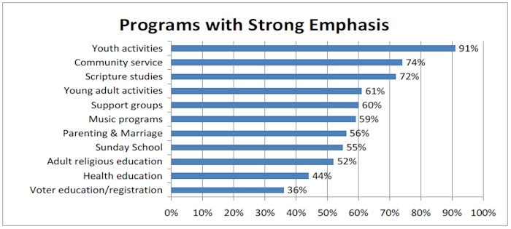
“Megachurch” Facts…

Slide 13
Shiloh Baptist Church Ministries
Armor Bearer Ministry
Clerks Ministry
Counters Ministry
Couples Ministry
Creative Arts Ministry
Dancing to A Different Beat
Deacon Board
Deaconess Board
Finance Ministry
Freedom Ministry
Gospel Aerobics Ministry
Greeters Ministry
Hospitality Ministry
Kitchen Ministry
Men's Ministry
Music Ministry
Parking Ministry
Pastoral Relations Committee
Prayer Ministry
Sheepfold Ministry
Sisters Of Promise Ministry
Technology Ministry
Telecare Ministry
Transportation Ministry
Ushers
Youth Ministry

Slide 14
Willow Creek Community Church, Bill Hybels, Minister:
“We may use up-to-date language, music and drama to communicate God's Word for today's culture, but our message is as old as the Bible itself. We embrace historic Christian teachings on all doctrines, emphasizing Jesus Christ's atoning death, salvation through repentance and faith as a work of divine grace, and the authority of the unique, God-inspired Bible.”

Slide 15
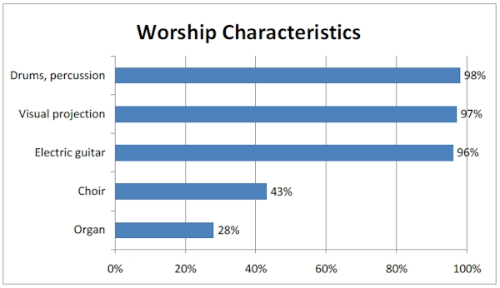
“Megachurch” Facts…

Slide 16
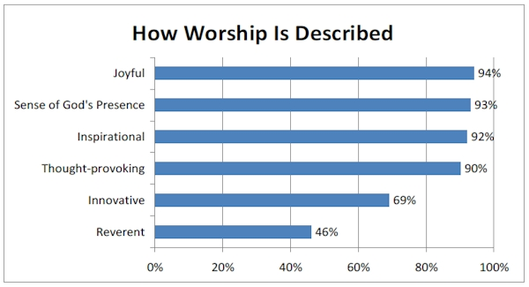
“Megachurch” Facts…

Slide 17
Are “megachurches” scriptural?
Basic definition- YES
Acts 2:40-42, 47
Unauthorized worship- NO

Slide 18
Scriptural Authority
3 Ways to establish authority
Direct Command
Approved Example
Necessary Inference

Slide 19
Scriptural Authority
2 Types of Authority
General
Specific
Example:
Buy office Supplies
Buy paper, pencils, & folders

Slide 20
Authorized Work of the church
Edification
1 Cor. 14:26
Benevolence
1 Tim. 5:16
Evangelism
1 Thess. 1:6-8

Slide 21
Applying Specific Authority
New Testament pattern is to sing
Eph. 5:19
Col. 3:16
ANY other music in the worship is unauthorized
*The silence of the scriptures must be respected*

Slide 22
Which Organization Is Authorized To Do (Perform) The Collective Work Given To The Church?
To Edify The Saints?
Local Church is Specified
Acts 20:28-32

Slide 23
Which Organization Is Authorized To Do (Perform) The Collective Work Given To The Church?
To Relieve Needy Saints?
Local Church is Specified
Romans 15:25-26

Slide 24
Which Organization Is Authorized To Do (Perform) The Collective Work Given To The Church?
To Preach The Gospel?
Local Church is Specified
Phil. 1:5

Slide 25
What is the New Testament Pattern of Acceptable Worship?
The Lord’s Supper
Matt 26:26-29
Singing
Heb 2:12; Heb 13:15
Prayer
1 Cor 14:15-16
Giving
1 Cor 16:2
Teaching God’s Word
2 Tim 2:2

Slide 26
Aids & Additions
What is an “Aid”?
That which assists or helps expedite our obedience to/in an authorized activity; hence, an expediency.
Example: Speaker System
Authorized or Unauthorized?

Slide 27
Aids & Additions
What is an “Addition”?
Introduces a new & different kind of activity.
Prov. 30:6

Slide 28
Difference Between Aids & Additions
Authorized | Aid | Addition
Ark | Ax, Saw, Hammer | Game Room (Another Building)
Baptism | Pool, Baptistery | Sprinkle (Another Action)
Lord’s Supper | Trays, cups | Milk & Cookies (Another Food)
Give | Basket | Sell (tickets, pies) (Another Action)
Sing | Book | Play (Another Action)

Slide 29
“And whatever you do in word or deed, do all in the name of the Lord Jesus…”
Colossians 3:17

