Slide 1
The Almighty Lord & the Power of His Word
Isaiah 55:6-11

Slide 2
Isaiah 55:6-11
⁶ Seek the LORD while He may be found, call upon Him while He is near. ⁷ Let the wicked forsake his way, and the unrighteous man his thoughts; let him return to the LORD, and He will have mercy on him; and to our God, for He will abundantly pardon. ⁸ “For My thoughts are not your thoughts, nor are your ways My ways,” says the LORD. ⁹ “For as the heavens are higher than the earth, so are My ways higher than your ways, and My thoughts than your thoughts. ¹⁰ For as the rain comes down, and the snow from heaven, and do not return there, but water the earth, and make it bring forth and bud, that it may give seed to the sower and bread to the eater, ¹¹ so shall My word be that goes forth from My mouth; it shall not return to Me void, but it shall accomplish what I please, and it shall prosper in the thing for which I sent it.

Slide 3
The Almighty Is Not Our Equal
For He is not a man, as I am, that I may answer Him, and that we should go to court together. Nor is there any mediator between us, who may lay his hand on us both (Job 9:32-33).
God’s nature is infinitely greater than man
Isaiah 45:5-9 Woe to man that quarrels with Maker
Isaiah 40:22-23 Man as a grasshopper before God
Isaiah 55:8-9 His thoughts & ways far above man
We should be silent, depending on God for direction
Job 40:1-3 Cannot contend with God; put hand on mouth
Habakkuk 2:20 “Let all the earth keep silence…”
Lamentations 3:25-28 In all things God speaks, we listen

Slide 4
Man Must Submit to Infinite God
Result of man walking in his own way is not good
Isa. 65:2 Results in rebellion against God
Prov. 14:12 Man thinks right, but end is ways of death
Submission to God is foundational to acceptance
Jas. 4:7-10 Begins & ends with subjection / humility
1 Pet. 5:6 Humble self under mighty hand of God
Gal. 2:20 Crucify self & life given over to Christ
Rom.6:11 Dead to sin, but alive unto God in Christ
Prov. 16:25 Man thinks right, but end is ways of death
Submission makes service possible (Rom. 12:1-2)

Slide 5
God’s Word Is Sufficient to Its Cause
God has a purpose for His word – to separate those who seek to be like God from those who do not
God’s word is sufficient to accomplish His purpose
2 Tim. 3:16-17 Results in rebellion against God
Acts 20:32 Word able to build up & give inheritance
How is that purpose achieved by God’s word?
Heb. 4:11-12 Aims at the heart of man to test its values
2 Thess. 2:13-15 Calls man to salvation & sanctification
1 Thess. 2:13 Must be accepted as of God to work within
When salvation not result of word, not its fault – God’s word always accomplishes its purpose

Slide 6
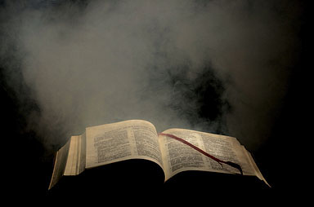
The Word of God Always Has Power to Accomplish His Will
Will You Let It Work His Will in You?

