Slide 1
God’s Warning & Faith’s Action
Hebrews 11:7

Slide 2
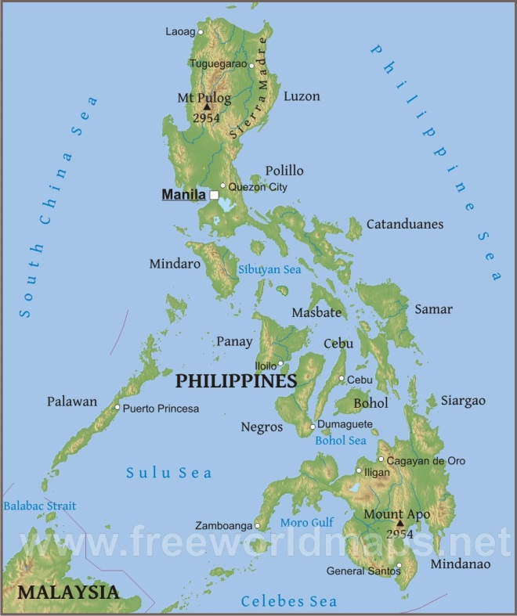
Preview of Philippine Trip
.
Bacolod

Slide 3
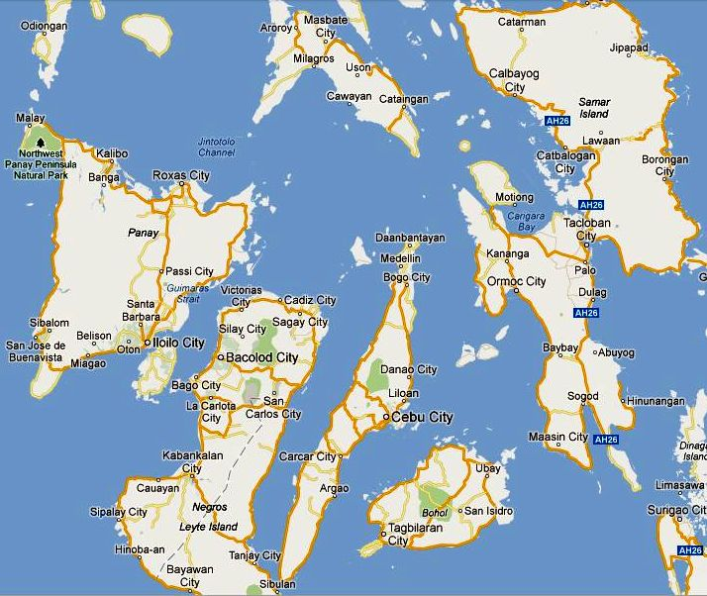

Slide 4
Preview of Philippine Trip
.
Bacolod

Slide 5
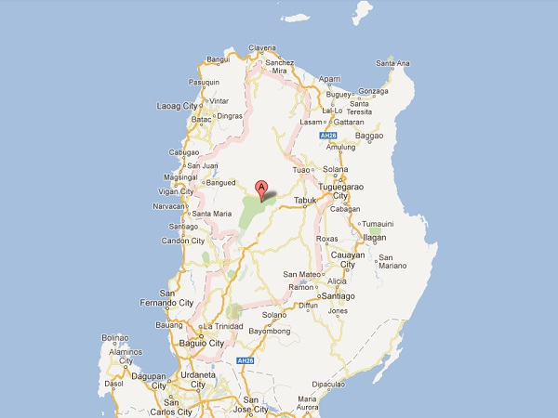

Slide 6
Preview of Philippine Trip
.
Bacolod

Slide 7
God’s Warning & Faith’s Action
Hebrews 11:7
By faith Noah, being divinely warned of things not yet seen, moved with godly fear, prepared an ark for the saving of his household, by which he condemned the world and became heir of the righteousness which is according to faith.

Slide 8
Noah Was Warned by God
Warning was of that not yet seen at the time - a flood
Gen. 2:5 Original order did not include rain
Matt. 24:37f Nothing apparent in advance
Judgment of God is sudden, but He has warned us about it (2 Pet. 3:9f)
None lost by God’s fault (Rev. 2:21)
God warns & gives time to repent

Slide 9
Noah Moved with Godly Fear to Obey God
Same stress in Genesis record
Gen. 6:9, 22 Just & perfect; walked w/ God
Gen. 7:5 After prepared, told 7 days to flood
True godly fear brings obedience
Deut. 10:12 Requires fear & obey from heart
Eccl. 12:13 Fear & obey is man’s purpose
1 Pet. 1:13-17 Holiness leads to obey in fear

Slide 10
He Saved His Own Family
Preaching of Noah is commended
2 Pet. 2:5 - preacher of righteousness
1 Pet. 3:18-20 - souls in prison (sin)
No rebuke for failure to change all
Must first teach our families truth
Deut. 6:7 & Josh. 24:15
Eph. 6:4
Unique opportunity with family

Slide 11
Separation Made by the Word
Preaching truth condemns world
Acts 2:37 Pricked hearts to obedience
Acts 24:25 Terrified, but negligent
John 16:8 Convicts of sin, righteousness…
Must preach truth to convict sinner
Truth brings obedient to reward
2 Corinthians 4:1-6 No salvation without it
If we love sinners, preach all truth

