Slide 1
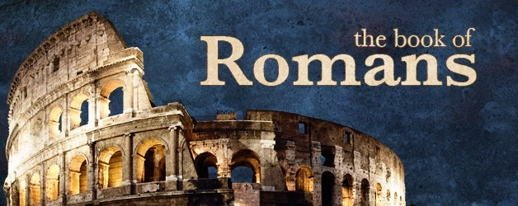
Romans 1

Slide 2
Romans 1:16-17
16 For I am not ashamed of the gospel of Christ, for it is the power of God to salvation for everyone who believes, for the Jew first and also for the Greek. 17 For in it the righteousness of God is revealed from faith to faith; as it is written, “The just shall live by faith.”

Slide 3
Romans 1:18-23
18 For the wrath of God is revealed from heaven against all ungodliness and unrighteousness of men, who suppress the truth in unrighteousness, 19 because what may be known of God is manifest in them, for God has shown it to them. 20 For since the creation of the world His invisible attributes are clearly seen, being understood by the things that are made, even His eternal power and Godhead, so that they are without excuse, 21 because, although they knew God, they did not glorify Him as God, nor were thankful, but became futile in their thoughts, and their foolish hearts were darkened. 22 Professing to be wise, they became fools, 23 and changed the glory of the incorruptible God into an image made like corruptible man—and birds and four-footed animals and creeping things.

Slide 4
Romans 1:24-27
24 Therefore God also gave them up to uncleanness, in the lusts of their hearts, to dishonor their bodies among themselves, 25 who exchanged the truth of God for the lie, and worshiped and served the creature rather than the Creator, who is blessed forever. Amen.
26 For this reason God gave them up to vile passions. For even their women exchanged the natural use for what is against nature. 27 Likewise also the men, leaving the natural use of the woman, burned in their lust for one another, men with men committing what is shameful, and receiving in themselves the penalty of their error which was due.

Slide 5
Romans 1:28-32
28 And even as they did not like to retain God in their knowledge, God gave them over to a debased mind, to do those things which are not fitting; 29 being filled with all unrighteousness, sexual immorality, wickedness, covetousness, maliciousness; full of envy, murder, strife, deceit, evil-mindedness; they are whisperers, 30 backbiters, haters of God, violent, proud, boasters, inventors of evil things, disobedient to parents, 31 undiscerning, untrustworthy, unloving, unforgiving, unmerciful; 32 who, knowing the righteous judgment of God, that those who practice such things are deserving of death, not only do the same but also approve of those who practice them.

