Slide 1
Vanity of Vanities
Ecclesiastes 1:14
² “Vanity of vanities,” says the Preacher, “Vanity of vanities, all is vanity” ... ¹⁴ I have seen all the works that are done under the sun; and, behold, all is vanity and a striving after wind.

Slide 2
Vain Pursuits to Give Life Meaning

Slide 3
Materialism
Many warnings in Scripture
Matt. 6:19-21
Luke 12:15f
1 Tim. 6:6-10
1 Tim. 6:17-19
Focusing on material things distracts our focus
Only spiritual things have true purpose & value
Thoughts must center on the heavenly:
Col. 3:2
Matt. 16:26

Slide 4
Sexual Immorality
Fornication is always condemned
Prov. 2:10-19
Prov. 5:7-13
Prov. 6:23-33
Eccl. 7:26
Folly of sexual sins is obvious to the wise
Yet, wisdom is often forgotten in time of lust
Need for sanctification is key (1 Thess. 4:3-6)
Don’t start down this path (Rom. 13:13f )

Slide 5
Pursuit of Pleasure
Pleasure is not purpose of life
Ecclesiastes 2:1-11
Ecclesiastes 7:2-6
Proverbs 14:13
Many pleasures & recreational pursuits not sinful, but cause omission of good
Preoccupation with recreation is great problem in today’s society (Lk. 8:14)
If spent same time on spiritual as on recreational, which would increase?

Slide 6
Carnal Power (Pride)
Worldly power is opposite our call
Mark 10:35-44
Proverbs 25:27
Romans 12:10-16
Desire for greater worldly power is result of pride (1 Kings 12:1-11; Isaiah 14:13-14)
Quest for power often goes w/ high opinion of self
Rehoboam first reject view of himself as a servant
Those of selfish desires aided his effort
Babylon’s power & pride seen in Nebuchadnezzar
Desire for power in business, politics, etc. = Same

Slide 8
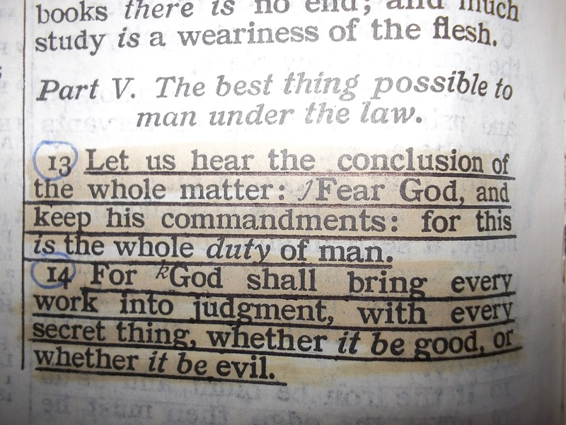
Is Life Always Vain & Aimless?
What Gives Meaning to Life?

