Slide 1
Ready to Listen
1st Thessalonians 2:13
For this reason we also thank God without ceasing, because when you received the word of God which you heard from us, you welcomed it not as the word of men, but as it is in truth, the word of God, which also effectively works in you who believe.

Slide 2
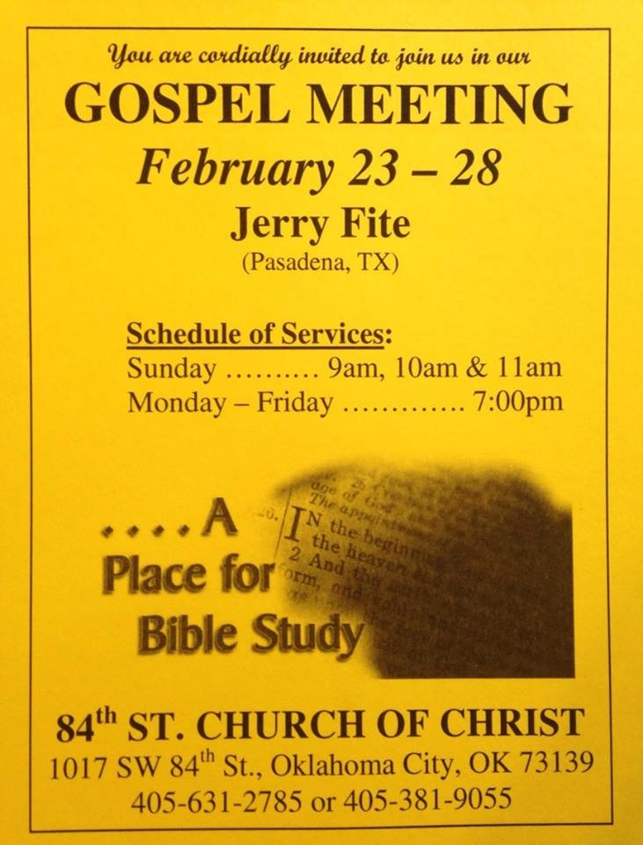
Our Spring Gospel Meeting Starts Next Sunday!
The gospel will be preached at every service, but it cannot bring those closer to God who do not hear

Slide 3
Readiness to Hear the Gospel
Conversions in Acts were result of readiness to hear the gospel
Acts 2:41 “Those who gladly received his word…”
Acts 8:6 “The multitudes… heeded the things spoken…”
Acts 8:30f Understand what read? “How can I except…”
Acts 10:33 “We are all present before God to hear all things”
Acts 13:7 Sergius Paulus “sought to hear the word of God”
Acts 16:14 “Lord opened her heart to heed all things spoken”
Acts 16:32f Spoke the word of the Lord to him & all in house
Acts 17:11 “They received the word with all readiness of mind”
Characteristics of the obedient listeners:
Wanted to know the will go God
Let the word of God change their hearts & lives
Did not know all of the word, but enough to believe in Christ
Responded quickly after they heard the word
Obeyed the gospel by doing exactly what was commanded

