Slide 2
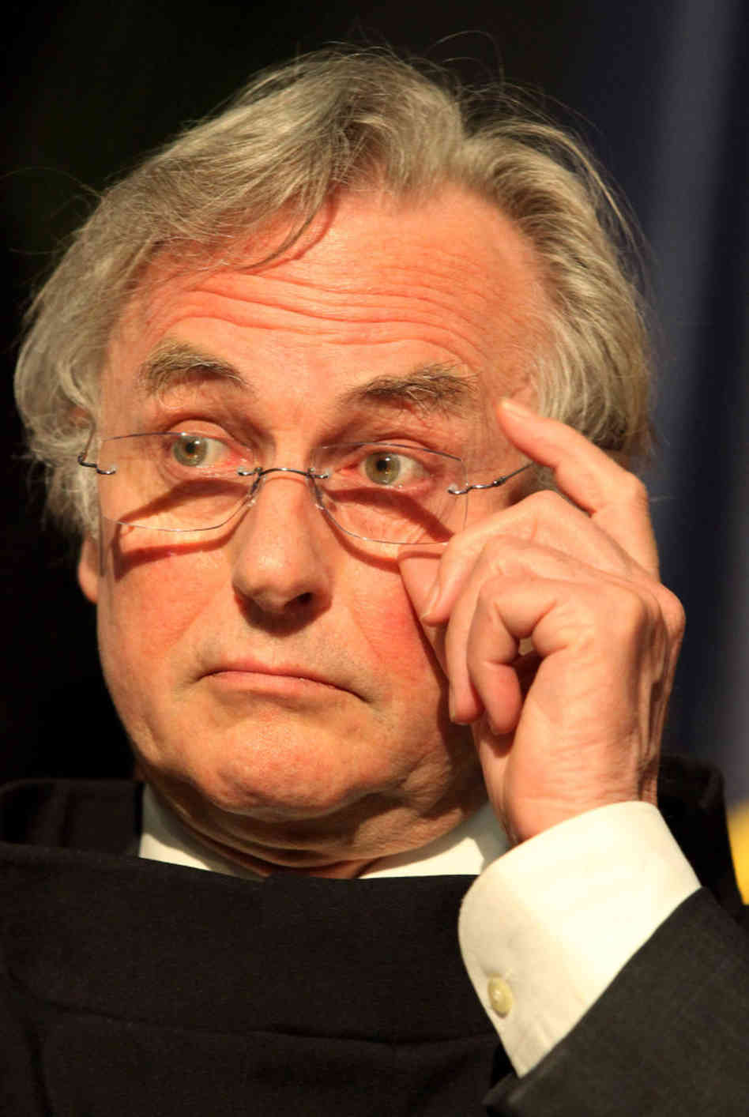
Some Things Have Purpose
A sextant, windmill, bicycle, or computer, etc.
“Whatever the designer or the manufacturer intended.”
Richard Dawkins

Slide 3
Not All Things Need to Have Purpose
What is the purpose of layers of rock, the Matterhorn, sand dunes, mud, the universe, or the Grand Canyon?
Richard Dawkins

Slide 4
Survival… of the fittest?
The “selfish Gene” ?
What is the Purpose of HUMAN LIFE?
What Does The Bible Say?

Slide 5
What Is Our Purpose?
Glorify God – Ascribing honor to our Creator (Rev. 4:11, Gen. 1:27-28, Gen. 9:6)
Glorify God: “Fear God and Keep His Commandments” (Eccl. 12:13 -14)
Many pursuits in life: Pleasure, Riches, Wisdom
All vanity – death occurs- what then? (Eccl. 2:15)
Injustice occurs (Eccl. 3:16-17)
Final accountability
Enjoy the fruits of your labor – your portion in life (Eccl. 2:24, 3:22, 5:18, etc.)

Slide 6
What Is Our Purpose?
Glorify God : Be Saved by His Gospel (I Tim. 1:15-17, 2 Tim. 4:18)
His Ways past tracing out (Rom. 11:33-36)
Glorious mystery now revealed (Rom. 16:25-27)
If we “honor” the Son, we “honor” the Father (Jn. 5:23,25)

Slide 7
What Is Our Purpose?
Glorify God : Be a member of His CHURCH (Eph. 3:10, 21)
Be strong inwardly (Eph. 3:16, I Cor. 6:18-20)
Rooted and Grounded in Love (Eph. 3:17)
Know the Love of Christ (Eph. 3:19)
Bear much fruit (Jn. 15:8)
Influencing the world around you – Good works (Matt. 5:16)
Serving others (I Peter. 4:11, Phil. 4:17-20)

Slide 8
What is the Purpose of HUMAN LIFE?
One Purpose: Glorify God Through Jesus Christ

