Slide 2
Who Are You To Judge Your Neighbor?
James 4:11-12

Slide 3
“Speak Not One Against Another”
Just Preach The Word – But do not “Reprove” and “Rebuke” (2 Tim. 4:2) ???
Did Paul and John Sin (2 Tim. 2:17-18, 3 Jn. 9-10)???
You Convert one from sin by not speaking against them? (James 5:19, 2 Sam. 12:1-6,7)???

Slide 4
“Speak Not One Against Another”
“KATALALOS” - “Backbiter” “evil speaking” ? (Rom. 1:30, I Pet. 2:1, 2 Cor. 12:20)
Condemning just lying about one another? (I Pet. 3:16, 2:12)

Slide 5
“Speak Not One Against Another”
Hypocritical Judgment (Matt. 7:1-5)

Slide 6
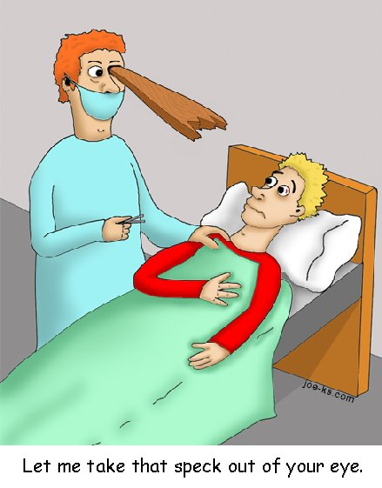
How?

Slide 7
“Speak Not One Against Another”
Hypocritical Judgment – God will judge you by same standard (Matt. 7:1-5)
Judge or Condemn the one who eats meat (Rom. 14:3)
Set at naught him that does not eat meat (Rom. 14:3)

Slide 8
“Speak Not One Against Another”
Judges or speaks against law (Jms. 4:11)
Judges Law (Jms. 4:11)
But If you judge the Law – you are a judge- not a doer (Jms. 4:11)
There is only one law giver and Judge – God- Able to Save and Destroy (Jms. 4:12)
Condemning brethren who do not meet your own standard? - Who are You???

Slide 9
“Speak Not One Against Another”
Fried foods, fatty foods, sugary foods are a sin??? (I Tim. 4:3, Mk. 7:18-19, I Cor. 6:19,13)
If you do not “home school” you do not really care for your children! If you “home school” you are not preparing your children for the real world!
Set at naught him that does not eat meat (Rom. 14:3)
Who Art Thou That Judgest Thy Neighbor?

Slide 10
“Speak Not One Against Another”
If you watch TV, you are worldly, and wasting time that should be used in Studying your Bible!
Set at naught him that does not eat meat (Rom. 14:3)
Who Art Thou That Judgest Thy Neighbor?

