Slide 2
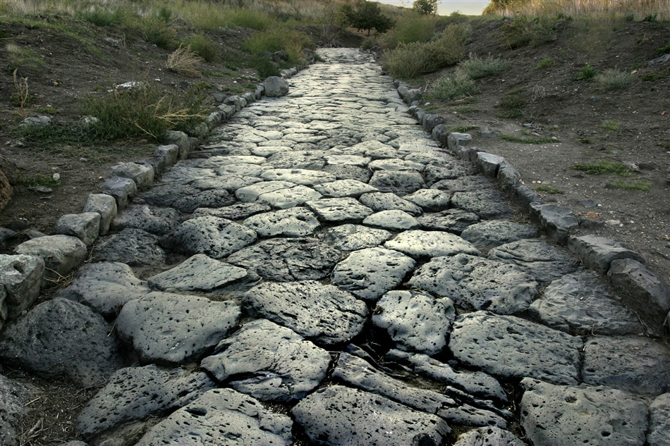
Salvation Revealed In The Book Of Romans
The Roman Road To Salvation

Slide 3
All receive the “wage” of sin – Death (Rom. 6:23)
All have sinned (Rom. 3:23, 9)
Universal Experience – Universal Need

Slide 4
The Way the Just God Justifies Man (Rom. 3:24-26)
The Way Expressing the Love of God (Rom. 5:8-10, 4:25)
Jesus is the Way For Salvation

Slide 5
Faith Justifies (Rom. 5:1,9; 10:17)
Confess Jesus as Lord (Rom. 10:9-10)
Call Upon The Name of the Lord – “Sinner’s Prayer”? (Rom. 10:13)
Man’s Response Resulting in Salvation

Slide 6
Repentance (Rom. 2:4-5)
Baptized into Christ (Rom. 6:3-4)
Other Necessary Stepping Stones in the Roman Road

Slide 7
Sinner
Baptized
Salvation
Rom. 6:3-4
Cleansed from sin by blood of Christ – Now in Christ!
Rom.6:17-18
Other Necessary Stepping Stones in the Roman Road

Slide 8
Why Is Being Baptized Absent?
Questions
In Romans…
If faith and Confessing Jesus is essential – Why not Baptism?
“Free Gift” – “No Strings Attached” – Why is confessing not an attached string, but being baptized is?
“Faith is the only thing you can do without doing anything.” ??? We believe (Jn. 8:24); we believe and we are baptized to be saved (Mk. 16:15-16)
Hearing the word of God (Rom. 10:17)
Faith (Rom. 5:1, 10:17, 1:5, 16:26)
Confessing Jesus as Lord (Rom. 10:9-10)
Repenting (Rom. 2:4-5)
Being Baptized Into Christ (Rom. 6:3-4)

Slide 9
What Must I Do To Be Saved?
Eunuch from Ethiopia (Acts 8:35-40)
Hear, Believe, Confess, Repent Baptized
Jailer in Philippi (Acts 16:30-34)
People at Pentecost (Acts 2:37-38)
Harmony of Roman Road with Acts
Paul – called on name of the Lord by being baptized – washing away sins (Acts 22;10,16, 9:6, 18)

Slide 10
Problem is not Romans, but religious teachers LEAVING OUT SOME OF THE STEPPING STONES!
Hear, Believe, Confess, Repent Baptized
Harmony of Roman Road with Acts
Follow the harmonious truth of the Gospel NOT DENOMINATIONAL ERROR!

