Slide 1
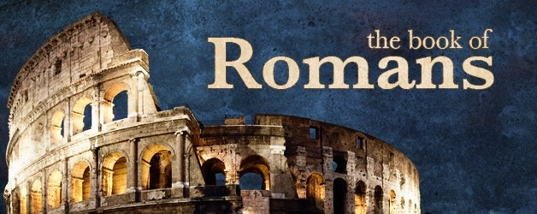
Romans 3

Slide 2
Romans 3:21-26
²¹ But now the righteousness of God apart from the law is revealed, being witnessed by the Law and the Prophets, ²² even the righteousness of God, through faith in Jesus Christ, to all and on all who believe. For there is no difference; ²³ for all have sinned and fall short of the glory of God, ²⁴ being justified freely by His grace through the redemption that is in Christ Jesus, ²⁵ whom God set forth as a propitiation by His blood, through faith, to demonstrate His righteousness, because in His forbearance God had passed over the sins that were previously committed, ²⁶ to demonstrate at the present time His righteousness, that He might be just and the justifier of the one who has faith in Jesus.

Slide 3
Romans 3:27-31
²⁷ Where is boasting then? It is excluded. By what law? Of works? No, but by the law of faith. ²⁸ Therefore we conclude that a man is justified by faith apart from the deeds of the law. ²⁹ Or is He the God of the Jews only? Is He not also the God of the Gentiles? Yes, of the Gentiles also, ³⁰ since there is one God who will justify the circumcised by faith and the uncircumcised through faith. ³¹ Do we then make void the law through faith? Certainly not! On the contrary, we establish the law.

Slide 4
Romans 4

Slide 5
Romans 4:1-8
¹ What then shall we say that Abraham our father has found according to the flesh? ² For if Abraham was justified by works, he has something to boast about, but not before God. ³ For what does the Scripture say? “Abraham believed God, and it was accounted to him for righteousness.” ⁴ Now to him who works, the wages are not counted as grace but as debt. ⁵ But to him who does not work but believes on Him who justifies the ungodly, his faith is accounted for righteousness, ⁶ just as David also describes the blessedness of the man to whom God imputes righteousness apart from works: ⁷ “Blessed are those whose lawless deeds are forgiven, and whose sins are covered; ⁸ Blessed is the man to whom the Lord shall not impute sin.”

Slide 6
Romans 4:9-12
⁹ Does this blessedness then come upon the circumcised only, or upon the uncircumcised also? For we say that faith was accounted to Abraham for righteousness. ¹⁰ How then was it accounted? While he was circumcised, or uncircumcised? Not while circumcised, but while uncircumcised. ¹¹ And he received the sign of circumcision, a seal of the righteousness of the faith which he had while still uncircumcised, that he might be the father of all those who believe, though they are uncircumcised, that righteousness might be imputed to them also, ¹² and the father of circumcision to those who not only are of the circumcision, but who also walk in the steps of the faith which our father Abraham had while still uncircumcised.

Slide 7
Romans 4:13-15
¹³ For the promise that he would be the heir of the world was not to Abraham or to his seed through the law, but through the righteousness of faith. ¹⁴ For if those who are of the law are heirs, faith is made void and the promise made of no effect, ¹⁵ because the law brings about wrath; for where there is no law there is no transgression.

Slide 8
Romans 4:16-22
¹⁶ Therefore it is of faith that it might be according to grace, so that the promise might be sure to all the seed, not only to those who are of the law, but also to those who are of the faith of Abraham, who is the father of us all ¹⁷ (as it is written, “I have made you a father of many nations”) in the presence of Him whom he believed—God, who gives life to the dead and calls those things which do not exist as though they did; ¹⁸ who, contrary to hope, in hope believed, so that he became the father of many nations, according to what was spoken, “So shall your descendants be.” ¹⁹ And not being weak in faith, he did not consider his own body, already dead (since he was about a hundred years old), and the deadness of Sarah’s womb. ²⁰ He did not waver at the promise of God through unbelief, but was strengthened in faith, giving glory to God, ²¹ and being fully convinced that what He had promised He was also able to perform. ²² And therefore “it was accounted to him for righteousness.”

Slide 9
Romans 4:23-25
²³ Now it was not written for his sake alone that it was imputed to him, ²⁴ but also for us. It shall be imputed to us who believe in Him who raised up Jesus our Lord from the dead, ²⁵ who was delivered up because of our offenses, and was raised because of our justification.

