Slide 1
The Folly of Hating Knowledge
Proverbs 1:22-25

Slide 2
Proverbs 1:22-25
“…fools hate knowledge…”
²⁰ Wisdom calls aloud outside; she raises her voice in the open squares. ²¹ She cries out in the chief concourses, at the openings of the gates in the city she speaks her words: ²² “How long, you simple ones, will you love simplicity? For scorners delight in their scorning, and fools hate knowledge. ²³ Turn at my rebuke; surely I will pour out my spirit on you; I will make my words known to you. ²⁴ Because I have called and you refused, I have stretched out my hand and no one regarded, ²⁵ because you disdained all my counsel, and would have none of my rebuke…

Slide 3
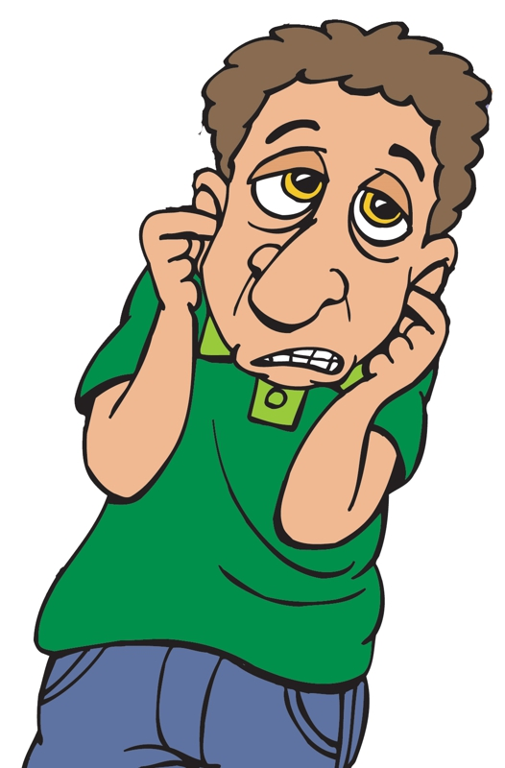
Why Do Some Refuse Knowledge of the Truth?

Slide 4
Due to Desire for Ignorance
“How long, you simple ones, will you love simplicity?” [Simple = fool, simpleton]
Prov. 7:6-23 Willful folly of sexual sins
Psa. 53:1 Willful folly of atheist (Rom. 1:20)
2 Pet. 3:3-7 Willful folly of denying judgment
Rom. 10:3 Why ignorant of God’s righteousness?
Matt. 13:15 Heart dull, ears hard of hearing
The “simple” can find “prudence” by seeking the instruction of God’s truth (Prov. 1:4)

Slide 5
Because of Lust for Sin
Desire to justify evil in their lives stops many from hearing truth that rebukes such
2 Tim. 4:3f Own lust… turn away their ears
Isa. 65:12 Did evil in God’s eyes; not hear
Isa. 66:4 Chose what did not delight God
Jer. 7:12f No answer because wickedness
Jer. 32:33f Set abominations up instead
Lust chokes out truth on modesty, dancing, drinking intoxicates, divorce & remarriage…

Slide 6
Because of No Love for Truth
Lack of love for truth & lack of commitment to submit to God’s will causes failure to hear
Jer. 6:10 Word of God seen as reproach
2 Thess. 2:10f Received not the love of truth
Ezek. 33:32 Some love good speaker, not truth
Jn. 3:19-20 Hated light, but loved darkness
Some today show same traits, but the gospel must be preach without change (2 Cor. 4:2f)

Slide 7
Due to Rebellion
Spirit of rebellion (the “anti-establishment” attitude) causes some to reject simple truth
Ezek. 12:2 Judah: “a rebellious house”
Zech. 7:11f Rebelled at “law” & “words”
Isaiah 30:1 No counsel of God, but added sin
Neh. 9:26 Rebellion was history of Israel
Problem never is inability to understand truth (Eph. 5:17)
Solution: Humbly submit (Jas. 4:7; 1 Pet. 5:5)

Slide 8
Because Hate Teacher of Truth
Reaction against truth is often by-product of personal animus for faithful preachers
Acts 7:54f Hated Stephen preaching truth
1 Kgs. 22:7f Ahab hated Micaiah the prophet
2 Ch. 24:17f Joash turned from love to hate
2 Ch. 36:15-16 “…till there was no remedy”
Mk. 6:17-19 Herodius sought to kill John
Jn. 15:18f World hated Jesus & will others
May call them names, mock or slander them, but open discuss of issues will show truth

Slide 9
Whenever We Reject Demands of Any Passage...
Watch Out &
Examine Self
Why Am I Not Listening to Truth?

