Slide 1
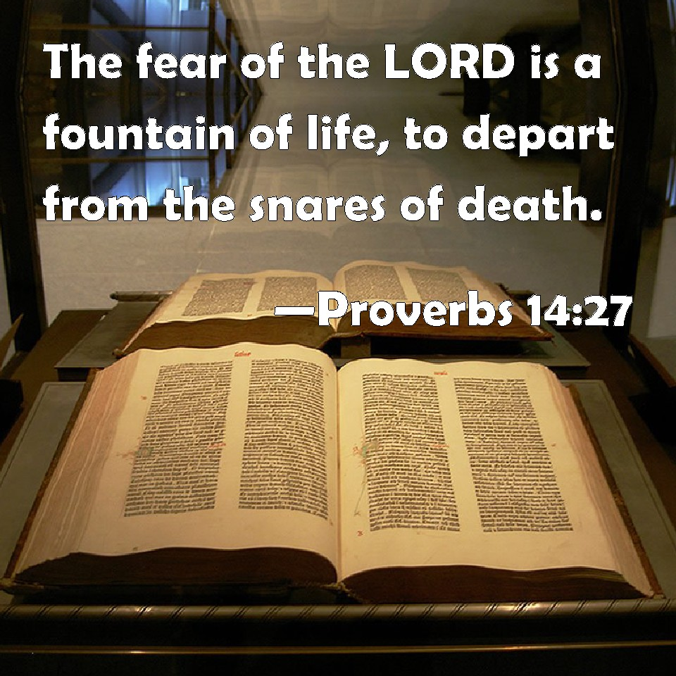
Fear – to be afraid, reverence, venerate, treat with deference or reverential obedience, a wholesome dread of power leading to awe

Slide 2
Promises to Those Fearing the Lord
Deuteronomy 10:12-22

Slide 3
Deuteronomy 10:12-22
¹² And now, Israel, what does the Lord your God require of you, but to fear the Lord your God, to walk in all His ways and to love Him, to serve the Lord your God with all your heart and with all your soul, ¹³ and to keep the commandments of the Lord and His statutes which I command you today for your good? ¹⁴ Indeed heaven and the highest heavens belong to the Lord your God, also the earth with all that is in it. ¹⁵ The Lord delighted only in your fathers, to love them; and He chose their descendants after them, you above all peoples, as it is this day. ¹⁶ Therefore circumcise the foreskin of your heart, and be stiff-necked no longer. ¹⁷ For the Lord your God is God of gods and Lord of lords, the great God, mighty and awesome, who shows no partiality nor takes a bribe. ¹⁸ He administers justice for the fatherless and the widow, and loves the stranger, giving him food and clothing. ¹⁹ Therefore love the stranger, for you were strangers in the land of Egypt. ²⁰ You shall fear the Lord your God; you shall serve Him, and to Him you shall hold fast, and take oaths in His name. ²¹ He is your praise, and He is your God, who has done for you these great and awesome things which your eyes have seen. ²² Your fathers went down to Egypt with seventy persons, and now the Lord your God has made you as the stars of heaven in multitude.

Slide 4
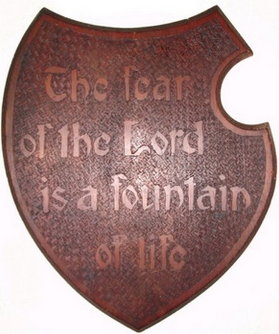
Promises to Those Fearing the Lord
Understand the Will of the Lord
Proverbs 1:7
Psalm 25:14
Acceptance by the Lord
Acts 10:35
Psalm 147:11
Receive His Mercy & Forgiveness
Psalm 103:11-13
Luke 1:50
Given His Goodness & Protection
Psalm 31:19-20
Psalm 115:13-15
Remembered Before the Lord
Malachi 3:16
Revelation 11:16-18
Proverbs
14:27

