Slide 1
A Kingdom Entrance Abundantly Supplied
2 Peter 1:5-11

Slide 2
2 Peter 1:5-11
⁵ But also for this very reason, giving all diligence, add to your faith virtue, to virtue knowledge, ⁶ to knowledge self-control, to self-control perseverance, to perseverance godliness, ⁷ to godliness brotherly kindness, and to brotherly kindness love. ⁸ For if these things are yours and abound, you will be neither barren nor unfruitful in the knowledge of our Lord Jesus Christ. ⁹ For he who lacks these things is shortsighted, even to blindness, and has forgotten that he was cleansed from his old sins. ¹⁰ Therefore, brethren, be even more diligent to make your call and election sure, for if you do these things you will never stumble; ¹¹ for so an entrance will be supplied to you abundantly into the everlasting kingdom of our Lord and Savior Jesus Christ.

Slide 3
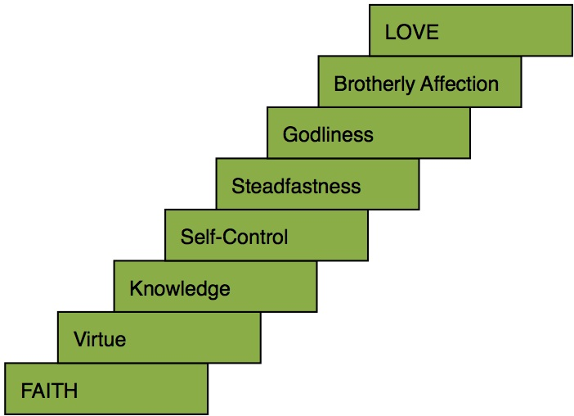
Must Diligently Add to Character

Slide 4
If These Things Are Yours & Abound
Acceptance with God has always demanded an abounding presence of proper character
Deut. 6:5 Love God with all heart, soul & might
Deut. 10:12 Walk & serve God in all ways w/ all heart
Gospel demands abounding service of Christians
1 Cor. 15:58 Always abounding in work of the Lord
2 Cor. 9:8 Abound unto every good work
If we seek the minimum of service (“what do we have to do”), our attitude will prevent full service
Our spiritual service is opportunity, not “have to”

Slide 5
Will Be Neither Barren or Unfruitful
Abounding service will produce obvious results
Lack of fruit is unacceptable to the Lord
Matt. 3:8-10 Jews condemned for being fruitless
Matt. 13:22 Thorny soil became unfruitful
Lk. 13:6-9 Time give to bear fruit, but must produce
Fruit is the natural product of Christian’s character
Eph. 5:7-10 “The fruit of the light is…”
Gal. 5:22f “The fruit of the Spirit is…”
Spreading truth & exemplifying godly character is fruit expected (1 Cor. 3:12-15; 2 Pet. 2:5)

Slide 6
Make Heavenly Calling & Election Sure
Promise of heavenly home is certain to the faithful
Jn. 14:1-3 “If it were not so, I would have told you”
Heb. 6:19-20 A hope both sure and steadfast
1 Pet. 1:3-7 Incorruptible, undefiled, fades not away
Col. 1:3-6 Hope laid up in the heavens
Heb. 11:16 Better, heavenly country for unashamed
Rev. 22:14 Right to enter based on purity
2 Cor. 5:1-9 Long for heaven, so live well-pleasing
Heaven is not an eternal destiny by surprise
It is a prepared place for a prepared people
Are we prepared for home of God’s holy servants?

