Slide 1
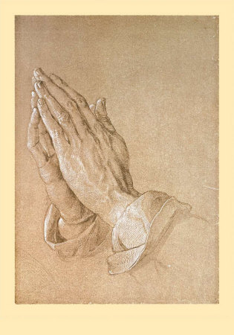
“In This Manner, Therefore, Pray”
Matthew 6:9-15

Slide 2
Matthew 6:9-15
⁹ In this manner, therefore, pray:
Our Father in heaven, Hallowed be Your name. ¹⁰ Your kingdom come. Your will be done On earth as it is in heaven. ¹¹ Give us this day our daily bread. ¹² And forgive us our debts [sins - Lk], As we forgive our debtors. ¹³ And do not lead us into temptation, But deliver us from the evil one. For Yours is the kingdom and the power and the glory forever. Amen.
Not “Lord’s Prayer” – But Model Prayer

Slide 3
Elements of Acceptable Prayer
A
C
T
S

Slide 4
Elements of Acceptable Prayer
A
C
T
S
ddressing God

Slide 5
Elements of Acceptable Prayer
A
C
T
S
ddressing God
“Our Father in heaven, Hallowed be Your name…”

Slide 6
Elements of Acceptable Prayer
A
C
T
S
ddressing God
“Our Father in heaven, Hallowed be Your name…”
onfessing sin

Slide 7
Elements of Acceptable Prayer
A
C
T
S
ddressing God
“Our Father in heaven, Hallowed be Your name…”
onfessing sin
“And forgive us our debts [sins], as we forgive our debtors…”

Slide 8
Elements of Acceptable Prayer
A
C
T
S
ddressing God
“Our Father in heaven, Hallowed be Your name…”
onfessing sin
“And forgive us our debts [sins], as we forgive our debtors…”
hanksgiving

Slide 9
Elements of Acceptable Prayer
A
C
T
S
ddressing God
“Our Father in heaven, Hallowed be Your name…”
onfessing sin
“And forgive us our debts [sins], as we forgive our debtors…”
“I thank You, Father, Lord of heaven and earth” Lk. 10:21
hanksgiving

Slide 10
Elements of Acceptable Prayer
A
C
T
S
ddressing God
“Our Father in heaven, Hallowed be Your name…”
onfessing sin
“And forgive us our debts [sins], as we forgive our debtors…”
“I thank You, Father, Lord of heaven and earth” Lk. 10:21
hanksgiving
upplication

Slide 11
Elements of Acceptable Prayer
A
C
T
S
ddressing God
“Our Father in heaven, Hallowed be Your name…”
onfessing sin
“And forgive us our debts [sins], as we forgive our debtors…”
“I thank You, Father, Lord of heaven and earth” Lk. 10:21
hanksgiving
“Lead us not into temptation, but deliver us from the evil one…”
upplication

Slide 12
Addressing God with Praise & Reverence
Jesus began the model prayer with reverent address to Father (Matt. 6:9 & Luke 11:2)
“Our Father in heaven, Hallowed be Your name…”
“Yours is the kingdom & power & glory forever”
John 17:11 “Holy Father” (17:25 Righteous Father)
Reverent prayer praises God for who He is
Daniel 9:4
Nehemiah 1:5; 9:6
Revelation 4:10-11 Coming before throne of God

Slide 13
Confessing Our Sins in Prayer
Jesus taught necessity of confessing sins in prayer
“And forgive us our debts [“sins” – Luke 11:4], as we forgive our debtors”
Confession of sins in prayer in necessary to be forgiven by God
Luke 15:18, 21
1 John 1:9
Psalm 32:3-5

Slide 14
Thanksgiving to God in Prayer
Jesus also taught thanksgiving in prayer
“I thank You, Father, Lord of heaven and earth” (Luke 10:21)
Thanksgiving recognizes God as the source of all spiritual & physical blessings
Colossians 3:15
1 Thessalonians 5:18
Colossians 1:12-14
Psalm 100:4

Slide 15
Supplication of God in Prayer
Jesus taught disciples to make supplication, asking blessings of God in prayer
“Lead us not into temptation, but deliver us from the evil one…”
Supplication in prayer is for self & others
Matthew 7:7-11
Matthew 26:41
John 17:1-26 Jesus’ supplication for disciples
Ephesians 6:18-19

