Slide 1
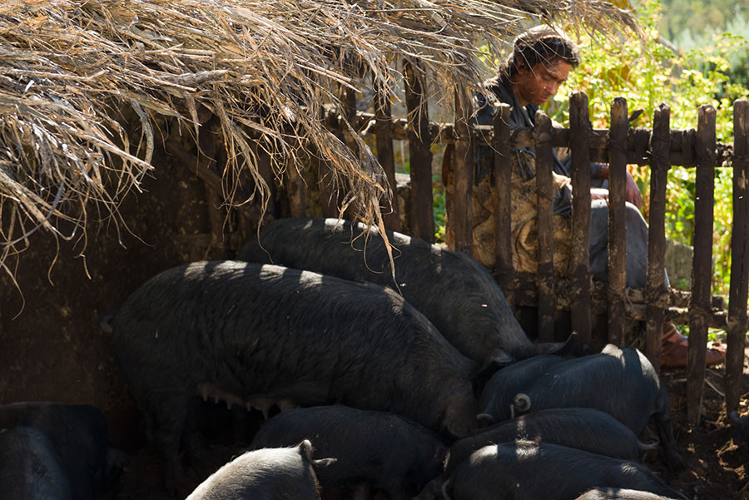
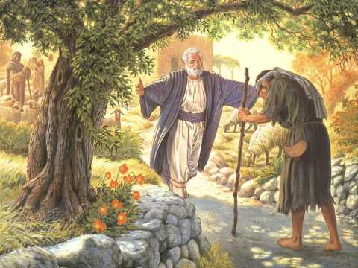
Pictures from a Parable
Luke 15:11-24

Slide 2
Luke 15:11-24
¹¹ Then He said: “A certain man had two sons. ¹² And the younger of them said to his father, ‘Father, give me the portion of goods that falls to me.’ So he divided to them his livelihood. ¹³ And not many days after, the younger son gathered all together, journeyed to a far country, and there wasted his possessions with prodigal living. ¹⁴ But when he had spent all, there arose a severe famine in that land, and he began to be in want. ¹⁵ Then he went and joined himself to a citizen of that country, and he sent him into his fields to feed swine. ¹⁶ And he would gladly have filled his stomach with the pods that the swine ate, and no one gave him anything. ¹⁷ “But when he came to himself, he said, ‘How many of my father’s hired servants have bread enough and to spare, and I perish with hunger! ¹⁸ I will arise and go to my father, and will say to him, “Father, I have sinned against heaven and before you, ¹⁹ and I am no longer worthy to be called your son. Make me like one of your hired servants.”’ ²⁰ “And he arose and came to his father. But when he was still a great way off, his father saw him and had compassion, and ran and fell on his neck and kissed him. ²¹ And the son said to him, ‘Father, I have sinned against heaven and in your sight, and am no longer worthy to be called your son.’ ²² “But the father said to his servants, ‘Bring out the best robe and put it on him, and put a ring on his hand and sandals on his feet. ²³ And bring the fatted calf here and kill it, and let us eat and be merry; ²⁴ for this my son was dead and is alive again; he was lost and is found.’ And they began to be merry.

Slide 3
Purpose of Parables
para
bole [from ballo]
alongside of
to throw
alongside
Principle To Be Learned
Picture Helping To Teach It

Slide 4
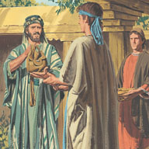
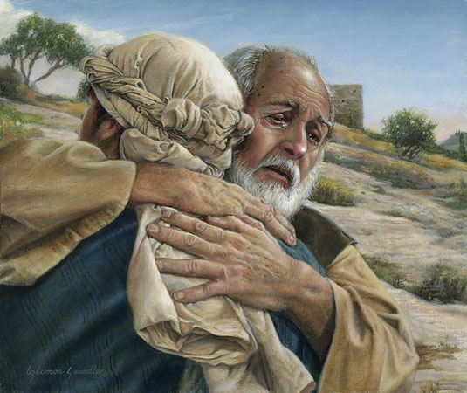
A Picture of Mercy & Grace
Father’s actions depict repeated mercy & grace
In giving portion to son
In forgiving the son of his sin
In restoring him as son
God’s mercy & grace seen many ways towards us
Matthew 5:44-48
Ephesians 2:1-10
Titus 3:4-7
Romans 5:6-11
1 John 3:1

Slide 5
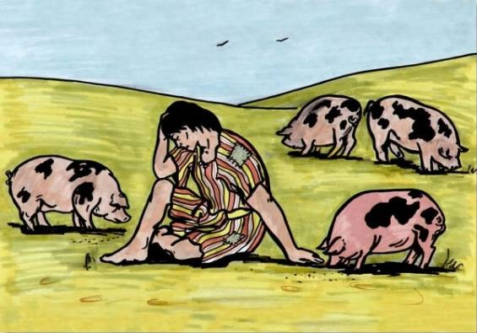
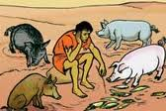
A Picture of Sin’s Destructiveness
Prodigal’s view of sin was not accurate (Prov. 16:12)
Compare Satan’s promise with reality in Genesis 3
Result not glory, but shame
The destructiveness & poverty of sin is its reality
2 Peter 2:20-22
Titus 3:3
Revelation 17:1-6
2 Timothy 3:13

Slide 6
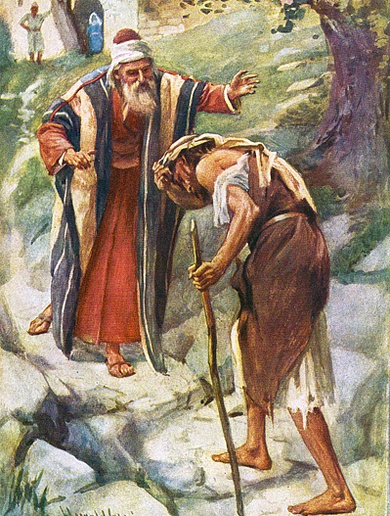
A Picture of Humility in Penitence
Consequence of his sin showed prodigal’s failure
No way to cover reality of his wrong (Prov. 28:13)
True repentance demands humility to admit wrong
Psalm 51:1-4, 17
Isaiah 57:15
Isaiah 66:2
Luke 18:13
Matthew 18:4

