Slide 1
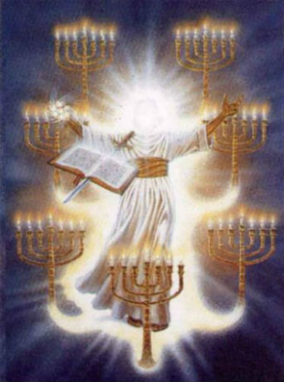
How Christ Judges Churches
Revelation
2:1-11

Slide 2
Revelation 2:1-7
¹ To the angel of the church of Ephesus write, “These things says He who holds the seven stars in His right hand, who walks in the midst of the seven golden lampstands: ² ‘I know your works, your labor, your patience, and that you cannot bear those who are evil. And you have tested those who say they are apostles and are not, and have found them liars; ³ and you have persevered and have patience, and have labored for My name’s sake and have not become weary. ⁴ Nevertheless I have this against you, that you have left your first love. ⁵ Remember therefore from where you have fallen; repent and do the first works, or else I will come to you quickly and remove your lampstand from its place – unless you repent. ⁶ But this you have, that you hate the deeds of the Nicolaitans, which I also hate. ⁷ He who has an ear, let him hear what the Spirit says to the churches. To him who overcomes I will give to eat from the tree of life, which is in the midst of the Paradise of God.’”

Slide 3
Revelation 2:8-11
⁸ And to the angel of the church in Smyrna write, “These things says the First and the Last, who was dead, and came to life: ⁹ ‘I know your works, tribulation, and poverty (but you are rich); and I know the blasphemy of those who say they are Jews and are not, but are a synagogue of Satan. ¹⁰ Do not fear any of those things which you are about to suffer. Indeed, the devil is about to throw some of you into prison, that you may be tested, and you will have tribulation ten days. Be faithful until death, and I will give you the crown of life. ¹¹ He who has an ear, let him hear what the Spirit says to the churches. He who overcomes shall not be hurt by the second death.”’

Slide 4
Standards of Judgment
Some judge churches by human standards:
Social activities among members
Number of people attending
Style, comfort or size of the building
Emotional atmosphere or aesthetics
Entertaining teachers & preachers
Christ is the one who has the right to judge
He walks amidst the candlesticks (Rev. 1)
What is His standard of judgment?
Does our standard differ from Christ’s?

Slide 5
Churches Commended & Condemned by Christ

Slide 6
Christ on Ephesus
COMMENDED
Could not bear evil men
Tried those with false claims & found them false
Patiently endured for Christ’s name’s sake
Hated the same works the Lord hated
CONDEMNED
Lord had something “against” them…
They had left their first love

Slide 7
Christ on Smyrna
COMMENDED
Rich (spiritually) amidst physical poverty & tribulation
Suffering to intensify, but would receive reward in continued to be faithful
CONDEMNED
No condemnation expressed

Slide 8
Christ on Pergamum
COMMENDED
Held fast the name of Christ despite evil surroundings
Did not deny the faith despite persecutions (even to death)
CONDEMNED
Had some who taught that which led others astray
Had some who held to false teachings of Nicolaitans

Slide 9
Christ on Thyatira
COMMENDED
Work, love, faith, service & patience known to be more at last than at first
CONDEMNED
Tolerated one in immorality; justified & seduced others to commit sin
Tolerance beyond time of long-suffering

Slide 10
Christ on Sardis
COMMENDED
Would be accepted if remembered & kept what originally heard
Had a few who were not defiled; worthy
CONDEMNED
Had a name for living, but were dead
That not dead was ready to die
No works found to be perfected before God

Slide 11
Christ on Philadelphia
COMMENDED
Open door set before them which none could shut
Had only a little power, but kept Christ’s word & did not deny His name
Kept the word of the Lord’s patience
CONDEMNED
No condemnation expressed

Slide 12
Christ on Laodicea
COMMENDED
No commendation expressed
CONDEMNED
Works were neither cold nor hot, but lukewarm; sickening
Wretched, miserable, poor, blind & naked spiritually despite thinking the opposite

Slide 13
Regarding Faithfulness to Truth
Christ expects faithfulness to His word
Must respect His “name” = His authority
Must hold it fast & put it into practice
Must oppose every doctrinal error & sinful way
Must not be ashamed of it when unpopular
Never commended tolerance of false doctrine
Never condemned reproving false doctrine
Mentioned more in letters to 7 churches than any other criteria of judgment

Slide 14
Regarding Priority of the Spiritual Over Physical
Those judging on the basis of physical or earthly standards gave wrong judgments
Some had a false sense of security due to:
Earthly wealth
Power, popularity & prestige of surroundings
Reputation (name that they lived, but dead)
Blindness to spiritual reality
Eternal & spiritual truth is all that matters

Slide 15
Regarding Patience in Obedience
Patience is necessary for true obedience
Our works must be perfected before God
Necessity of patience to obey seen in:
Studying to find truth (2 Tim. 2:15)
Holding to truth when unpopular (2 Tim. 4:1f)
Vigilance to withstand error (Rom. 16:17)
Maintaining faith when doubts arise (Jas. 1:6)
Godly living despite persecution (1 Pet. 4:1-6)
Waiting for the Lord to open doors in His time

